Slide 1
Using Principled-Design to Support Coherence in State and Local Assessment Systems
Ellen Forte and Elizabeth Summers, edCount, LLC
Andrew Wiley, ACS Ventures, LLC
Tuesday, February 20, 2018, 1:30-2:30 pm

Slide 2
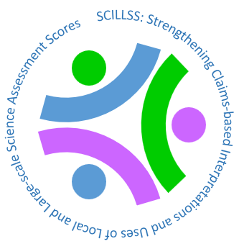
Overview
The SCILLSS Project:
purpose, players, and products
Coherence as a Guiding Principle for Assessment in Education
Coherence-based Principled-design
  Large-scale science assessments
  Classroom-based, instructionally-embedded assessments (not a focus of this presentation)
  Self-evaluation Protocols: Reflecting on and evaluating assessment systems
  Assessment Literacy Modules

Slide 3
SCILLSS
Strengthening Claims-based Interpretations and Uses of Local and Large-scale Science Assessment Scores (SCILLSS)
  One of two projects funded by the US Department of Education’s Enhanced Assessment Instruments Grant (EAG) Program, announced in December, 2017
  Collaborative partnership including three states, four organizations, and 10 expert panel members
  Nebraska is the grantee and lead state; Montana and Wyoming are partner states
  Both EAG projects focus on science as defined in the NGSS

Slide 4
SCILLSS Goals
Create a science assessment design model that establishes alignment with three-dimensional standards by eliciting common construct definitions that drive curriculum, instruction, and assessment
Strengthen a shared knowledge base among instruction and assessment stakeholders for using principled-design approaches to create and evaluate science assessments that generate meaningful and useful scores
Establish a means for state and local educators to connect statewide assessment results with local assessments and instruction in a coherent, standards-based system

Slide 5
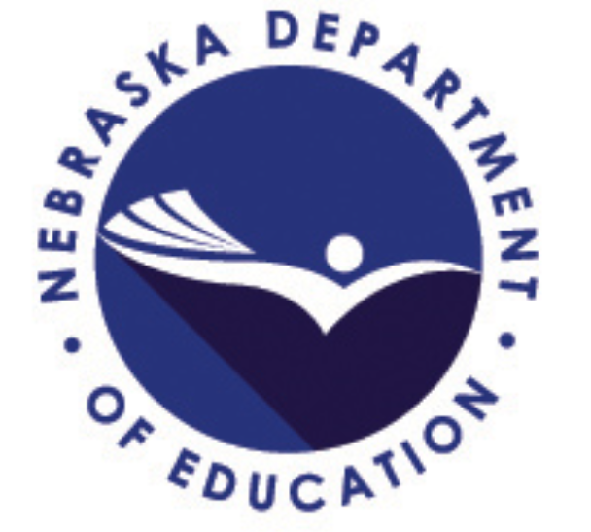
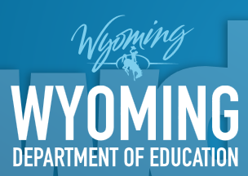
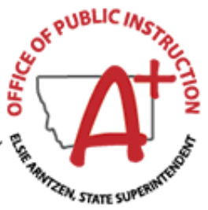




the SCILLSS Team

Slide 6
SCILLSS Partner states, organizations, and staff
Co-Principal Investigators: Ellen Forte and Chad Buckendahl
Project Director: Liz Summers
Deputy Project Director: Erin Buchanan
Psychometric Leads: Andrew Wiley and Susan Davis-Becker
Principled-Design Leads: Howard Everson and Daisy Rutstein

Slide 7
Project Deliverables
1 - Project Foundations
SCILLSS website
Theory of Action for the project and for each state
Local and state needs assessment tools
Assessment literacy module 1
Three prioritized science claims
2 - Large-scale assessment resources
Three sets of claim-specific resources:
  PLDs
  measurement targets, task models, and design patterns
  sample items
Assessment literacy modules 2-5
Year 1
Year 2
Year 3
Year 4
3 - Classroom-based assessment resources
Six task models
Six tasks
Six sets of student artifacts
4 - Reporting and Dissemination
Database of student artifacts corresponding to the performance levels
Post-project survey
Post-project action
plans for each state
Final project report
Notes:
In utilizing our ToA and keeping in mind the overall goals for the project and the benefits of using a principled-design approach, what does that look like for the SCILLSS project in terms of deliverables.
Review the deliverables across each of Years 1-4.
Note we are expecting to deliver the ALMs in years 1-2 rather than one per year.

Slide 8
Overview
The SCILLSS Project:
purpose, players, and products
Coherence as a Guiding Principle for Assessment in Education
Coherence-based Principled-design
  Large-scale science assessments
  Self-evaluation Protocols: Reflecting on and evaluating assessment systems
  Assessment Literacy Modules

Slide 9
SCILLSS
The Big Idea

Slide 10
SCILLSS
Coherence

Slide 11
If
Then scores may reflect…
And may be used…
Constructs are well-defined
what students know and can do
to build and deliver instruction aligned with academic expectations
Construct definitions are shared across the system
to monitor or track student progress
or
The system is well-designed
what students have learned this year/ in this course;
for school accountability decisions and program evaluation
The system is well-implemented

Slide 12

Refresher: Standards-based Assessment and Accountability Model
Curriculum and Instruction
Content Standards
Evaluation and Accountability
Performance Standards
Assessment
Standards define expectations for student learning
Curricula and assessments are interpretations of the standards
Evaluation and accountability rely on the meaning of scores
Without clear alignment among standards, curricula, and assessment the model falls apart

Slide 13
Overview
The SCILLSS Project:
purpose, players, and products
Coherence as a Guiding Principle for Assessment in Education
Coherence-based Principled-design
  Large-scale science assessments
  Self-evaluation Protocols: Reflecting on and evaluating assessment systems
  Assessment Literacy Modules
Summary

Slide 14
Benefits of principled-design for large-scale assessment
Principled articulation and alignment of design components
Articulation of a clear interpretation and use argument and population of a strong validity argument
Reuse of extensive libraries of design templates
For accountability
  Clear warrants for claims about what students know and can do
  Build accessibility into design of tasks (not retrofitted into tasks)
  Cost versus scale

Slide 15
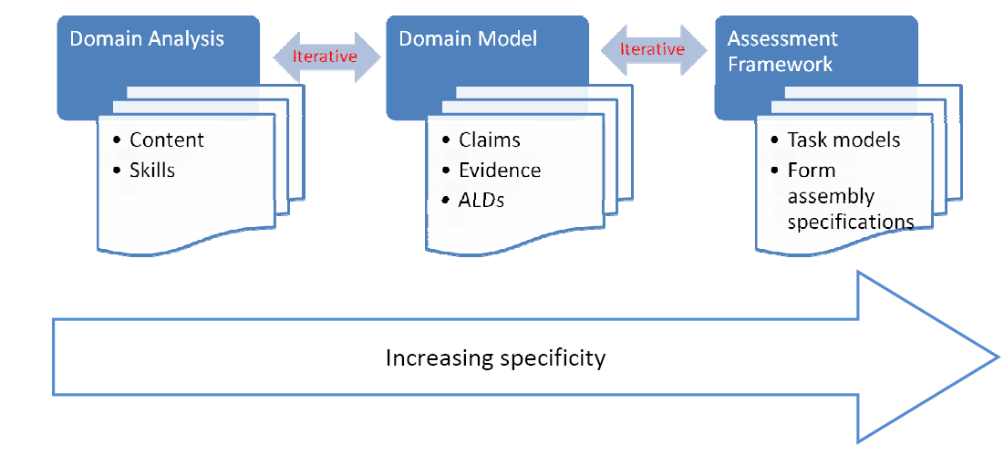
Three Critical Evidence-Centered Design Phases
Representations of the three dimensions in the NGSS
Articulation of how the construct should manifest in the assessment
Task models → items
Items → tests
Adapted from Huff, Steinberg, & Matts, 2010
Notes:
Evidence-centered design (ECD) is a principled approach to assessment development. It consists of multiple activities that result in a set of useful documentation; these activities include domain analysis, domain modeling, and the construction of the assessment framework.
Domain Analysis entails analyzing the domain, which results in the prioritization of content and skills, organized conceptually to facilitate curriculum and assessment design to support deep understanding.
Domain Modeling entails modeling the domain, which results in claims and corresponding evidence that emerge directly from the content and skills produced by the domain analysis. Domain modeling also involves the articulation of achievement level descriptors that identify what examinees at each of the achievement levels are expected to know and be able to do.
Constructing the Assessment Framework results in tasks models and form assembly specifications. Task models are a collection of task features that define the task according to the evidentiary focus and intended cognitive demand.
In brief, ECD is a set of activities and artifacts that facilitate explicit thinking about (a) what content and skills are both useful and interesting to claim about examinees given the purpose of the assessment; (b) what is the reasonable and observable evidence in student work or performance required to support the claims; and (c) how tasks (items) can be developed within the constraints of the assessment.

Slide 16
Unpack DCIs
Articulate Performance Expectations
Phase 1:
Domain Analysis
What do we
intend to measure?
Create Integrated Dimension Map
Unpack Practices
Unpack Concepts
Apply Fairness/
Equity Frame-work
Identify Reporting Categories
Phase 2:
Domain Modeling
What does that look like in an assessment context?
Clarify KSAs & Evidence Statements
Create Design Patterns
Create Blueprints
Identify Delivery Parameters
Phase 3:
Task Development and
Implementation
Build and Implement
the assessment
Create Task Models and Templates
Create Tasks and Rubrics
and Build Forms
Develop PLDs
Notes:
KEY TERMINOLOGY:
Science Claims: Claims and subclaims articulate overarching disciplinary statements that are applicable across grades/bands that allow for students to demonstrate core ideas and competencies at varying levels of depth and sophistication as they progress from grade 5 to 8 to 11. The SCILLSS project will include one overall claim and three subclaims that are common to the elementary, middle, and high school grade bands.
End of Year Learning Profiles: edCount content specialists will develop end of year student learning profiles at grades 11, 8, and 5 to describe the essential ideas, practices, and concepts that students should know and be able to demonstrate by the end of those grade levels to be on track for college and career readiness. The set of three profiles will be developed for the overarching claim for a total of 3 profiles. The profiles will inform the development of measurement targets for each claim at each grade level.
Matrices: Three matrices will be developed, one for each grade (5, 8, 11), to show the DCIs, SEPs, and CCCs addressed at each grade level/band (vs. those that are not). We may want to bold particular areas that are most applicable to grade 11 based on existing information about learning progressions and how content may be taught or prioritized in schools across grades. The matrices will inform the development of measurement targets for each claim at each grade level.
Measurement Targets: Measurement targets are claim-specific statements that combine practices, core ideas, and crosscutting concepts into a single statement of what is to be assessed. Targets can be representative of one performance expectation or clusters of performance expectations.
Unpacked DCIs, practices, and cross-cutting concepts: edCount content specialists will unpack the essential DCIs, practices, and crosscutting concepts for one measurement target at each assessed grade. The unpacking process reveals the essential elements of each of the three dimensions encompassed in the target. Unpacking disciplinary core ideas, practices, and crosscutting concepts entails thoughtful consideration of ideas, practices, and concepts in relation to students’ grade level, or expected level of expertise (Constructing Assessment Tasks that Blend Disciplinary Core Ideas, Crosscutting Concepts, and Science Practices for Classroom Formative Applications, p.6).
Integrated Dimension Maps: The integrated dimension maps are visual representations that describe the essential disciplinary core idea relationships and link them to aspects of the targeted crosscutting concepts and science practices (or to closely related crosscutting concepts and practices as identified by the unpacking process). Each map represents the “terrain” of the measurement target; it illustrates how the three dimensions are intended to work together to demonstrate proficiency with a measurement target, and shows the possible ways for combining aspects of the three dimensions.
Learning Performances: Learning performances (LPs) are knowledge-in-use statements that integrate aspects of a disciplinary core idea, practice, and crosscutting concept encompassed in a measurement target. LPs are smaller in scope and partially represent a measurement target. A related set of learning performances function together to describe the performances needed or “what it takes” to achieve a measurement target.
KSAs, Evidence Statements, and Design Patterns: We will consider relationships among the claims we want to make about what students know and can do, evidence that would demonstrate competency with respect to these claims, and features of tasks to elicit the desired evidence.

Slide 17
  Design Pattern Structure
ATTRIBUTE | DESCRIPTION
Focal Knowledge, Skills, Abilities | The primary knowledge / skills / abilities (KSAs) targeted by this design pattern.
Rationale | How/why this DP addresses evidence about focal KSAs
Additional KSAs | Other knowledge/skills/abilities that may be required by tasks.
Characteristic features of tasks | Aspects of assessment situations that are needed to evoke evidence about the focal KSAs.
Variable features of tasks | Aspects of assessment situations that can be varied to shift difficulty or focus.
Potential work products | What students actually say, do, or make, to produce evidence.
Potential observations | Aspects of work products we might identify and evaluate, as evidence about students’KSAs.
Potential rubrics | Ways of evaluating work products to produce values of observations.
Notes:
17

Slide 18
Overview
The SCILLSS Project:
purpose, players, and products
Coherence as a Guiding Principle for Assessment in Education
Coherence-based Principled-design
  Large-scale science assessments
  Self-evaluation Protocols: Reflecting on and evaluating assessment systems
  Assessment Literacy Modules
Summary

Slide 19
Self-Evaluation Protocol Purpose
The local and state self-evaluation tools are frameworks to support state and local educators in reflecting upon and evaluating the assessments they use.
Local or District | State
Designed to focus on assessments that districts or schools require Usually used for lower-stakes decisions Curriculum reviews Malleable instructional decisions Monitoring student progress proximally | Focused on large-scale assessments required statewide Some assessments have high stakes Accountability for students Accountability for educators Accountability for schools, districts, programs

Slide 20
Self-evaluation protocol Steps
Articulate
Articulate the primary goals and objectives of your assessment program
Identify
Identify all current and planned assessments
Evaluate
Evaluate the data and evidence available for each assessment to support the program goals and objectives and to address four fundamental validity questions
Synthesize
Synthesize results from the initial steps to determine an appropriate path forward
Notes:
.

Slide 21
Validity questions
To what extent has the assessment been designed and developed to yield scores that can be interpreted in relation to the target domain?
To what extent does the assessment yield scores that are comparable across students, sites, time, forms?
To what extent are students able to demonstrate what they know and can do in relation to the target knowledge and skills on the test in a manner that can be recognized and accurately scored?
To what extent does the test yield information that can be and is used appropriately to achieve specific goals?
Construct Coherence
Comparability
Accessibility and Fairness
Consequences
Notes:
Across the entire project, we will aim to keep these 4 fundamental validity questions in mind, using these to guide our process and deliverable development. We feel if we work to keep content coherence, comparability, accessibility and fairness, as well as consequences in mind throughout this project, then our products will be generalizable and usable to a wide variety of states and systems across the Nation. We are excited to work on this project with all of our partners and make available our lessons learned in re-envisioning science assessment.

Slide 22
Overview
The SCILLSS Project:
purpose, players, and products
Coherence as a Guiding Principle for Assessment in Education
Coherence-based Principled-design
  Large-scale science assessments
  Self-evaluation Protocols: Reflecting on and evaluating assessment systems
  Assessment Literacy Modules
Summary

Slide 23
Assessment Literacy Module Purpose
The four assessment literacy modules are designed to:
Inform state and local educators and other stakeholders on the purposes of assessments Ensure a common understanding of the purposes and uses of assessment scores, and how those purposes and uses guide decisions about test design and evaluation Complement the needs assessment by providing background information and resources for educators to grow their knowledge about foundational assessment topics Address construct coherence, comparability, accessibility and fairness, and consequences

Slide 24
Assessment Literacy Module One
Validity is the cornerstone of educational measurement.
Validity relates to the interpretation and use of test scores, not to tests themselves.
Validity evaluation involves the consideration of a body of evidence gathered from all phases of the assessment life cycle.
The assessment life cycle compasses:
  Design and development
  Administration
  Scoring
  Analysis
  Reporting
  Score Use
Validity evidence should be collected to address key validity questions
Notes:
Note here that subsequent modules will address aspects of the remaining validity questions, including comparability, accessibility and fairness, and construct coherence

Slide 25
Assessment Literacy Modules two - Five
ALM-2: Construct Coherence
ALM-3: Comparability
ALM-4: Accessibility and Fairness
ALM-5: Consequences
Notes:
Note here that subsequent modules will address aspects of the remaining validity questions, including comparability, accessibility and fairness, and construct coherence

Slide 26

Questions

Slide 27
References
Huff, K., Steinberg, L., & Matts, T. (2010). The promises and challenges of implementing evidence-centered design in large-scale assessment. Applied Measurement in Education, 23(4), 310-324.

Slide 28
About the presenter
Dr. Ellen Forte, CEO and Chief Scientist
edCount, LLC
Dr. Forte has two decades of experience conducting research, providing advice, and reporting on standards, assessments, and accountability, and is a respected authority on assisting state and local education agencies to successfully interpret and implement education policies. Dr. Forte has served as the Principal Investigator for numerous validity evaluation, item development, and alignment projects for many states, districts, and several multi-state initiatives. Dr. Forte serves on numerous Technical Advisory Committees and she is a member of the editorial boards for Educational Measurement: Issues and Practice, and the National Council on Measurement in Education newsletter. She is currently the Co-Principal Investigator for the SCILLSS project.

Slide 29
About the presenter
Dr. Elizabeth Summers, Executive Vice President
edCount, LLC
Dr. Summers has extensive experience in assessment validity and alignment evaluation, particularly related to alternate assessments based on alternate achievement standards (AA-AAS) for students with significant cognitive disabilities. She has led and assisted numerous local, regional, and national studies of both general and alternate assessment systems, served as coordinator and manager of various projects to improve, design, or redesign assessment systems, and has played a pivotal role in the development and evaluation of alternate assessment systems around the country. Dr. Summers currently serves as the Project Director for the SCILLSS project.

Slide 30
About the presenter
Dr. Andrew Wiley
edCount, LLC
Insert

