Slide 1
Implementation and Use of Results of Self-Evaluation Tools for Assessment Systems
NCME Classroom Assessment Conference
Panel Discussion
Wednesday, October 10
8:30 a.m. – 9:30 a.m.
This presentation was developed with funding from the U.S. Department of Education under Enhanced Assessment Grants Program CFDA 84.368A. The contents do not necessarily represent the policy of the U.S. Department of Education, and no assumption of endorsement by the Federal government should be made.

Slide 2
Welcome and Introductions
Andrew Wiley, Ph.D., Assessment Design and Evaluation Expert, ACS Ventures, LLC
Rhonda True, M.A., Enhanced Assessment Grant Coordinator, Nebraska Department of Education
Shannon Nepple, M.Ed., Director of Curriculum, Instruction, and Assessment, Adams Central Public Schools, Nebraska
Peter Gomez, Science Teacher and Department Chair, Hemingford Public Schools, Nebraska

Slide 3
Objectives
Provide an introduction to the Strengthening Claims-based Interpretations and Uses of Local and Large-Scale Science Assessment Scores (SCILLSS) Project
Provide an overview of the Local and State Self-evaluation Protocols and the Digital Workbook on Educational Assessment Design and Evaluation
Engage the perspectives of assessment experts and state and local education agency representatives in a panel discussion to encourage participants to consider:
How needs assessment tools can help strengthen the knowledge base among educators about the purpose and use of assessments
How these tools can be used to guide decision-making about assessment design, redesign, and evaluation

Slide 4
Introduction to the SCILLSS Project

Slide 5
About SCILLSS
One of two projects funded by the US Department of Education’s Enhanced Assessment Instruments Grant Program (EAG), announced in December 2016
Collaborative partnership including three states, four organizations, and 10 expert panel members
Nebraska is the grantee and lead state; Montana and Wyoming are partner states
Four-year timeline (April 2017 – December 2020)
Notes:
The Strengthening Claims-based Interpretations and Uses of Local and Large-scale Science Assessment Scores (SCILLSS) project is funded by the US Department of Education’s Enhanced Assessment Instruments Grant Program. As lead state and grantee, the Nebraska Department of Education is working in collaboration with two other state education agencies, Wyoming and Montana, along with four organizations, and a technical advisory panel of 10 experts that contribute an essential combination of expertise in principled-design, measurement, assessment literacy, and classroom practices to support the implementation of this project.

Slide 6
SCILLSS Project Goals
Create a science assessment design model that establishes alignment with three-dimensional standards by eliciting common construct definitions that drive curriculum, instruction, and assessment
Strengthen a shared knowledge base among instruction and assessment stakeholders for using principled-design approaches to create and evaluate science assessments that generate meaningful and useful scores
Establish a means for state and local educators to connect statewide assessment results with local assessments and instruction in a coherent, standards-based system
Notes:
SCILLSS has 3 overarching project goals. We intend to create a science assessment design model that establishes alignment with three-dimensional standards by eliciting common construct definitions that drive curriculum, instruction, and assessment; strengthen a shared knowledge base among stakeholders for using principled-design approaches to create and evaluate quality science assessments that generate meaningful and useful scores. We further intend to establish a way for states to connect statewide assessment results with local assessments and instruction in a coherent, standards-based system.
Each of our three states has a strong commitment to local assessment. As such, we hope to capitalize on that relationship between the local and statewide summative assessment systems to improve the way in which we vision science assessment.

Slide 7
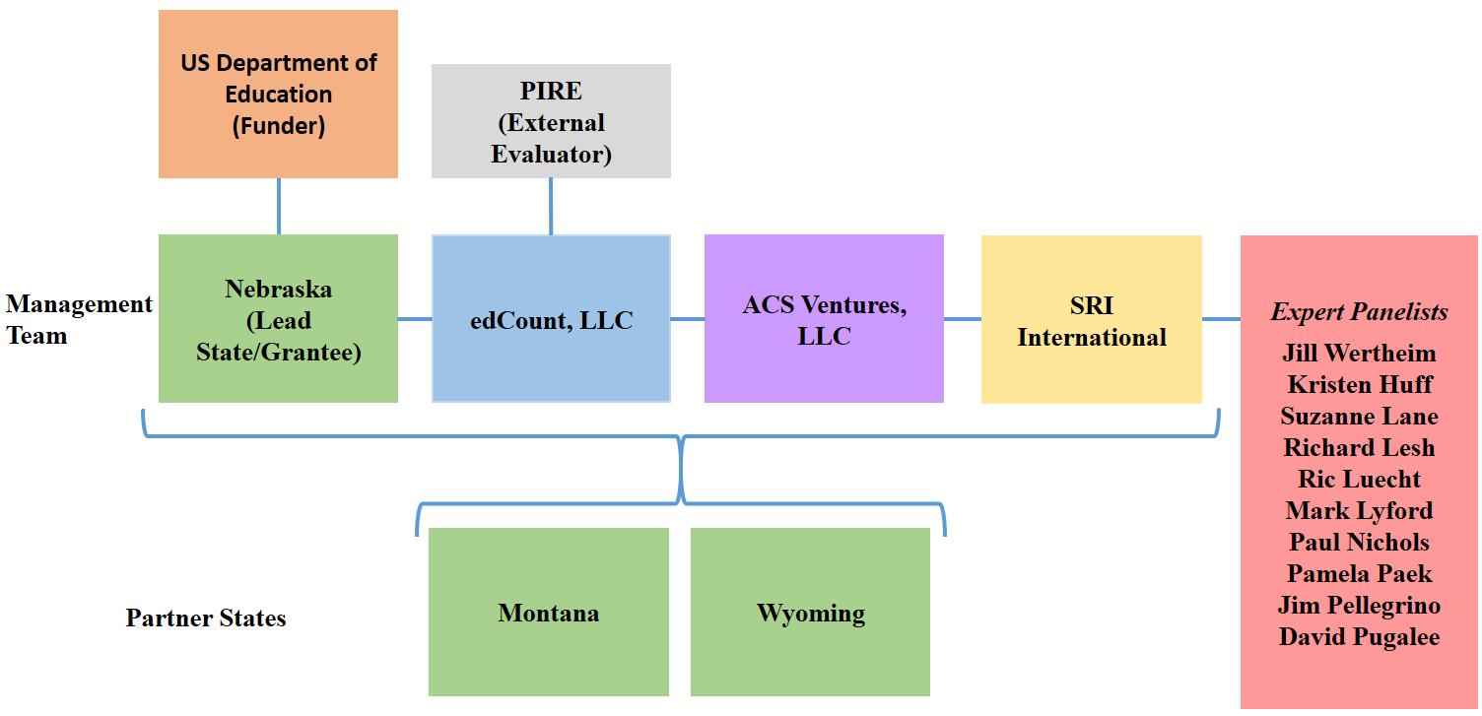
SCILLSS Partner States, Organizations, and Staff
Co-Principal Investigators: Ellen Forte and Chad Buckendahl
Project Director: Liz Summers
Deputy Project Director: Erin Buchanan
Psychometric Leads: Andrew Wiley and Susan Davis-Becker
Principled-Design Leads: Howard Everson and Daisy Rutstein
Notes:
The SCILLSS project includes three partner states and four partner organizations. NE is the lead SCILLSS state along with MT and WY. edCount serves as the primary contractor to NE and the other organizations serve as subcontractors to edCount.
edCount and ACS will share in the substantive activities for this project while SRI provides their principled-design expertise, and PIRE provides external project evaluation services for SCILLSS.
We have quite a distinguished list of expert panelists also involved with SCILLSS. The purpose of having a technical advisory committee is to seek feedback, commendations, and recommendations to improve the overall quality of each of the SCILLSS’ deliverables. The expert panelists will convene, along with the management team and state leads, at the SCILLSS’ annual yearly meetings to contribute expertise and experience in meeting the project goals. At various stages in the project, TAC members will contribute to different tasks during the design and development phases rather than upon completion during the yearly meetings.

Slide 8
Overview of the Local and State Self-Evaluation Protocols
Purpose, Audience, and Structure

Slide 9
Self-evaluation Protocols Purposes
The local and state self-evaluation protocols are designed to provide frameworks for how local schools or districts can consider how to best implement their local assessment program, and how states can evaluate their options for their statewide assessment program.
Local or District | State
Designed to focus on assessments used within the classroom Usually used for lower-stakes decisions Helps guide curriculum Provides information to teachers on the status of students’ progression through key topics or curriculum items | Focused on higher-stakes assessments Usually used within accountability models

Slide 10
Self-evaluation Protocols
Goals and Objectives
Identify intended use(s) of test scores
Foster an internal dialogue to clarify the goals and intended uses of an assessment program
Evaluate whether given test interpretations are appropriate
Identify gaps in assessment programs
Identify overlap across multiple assessment programs

Slide 11
Self-evaluation Protocol Structure
4 Steps
Articulate
Articulate your current and planned needs for assessment scores and data
Identify
Identify all current and planned assessments
Gather
Gather and evaluate the evidence for each assessment
Review
Review the evidence across assessments

Slide 12
Gather and Evaluate Validity Evidence
FOUR FUNDAMENTAL VALIDITY QUESTIONS
To what extent does the assessment as designed capture the knowledge and skills defined in the target domain?
To what extent does the assessment as implemented yield scores that are comparable across students, sites, time, forms?
To what extent are students able to demonstrate what they know and can do in relation to the target knowledge and skills on the test in a manner that can be recognized and accurately scored?
To what extent does the test yield information that can be and is used appropriately within a system to achieve specific goals?
Construct Coherence
Comparability
Accessibility and Fairness
Consequences
Notes:
Across the entire project, we will aim to keep these 4 fundamental validity questions in mind, using these to guide our process and deliverable development. We feel if we work to keep content coherence, comparability, accessibility and fairness, as well as consequences in mind throughout this project, then our products will be generalizable an usable to a wide variety of states and systems across the Nation. We are excited to work on this project with all of our partners and make available our lessons learned in re-envisioning science assessment.

Slide 13
Overview of the Digital Workbook on Educational Assessment Design and Evaluation
Purpose, Audience, and Structure

Slide 14
Digital Workbook Purpose
The digital workbook includes five assessment literacy chapters designed to:
Inform state and local educators and other stakeholders on the purposes of assessments Ensure a common understanding of the purposes and uses of assessment scores, and how those purposes and uses guide decisions about test design and evaluation Complement the needs assessment by providing background information and resources for educators to grow their knowledge about foundational assessment topics Address construct coherence, comparability, accessibility and fairness, and consequences

Slide 15
Assessment Literacy
Being assessment literate means that one understands key principles about how tests are designed, developed, administered, scored, analyzed, and reported upon in ways that yield meaningful and useful scores.
An assessment literate person can accurately interpret assessment scores and use them appropriately for making decisions.
Knowledge and skills—
Why, when, and how to use tests and test scores
When and why tests and test scores may not be the best option
How to determine which test may be most appropriate for a given purpose
How to evaluate the quality and usefulness of test scores

Slide 16
Digital Workbook Audience
The digital workbook is intended for a specific audience:
State and district administrators who may be— Instructional leaders Content specialists Assessment specialists Decision-makers regarding state or local assessments Responsible for implementing State and Local Self-Evaluation Protocols These educational leaders will strengthen their assessment literacy by building their knowledge base, understanding the nuances of validity and reliability, and applying their knowledge in the evaluation of their own systems.

Slide 17
Digital Workbook Series Overview
Chapter 1 | Validity, validity evidence, and the assessment life cycle (design and development, administration, scoring, analysis, reporting, score use)
Chapter 2 | Construct Coherence: To what extent do the test scores reflect the knowledge and skills we’re intending to measure, for example, those defined in the academic content standards?
Chapter 3 | Comparability: To what extent are the test scores reliable and consistent in meaning across all students, classes, and schools?
Chapter 4 | Accessibility and Fairness: To what extent does the test allow all students to demonstrate what they know and can do?
Chapter 5 | Consequences: To what extent are the test scores used appropriately to achieve specific goals?

Slide 18
Accessing the Digital Workbook
The local and state needs assessments and first two chapters in the digital workbook can be found at this link: http://www.scillsspartners.org/scillss-resources/
The remaining three chapters of the digital workbook are currently being developed and will be made available by March 2019.

Slide 19
Panel Discussion - Process
When you completed the protocol, what steps did you follow?
People
Process
What challenges did you face when completing the protocol?
Notes:
What assessments were the focus of your review?
A single grade or all grades?
How many people were involved?
Who was involved?
What were the roles of the people involved?
Did you coordinate with multiple people to review together or did individuals review on their own?

Slide 20
Panel Discussion - Insight
To what extent did the review of the self-evaluation protocol provide insight into science assessment practices within your school/district/state?
Did it leave to any immediate changes or plans to your science assessments?
Notes:
Did it highlight the amount of information (or missing information) you have available about the assessments?
For example, did it highlight any areas where the test was missing validity evidence to support the use of test scores?
Did it highlight any inconsistencies in peoples’ goals and objectives for the assessments?
Did completing the protocol lead to any shifts or changes within your assessment activities?

Slide 21
Panel Discussion
Are there recommendations for how a state or district could implement the self-evaluation tool?
Do you have any thoughts on how the self-evaluation tool might be used in the future?
Notes:
Some possible future uses: Orientation materials for new staff; group activities for PD workshops

Slide 22
Panel Discussion – Digital Workbook
How would a tool like the digital workbook be useful in your state or district if it was a stand-alone tool?
How could this type of tool be disseminated within your state or district?
Who might be an appropriate target audience for the tool?
Notes:
Acknowledge that not everyone here has seen any versions of the materials being developed
We would like the digital workbook to be used as both a stand-alone tool and while completing the self-evaluation tool
To what extent would the digital workbook have been useful as you were completing the self-evaluation tool?
How could you have used it?

Slide 23
Nebraska’s Proposed
Science Assessment System
Designed for Nebraska’s College and Career Ready Standards for Science

Slide 24
Nebraska-ized Content
2 levels of specificity
Standards--cue instruction
Indicators--intersection with assessment
Indicators are EXAMPLES
Any intersection of the 3 dimensions is assessable
Prioritized instructional shifts
3-D Teaching and Learning
Integrated Science
Interdisciplinary Approaches
6-8 grade level specific
Closely follows CA preferred integrated model
Engineering design embedded
Additional connections (e.g. computer science, NE, Citizen Science)
Local control of curriculum
Notes:
Sara

Slide 25
What is Nebraska’s timeline for assessment development?
Notes:
Jeremy

Slide 26
Development Timeline
Assess
Spring 2021
Pilot Spring 2019
NWEA Meeting April 2018
Field Test Spring 2020
Assessment Development Summer 2018
Visioning
Nov. 2017
Task Force Jan. 2018
Adoption Sept. 2017
Notes:
Jeremy: Rationale for extra year: time to develop new assessment system, time for districts to implement and change instruction
Pilot and field test--purpose

Slide 27
What is Nebraska’s Theory of Action for an assessment system?
Notes:
Rhonda

Slide 28
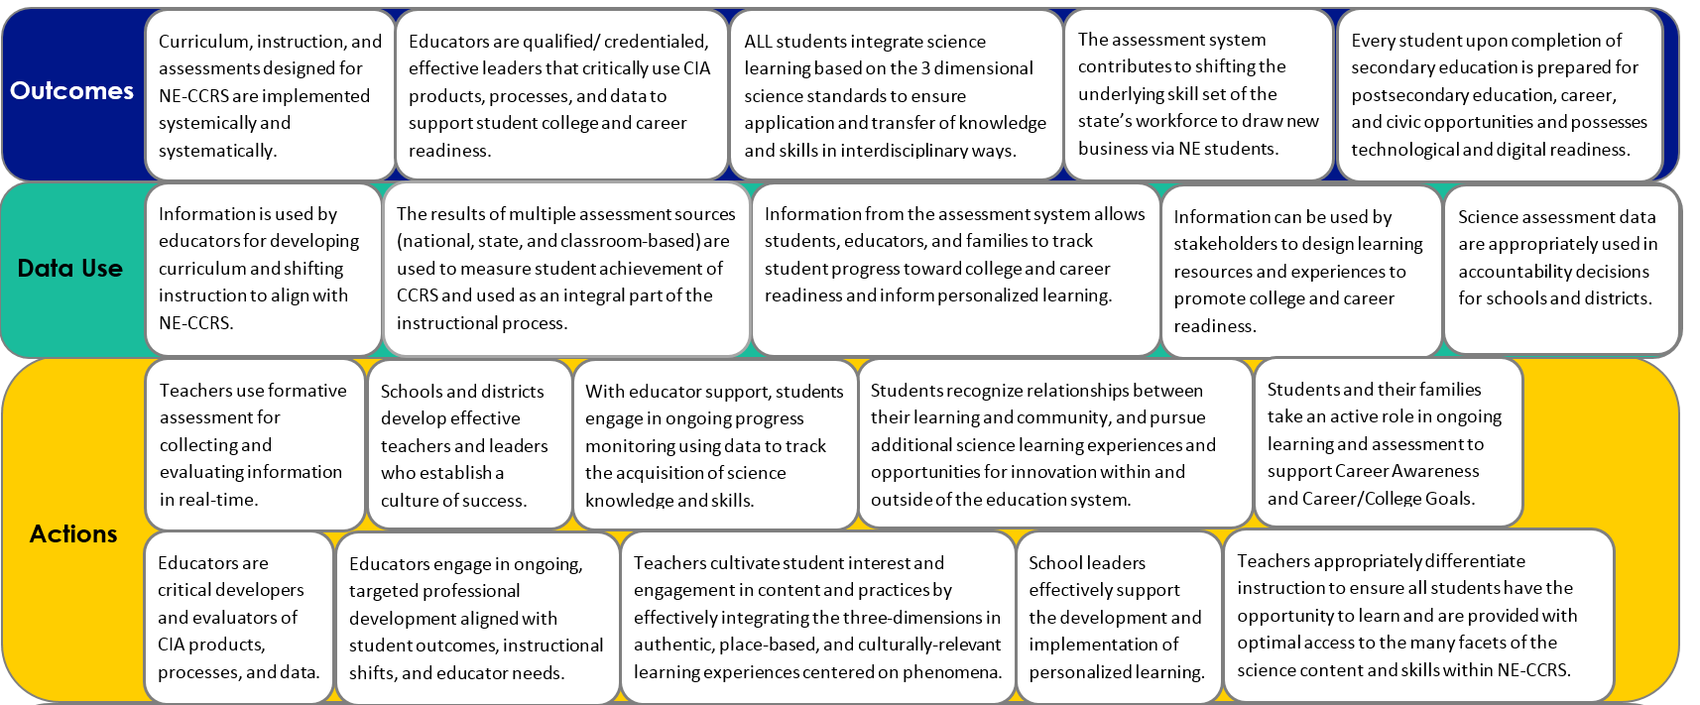
Theory of Action
Theory of Action
Curriculum, instruction, and assessments designed for NE-CCRS are implemented systemically and systematically.
Educators are qualified/ credentialed, effective leaders that critically use CIA products, processes, and data to support student college and career readiness.
ALL students integrate science learning based on the 3 dimensional science standards to ensure application and transfer of knowledge and skills in interdisciplinary ways.
The assessment system contributes to shifting the underlying skill set of the state’s workforce to draw new business via NE students.
Every student upon completion of secondary education is prepared for postsecondary education, career, and civic opportunities and possesses technological and digital readiness.
Outcomes
Notes:
Rhonda
First portion of SCILLSS work. Incorporates AQuESTT tenets and NEQuESTT components.

Slide 29
How has Nebraska been developing the assessment system?
Notes:
Rhonda

Slide 30
Building from the Classroom Level
Quality Summative Assessments
Quality Interim Assessments
Quality Formative Assessments
Quality Instruction
Quality Standards
Notes:
Rhonda: Want to make sure we are offering support at all steps

Slide 31
Goals for Student Learning
Exploring unknown/novel situations
Transfer of understanding
Flexible & logical thinkers
Science learning in all grades
Integrated application of knowledge & skill
Cross-
content integration
Reasoning and evidence in all content areas
Problem solving & critical thinking
Learning science by doing science
Grade-Appropriate, Progressive Three-Dimensional Learning
Notes:
Rhonda: Stakeholder developed goals for student learning that became embedded in the assessment system design

Slide 32
(DRAFT) Claims
Overall Claim
Students can demonstrate the scientific literacy necessary to be civic minded decision makers and demonstrate readiness for college, career, and lifelong learning through application of science and engineering practices and crosscutting concepts within and among the disciplines of science.
Critical Consumers of Information
Students can gather, analyze, and communicate information from multiple sources to use as evidence to make sense of familiar and unfamiliar phenomena and problems.
Interconnectedness of Science
Students can make connections between disciplinary core ideas within the physical science, life science, and Earth and Space sciences domains, across multiple science domains, and across multiple content areas (such as mathematics and English language arts) to make sense of familiar and unfamiliar phenomena and problems.
Notes:
Jeremy

Slide 33
Features to Maintain Consistency
Phenomena and problem-
focused
Engage diverse sense-
making
Require reasoning with evidence
Grade
appropriate
3-D
targets
Demonstrate science under-
standing by doing science
Notes:
Sara Handout: Define the knobs
Shift from rote understanding toward autonomous (independent and collaborative) practical application, evaluation, modeling unknown scenarios in learning and assessment via reasoning with evidence
Emphasis on the SEPs and CCCs—increased sophistication over time, as reflected by integrating multiple SEPs, decreased scaffolding, different CCCs lenses, and increasingly distal transfer
Phenomena and problems as drivers of student thinking and demonstration
Student agency and identify respected in assessment via choice and perseverance
Emphasis on authenticity: authentic scenarios, integration across scientific disciplines as well as cross-content areas
Integrated performances

Slide 34
Assessment System Components
*
*Common Thread: Professional learning for educators*
Curriculum Embedded
Tasks
(K-12)
Task
Library
(K-12)
Monitoring Tasks
(3,4,6,7,9,10)
Statewide Summative (5,8,11**)
**ACT for 3rd year cohort
Notes:
Jeremy: Classroom embedded in replacement units which serve as models of instruction for teachers as we transition

Slide 35
Comments and Questions

