Slide 1
Strengthening Claims-based Interpretations and Uses of Local and Large-scale Science Assessment Scores (SCILLSS)
NCME Classroom Assessment Conference: Exploring the Relationship Between Large-Scale and Local Assessments
October 9, 2018
10:30 am - 12:00 pm CT
Notes:
Ellen

Slide 2
Welcome and Introductions
Ellen Forte, edCount, LLC
Sara Cooper, Nebraska Department of Education
Kristen Huff, Curriculum Associates
Daisy Rutstein, SRI International
Notes:
Ellen

Slide 3
Objectives
Provide an introduction to the Strengthening Claims-based Interpretations and Uses of Local and Large-Scale Science Assessment Scores (SCILLSS) Project
Provide an overview of science assessment development and implementation challenges in creating a coherent system of assessment
Engage in a panel discussion to encourage participants to contemplate:
the degree to which large-scale and local assessment should work together as a coherent system, and
which methods and strategies have worked well, and which methods and strategies have not worked well in terms of promoting greater coherence between large-scale and local assessment.
Notes:
Ellen

Slide 4
Introduction to the SCILLSS Project
Notes:
Ellen

Slide 5
About SCILLSS
One of two projects funded by the US Department of Education’s Enhanced Assessment Instruments Grant Program (EAG), announced in December 2016
Collaborative partnership including three states, four organizations, and 10 expert panel members
Nebraska is the grantee and lead state; Montana and Wyoming are partner states
Four year timeline (April 2017 – December 2020)
Notes:
Ellen

Slide 6
SCILLSS Project Goals
Create a science assessment design model that establishes alignment with three-dimensional standards by eliciting common construct definitions that drive curriculum, instruction, and assessment
Strengthen a shared knowledge base among instruction and assessment stakeholders for using principled-design approaches to create and evaluate science assessments that generate meaningful and useful scores
Establish a means for state and local educators to connect statewide assessment results with local assessments and instruction in a coherent, standards-based system
Notes:
Ellen
SCILLSS has 3 overarching project goals. We intend to create a science assessment design model that establishes alignment with three-dimensional standards by eliciting common construct definitions that drive curriculum, instruction, and assessment; strengthen a shared knowledge base among stakeholders for using principled-design approaches to create and evaluate quality science assessments that generate meaningful and useful scores. We further intend to establish a way for states to connect statewide assessment results with local assessments and instruction in a coherent, standards-based system.
Each of our three states has a strong commitment to local assessment. As such, we hope to capitalize on that relationship between the local and statewide summative assessment systems to improve the way in which we vision science assessment.

Slide 7
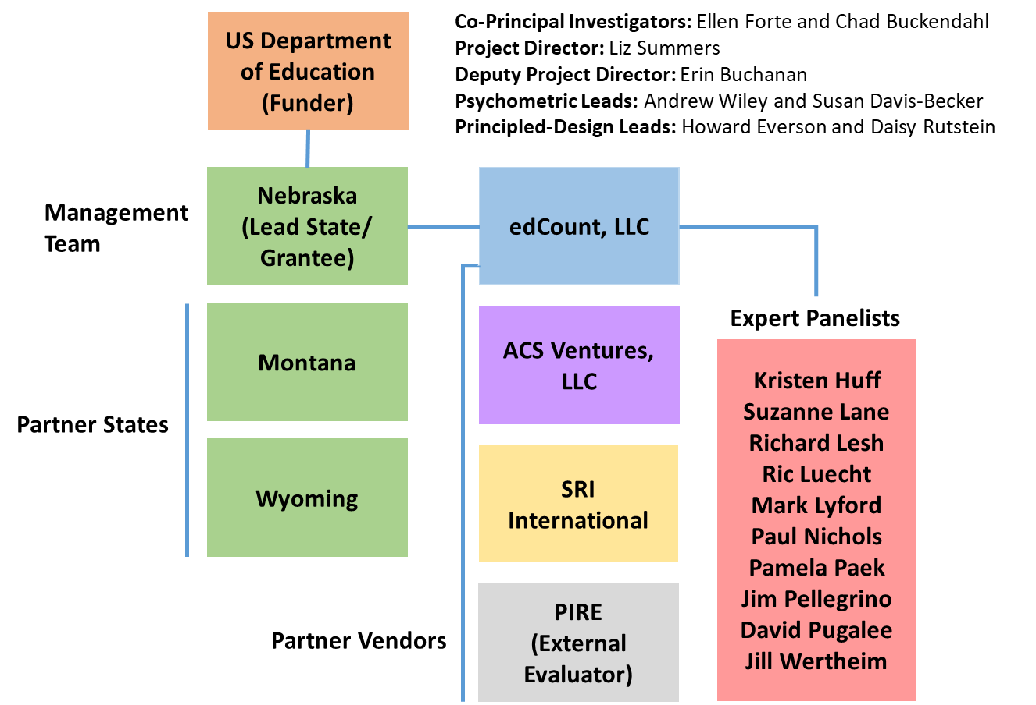
SCILLSS Partner States, Organizations, and Staff
Notes:
Ellen
The SCILLSS project includes three partner states and four partner organizations. NE is the lead SCILLSS state along with MT and WY. edCount serves as the primary contractor to NE and the other organizations serve as subcontractors to edCount.
edCount and ACS will share in the substantive activities for this project while SRI provides their principled-design expertise, and PIRE provides external project evaluation services for SCILLSS.
We have quite a distinguished list of expert panelists also involved with SCILLSS. The purpose of having a technical advisory committee is to seek feedback, commendations, and recommendations to improve the overall quality of each of the SCILLSS’ deliverables. The expert panelists will convene, along with the management team and state leads, at the SCILLSS’ annual yearly meetings to contribute expertise and experience in meeting the project goals. At various stages in the project, TAC members will contribute to different tasks during the design and development phases rather than upon completion during the yearly meetings.

Slide 8
Project Deliverables
1 - Project Foundations
SCILLSS website
Theory of Action for the project and for each state
Local and state needs assessment tools
Assessment literacy module 1
Three prioritized science claims
2 - Large-scale assessment resources
Three sets of claim-specific resources:
PLDs
measurement targets, task models, and design patterns
sample items
Assessment literacy modules 2-5
Year 1
Year 2
Year 3
Year 4
3 - Classroom-based assessment resources
Six task models
Six tasks
Six sets of student artifacts
4 - Reporting and Dissemination
Database of student artifacts corresponding to the performance levels
Post-project survey
Post-project action plans for each state
Final project report
Notes:
Ellen
In utilizing our ToA and keeping in mind the overall goals for the project and the benefits of using a principled-design approach, what does that look like for the SCILLSS project in terms of deliverables.
Review the deliverables across each of Years 1-4.

Slide 9
Nebraska’s Assessment Challenges
Notes:
Sara

Slide 10
1. Consistently Communicating our Vision
Notes:
Sara

Slide 11
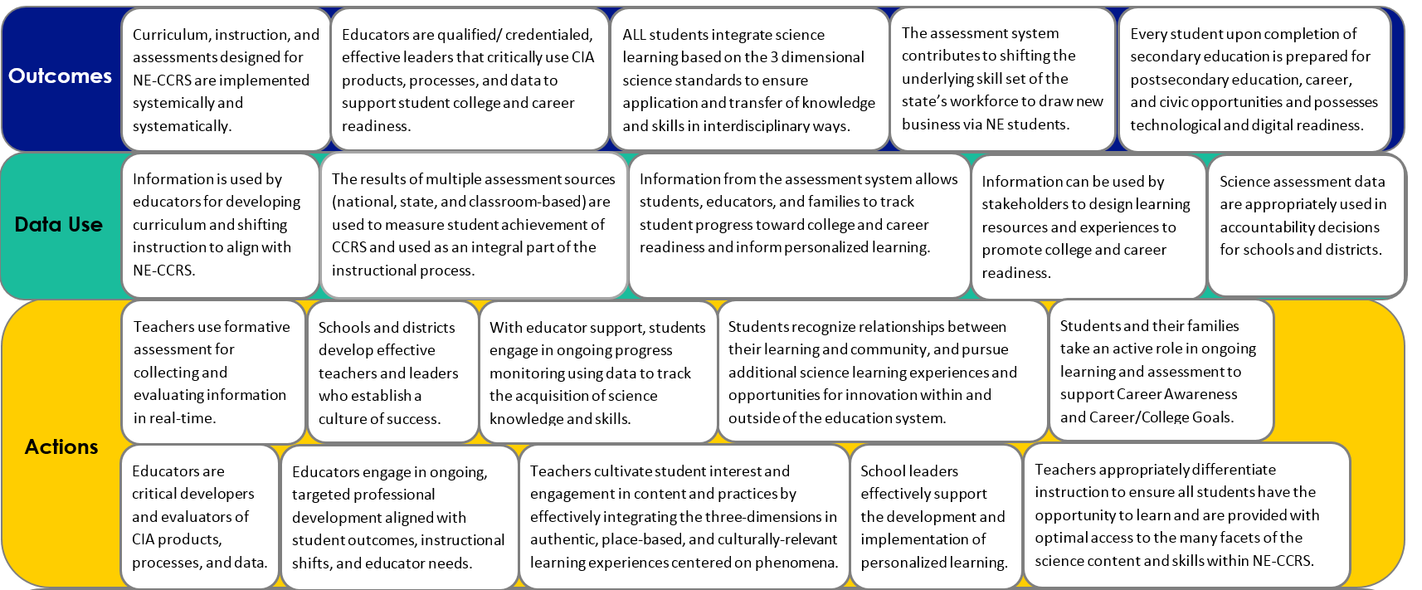
Theory of Action
Theory of Action
Curriculum, instruction, and assessments designed for NE-CCRS are implemented systemically and systematically.
Educators are qualified/ credentialed, effective leaders that critically use CIA products, processes, and data to support student college and career readiness.
ALL students integrate science learning based on the 3 dimensional science standards to ensure application and transfer of knowledge and skills in interdisciplinary ways.
The assessment system contributes to shifting the underlying skill set of the state’s workforce to draw new business via NE students.
Every student upon completion of secondary education is prepared for postsecondary education, career, and civic opportunities and possesses technological and digital readiness.
Outcomes
Notes:
Sara
First portion of SCILLSS work. Incorporates AQuESTT tenets and NEQuESTT components to help us consistently communicate our desired outcomes for the system.

Slide 12
Claims
Overall Claim
Students can demonstrate the scientific literacy necessary to be civic minded decision makers and demonstrate readiness for college, career, and lifelong learning through application of science and engineering practices and crosscutting concepts within and among the disciplines of science.
Critical Consumers of Information
Students can gather, analyze, and communicate information from
multiple sources to use as evidence to make sense of familiar and
unfamiliar phenomena and problems.
Interconnectedness of Science
Students can make connections between disciplinary core ideas within
the Physical Science, Life Science, and Earth and Space Sciences
domains, across multiple science domains, and across multiple content
areas (such as mathematics and English language arts) to make sense of
familiar and unfamiliar phenomena and problems.
Notes:
Sara
ECD forced us to really focus on the claims we want to make about our students related to science. The claims help us focus our messages and our work as we develop the system components.

Slide 13
2. Maintaining Coherence Within the System
Notes:
Sara

Slide 14
Nebraska’s Assessment Components
*
*Common Thread: Professional learning for educators*
Curriculum Embedded
Tasks
(K-12)
Task
Library
(K-12)
Monitoring Tasks
(3,4,6,7,9,10)
Statewide Summative (5,8,11**)
**ACT for 3rd year cohort
Notes:
Sara
A multicomponent system requires focus on coherence. SCILLSS is helping us anchor each end, but the middle is critical too.

Slide 15
Features to Maintain Consistency
Phenomena and Problem-
focused
Engage diverse sense-
making
Require reasoning with evidence
Grade
appropriate 3D
targets
Demonstrate science under-
standing by doing science
Notes:
Sara
These are the features driving consistency and coherence across the system. There are many variables as well, but these are constants. The SCILLSS work maintains these features as well.

Slide 16
3. Developing Educator Capacity
Notes:
Sara

Slide 17
Support at All Levels
Quality Summative Assessments
Quality Interim Assessments
Quality Formative Assessments
Quality Instruction
Quality Standards
Notes:
Sara
Building a coherent system requires support at all levels. In NE, we believe our educators are our best technology and investments in their professional learning is a priority. SCILLSS is developing tools, assessment literacy modules, and professional learning models for educators to help build educator capacity for implmeting our science assessment system.

Slide 18
Panel Discussion
Notes:
Ellen - Discussant

Slide 19
Guiding Questions
How can the project resources be designed to address our partner states’ challenges as they proceed with development of their on-demand, summative, and classroom-based science assessments?
How does the SCILLSS principled-design process for on-demand state assessment tasks translate to a process for the development of SCILLSS classroom-embedded assessment tasks?
How does the SCILLSS principled-design process translate for use across states/districts?
Notes:
For Kristen: How can the project resources be designed to address our partner states’ challenges as they proceed with development of their on-demand, summative and classroom-based science assessments?
For Daisy: How does the SCILLSS principled-design process for on-demand state assessment tasks translate to a process for the development of SCILLSS classroom-embedded assessment tasks?
For Daisy: How does the SCILLSS principled-design process translate for use across states/districts?

Slide 20
Comments and Questions

Slide 21
References
Forte, E. (2017). Applications of a comprehensive alignment framework. Workshop presented at the Annual Meeting of the Northeastern Education Research Association, Trumbull, CT.

