Slide 1
Strengthening the Meaning and Utility of Test Scores for their Intended Uses
2019 OPI Data and Assessment Conference:
Get READY for 2020!
Bozeman, Montana
This presentation was developed with funding from the U.S. Department of Education under Enhanced Assessment Grants Program CFDA 84.368A. The contents do not necessarily represent the policy of the U.S. Department of Education, and no assumption of endorsement by the Federal government should be made.

Slide 2
About SCILLSS
Strengthening Claims-based Interpretations and Uses of Local and Large-scale Science Assessment Scores
One of two projects funded by the US Department of Education’s Enhanced Assessment Instruments Grant Program (EAG), announced in December 2016
Four-year timeline (April 2017 – December 2020)
Collaborative partnership including three states, four organizations, and 10 expert panel members
Nebraska is the grantee and lead state; Montana and Wyoming are partner states
Notes:
The Strengthening Claims-based Interpretations and Uses of Local and Large-scale Science Assessment Scores (SCILLSS) project is funded by the US Department of Education’s Enhanced Assessment Instruments Grant Program. As lead state and grantee, the Nebraska Department of Education is working in collaboration with two other state education agencies, Wyoming and Montana, along with four organizations, and a technical advisory panel of 10 experts that contribute an essential combination of expertise in principled-design, measurement, assessment literacy, and classroom practices to support the implementation of this project.

Slide 3
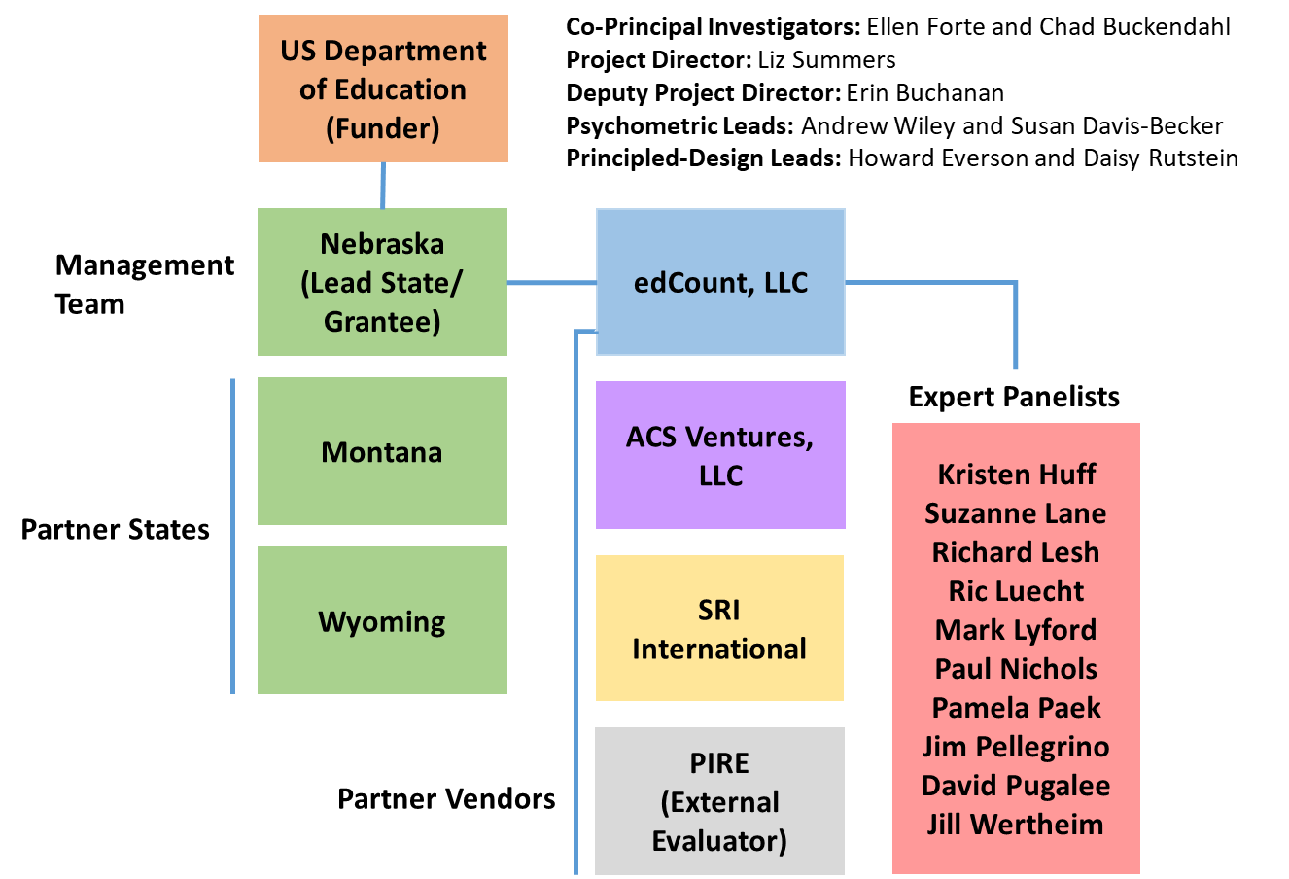
SCILLSS Partner States, Organizations, and Staff
Notes:
The SCILLSS project includes three partner states and four partner organizations. NE is the lead SCILLSS state along with MT and WY. edCount serves as the primary contractor to NE and the other organizations serve as subcontractors to edCount.
edCount and ACS will share in the substantive activities for this project while SRI provides their principled-design expertise, and PIRE provides external project evaluation services for SCILLSS.
We have quite a distinguished list of expert panelists also involved with SCILLSS. The purpose of having a technical advisory committee is to seek feedback, commendations, and recommendations to improve the overall quality of each of the SCILLSS’ deliverables. The expert panelists will convene, along with the management team and state leads, at the SCILLSS’ annual yearly meetings to contribute expertise and experience in meeting the project goals. At various stages in the project, TAC members will contribute to different tasks during the design and development phases rather than upon completion during the yearly meetings.

Slide 4
SCILLSS Project Goals
Create a science assessment design model that establishes alignment with three-dimensional science standards by eliciting common construct definitions that drive curriculum, instruction, and assessment
Strengthen a shared knowledge base among instruction and assessment stakeholders for using principled-design approaches to create and evaluate science assessments that generate meaningful and useful scores
Establish a means for state and local educators to connect statewide assessment results with local assessments and instruction in a coherent, standards-based system
Notes:
SCILLSS has 3 overarching project goals. We intend to create a science assessment design model that establishes alignment with three-dimensional standards by eliciting common construct definitions that drive curriculum, instruction, and assessment; strengthen a shared knowledge base among stakeholders for using principled-design approaches to create and evaluate quality science assessments that generate meaningful and useful scores. We further intend to establish a way for states to connect statewide assessment results with local assessments and instruction in a coherent, standards-based system.
Each of our three states has a strong commitment to local assessment. As such, we hope to capitalize on that relationship between the local and statewide summative assessment systems to improve the way in which we vision science assessment.

Slide 5
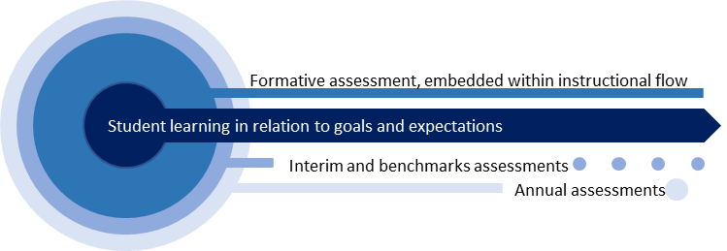
Assessment of Student Learning

Slide 6
SCILLSS Resources and Student Learning
SCILLSS Goal 1, Coherence: Establish a means for states to strengthen the meaning of statewide science assessment results and to connect those results with local science curriculum, instruction, and assessment
SCILLSS Goal 2, Support Implementation of Principled-Design: Strengthen the knowledge base and experience among stakeholders in using principled-design approaches to create and evaluate quality science assessments that generate meaningful and useful scores
Student learning in relation to goals and expectations
Interim and other classroom assessments
Guide to Developing Three-Dimensional Science Tasks for Classroom Assessments
Purpose: To guide implementation of principled-approaches for developing three-dimensional tasks aligned to NGSS-like standards for use within classrooms
Audience: Local educators and administrators
Format: Guidebook; templates; tasks; exemplars
Professional Learning Sessions on Using a Principled Approach to Designing Classroom Assessment Tasks
Purpose: To support local educators in applying principled-design in the development of classroom assessment tasks that link to curriculum and instruction
Audience: Local educators and administrators
Format: Workbook; templates; PPT slides; guiding questions
Annual assessments
SCILLSS
Guide to Developing Three-Dimensional Science Tasks for Large-Scale Assessments
Purpose: To guide implementation of principled-approaches for developing three-dimensional tasks aligned to NGSS-like standards for large-scale science assessments
Audience: State administrators; vendors
Format: Guidebook; templates; tasks; exemplars
resources
A Principled-Design Approach to Creating PLDs and Building Score Scales
Purpose: To explain how and why to develop PLDs and score scales using a principled-design approach
Audience: State and local educators; vendors
Format: White paper
Assessment Fundamentals
Self-Evaluation Protocols
Purpose: To support educators in evaluating the quality of the assessments in their assessment systems
Audience: State and local educators; vendors
Format: Protocol
Assessment Literacy Workbook
Purpose: To strengthen educators’ understanding of and ability to make good decisions about assessments
Audience: State and local educators; vendors
Format: Digital workbook
Theory of Action Principles
Assessment systems are developed such that they can inform improvements to curriculum and instruction
Assessments are equitable, accessible, and culturally relevant for widest range of students
Educators use student performance data appropriately to monitor progress toward CCR and to inform teaching
State assessments connect coherently to local C-I-A in a way that provides comprehensive coverage of the standards
Stakeholders collaborate to effectively coordinate alignment of C-I-A systems

Slide 7
Assessment Literacy and Validity Evidence
Purpose and Use of Assessment Scores
The Life Cycle of a Test
Four Fundamental Validity Questions

Slide 8
Assessment Literacy
Being assessment literate means that one understands key principles about how tests are designed, developed, administered, scored, analyzed, and reported upon in ways that yield meaningful and useful scores.
An assessment literate person can accurately interpret assessment scores and use them appropriately for making decisions.

Slide 9
Why use tests?
Every test must have a purpose: what are the scores to be used for?
Each use is associated with stakes.
All tests should have validity evidence to support score meaning.
The higher the stakes, the more critical validity evidence becomes.

Slide 10
Purposes and Uses of Assessment Scores
What do you want to know?
Why do you want to know this and what will you do with this information?

Slide 11
Purposes and Uses of Assessment Scores
What do you want to know?
Why do you want to know this and what will you do with this information?
What do students already know about what I’m about to teach?
How well are students understanding this lesson so far?
How well did students learn the concepts from the unit I just taught?
How well are students achieving in relation to the standards for science in their grade?
How well are students achieving in science this year as compared with students in this grade last year?

Slide 12
Purposes and Uses of Assessment Scores
What do you want to know?
Why do you want to know this and what will you do with this information?
I need to tailor my upcoming lesson to better match students’ needs.
I need to know whether and how to reteach or if it’s time to move on.
I need information to give as feedback to students or to use in grading.
We need to determine whether and how to adjust our science curricula for next semester or next year.
We need to evaluate our science programs and resources.
We need to evaluate how we distribute resources to districts or schools to support improvements in science instruction.

Slide 13
Why use tests?
To…
guide next steps in instruction | evaluate learning for calculating grades | evaluate teachers
evaluate instruction | determine eligibility for program entry or exit | evaluate schools or districts
evaluate curriculum | diagnose learning difficulties | evaluate programs or services
 | predict performance in a later setting
These uses are more formative. They have relatively low stakes for students and educators, as long as scores are considered in combination with other information and decisions allow for flexibility in implementation. | These uses have high stakes for individual students and scores must always be considered in combination with other information. | These uses have high stakes for educators and some administrators and scores must always be considered in combination with other information.

Slide 14
The Life Cycle of a Test
Design and development
Administration
Scoring
Analysis
Reporting
Use of Scores
Validity
Purpose

Slide 15
The Life Cycle of a Test
Key questions for Design and Development
How will the scores be used?
What is the test intended to measure? These are the measurement targets.
How can these targets best be measured?
What questions or tasks will work best and how should they be combined into a test?
How will students interact with the questions and record their responses?
How will responses be scored, analyzed, and reported?
Design and development
Administration
Scoring
Analysis
Reporting
Use of Scores
Validity

Slide 16
The Life Cycle of a Test
Key questions for Administration
How will the items be presented to students?
How will students record their answers?
How much time will students get?
Will students have access to a calculator, ruler, formula sheet, textbook, etc.?
Will some students need accommodations?
How will I handle any irregularities that arise during administration?
Design and development
Administration
Scoring
Analysis
Reporting
Use of Scores
Validity

Slide 17
The Life Cycle of a Test
Key questions for Scoring
How will students’ responses be scored, when, and by whom?
If students’ responses are to be scored using a rubric, how was the rubric developed and how is it applied accurately and consistently?
How will scoring be evaluated?
How will scores be recorded and saved to ensure accuracy and protect students’ privacy?
Design and development
Scoring
Analysis
Reporting
Use of Scores
Administration
Validity

Slide 18
The Life Cycle of a Test
Key questions for Analysis
What scores must be reported for individual students? For groups of students? For the total test? For sections or parts of the test? For items?
Will raw scores be reported?
Will scale scores be reported?
How and when will scores be calculated?
What analyses are necessary to support comparisons of scores across different administrations? Different groups of students?
Design and development
Scoring
Analysis
Reporting
Use of Scores
Administration
Validity

Slide 19
The Life Cycle of a Test
Key steps for Reporting
What information is to be reported to students? Their parents? Their teachers?
How is this information to be used?
How will scores and guidance on what they mean be conveyed? When?
How will each student’s private testing information be protected during and after the reporting process?
Who will have access to students’ scores and any other information about their participation and performance?
Design and development
Scoring
Analysis
Reporting
Use of Scores
Administration
Validity

Slide 20
The Life Cycle of a Test
Key steps for the Use of Scores
How do educators use the scores? How do students and their parents use them?
Are the actual uses consistent with the intended uses?
Are scores used in ways that were not intended? Are these uses supported by evidence?
Are scores accompanied by sufficient guidance about their appropriate and inappropriate uses?
Design and development
Scoring
Analysis
Reporting
Use of Scores
Administration
Validity

Slide 21
Validity in Assessments
The degree to which evidence and theory supports the interpretations of test scores for the proposed uses of the tests.
No test can be valid in and of itself.
Validity depends on the strength of the evidence regarding what a test measures and how its scores can be interpreted and used.
Assessment validity is a judgment based on a multi-faceted body of evidence.

Slide 22
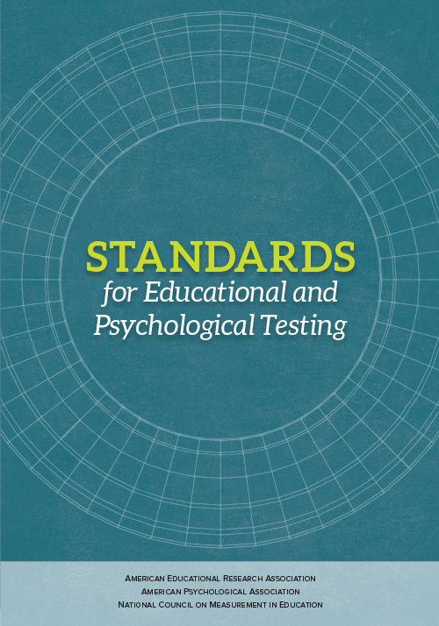
Standard 1.0. Clear articulation of each intended test score interpretation for a specified use should be set forth, and appropriate validity evidence in support of each intended interpretation should be provided.
(AERA, APA, & NCME, 2014, p. 23)

Slide 23
Standard 4.0. Tests and testing programs should be designed and developed in a way that supports valid interpretations of the test scores for their intended uses. Tests developers and publishers should document steps taken during the design and development process to provide evidence of fairness, reliability, and validity for the intended uses for individuals in the intended examinee population.
(AERA, APA, & NCME, 2014, p. 85)

Slide 24
Validity Questions
Construct Coherence
To what extent do the test scores reflect the knowledge and skills we’re intending to measure, for example, those defined in the academic content standards?
Comparability
To what extent are the test scores reliable and consistent in meaning across all forms, students, test sites, and time?
Accessibility & Fairness
To what extent does the test allow all students to demonstrate what they know and can do?
Consequences
To what extent are the test scores used appropriately to achieve specific goals?

Slide 25
Validity Questions
Construct Coherence
Design and development
Administration
Scoring
Analysis
Reporting
Use of Scores
Comparability
Validity
Accessibility & Fairness
Consequences
25

Slide 26
Construct Coherence
To what extent does the assessment yield scores that reflect the knowledge and skills we intend to measure (e.g., academic standards)?
Construct:
The concept or characteristic that a test is designed to measure.
Why is this evidence important?
To ensure that the assessment has been designed, developed, and implemented to yield scores that reflect the constructs we intend to measure

Slide 27
Comparability
To what extent are the assessment scores reliable and consistent in meaning across all students, classes, and schools?
Why is this evidence important?
To ensure the assessment scores carry consistent meaning across test forms, students, administration sites, and time

Slide 28
Accessibility and Fairness
To what extent does the assessment allow all students to access the content and demonstrate their knowledge and skills?
Why is this evidence important?
To ensure that test scores reflect what we’re intending to measure about students’ knowledge and skills and not irrelevant characteristics

Slide 29
Consequences
To what extent does the assessment yield information that is used appropriately to achieve specific goals?
Why is this evidence important?
To ensure that test scores are interpreted and used in ways that are appropriate and not interpreted and used in ways that are inappropriate
29

Slide 30
Overview of the Local and State Self-Evaluation Protocols
Purpose, Audience, and Structure

Slide 31
Self-evaluation Protocols Purposes
The local and state self-evaluation protocols are designed to provide frameworks for how local schools or districts can consider how to best implement their local assessment program, and how states can evaluate their options for their statewide assessment program.
Local or District | State
Designed to focus on assessments used within the classroom Typically used for lower-stakes decisions Helps guide curriculum Provides information to teachers on the status of students’ progression through key topics or curriculum items | Focused on higher-stakes assessments Typically used within accountability models

Slide 32
Self-evaluation Protocols Audience
The self-evaluation protocols are intended for a specific audience:
State and district administrators who may be— Instructional leaders Content specialists Assessment specialists Decision-makers regarding state or local assessments These educational leaders will strengthen their assessment literacy by building their knowledge base, understanding the nuances of validity and reliability, and applying their knowledge in the evaluation of their own systems.

Slide 33
Self-evaluation Protocols
Goals and Objectives
Identify intended use(s) of test scores
Foster an internal dialogue to clarify the goals and intended uses of an assessment program
Evaluate whether given test interpretations are appropriate
Identify gaps in assessment programs
Identify overlap across multiple assessment programs

Slide 34
Self-evaluation Protocol Structure
4 Steps
Articulate
Articulate your current and planned needs for assessment scores and data
Identify
Identify all current and planned assessments
Gather
Gather and evaluate the evidence for each assessment
Review
Review the evidence across assessments

Slide 35
Step 1: Articulate Current Needs
What is the purpose of the given assessment and how will it be used?
What are the stakes associated with your assessment?
Low stakes – Instructional guidance
High stakes – Evaluate programs or services
What questions are you trying to answer about student achievement?
What information is provided from your assessment and how does it address your questions about student achievement?
Is there additional information that the assessment could provide to help address these questions?

Slide 36
Step 2: Identify Current Assessments
Gather all current and planned assessments
Assessments can be organized multiple ways
All assessments within a grade level
All assessments within a given content area
Identify areas where overlap in information has occurred
Identify areas where a gap appears to exist

Slide 38
Step 3: Gather and Evaluate Validity Evidence
FOUR FUNDAMENTAL VALIDITY QUESTIONS
To what extent does the assessment as designed capture the knowledge and skills defined in the target domain?
To what extent does the assessment as implemented yield scores that are comparable across students, sites, time, forms?
To what extent are students able to demonstrate what they know and can do in relation to the target knowledge and skills on the test in a manner that can be recognized and accurately scored?
To what extent does the test yield information that can be and is used appropriately within a system to achieve specific goals?
Construct Coherence
Comparability
Accessibility and Fairness
Consequences
Notes:
Across the entire project, we will aim to keep these 4 fundamental validity questions in mind, using these to guide our process and deliverable development. We feel if we work to keep content coherence, comparability, accessibility and fairness, as well as consequences in mind throughout this project, then our products will be generalizable an usable to a wide variety of states and systems across the Nation. We are excited to work on this project with all of our partners and make available our lessons learned in re-envisioning science assessment.

Slide 42
Step 4: Review and Evaluate Current Assessment Program
Review each assessment’s purpose and use
Identify areas with adequate evidence for test scores
Identify areas where the degree of data available is either incomplete or lacking

Slide 44
Overview of the Digital Workbook on Educational Assessment Design and Evaluation
Purpose, Audience, and Structure

Slide 45
Digital Workbook Purpose
The digital workbook includes five assessment literacy chapters designed to:
Inform state and local educators and other stakeholders on the purposes of assessments Ensure a common understanding of the purposes and uses of assessment scores, and how those purposes and uses guide decisions about test design and evaluation Complement the needs assessment by providing background information and resources for educators to grow their knowledge about foundational assessment topics Address construct coherence, comparability, accessibility and fairness, and consequences

Slide 46
Digital Workbook Audience
The digital workbook is intended for a specific audience:
State and district administrators who may be— Instructional leaders Content specialists Assessment specialists Decision-makers regarding state or local assessments Responsible for implementing State and Local Self-Evaluation Protocols These educational leaders will strengthen their assessment literacy by building their knowledge base, understanding the nuances of validity and reliability, and applying their knowledge in the evaluation of their own systems.

Slide 47
Digital Workbook Series Overview
Chapter 1 | Validity, validity evidence, and the assessment life cycle (design and development, administration, scoring, analysis, reporting, score use)
Chapter 2 | Construct Coherence: To what extent do the test scores reflect the knowledge and skills we’re intending to measure, for example, those defined in the academic content standards?
Chapter 3 | Comparability: To what extent are the test scores reliable and consistent in meaning across all students, classes, and schools?
Chapter 4 | Accessibility and Fairness: To what extent does the test allow all students to demonstrate what they know and can do?
Chapter 5 | Consequences: To what extent are the test scores used appropriately to achieve specific goals?

Slide 48
Accessing the Digital Workbook
The local and state needs assessments and first two chapters in the digital workbook can be found at this link: http://www.scillsspartners.org/scillss-resources/
The remaining three chapters of the digital workbook are currently being developed and will be made available by March 2019.

Slide 49
Key Take-aways: Purpose
Every test must have a purpose.
Validity relates to the interpretation and use of test scores for a specific purpose and not to the test itself.
Test scores may be used for more than one purpose, but validity evidence is necessary for each purpose.

Slide 50
Key Take-aways: Validity Evidence
Validity evidence should be gathered in relation to key questions related to:
Construct coherence
Comparability
Accessibility and fairness
Consequences
Validity evidence should gathered throughout the life cycle of a test.

Slide 51
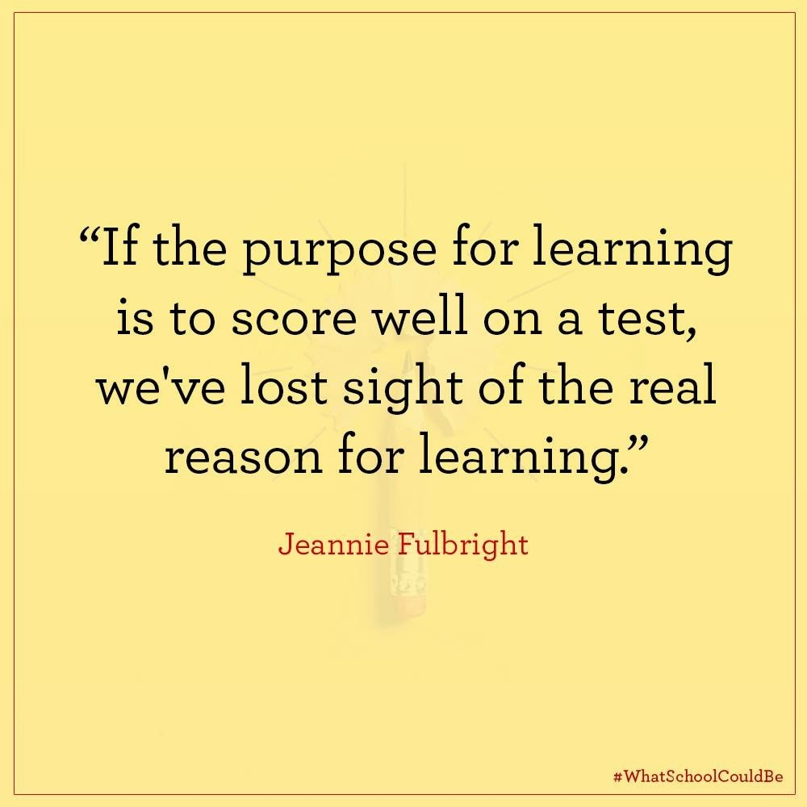

Slide 52
Comments and Questions
Liz Summers
202-297-8629
LSUMMERS@EDCOUNT.COM

