Slide 1
Strengthening Claims-based Interpretations and Uses of Local and Large-scale Science Assessment Scores
(SCILLSS)
National Council on Measurement in Education
2019 Annual Meeting
April 6, 2019
Toronto, Canada

Slide 2
Welcome and Introduction
Liz Summers, Ph.D.,
Executive Vice President,
edCount, LLC

Slide 3
About SCILLSS
One of two projects funded by the US Department of Education’s Enhanced Assessment Instruments Grant Program (EAG), announced in December, 2016
Collaborative partnership including three states, four organizations, and 10 expert panel members
Nebraska is the grantee and lead state; Montana and Wyoming are partner states
Four year timeline (April 2017 – December 2020)
Notes:
The Strengthening Claims-based Interpretations and Uses of Local and Large-scale Science Assessment Scores (SCILLSS) project is funded by the US Department of Education’s Enhanced Assessment Instruments Grant Program. As lead state and grantee, the Nebraska Department of Education is working in collaboration with two other state education agencies, Wyoming and Montana, along with four organizations, and a technical advisory panel of 10 experts that contribute an essential combination of expertise in principled-design, measurement, assessment literacy, and classroom practices to support the implementation of this project.

Slide 4

SCILLSS Project Goals
Create a science assessment design model that establishes alignment with three-dimensional standards by eliciting common construct definitions that drive curriculum, instruction, and assessment
Strengthen a shared knowledge base among instruction and assessment stakeholders for using principled-design approaches to create and evaluate science assessments that generate meaningful and useful scores
Establish a means for state and local educators to connect statewide assessment results with local assessments and instruction in a coherent, standards-based system
Notes:
SCILLSS has 3 overarching project goals. We intend to create a science assessment design model that establishes alignment with three-dimensional standards by eliciting common construct definitions that drive curriculum, instruction, and assessment; strengthen a shared knowledge base among stakeholders for using principled-design approaches to create and evaluate quality science assessments that generate meaningful and useful scores. We further intend to establish a way for states to connect statewide assessment results with local assessments and instruction in a coherent, standards-based system.
Each of our three states has a strong commitment to local assessment. As such, we hope to capitalize on that relationship between the local and statewide summative assessment systems to improve the way in which we vision science assessment.

Slide 5
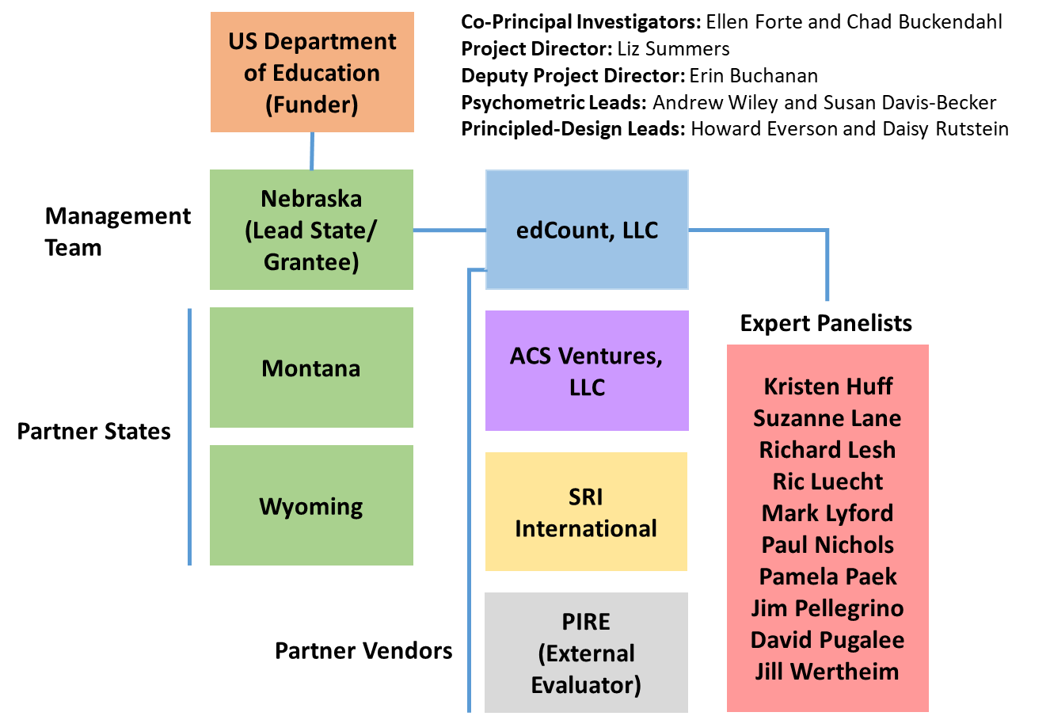
SCILLSS Partner States, Organizations, and Staff
Notes:
We have quite a distinguished list of expert panelists also involved with SCILLSS. The purpose of having a technical advisory committee is to seek feedback, commendations, and recommendations to improve the overall quality of each of the SCILLSS’ deliverables. The expert panelists will convene, along with the management team and state leads, at the SCILLSS’ annual yearly meetings to contribute expertise and experience in meeting the project goals. At various stages in the project, TAC members will contribute to different tasks during the design and development phases rather than upon completion during the yearly meetings.

Slide 6
Ensuring Rigor in State and Local Assessment Systems: A Self-Evaluation Protocol
Andrew Wiley, Ph.D.,
Assessment Design & Evaluation Expert,
ACS Ventures, LLC

Slide 7
Self-evaluation Protocols Purposes
The local and state self-evaluation protocols are designed to provide frameworks for how local schools or districts can consider how to best implement their local assessment program, and how states can evaluate their options for their statewide assessment program.
Local or District | State
Designed to focus on assessments used within the classroom Usually used for lower-stakes decisions Helps guide curriculum Provides information to teachers on the status of students’ progression through key topics or curriculum items | Focused on higher-stakes assessments Usually used within accountability models

Slide 8
Self-evaluation Protocols
Goals and objectives
  Identify intended use(s) of test scores
  Foster an internal dialogue to clarify the goals and intended uses of an assessment program
  Evaluate whether given test interpretations are appropriate
  Identify gaps in assessment programs
  Identify overlap across multiple assessment programs

Slide 9
Self-evaluation Protocol Structure
4 Steps
Articulate
Articulate your current and planned needs for assessment scores and data
Identify
Identify all current and planned assessments
Gather
Gather and evaluate the evidence for each assessment
Review
Review the evidence across assessments

Slide 10
Gather and Evaluate Validity Evidence
FOUR FUNDAMENTAL VALIDITY QUESTIONS
To what extent does the assessment as designed capture the knowledge and skills defined in the target domain?
To what extent does the assessment as implemented yield scores that are comparable across students, sites, time, forms?
To what extent are students able to demonstrate what they know and can do in relation to the target knowledge and skills on the test in a manner that can be recognized and accurately scored?
To what extent does the test yield information that can be and is used appropriately within a system to achieve specific goals?
Construct Coherence
Comparability
Accessibility and Fairness
Consequences
Notes:
Across the entire project, we will aim to keep these 4 fundamental validity questions in mind, using these to guide our process and deliverable development. We feel if we work to keep content coherence, comparability, accessibility and fairness, as well as consequences in mind throughout this project, then our products will be generalizable an usable to a wide variety of states and systems across the Nation. We are excited to work on this project with all of our partners and make available our lessons learned in re-envisioning science assessment.

Slide 11

Self-Evaluation Protocol, Steps One and Two:
Identifying Purposes and Assessments Used to Serve those Purposes
Need/purpose | Assessment(s) Used to Serve this Purpose
Evaluate science curricula
ISTEP+: science in grades 4, 6, and 10
Monitor learning and guide instruction in math
MAP Growth in grades K-10
Monitor reading development
Edmentum Reading Eggs

Slide 12
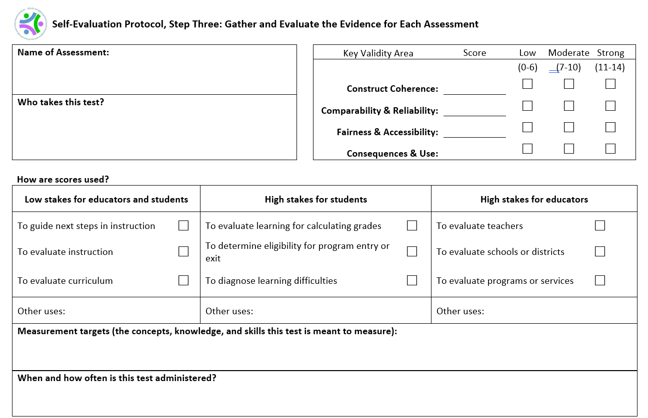
MAP Growth in grades K-10
All* students in grades K-10
*Except some students with disabilities and English learners?
✓
Four times annually: September, December, February, April

Slide 13
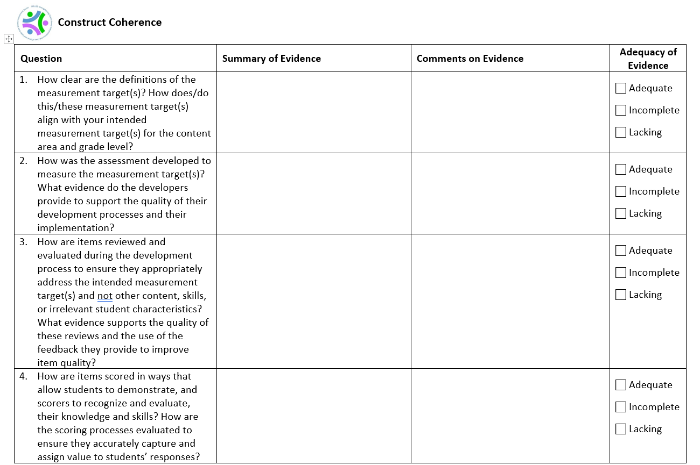

Slide 14
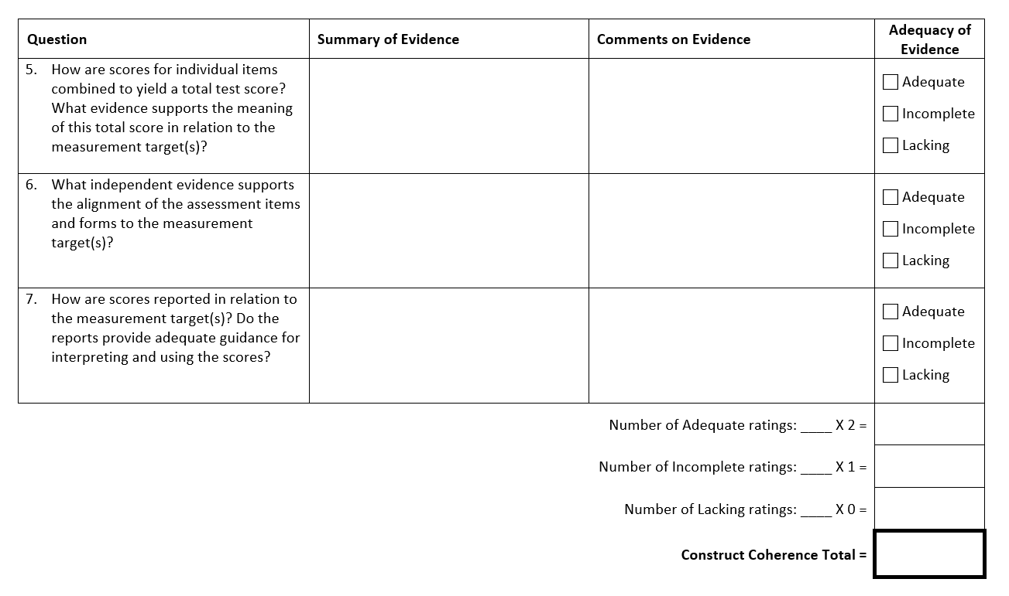

Slide 15
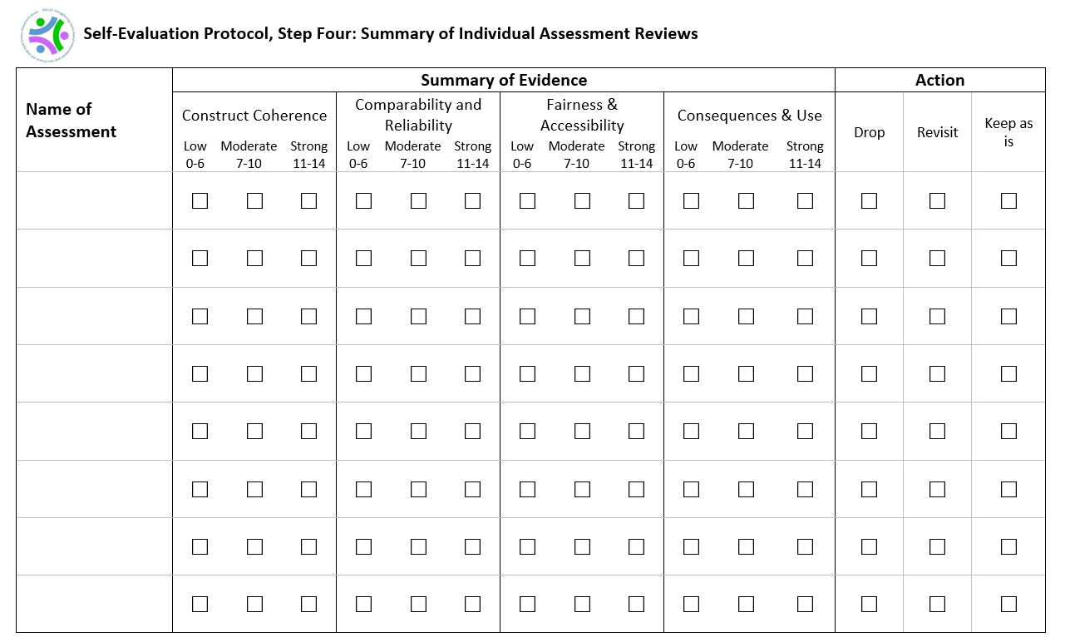
MAP Growth in grades K-10

Slide 16
The SCILLSS Digital Workbook on Educational Assessment Design and Evaluation
Ellen Forte, Ph.D.,
CEO & Chief Scientist,
edCount, LLC

Slide 17
Digital Workbook Purpose
Inform state and local educators and other stakeholders on the purposes of assessments;
Ensure a common understanding of the purposes and uses of assessment scores, and how those purposes and uses guide decisions about test design and evaluation;
Complement the needs assessment by providing background information and resources for educators to grow their knowledge about foundational assessment topics; and
Address construct coherence, comparability, accessibility and fairness, and consequences.

Slide 18
Digital Workbook Audience
State and district administrators who may be—
  Instructional leaders
  Content specialists
  Assessment specialists
  Decision-makers regarding state or local assessments
  Responsible for implementing State and Local Self-Evaluation Protocols
These educational leaders will strengthen their assessment literacy by building their knowledge base, understanding the nuances of validity and reliability, and applying their knowledge in the evaluation of their own systems.

Slide 19
Assessment Literacy
Being assessment literate means that one understands key principles about how tests are designed, developed, administered, scored, analyzed, and reported upon in ways that yield meaningful and useful scores.
An assessment literate person can accurately interpret assessment scores and use them appropriately for making decisions.

Slide 20
Digital Workbook Series Organizing
Principles
Validity Questions
Phases of the Test Life Cycle
Construct Coherence
Design and development
Administration
Scoring
Analysis
Reporting
Use of Scores
Comparability
Validity
Fairness & Accessibility
Consequences

Slide 21
Digital Workbook Series Organizing
Principles
Validity Questions
Construct Coherence
To what extent do the test scores reflect the knowledge and skills we’re intending to measure, for example, those defined in the academic content standards?
Comparability
To what extent are the test scores reliable and consistent in meaning across all forms, students, test sites, and time?
Fairness & Accessibility
To what extent does the test allow all students to demonstrate what they know and can do?
Consequences
To what extent are the test scores used appropriately to achieve specific goals?

Slide 22
Digital Workbook Series Chapters
Chapter 1 | Overview: definition of validity, validity evidence, and the assessment life cycle (design and development, administration, scoring, analysis, reporting, score use)
Chapter 2 | Construct Coherence: To what extent do the test scores reflect the knowledge and skills we’re intending to measure, for example, those defined in the academic content standards?
Chapter 3 | Comparability: To what extent are the test scores reliable and consistent in meaning across all students, classes, and schools?
Chapter 4 | Fairness and Accessibility: To what extent does the test allow all students to demonstrate what they know and can do?
Chapter 5 | Consequences: To what extent are the test scores used appropriately to achieve specific goals?

Slide 23
Examples of Construct Coherence Questions
What are you intending to measure with this test? (What are the measurement targets?)
How was the assessment developed to measure these measurement targets?
How were items reviewed and evaluated during the development process to ensure they appropriately address the intended measurement targets and not other content, skills, or irrelevant student characteristics?
How are items scored in ways that allow students to demonstrate, and scorers to recognize and evaluate, their knowledge and skills? How are the scoring processes evaluated to ensure they accurately capture and assign value to students’ responses?
How are scores for individual items combined to yield a total test score? What evidence supports the meaning of this total score in relation to the measurement target(s)? How do items contribute to subscores and what evidence supports the meaning of these subscores?
What independent evidence supports the alignment of the assessment items and forms to the measurement targets?
How are scores reported in relation to the measurement targets? Do the reports provide adequate guidance for interpreting and using the scores?

Slide 24
Examples of Comparability Questions
How is the assessment designed to yield consistent, reliable scores? What evidence supports score reliability?
How is the assessment designed to support comparability of scores across forms? What evidence supports such comparability?
How is the assessment designed to support comparability of scores across time? What evidence supports such comparability?
How is the assessment designed to support comparability of scores across administration sites? What evidence supports such comparability?
How is the assessment administered to protect against various types of cheating so that the scores reflect students’ knowledge and skills and not inappropriate access to testing materials? What evidence supports the implementation of these safeguards and security protocols?
How is the assessment scored such that scores reflect students’ knowledge and skills and not inaccuracies or inconsistencies in the scoring process? What evidence supports implementation of these scoring procedures?
How are scores reported in ways that appropriately support or disrupt comparability in score interpretation across time, administration sites, or variations in student characteristics?

Slide 25
Examples of Fairness & Accessibility Questions
How were the assessment questions developed to ensure that scores do not reflect student characteristics that are irrelevant to the measurement targets?
How were the needs of students with disabilities addressed during assessment development? What evidence supports these efforts and their effectiveness?
How were the needs of English learners addressed during assessment development? What evidence supports these efforts and their effectiveness?
How are students with disabilities able to demonstrate their knowledge and skills through the availability and use of any necessary accommodations? What evidence supports the identification and use of these accommodations at the time of testing?
How are English learners able to demonstrate their knowledge and skills through the availability and use of any necessary accommodations? What evidence supports the identification and use of these accommodations at the time of testing?
How are students’ responses scored in ways that reflect only the construct-relevant aspects of those responses? What evidence supports the minimization of construct-irrelevant influences on students’ responses?
How are assessment scores interpreted in relation to knowledge and skills that test takers have had an opportunity to learn or are preparing to learn? What evidence supports the interpretation of students’ scores in relation to their learning opportunities?

Slide 26
Examples of Consequences Questions
How is the assessment developed, administered, scored, and reported in ways that deter and limit instances of cheating by students or others associated with the assessment or its stakes? What evidence supports the implementation and effectiveness of these efforts?
How are the scores from the assessment intended to be used as described by the test developers and how are they used by your state? How well do these uses align?
If your state is using test scores for purposes other than those for which the test developers intended, what evidence supports those uses?
If assessment scores are associated with recommendations for instruction or other interventions for individual students, what evidence supports such interpretations and uses of these scores? What tools and resources are available to educators for evaluating and implementing these recommendations?
If assessment scores are associated with recommendations for whole-class or group instruction, what evidence supports such interpretations and uses of these scores? What tools and resources are available to educators for evaluating and implementing these recommendations?
If assessment scores are associated with high stakes decisions for teachers, administrators, schools, or other entities or individuals, what evidence supports such interpretations and uses of these scores?
How are scores reported to students and parents in ways that support their understanding of the scores and any associated recommendations or decisions?

Slide 27
The Benefits, Challenges, and Lessons Learned from Using the SCILLSS Resources
Rhonda True, M.A.,
EAG Grant Coordinator,
Nebraska Department of Education

Slide 28

Development Timeline
Field Test
Spring 2020
Pilot
Spring 2019
Pilot
Development
Summer 2018
Operational Spring 2021
Field Test
Development
Summer 2019
Future
Field Test
Development
Summer 2020
VisioningNov. 2017
Task Force
Jan. 2018
Adoption
Sept. 2017
Notes:
This is where Nebraska is in their Science Development Timeline.

Slide 29
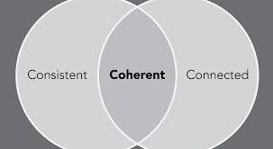
Tools & Processes Developed by the
SCILSSS Project
Tools & Processes Developed by SCILLSS Project
Support
Science System

Slide 30
Coherence Connected
Notes:
The tools and processes created through this grant have helped NE with our System Vision for Science. Connecting all parts of the system from local to state.

Slide 31
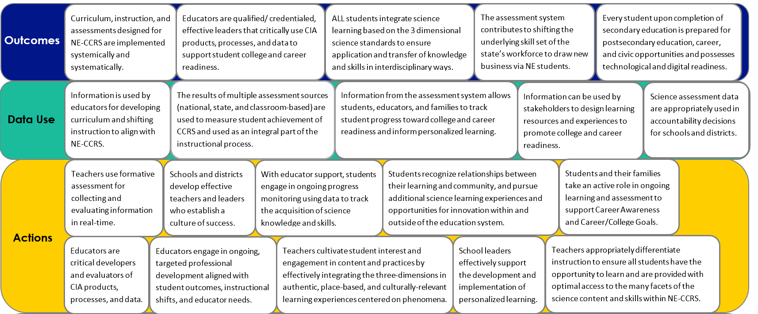


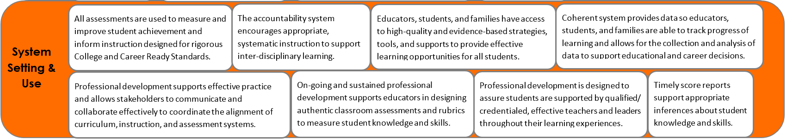





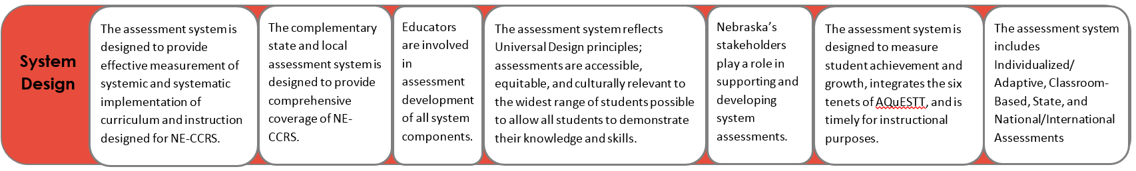
Theory of Action
Theory of Action
Theory of Action
Curriculum, instruction, and assessments designed for NE-CCRS are implemented systemically and systematically.
Educators are qualified/ credentialed, effective leaders that critically use CIA products, processes, and data to support student college and career readiness.
ALL students integrate science learning based on the 3 dimensional science standards to ensure application and transfer of knowledge and skills in interdisciplinary ways.
The assessment system contributes to shifting the underlying skill set of the state’s workforce to draw new business via NE students.
Every student upon completion of secondary education is prepared for postsecondary education, career, and civic opportunities and possesses technological and digital readiness.
Outcomes
Outcomes
Notes:
Rhonda
First portion of SCILLSS work. Incorporates AQuESTT tenets and NEQuESTT components.

Slide 32
Assessment System Components
*
*Common Thread: Professional learning for educators*
Curriculum Embedded
Tasks
(K-12)
Task
Library
(K-12)
Monitoring Tasks
(3,4,6,7,9,10)
Statewide Summative (5,8,11**)
**ACT for 3rd year cohort

Slide 33
Consistency
Notes:
The tools and processes developed will help states maintain consistency in their science systems. Self-evaluation protocols provide a framework for educators at state level to use in any evaluation of aspects of their state assessment system. Theory of Action provides a framework to share what is valued and what outcomes you are wanting in your system.

Slide 34
Features to Maintain Consistency
Phenomena and Problem-
focused
Engage diverse sense-
making
Require reasoning with evidence
Grade
appropriate 3D
targets
Demonstrate science under-
standing by doing science
Notes:
The summative assessment is just one component of the NSCAS-Science system. These 5 features have been identified to help ensure we maintain consistency across all components of the system.

Slide 35
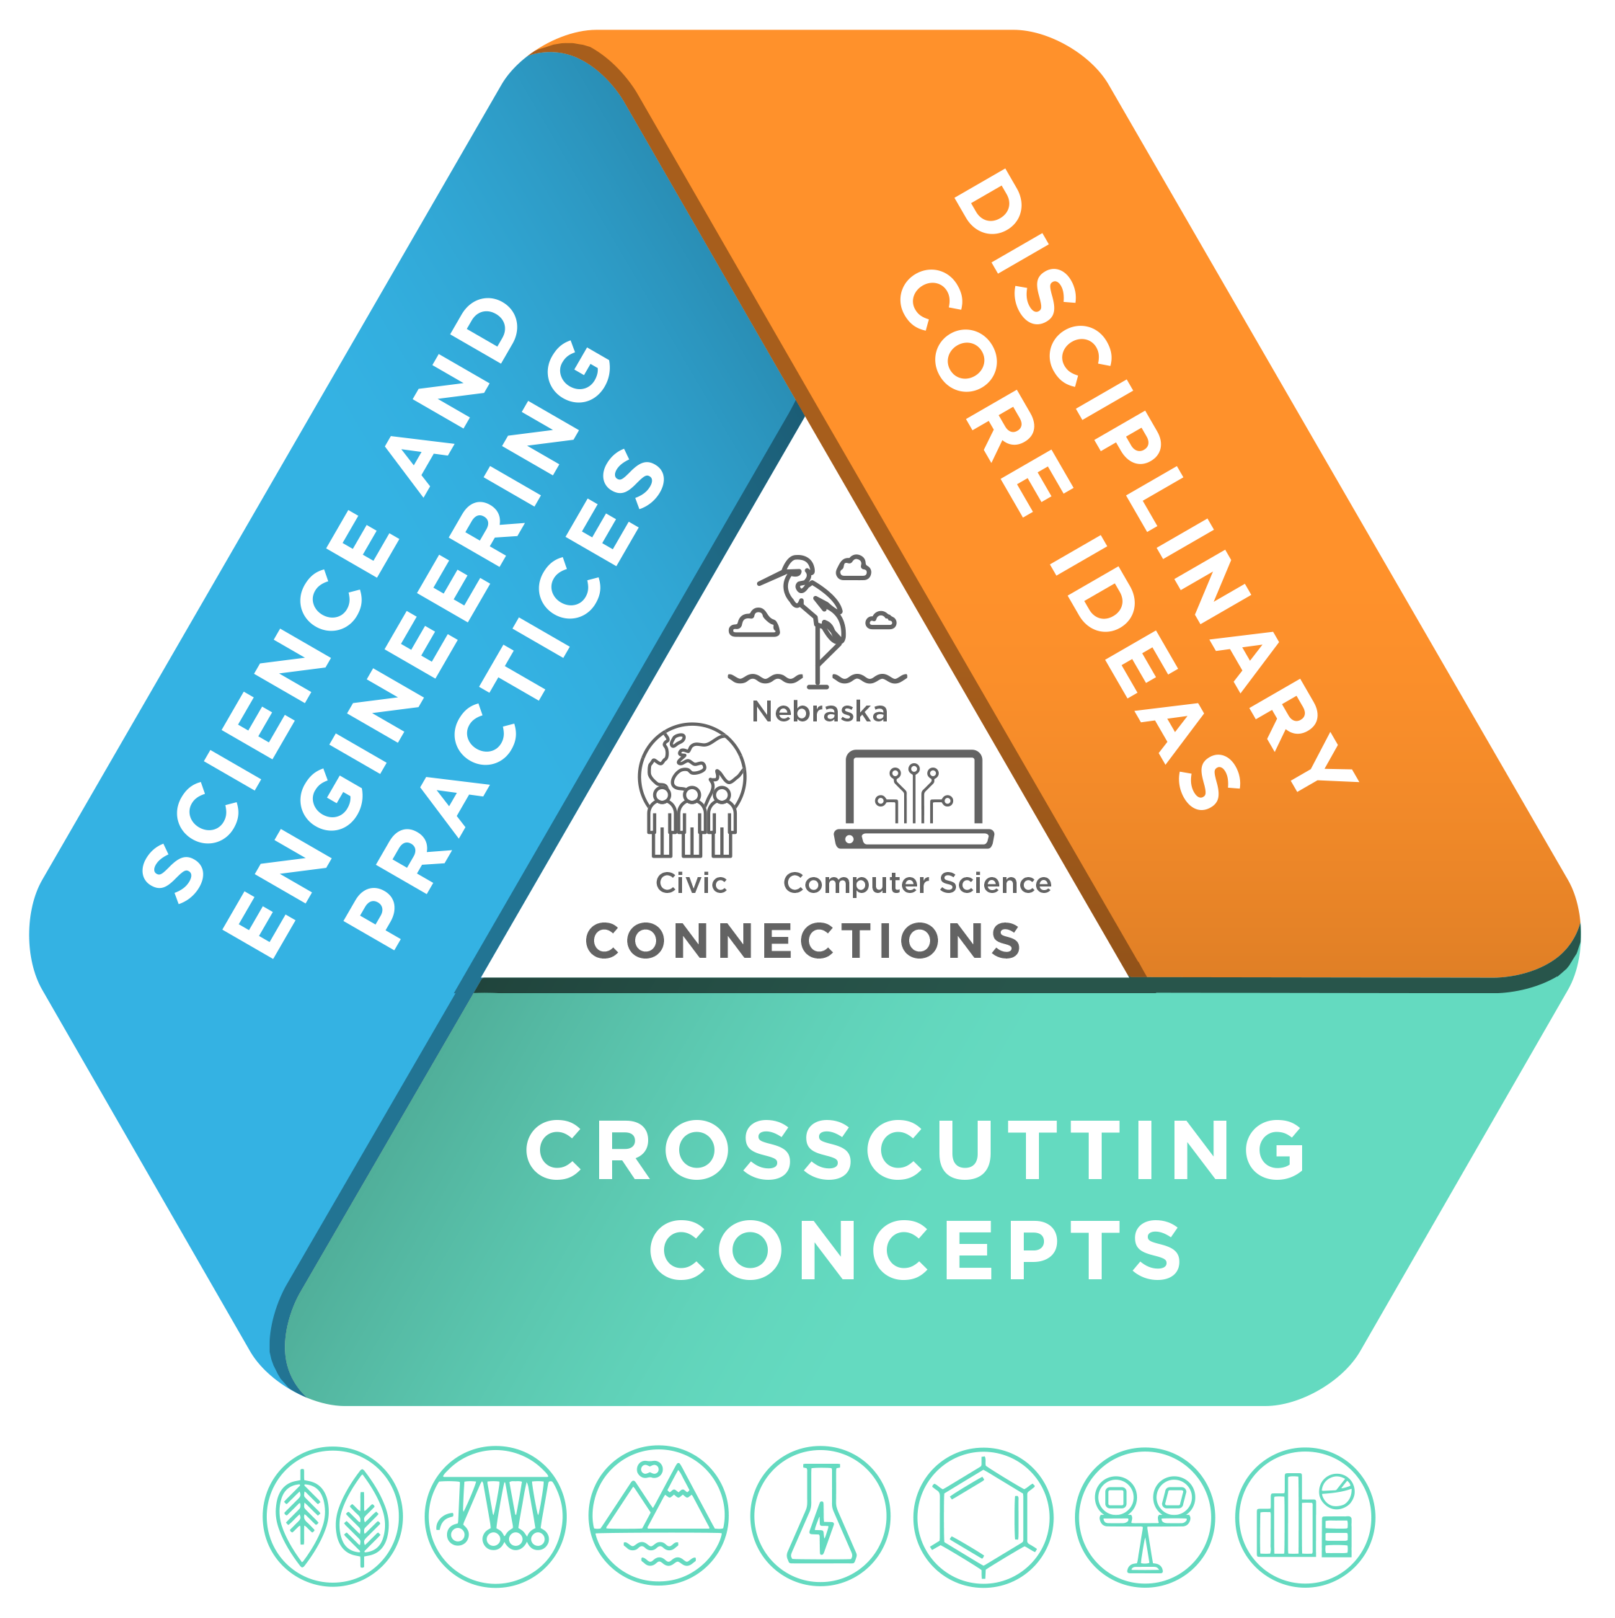
Figuring ut
Learning
about
Notes:
As we have had conversations around the state guiding Nebraska’s vision for science education, it was clear that this was the biggest shift we wanted to see in our science classrooms.

Slide 36
Goals for Student Learning
Goals for Student Learning
Exploring unknown/novel situations
Flexible & logical thinkers
Transfer of understanding
Science learning in all grades
Integrated application of knowledge & skill
Cross-
content integration
Reasoning and evidence in all content areas
Problem solving & critical thinking
Learning science by doing science
Grade-Appropriate, Progressive Three-Dimensional Learning
Notes:
These are our stakeholder developed goals for student learning that became embedded in the assessment system design. Working within constraints and limitations of large-scale testing models and platforms, We have done our best to incorporate all of these goals into the NSCAS-Summative Science assessment design.

Slide 37
Nebraska’s Claims
Overall Claim
Students can demonstrate the scientific literacy necessary to be civic minded decision makers and demonstrate readiness for college, career, and lifelong learning through application of science and engineering practices and crosscutting concepts within and among the disciplines of science.
Critical Consumers of Information
Students can gather, analyze, and communicate information from multiple sources to use as evidence to make sense of familiar and unfamiliar phenomena and problems.
Interconnectedness of Science
Students can make connections between disciplinary core ideas within the physical science, life science, and Earth and Space sciences domains, across multiple science domains, and across multiple content areas (such as mathematics and English language arts) to make sense of familiar and unfamiliar phenomena and problems.
Notes:
Our shareholders also provided the foundation for our science assessment system claims. Ultimately, we want our students to be scientifically literate, to be critical consumers of information, and to see the interconnectedness of science.

Slide 38
Ensuring Rigor in State Assessment Systems:
A Self-evaluation Protocol
Notes:
Begin to walk them through the State Self-Evaluation Protocol. Talk about how NE has been using it as a tool for Science as we are in the development phase and with a new vendor to make sure we have evidence of these components.

Slide 39
Purpose
To support state departments of education in evaluating each of their assessments as well as their overall assessment system.

Slide 40
Protocol is Designed To
Provide a framework for educators at state level to use in any evaluation of aspects of their state assessment system.
Focus on assessments that are state-mandated or on support programs that are supplied by the state
Educators at a state level can use and modify the protocol as needed.
SCILLSS Digital Workbook is designed as a resource to support the protocol.

Slide 41
Self-Evaluation Protocol
Step 1:
Articulate your current and planned needs for assessment scores
What are your intended uses of assessment scores? For what purpose will they be used?

Slide 42
Self-Evaluation Protocol
Step 2:
Identification of the complete array of assessments you use to address specific needs.
Help identify overlap as well as areas with gaps
Identify all current and planned assessments
Notes:
Areas of overlap can allow for multiple sources of data to enhance decisions.
Too much overlap can signal a need to reduce testing to conserve instructional time
A gap could mean that you are missing valuable pieces of a puzzle.

Slide 43
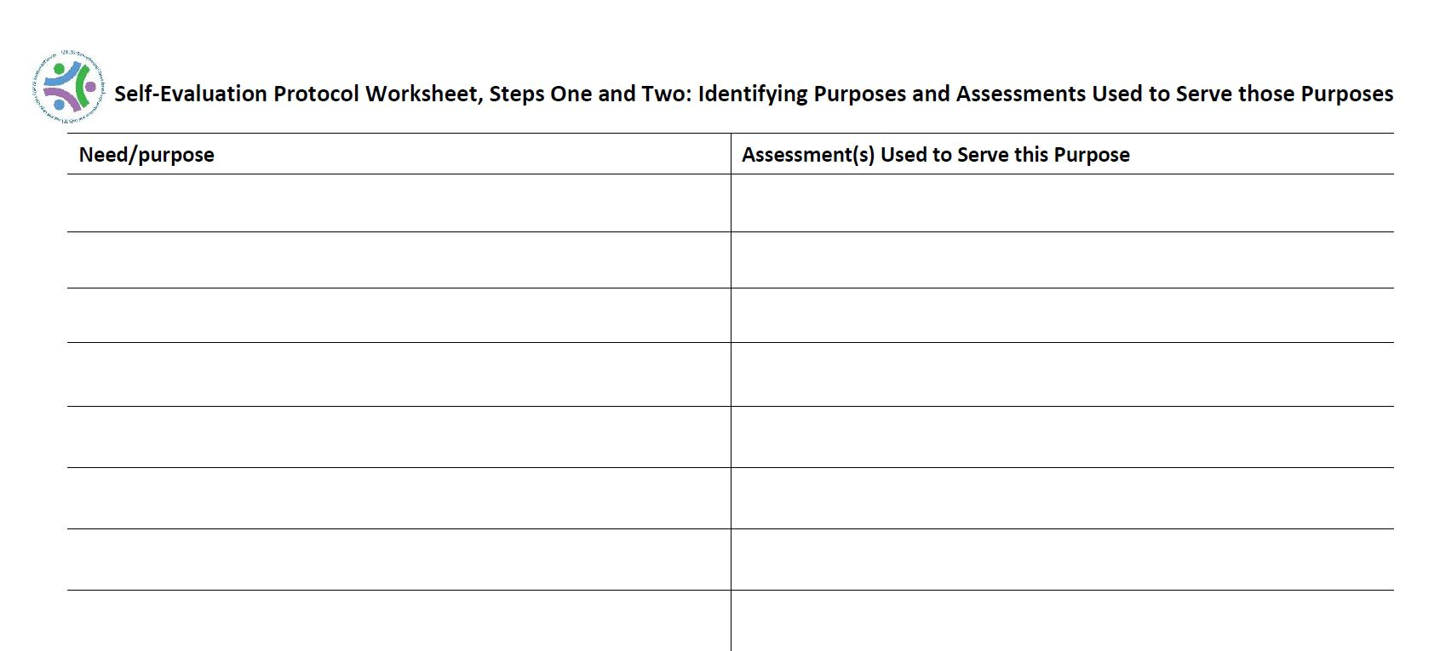
Notes:
Intended to guide you through the purposes, assessment uses, and associated stakes for your assessment system.

Slide 44
Self-Evaluation Protocol
Self-Evaluation Protocol
Step 3:
Gather and evaluate evidence for each assessment
Data and evidence that is available to support the interpretation and use of the assessment scores for their intended purposes.

Slide 45
Evidence For
Construct Coherence
  Does the assessment have evidence for construct coherence with your overall standards?
  Has the assessment been designed in such a way to ensure that the content of the assessment is consistent with your state standards and the curriculum in the classroom?
In other words, to what extent does the assessment as designed capture the knowledge and skills defined in the target domain?

Slide 46
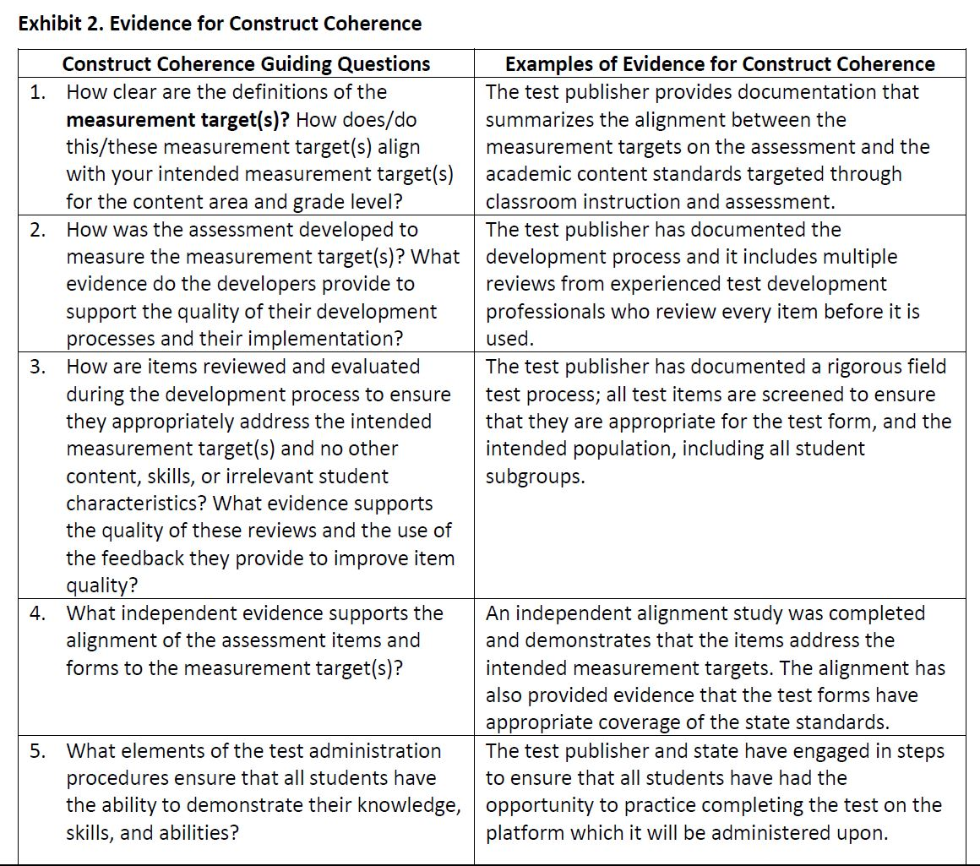

Slide 47
Evidence For
Comparability and Reliability
  Are the test scores comparable, or are the test scores reliable and consistent in meaning across all students, classes, and schools?
  Is there evidence to support the concept that the test scores mean the same thing for all students, regardless of which year the student takes the test or the exact test form that is taken?
  Is there evidence that includes reliability estimates, including documentation for how the estimates were determined and if the estimates are applicable across students that take the assessment?

Slide 48
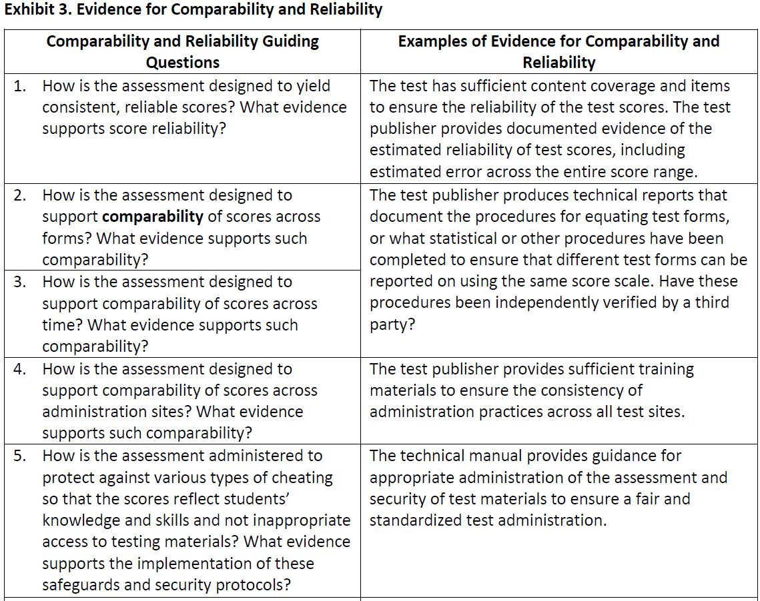

Slide 49
Evidence For
Fairness and Accessibility
  Are the tests accessible and fair for all students?
  Has the test publisher provided evidence that all students can complete the assessment and fully understand the concepts being assessed?
  To what extent are students able to demonstrate what they know and understand in your state and within your current curriculum?

Slide 50
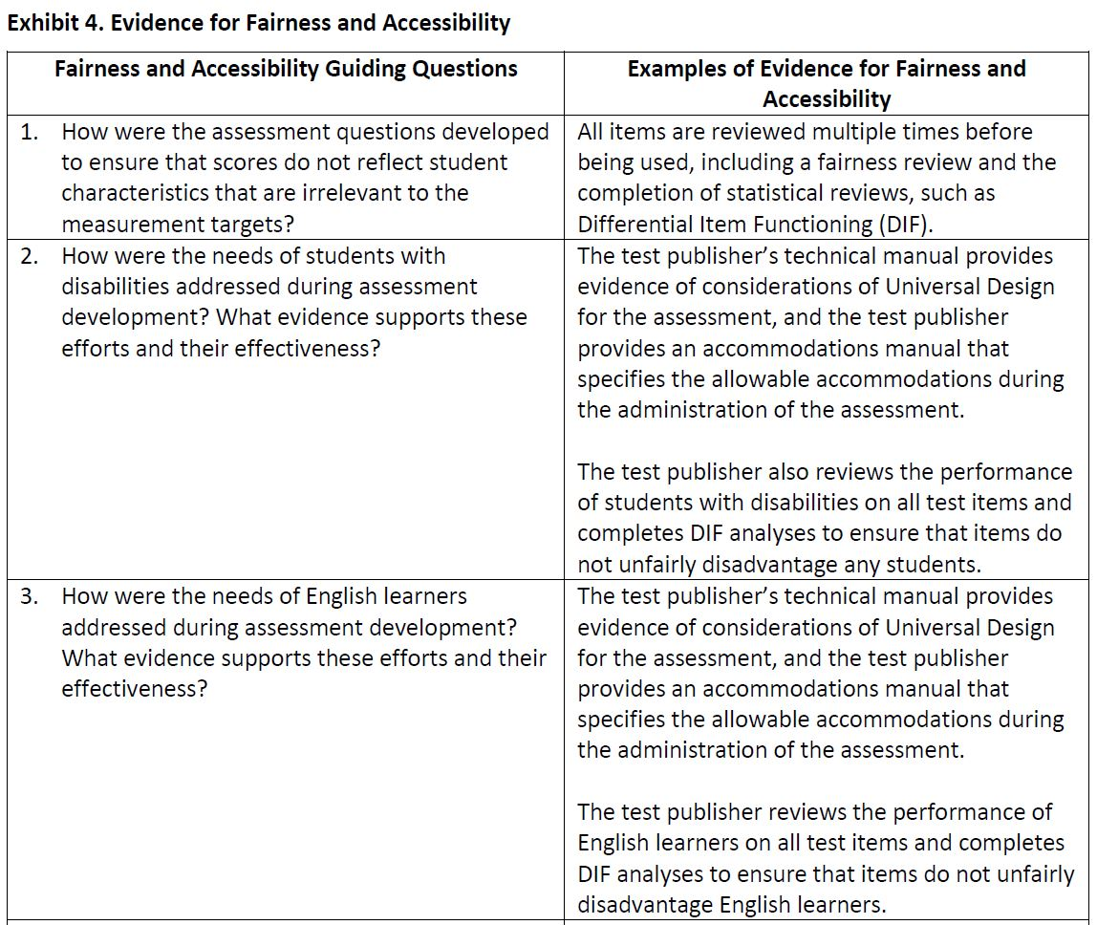

Slide 51
Evidence For
Consequences and Use
  Does the use of the test scores lead to positive consequences and not negative unintended consequences for your students, schools, and teachers?
  To what extent does the test yield information that is used appropriately within a system to achieve specific goals?

Slide 52
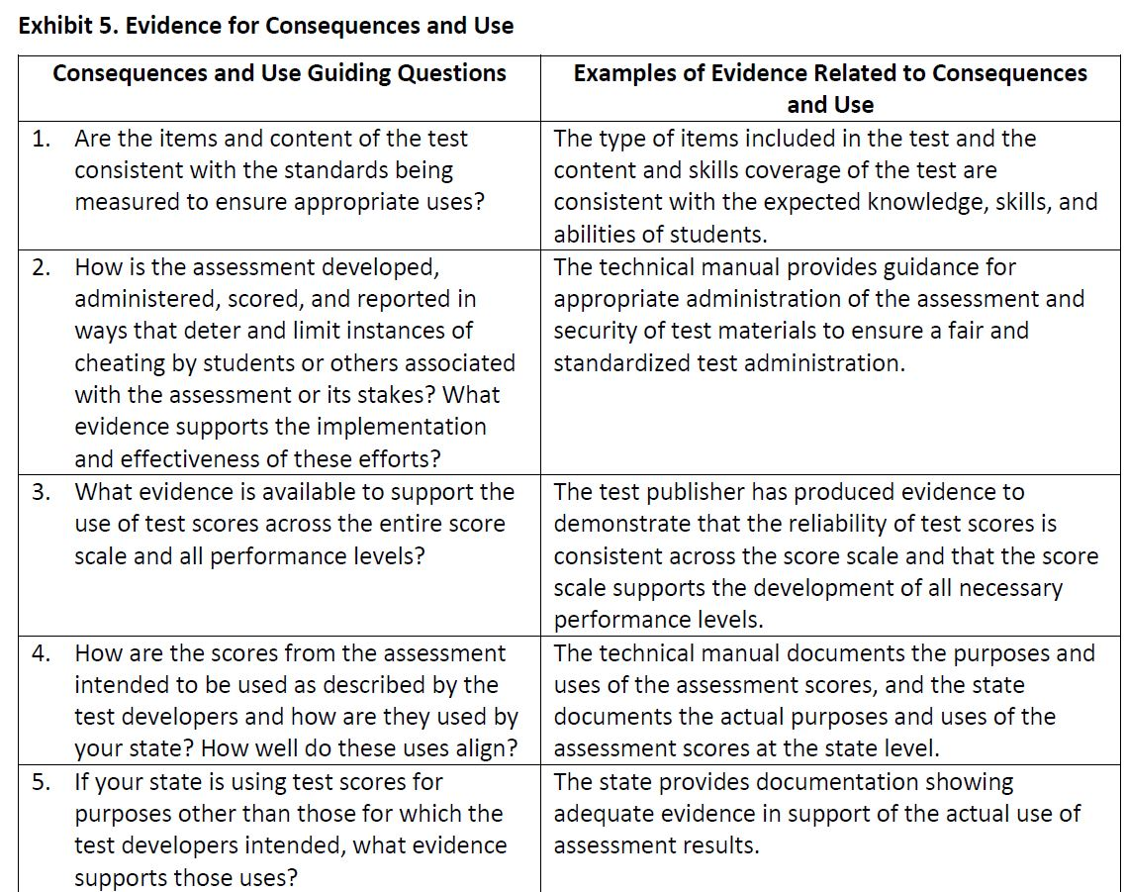

Slide 53
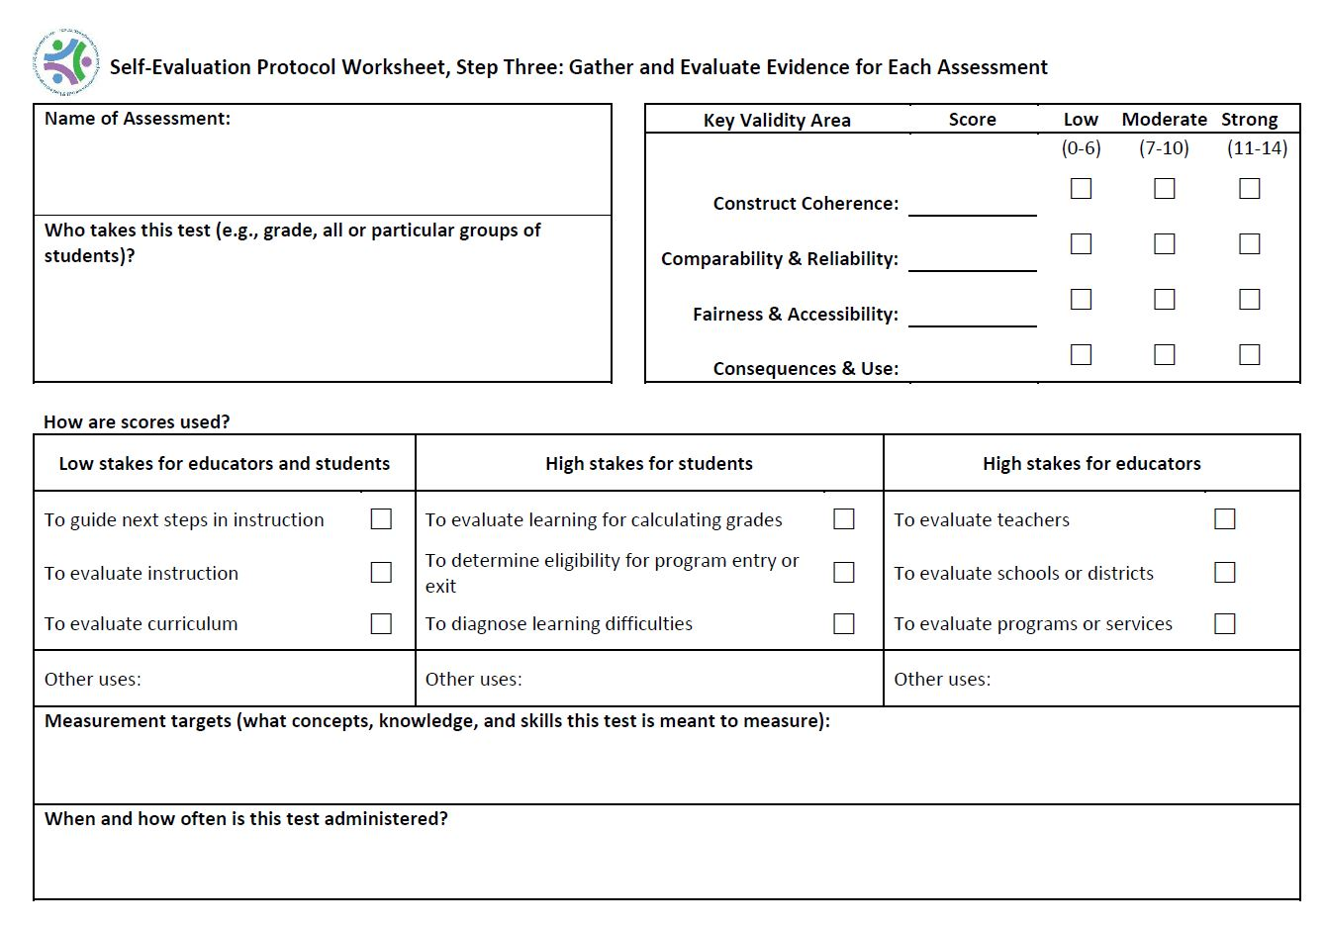

Slide 54
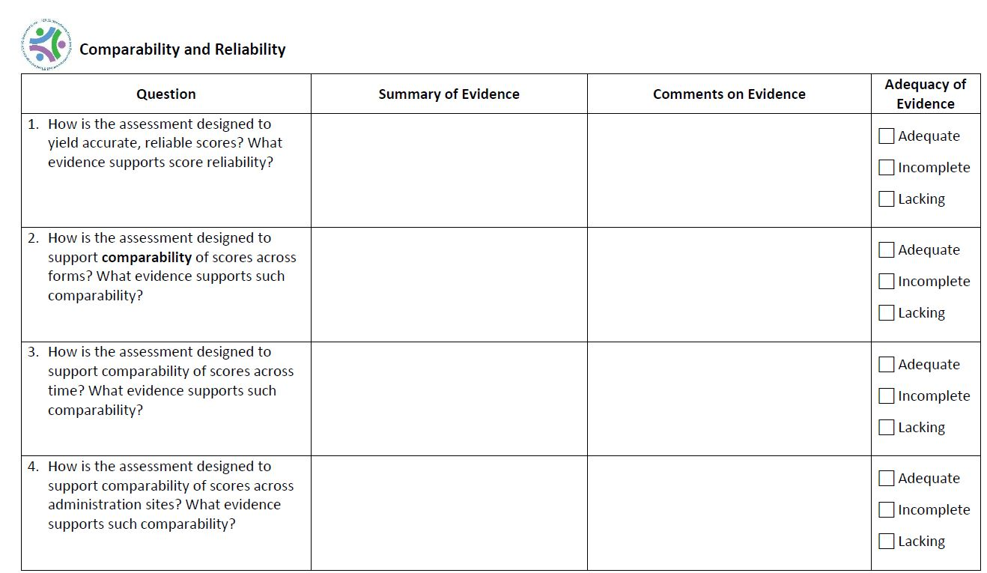

Slide 55
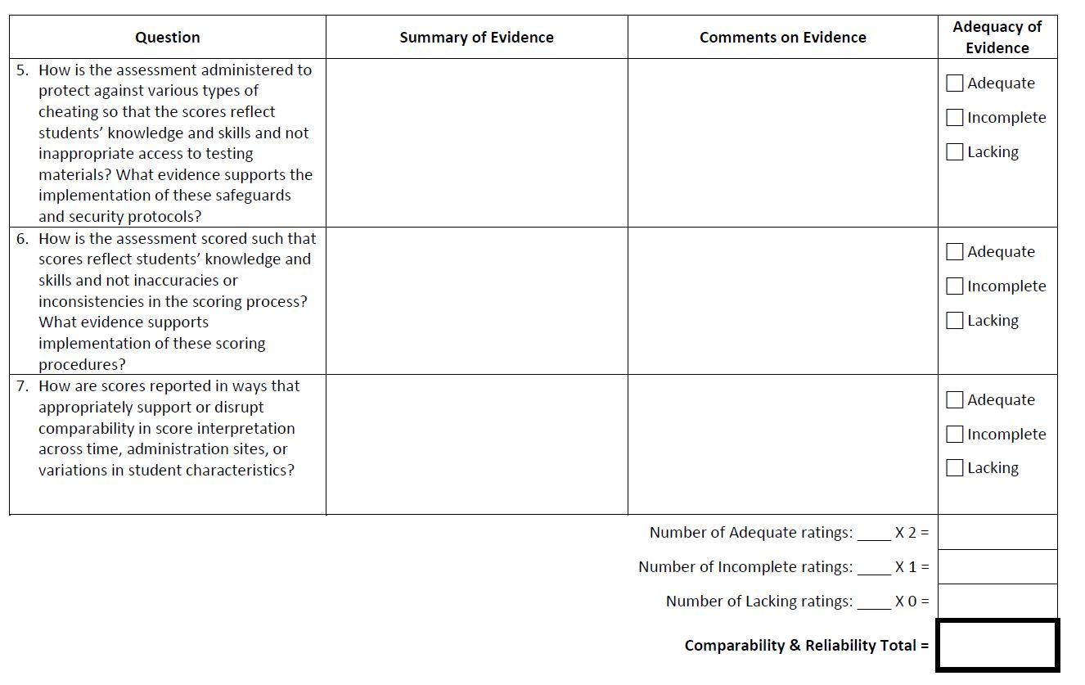
Notes:
There is a section like this for each of the 4 questions.

Slide 56
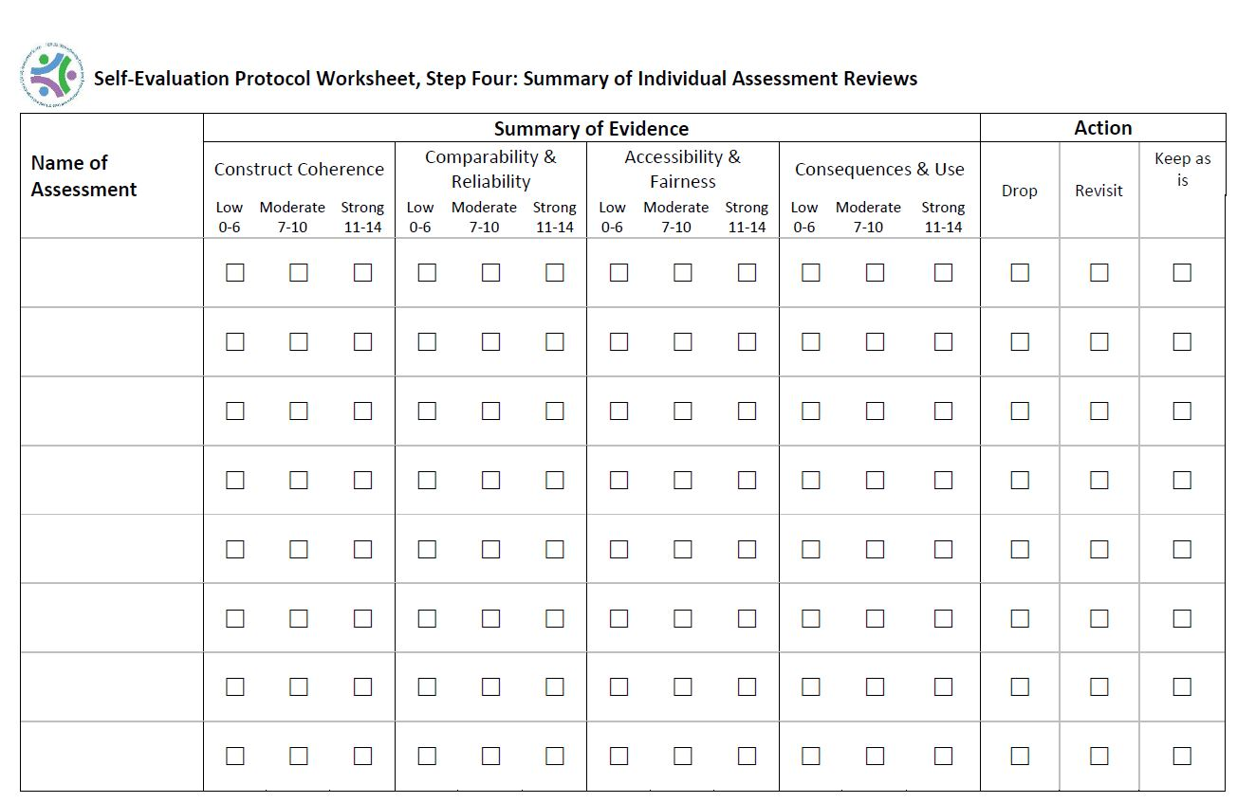
Notes:
Final sheet to tally and summarize the evidence

Slide 57
The Benefits, Challenges, and Lessons Learned from Using the SCILLSS Resources
Charity Flores, Ph.D.,
Director of Assessment,
Indiana Department of Education

Slide 58
Focus on Assessment Literacy
Initiated in 2017
Aspect of legislation
  Department with State Board is charged to improve teacher, parent and community understanding of assessment results, use data to inform student growth, instruct teachers on formative assessment as part of daily instruction.
  (excepted from IAC 20-32-5.1-18)

Slide 59
Assessment occurs every day as part of quality instruction.
Notes:
The essential belief supporting the Formative Assessment Grant is that assessment occurs every day as part of quality instruction. Assessment is not just a single event and is not limited to “formal” summative testing, but rather is integrated into instruction as a way to monitor student understanding and adjust teaching and learning for the success of each student.

Slide 60



What is Assessment?
A process of collecting evidence
to make informed decisions.
“Assessment is crucial to move from opinions to informed action.” (National Research Council, 2001)
Notes:
Before we can understand formative assessment, we must first understand what assessment is. Assessment in its truest form is a process of evaluating the current state of something so that informed decisions can be made about how to move forward.
We often use assessment in life, such as when we take a car to the mechanic for evaluation. The mechanic collects data about what is wrong with the car, then provides the evidence to the customer so that he/she can decide the best way to move forward.
Assessment in education follows a similar process. Educators collect data about what a student knows and then use that data to make the best decisions for students.

Slide 61
Assessment Literacy
Assessment literacy includes three big ideas: What someone knows about assessment, what someone believes about assessment, and what someone does with assessment.
An Assessment-Literate Individual:
Understands the types and purposes of assessment;
Believes that assessment is an essential part of teaching and learning;
Utilizes data to drive informed decision-making for the success of every child.
https://www.doe.in.gov/assessment/assessment-literacy
Notes:
In order to implement assessments and use data to support student growth, stakeholders need to obtain assessment literacy. Assessment literacy refers to three big ideas: what someone knows about assessment, what someone believes about assessment, and what someone does with assessment data. Over the last few months, the Department identified three statements that describe someone who is assessment-literate. First, this individual must understand the different types and purposes of assessment. All assessments are not created equal. The purpose of the assessment defines both how the assessment is crafted and how the data should be used for educational decision-making. All stakeholders need to have a basic understanding of what these different assessment types are and how we view their data differently.
Second, an assessment-literate individual believes that assessment is an essential part of teaching and learning. If educators, students, and parents do not believe that data makes a different, they will not use data to drive educational decision-making. Therefore, the assessment becomes a waste of time. Currently, many community members, educators, parents, and students feel that assessment is a waste of their time because they do not understand its purposes and uses. Targeting this belief system is an important part of creating your balanced system of assessment: it’s not going to work if key stakeholders do not believe in it.
Finally, an assessment-literate individual utilizes data to drive informed decision-making. This could include targeting instruction to meet individual needs, revising curriculum maps, implementing new instructional strategies, or creating personalized learning goals. For policy-makers, this could include creating new initiatives to target areas of need within educational programing. However you cut it, you must use the data for the assessment to further student success.

Slide 62

Who Should be Assessment-Literate?
Anyone who has a part in educational decision-making should be assessment-literate to some degree.
Teachers
Administrators
Coaches
Students
Parents
Voters
Policy-Makers
Community Members
Notes:
Who needs to be assessment-literate? At first, it may be assumed that only educators need to understand assessment, but really all stakeholders must achieve some level of assessment literacy in order to the assessment system to be successful. Of course, educators will need a much deeper level of assessment literacy, but students also need to understand what their data means and be able to set educational goals for themselves. Parents must be able to read assessment results and interpret the data to make decisions regarding their child’s academic needs. Policy-makers such as school board members and even legislators need to be assessment literate as they often make requirements regarding assessment. They may also need to use assessment data to make informed decisions regarding curriculum and instruction.

Slide 63
Types of Assessment
Summative
Assessment of learning.
Examples: ILEARN, ISTEP+ Grade 10, SAT, Final Exam
Formative
Assessment for learning.
Examples: Exit tickets, Questioning, Rich Tasks
Interim
Diagnostic
Progress monitoring over time.
Examples: NWEA, iReady, Star
Diagnosis of specific student needs for a certain skill set.
Examples: DIBELS, GRADE,
Notes:
There are four main types of assessment. Each type of assessment has a different purpose. As such, each assessment is constructed differently, and the data should be viewed and used with those different purposes in mind.
First we have summative assessment. This is assessment of learning at the end of learning. Some examples are ISTEP and ILEARN.
Second is formative assessment. This is assessment for learning during learning. Some examples are Questioning and Rich Tasks.
The third type of assessment can often be placed into either the summative or formative bucket, but I want to call it out separately for our discussion here: Interim assessment. These assessments monitor progress over time and are often referred to as benchmarks. Some common interim assessments used across Indiana are NWEA, iReady, and Star Reading and Math.
Finally, we have diagnostic assessment. These assessment diagnose specific student needs for a certain skill set. For example, reading diagnostics break down essential reading skills and identify which of those skills a student may lack, causing him to be unsuccessful in reading. Diagnostic assessments are often more time-consuming as they must drill down to very basic levels of standards to determine student needs.
In a balanced system of assessment, you will likely need to include all forms of assessment in some way. Let’s take a look now at the purposes of these assessments and what type of data they yield.

Slide 64

A Balanced System of Assessment
A system of data collection that provides all stakeholders with the actionable data that they need to make informed educational decisions.
Formative
Interim
Summative
Diagnostic
Notes:
So why is this system so important? Because research shows that student success depends on it.

Slide 65
Educator-Specific Training
Notes:
The essential belief supporting the Formative Assessment Grant is that assessment occurs every day as part of quality instruction. Assessment is not just a single event and is not limited to “formal” summative testing, but rather is integrated into instruction as a way to monitor student understanding and adjust teaching and learning for the success of each student.

Slide 66
Purposes of the Conversations Today
Consider your role in assessment.
  Summative, interim, diagnostic, formative
Consider what you know about the assessments that you provide in your classroom.
  Why are you giving the assessment?
  What information does the assessment and corresponding data provide?
  What do you do with the information?
Analyze and reflect on an assessment you brought with you.
  Any surprises about the content?
  Any surprises about the item presentation?
  Any changes or improvements you might consider?

Slide 67
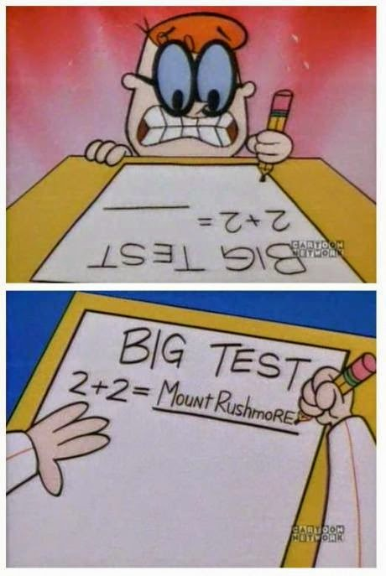
Foundations of Quality Assessment
What steps/reflective practices promote quality assessments…
  …at the State level?
  …at the classroom level?
Use your Assessment Development Practices roadmap to follow along.
Notes:
Assessment Team
How do we create a quality assessment?
At a standardized (high stakes) level, there are many research-based steps that we take in order to create a valid measurement of student ability. These practices are reflected in your “Assessment Development Practices” handout.
These more formalized practices can be used at a classroom level as well in many cases. Let’s take a quick walk through the Assessment Development Practices road map that you have and talk a bit about what these practices might look like in your classroom.

Slide 68
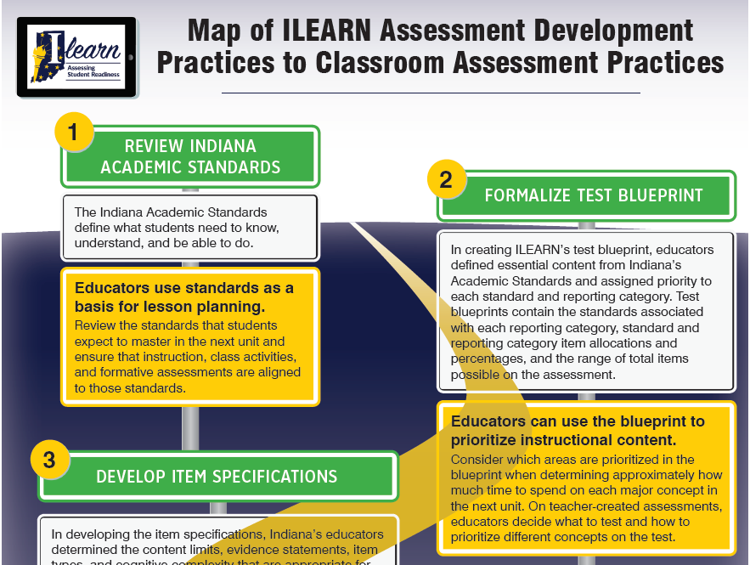
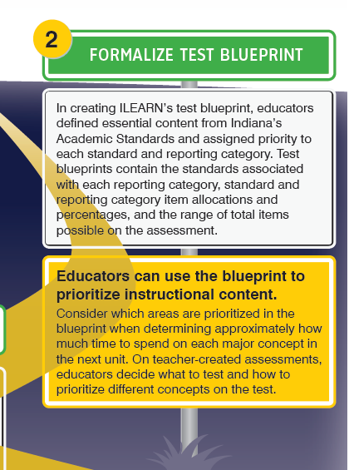
Notes:
Assessment
Alignment to standards
This could be the IN Academic standard, or your classroom learning goal. We always start with identifying that knowledge/skill that we want to measure.
Alignment to your grade level standards – are you too low? At a different grade level?
Strong alignment – the focal point of the standard
Weak alignment – a non-focal point of the standard. Not to be thrown out as these parts of the standard should be taught in the classroom. But should be part of the reflection regarding the purpose
Test Blueprints
When creating an assessment (or reviewing one), you will want to reflect on what content (standards) you wish to measure and if you have different priorities for that content. For example, you may wish to create a quiz that measures just one standard (in which case, your blueprint is very simple). Or, you may wish to create a test that measures several standards taught over the course of a unit of study. Are some of those standards of higher priority to assess? How will you weight them?

Slide 69
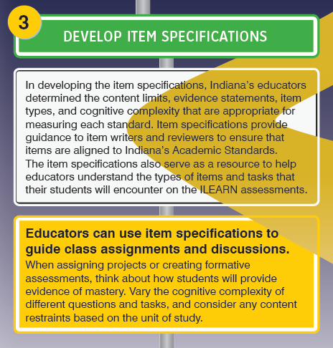
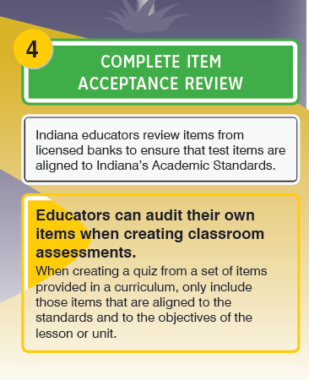
Notes:
Assessment
Item Specifications
For ILEARN, item specifications define exactly how a standard is measured. What is that evidence we are looking for that will help us understand if a student has met a certain standard? As you measure different knowledge and skills, you will want to think about what evidence will tell you whether or not a student has mastered each standard or learning goal. Item specification may help you get started with this task, but remember that teaching and assessing in the classroom can and should go beyond the scope of what can be measured by a standardized assessment.
Item Acceptance Review
Curriculum often comes with item banks for creating an assessment. These can be a great tool, or starting point, for creating an assessment but should always be used cautiously and reflectively. Remember, you are the professional and the expert. You should always think about each item you are using to measure student achievement and evaluate if it will give you the specific data that you are looking for. Specifically mention pinterest and Teachers-pay-teachers here as well.

Slide 70
Relationship to Instructional Practices
Thinking about your assessment:
What standard are you assessing with each item?
  Is it a strong or weak alignment?
What is the DOK?
What is your blueprint ?
Notes:
School Improvement
Before we look at your assessment, let’s review the Depth of Knowledge and Complexity?

Slide 71
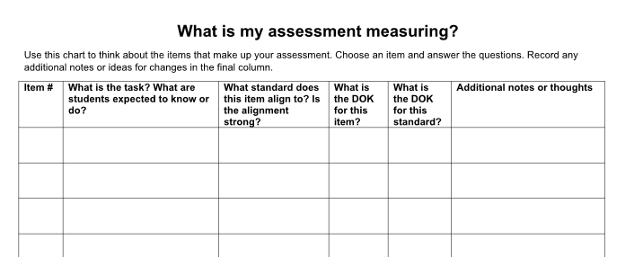
Beginning the Task
Use Worksheet “What is my assessment measuring?”
Reflect on the items within your assessment.
Complete a row for each item.
Discuss with your working group as needed.
Notes:
School Improvement
Now let’s get to some working group time. Please take out the classroom assessments that you brought. Handout specific to examples – worksheet will prompt them what to look at . Complete one example.

Slide 72
Table Talk
What did you notice about your assessment items?
What areas might need to be strengthened?
Do you have a range of complexity?
Notes:
More work time will follow.

Slide 73
Quality Review Checklist
Standards. The item aligns to one primary standard at the appropriate grade level.
Specifications. The item aligns to characteristics of the item specification.
Depth of Knowledge (DOK). The item aligns to the DOK (cognitive complexity) defined by the standard.
Content. The content of the items is accurate and grade-level appropriate.
Scoring. The item has a single correct key for multiple-choice items. The distractors, while plausible, are incorrect.
Accessibility. Items should minimize language complexity (written in simple sentences with few clauses) so that the task is clear to all students.

Slide 74
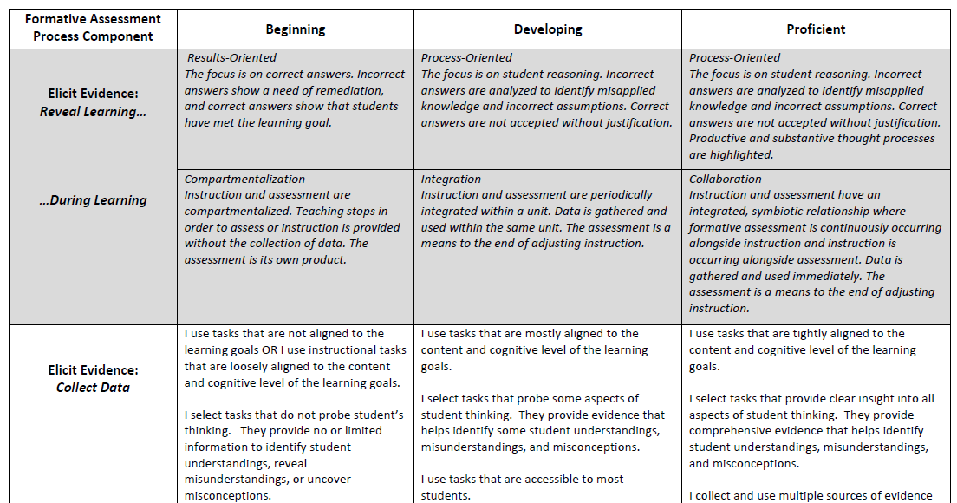
Formative Assessment Rubric
https://www.doe.in.gov/sites/default/files/assessment/learning-progression-guided-formative-assessment-self-reflective-rubric.pdf

Slide 75
Leadership-Specific Training
Notes:
The essential belief supporting the Formative Assessment Grant is that assessment occurs every day as part of quality instruction. Assessment is not just a single event and is not limited to “formal” summative testing, but rather is integrated into instruction as a way to monitor student understanding and adjust teaching and learning for the success of each student.

Slide 76
Purpose and Vision of the Grant
Data
Data
Power to Make Better Decisions
Data
Data
Indiana’s Formative (Interim) Assessment Grant provides funding to schools for formative (interim) assessment programs, tools, and professional development in order to increase data-driven instructional practices and enrich learning for all students.
Student and School Success
Notes:
Data is just another term for information. The more information we have, the more empowered we are to move forward with decisions that impact students for the better. Whether those decisions are to individualize instruction or whether they are higher-reaching decisions like curricular or instructional changes or changes to educational, social/emotional well-being, the more information we have about what’s working and what’s not working, the better our decisions will be.
The Formative (Interim) Assessment Grant was created to provide some of this data to schools. Data can be collected and analyzed in many different ways, so this grant has grown to be increasingly more flexible in its funding uses. This committee’s focus will be on only one of the allowable uses of funds for this grant: Approved Interim/benchmark assessment programs that provide achievement and/or growth data to schools.

Slide 77
Purpose of this Committee
Evaluate proposals from assessment program vendors
Identify assessment programs that provide high-quality services aligned to the purpose and expectations of the Formative (Interim) Assessment Grant
Notes:
This committee has two main purposes: 1) to evaluate the proposals and documentation submitted to the Department by assessment program vendors. Vendors will submit documentation to verify whether or not they meet the criteria in place to be an approved program for this grant. It will be the job of this committee to evaluate that documentation based on specific criteria, which we will talk about in a few minutes.
The second purpose is to identify assessment programs that provide quality services for the State of Indiana for this particular grant. Historically, Indiana has had a long list of approved providers and has been rather open with which providers are approved in an attempt to provide flexibility for schools to choose. However, schools have expressed the desire for a bit more help in making the selection of which programs provide the highest quality services. The Department, through this committee, would like to identify only those providers that are providing the highest quality services for approval. This likely will result in a substantially shorter list of approved assessment programs for 2019-2020 than has been seen in the past.
To meet these purposes, you will review confidential information from assessment program vendors. While some information may be shared and freely discussed, the Department and associated committees must honor requests for confidentiality by vendors. If you have not already done so, please complete the non-disclosure form sent to you via email and return to me. I will not be able to share documentation with you until we have this form on file.

Slide 78
Slight Adjustments to Metric
Evidence Requested | Evidence Desired | Comments | Adequacy of Evidence
Construct Coherence
Does the assessment measure the breadth and depth of Indiana Academic Standards? Are there standards that the assessment does not measure as intended (e.g., writing, process, etc.)? What evidence shows that the assessment is sufficiently rigorous? What set of standards or learning outcomes does the assessment align to? | A formal alignment study must be provided. A narrative describing the methodology of the alignment study should be included. At least 85% of Indiana standards for each grade/content area must be assessed as a minimum. The 15% of non-assessed standards may account for standards that lend themselves towards classroom assessment. 100% of the assessment should align to one (or more) Indiana Academic Standard(s). Varying levels of rigor should be measured across each test form, from Depth of Knowledge (DOK) 1 to 3 (or similar measurements on a different scale). DOK 1 should be emphasized less than DOKs 2 and 3. |  | Adequate Incomplete Lacking

Slide 79
A User’s Perspective of Implementing the SCILLSS Local Self-Evaluation Protocol
Shannon Nepple,
Curriculum Director,
Nebraska District Representative

Slide 80
Demographics of Adams Central
At the time we went through the SCILLSS self evaluation protocol, we had 3 different sites with one classroom of each grade level.
5th and 6th grade teachers walked through the self evaluation protocol.
Spent 4 hours using this resource looking at the Science test from NWEA.
Met with the SCILLSS team for debriefing about the protocol. This was crucial part of the process so we understood the protocol better.

Slide 81
How we used the information from SCILLSS
Adams Central used an inservice day to dive deeper into what is being taught in Science, how long each topic is being covered, and what assessments are given.
The teachers who were able to use the protocol had a deeper understanding on creating assessments and how it was important to be consistent.
As we move forward with the new NE standards, we are creating curriculum mapping to ensure all students are receiving similar instruction, assessments, and topics covered.

Slide 82
What we learned using the protocol?
With our 3 small schools coming together as one, we need to be more consistent with how we assess our students.
This protocol can help us become more fair and consistent.

Slide 83
Contact Information
Name | Email
Liz Summers | lsummers@edCount.com
Andrew Wiley | awiley@acsventures.com
Ellen Forte | eforte@edCount.com
Rhonda True | rhonda.true@nebraska.gov
Charity Flores | cflores@doe.in.gov
Shannon Nepple | shannon.nepple@adams-central.org

