Slide 1
Strengthening Claims-based Interpretations and Uses of Local and Large-scale Science Assessment Scores
(SCILLSS)
SCILLSS Classroom Science Assessment Workshop
DAY 1
Notes:
Welcome to the SCILLSS Classroom Science Assessment Workshop. This three-day workshop is intended to help you develop an understanding of a principled-approach for developing three-dimensional science tasks aligned to NGSS-like standards for use within classrooms. Over the next three days, you will be collaborating in grade-level or grade-band teams and using this approach to develop a classroom science assessment task and rubric to support instruction and learning. Through this experience, we also hope you will develop a deeper understanding of classroom-based science assessments, their relationship to other forms of assessment, and their purposes and uses in a standards-based system of curriculum, instruction, and assessment.

Slide 2
Welcome and Introductions
[Presenter Name(s)]
9:00 a.m. – 9:15 a.m.
Notes:
[Allow participants and facilitators to introduce themselves using an icebreaker activity. For example, individuals can share two facts about themselves: one fact about their experiences or expertise as a science educator, and one fact that is interesting or that few people know (e.g., an uncommon talent or hobby, a memorable experience.]

Slide 3
Overview of Agenda and Workshop Goals
[Presenter Name(s)]
9:15 a.m. – 9:25 a.m.
Notes:
Let’s take several minutes to review our agenda for this three-day session as well as our workshop goals.

Slide 4
Educator Meeting Objectives
To develop a deeper understanding of classroom-based science assessments, their relationship to other forms of assessment, and their purposes and uses in a standards-based system of curriculum, instruction, and assessment
To develop an understanding of a principled-approach for developing three-dimensional tasks aligned to NGSS-like standards for use within classrooms
To collaborate to develop a classroom science assessment task, rubric and exemplar response(s) for your assigned grade or domain to support instruction, which includes:
  Developing an understanding of the characteristics and features of high-quality assessment tasks
  Unpacking and articulating the knowledge, skills, and abilities (KSAs) for measurement
  Understanding assessment evidence and how it is elicited by an assessment task
  Developing rubrics that support the identification, integration, and scoring of evidence
  Evaluating the extent to which evidence in support of the targeted KSAs are elicited by an assessment task
Notes:
Through the course of our work together, we have several goals for how we hope you will benefit from this workshop.
First, we want you to think about connections you see between classroom-based, summative, and large-scale assessments and the process we discuss here today. We want you to be continually reflective of the purposes and uses you see in designing assessments using a standards-based system.
Additionally, the bulk of our work will be focused on working collaboratively to develop three-dimensional tasks aligned to NGSS-like standards for classroom use. Through the construction of these tasks, we hope you develop a deeper understanding of a principled-design approach.

Slide 5
Meeting Activities
Educators will, in groups, pick a performance expectation (PE) to work with
For this PE, the group will:
  Use a tool to unpack the PE and its corresponding dimensions in order to highlight the important aspects of the PE
  Use a tool to develop guidance for the development of tasks and rubrics
  Develop tasks and rubrics that will measure the target PE
  Review and revise these tasks and rubrics
At the end of this meeting each group will produce:
  A set of design documents
  A rough draft of a task and scoring rubric(s)
Notes:
This is a description of the activities we will complete during the workshop. You will, as a grade level group, choose a performance expectation, or PE, to work with as you create an Unpacking Tool to highlight the important aspects of the PE, create a guiding tool for the development of tasks and rubrics, develop corresponding tasks and rubrics, and review and revise these. By the conclusion of our meeting you will have produced a set of design documents and a rough draft of a task and scoring rubric.

Slide 6
Agenda
Day 1 Morning
8:00 am – 9:00 am | Breakfast (if applicable)
9:00 am – 9:15 am | Welcome / Introductions | Presenter(s)
9:15 am – 9:25 am | Overview of Agenda and Workshop Goals | Presenter(s)
9:25 am – 10:00 am | A Principled-approach to Develop Classroom Science Assessment Tasks | Presenter(s)
10:00 am – 10:30 am | Overview of the Purpose and Development of an Unpacking Tool | Presenter(s)
10:30 am – 11:30 am | Breakout Activity and Discussion: Unpacking Tool Activity | Team Facilitators
11:30 am – 12:30 pm | Working Lunch / Collaborative Teams: Unpacking Tool Development
Notes:
[Read and explain the Day 1 Morning Agenda using the facilitator’s process agenda as guidance.]

Slide 7
Agenda
Day 1 Afternoon
12:30 pm – 1:30 pm | Collaborative Teams: Unpacking Tool Development | Team Facilitators
1:30 pm – 2:00 pm | Overview and Guided Activity: Purpose and Development of Task Specifications Tool (Part 1) | Presenter(s)
2:00 pm – 2:30 pm | Collaborative Teams: Develop Task Specifications Tool | Team Facilitators
2:30 pm – 3:00 pm | Overview and Guided Activity: Purpose and Development of Task Specifications Tool (Part 2) | Presenter(s)
3:00 pm – 3:30 pm | Collaborative Teams: Develop Task Specifications Tool | Team Facilitators
3:30 pm – 4:00 pm | Overview and Guided Activity: Purpose and Development of Task Specifications Tool (Part 3) | Presenter(s)
4:00 pm – 4:30 pm | Collaborative Teams: Develop Task Specifications Tool | Team Facilitators
4:30 – 4:45 pm | Group Share and Adjourn
Notes:
[Read and explain the Day 1 Afternoon Agenda using the facilitator’s process agenda as guidance.]

Slide 8
Agenda
Day 2 Morning
8:00 am – 9:00 am | Breakfast (if applicable)
9:00 am – 9:30 am | Welcome / Agenda Overview / Questions | Presenter(s)
9:30 am – 10:00 am | Overview of Task Development | Presenter(s)
10:00 am – 11:00 am | Breakout Activity and Discussion: Evaluation and Comparison of Grade 8 Science Tasks | Team Facilitators
11:00 am – 11:30 am | Collaborative Teams: Review of Example Task Ideas | Team Facilitators
11:30 am – 12:30 pm | Working Lunch / Collaborative Teams: Draft Task and Revisit Tools
Notes:
[Read and explain the Day 2 Morning Agenda using the facilitator’s process agenda as guidance.]

Slide 9
Agenda
Day 2 Afternoon
12:30 pm – 2:00 pm | Collaborative Teams: Draft Task and Revisit Tools | Team Facilitators
2:00 pm – 2:30 pm | Overview of Rubric and Exemplar Response Development | Presenter(s)
2:30 pm – 4:15 pm | Collaborative Teams: Draft Rubric and Exemplar Response | Team Facilitators
4:15 pm – 4:30 pm | Group Share and Adjourn | Presenter(s)
Notes:
[Read and explain the Day 2 Afternoon Agenda using the facilitator’s process agenda as guidance.]

Slide 10
Agenda
Day 3 Morning
8:00 am – 9:00 am | Breakfast (if applicable)
9:00 am – 9:30 am | Welcome / Agenda Overview / Questions | Presenter(s)
9:30 am – 10:30 am | Collaborative Teams: Finalize Tools, Task, Rubric, and Exemplar Response for Cross-Group Review | Presenter(s)
10:30 am – 12:00 pm | Cross-Group Review and Revision of Tools, Tasks, and Rubrics | Team Facilitators
Notes:
[Read and explain the Day 3 Morning Agenda using the facilitator’s process agenda as guidance.]

Slide 11
Agenda
Day 3 Afternoon
12:00 pm – 1:00 pm | Working Lunch / Collaborative Teams: Revision of Tools, Tasks, and Rubrics
1:00 pm – 2:30 pm | Collaborative Teams: Revision of Tools, Tasks, and Rubrics | Team Facilitators
2:30 pm – 3:45 pm | Verification of Task Alignment Activity | Team Facilitators
3:45 pm – 4:15 pm | Group Share: Lessons Learned and Key Takeaways | Team Facilitators
4:15 pm – 4:30 pm | Complete Meeting Evaluations | Presenter(s)
4:30 pm | Adjourn
Notes:
[Read and explain the Day 3 Afternoon Agenda using the facilitator’s process agenda as guidance.]

Slide 12
A Principled-Approach to Develop Classroom Science Assessment Tasks
[Presenter Name(s)]
9:25 a.m. – 10:00 a.m.

Slide 13
Assessment in the Service of Learning
Assessment is the art and science of knowing what students know.
Assessments provide “evidence” of students’ knowledge, skills, and abilities (KSAs).
Evidence supports teacher “inferences” of what students know and can do.
Inferences guide and inform instruction.
Notes:
Assessment as the art and science of knowing what students know is a radically new idea. We must begin thinking about assessment design and uses in the service of learning. To do that well, we need to understand the role of assessments in the curriculum and instruction system. Our purposes are to guide and inform instruction; if we find out through the process of instruction kids aren’t learning key concepts or ideas then we need to go back and help kids develop that understanding. The other goal with assessments is to help us as teachers understand how our students are developing their understanding. We want to make their thinking visible to identify misconceptions and to repair their misunderstandings through instruction.
It is important that teachers understand what is knowledge, what are skills, and what are abilities. This is important for teachers to ensure that they are assessing their students sufficiently across the expected knowledge, skills and abilities. We cannot see the thinking of students; therefore, we depend upon behavioral evidence to give us information about internal processes.
We must try to take a better approach and try to elicit the evidence of student learning. When we give an assessment, what we are looking for as a result of the activity is evidence – evidence of students’ knowledge, skills, and abilities. The reasons we do this and reason with the evidence is because we want to make inferences from the student artifacts to develop an understanding of the depth of students’ understanding of the topic. We translate scores into judgements or inferences that guide and inform our instruction.

Slide 14
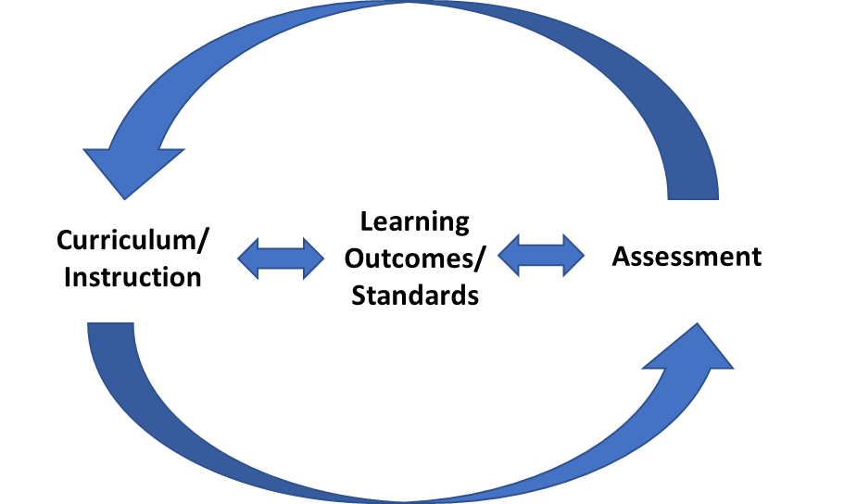
Assessment, Standards, and Curriculum
Notes:
Assessment should be in support of learning, which means that there must be cohesion between the desired learning outcomes (or standards), the curriculum, instruction, and assessment.
This cohesive function is a crucial one because if the assessment does not provide coverage of the topics that are included in the instruction, then there is no feedback on how students are doing with these topics or instruction.
At the same time, if students are not doing well on assessments because of material that is not a goal of curriculum, or if teachers have to spend time focusing on material that is not relevant in order to support their students in doing well on assessments, then these assessment are not helpful to teachers and can in fact detract from student learning by taking time away from instruction.

Slide 15
Assessment: A Process of Reasoning from Evidence
Cognition – model of how students represent knowledge
Observations – tasks or situations that allow us to observe students’ performance
Interpretation – method of making sense of the data
Inference – judging what students know and can do
Cognition
Inferences
Observations
Interpretation
Notes:
A model of learning can serve as a unifying element—a nucleus that brings cohesion to curriculum, instruction, and assessment. This cohesive function is a crucial one because educational assessment does not exist in isolation, but must be aligned with curriculum and instruction if it is to support learning.
Over the past several decades, powerful insights have been gained into how students represent knowledge and develop competence in specific domains, as well as how tasks and situations can be designed to provide evidence for inferences about what students know and can do for students across a full range of performance.
The key is that the model of student learning that teachers use in curriculum, instruction, and their classroom assessments be the SAME model that assessment developers use in designing the summative assessment. State and local education agencies must seek to create a system which prepares teachers (and students) for the summative assessment, ensuring that there is a common model and expectations for teaching and learning for both instruction and assessment.
The Cognition vertex is a link between assessment, curriculum, and instruction. It includes:
Model of learning as a unifying element; and
Representation of how students develop competence (knowledge, skills, abilities) in the subject domain.
It represents:
What you want to teach students;
What you want the curriculum materials to focus on; and
What you want to assess.
Observations, which include assessment tasks along with the criteria for evaluating students’ responses, must be carefully designed to elicit the knowledge and cognitive processes that the model of learning suggests are most important for competence in the domain. The capabilities must be defined because the design and selection of the tasks need to be tightly linked to the specific inferences about student learning that the assessment is intended to support.
The Observations vertex focuses on what information you are going to gather about your students. The focus is on defining the Assessment System, which includes:
What tests will be developed;
How tests will be administered; and
How tests will be scored.
The third corner of the triangle is Interpretation, meaning the methods and tools used to reason from the observations that have been collected. An essential feature of good assessment design is an Interpretation model that fits the model of cognition and learning. The method used for a large-scale standardized test might involve a statistical model. Interpretation of the evidence produced should, in turn, supply insights into students’ progress that match up with that same model.
The Interpretation vertex focuses on what you do with the evidence you observed. The focus is on what will be reported, and how those reports will be used. It includes:
Aligning observations to scores or feedback (taking into account possible measurement error and examining statistical qualities of the observations);
Determining how to compare students (e.g., standard settings or scaling);
Determining what feedback will be reported back to the stakeholders; and
Determining how stakeholders should use this feedback.

Slide 16

Coherence is Key
Notes:
Radically changing one of these elements and not the others runs the risk of producing an incoherent system. All of the elements and how they interrelate must be considered together. Thus, designing an assessment is a process in which every decision should be considered in light of each of these three elements.
The Evidence-Centered Design (ECD) approach, developed by Mislevy and colleagues (see, e.g., Almond et al., 2002; Mislevy, 2007; Mislevy et al., 2002; Steinberg et al., 2003), is one framework for developing assessments that takes into account the logic embedded in the assessment triangle and closely follows the evidentiary reasoning logic spelled out by the National Research Council (NRC) assessment triangle.
Recall, evidence that test content reflects the concepts that were meant to be measured is one of the critical sources of information necessary to support valid interpretations of test scores (AERA, APA, and NCME, 2014). Alignment is about coherent connections across various aspects within and across a system (Forte, 2013a, 2013b).

Slide 17
Principled-design Development Purpose
What is a principled-design development process?
A guide to the development of a task that focuses the developer on the purpose of the assessment and the information required in order to design tasks that meet that purpose
Why do we use a principled-design development process?
To highlight the design decisions that need to be made in the process in order to develop tasks that support valid and meaningful interpretations about what students know and can do in science
Notes:
Principled-design is a disciplined approach aimed at designing assessment systems while keeping in mind the inferences end users wish to make based on test scores. If assessment information (i.e., subscores, total scores, etc.) is expected to have value and usefulness for educators, then early in the design phase assessment developers must have a clear sense of how the test scores will be used to support inferences about teaching and learning. Principled-design is an approach to constructing assessments that ensures the evidence, and interpretations of evidence from the assessment, align with and support the intended claims, purposes, and uses of the assessment.
Using a principled-design approach for the assessment development process helps ensure that the assessment yields valid and reliable results, and that the assessment is capable of meeting and surpassing federal accountability standards. Because this approach to development centers around the assessment purpose and intended use of scores, alignment and accessibility are built into the assessment from the beginning. Rather than focusing on a single theory or set of standards, principled-design focuses on the end goal and uses for the assessment, leaving space for the integration of multiple frameworks and perspectives (e.g., Universal Design for Learning (UDL), ECD, and Social and Emotional Learning (SEL)). The principled-design approach also provides stakeholders with ample documentation of design and development logic and decisions, which can be used for future learning, evaluations, and development projects.

Slide 18
Evidence-Centered Design (ECD)
Formal, multiple-layered framework for assessment development based on Messick’s (1994) guiding questions:
What complex of knowledge, skills, or other attributes should be assessed?
What behaviors or performances should reveal those constructs?
What tasks or situations should elicit those behaviors?
Notes:
There are many different types of principled design approaches. ECD is based on the work of Messick from 1994. This approach asks three key questions. The first is, “What is it that I actually want to know about the students?” That’s what we refer to as our student model. What do I want to say, and what do I want to know? It might be one thing, or it might be multiple things. The orange dots in the graphic represent each of the things you want students to know and demonstrates how they are connected.
The second question is, “What behaviors or performances let me know that students know and can do what I want them to? This is referred to as the evidence model. This is where we think about the kind of evidence that we need to collect. What do I need to see my students do? What do I need to hear them say?
Then the third question is asking, “What tasks and situations would provide that evidence?” What do you want to be presented back to you? What do students need to produce (in green) that would give you the evidence you need? What is it that should be presented to students and what are students actually producing to give you the evidence you need? What do you do with the evidence? How do you score it, and what does it tell you about your students? Think about your evidence model; “I know what I want to see the students do. How can I create tasks that give them the opportunity to do that?”

Slide 19
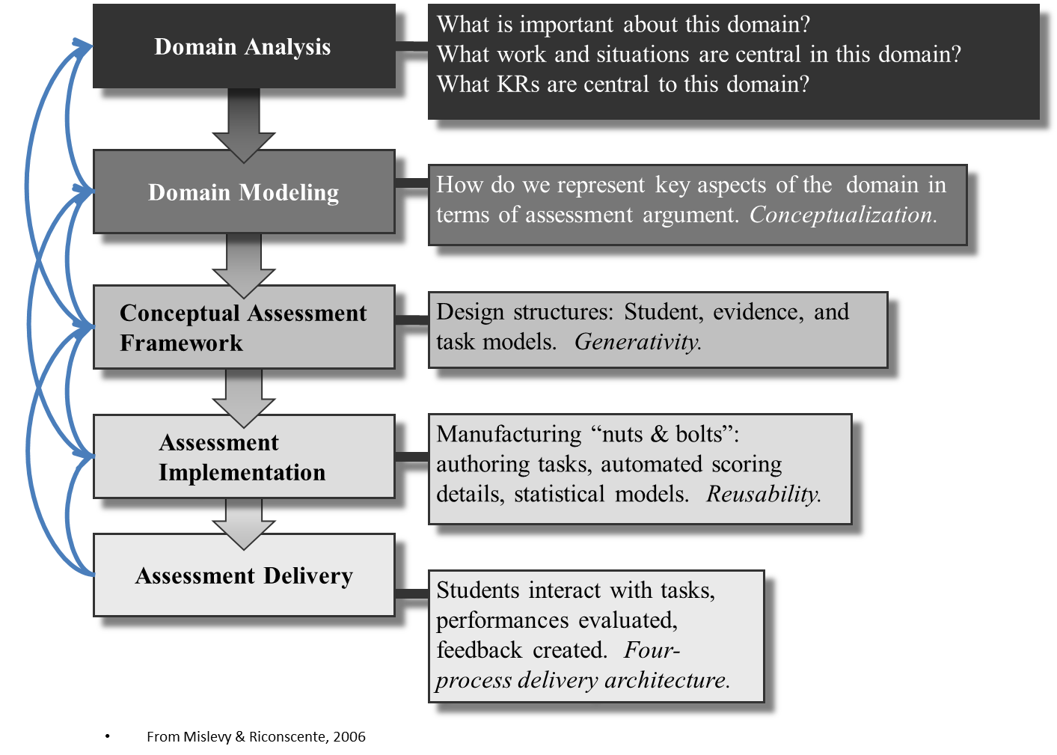
Notes:
ECD is a layered approach with five phases.
In Phase 1, Domain Analysis, the assessment developer focuses on what the standard, or performance expectation, means. What should a student know and be able to do? What are the requirements of students and what I am trying to measure?
In Phase 2, Domain Modeling, the assessment developer thinks about the many possible ways the construct could be measured. What are the possible things I want to say about my students? What evidence needs to be gathered? What are the characteristic features of tasks? What is it that students need to be engaging with? In this phase, the assessment developer is still not thinking about this in the context of a particular task, but is dividing the space of the domain to figure out what s/he is trying to assess and what that looks like.
In Phase 3, the Conceptual Assessment Framework layer, the assessment developer begins to think about the constraints for the task. For example, let’s say the teacher has 10 minutes to administer a task during a lesson or instructional sequence, s/he will need to think about what is feasible to administer to students within that time period.
In Phase 4, the Assessment Implementation layer, once the assessment developer has narrowed down the constraints for the task, then s/he can go about designing the item or task.
In Phase 5, Assessment Delivery, students interact with the tasks.
In truth, this is iterative. You’re always going back and making improvements. At the end of the day, you have the documentation of your logic behind your design and decisions. There are different ways to partition this and think about it without making it a burdensome process.
A few key notes to highlight are: 1) these layers are not done in isolation, 2) many different people contribute at all layers of the process: content experts, assessment experts, UDL experts, etc., and 3) document your decisions throughout the assessment design process.

Slide 20
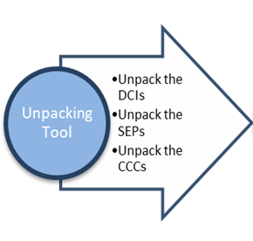
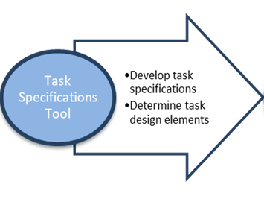
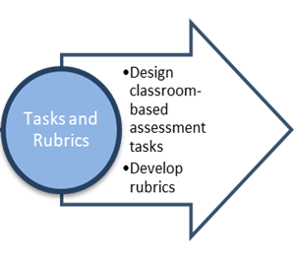
ECD for Classroom-based Assessments
Notes:
While the entire layered approach may seem daunting, and it may not be necessary for all assessments to delve into each layer in detail, the general idea of starting with understanding the goals and the context, determining the evidence that is needed, and then creating tasks is still critical.
For our classroom assessment we have broken this into three parts, each with tools to support them.
First is our Unpacking Tool. This is very aligned to the domain analysis, where the goal is to really understand the science standards or PEs and to determine the critical aspects of student learning.
Next, we delve into the Task Specifications Tool, which provides guidance on how tasks should be developed and lays out some of the decisions that should be made when developing the task.
Finally, the task and rubric are developed.
Note that this sometimes feels backwards for people not used to this process, as it can seem more natural to start diving into task development and then seeing what that measures. Here we really want to focus on thinking about the evidence first and then use that information to determine how a task should be developed.

Slide 21
Benefits of a Principled Approach to Developing Classroom-based Assessments of Three-dimensional Science Learning
Highlights the intended outcomes of classroom-based assessment
Points to the connections among curriculum, instruction, and assessment, which are linked in a coherent system
Provides tools to accomplish the development of classroom-based assessment tasks and rubrics
Notes:
Linking your assessment to your curriculum and instruction is important and having this process of thinking about what you want to know about students can help build the coherence into this process. It is important to focus on what it is you really want to get out of the classroom assessments and what tools you would use.
The goal is to think critically about the domain and what you’re trying to measure and then work your way through the task. This helps you think about the outcomes and what you are trying to measure. This helps you not only think about what you want to assess, but also what you want to teach. This process can benefit both assessment and instruction.

Slide 22
Overview of the Principled-design Approach: Domain Analysis
Goal:
  To obtain a deep understanding of the PE and its components
  To provide information on how students engage with the different components
  To provide information on the boundaries of student performance
Notes:
The first stage of this process is called “Unpacking.” Today you will be working with an “Unpacking Tool.” Using the Unpacking Tool, you will be asked to think critically about the three dimensions of the PEs and what they really mean. You will divide out the Crosscutting Concepts (CCCs), Science and Engineering Practices (SEPs), and Disciplinary Core Ideas (DCIs), and ask what the expectations within those dimensions mean. Think about them separately to ensure that when you bring them back together you are ensuring you are actually hitting on all of the dimensions in your assessment task.
This is related to domain analysis where you get a deeper dive into understanding the DCIs, SEPs, and CCCs. The reason we do this is because we want to ensure that the task at the end focuses on all of these components and the end result is that the task is multi-dimensional.

Slide 23
Overview of the Principled-design Approach: Domain Modeling and Conceptual Assessment Framework
Goal:
  To clearly lay out the assessment argument
    What will be covered?
    What will not be covered?
    How will students demonstrate their knowledge?
    What do tasks look like?
Notes:
After we have completed our Unpacking Tool, then we consider the Task Specifications Tool. This tool gives an overview of the specifications to follow when making decisions about the actual design of the task, without getting into the specifics of the task. In the Task Specifications Tool, you begin to think about the assessment task. What are the requirements of the task? What might be covered in the task? How will students demonstrate their knowledge? What do tasks look like? Multiple tasks can be created using the Task Specifications Tool.

Slide 24
Overview of the Principled-design Approach: Assessment Implementation
Goal:
  To develop tasks and rubrics that are aligned to the assessment argument
Notes:
The final stage is the development of the task and the rubric. This is when you will use all the information you have to design your task and check the alignment. An important step in this process is considering how you are going to score the task; therefore, the scoring rubric is developed at the same time as the task. The rubric helps to highlight what you’re actually measuring with the task, and helps to evaluate whether the task allows students to provide evidence that they have attained the KSAs.

Slide 25
Concluding Remarks
Iterative process
May seem like a lot of work in the beginning but can save time later
ECD does not specify the specifics of the fields; ECD is about the structure and the process
  Part of following an ECD approach is to determine which process best fits the specific situation
Notes:
Here are a few things to keep in mind when engaging in this process. First, this is an iterative process, especially at the beginning. You may work your way through the process and then realize that you want to go back and change something about the task because you aren’t getting enough information. This can seem daunting, but keep in mind that once you get in the habit of using this process it will get easier and the thought process about how to effectively develop assessment tasks will become more automatic. One key benefit to this work is that it provides a way of thinking about assessment.
This principled-design approach is about taking into account the student model, evidence model and task model at the same time so you can help ensure that they fit together. That’s where this approach adds validity.
The documents provided in this training and the formats of the templates are iterated and not set in stone. Principled-design does not require that these are the documents you use. There is room for modification.
Where does this process connect with curriculum development as it pertains to the districts? How can this apply to the assessments we currently receive from our curriculum departments? There is actually a lot of overlap. The domain analysis phase in particular where you are thinking about what it means for a student to engage with the three dimensions, you can use that to build your curriculum and build your assessment. So as long as you are aligned to these same goals for student learning, then your assessment should be aligned to your curriculum. It is a way to also make sure that there actually is alignment. The domain analysis and domain modeling phases to assessment design are frequently completed up-front and in coordination with the design of the standards and the establishment of performance expectations for students.

Slide 26

Comments and Questions
Notes:
[Pause for comments and questions from participants.]

Slide 27
References
Messick, S. (1994). The interplay of evidence and consequences in the validation of performance assessments. Educational Researcher, 23(2), 13-23.
Mislevy, R. J., & Riconscente, M. M. (2006). Evidence-centered assessment design: Layers, concepts, and terminology. In S. Downing & T. Haladyna (Eds.), Handbook of Test Development (pp. 61-90). Mahwah, NJ: Erlbaum.

Slide 28

Break
Notes:
[Recommended morning break.]

Slide 29
Overview of the Purpose and Development of an Unpacking Tool
[Presenter Name(s)]
10:00 a.m. – 10:30 a.m.

Slide 30
Unpacking the Dimensions of a
Performance Expectation
Provides a clear focus for what is to be measured and helps educators to plan for assessment
Ensures educators who are designing NGSS-aligned tasks have a clear and deep understanding of each of the dimensions represented in a PE prior to beginning task development
Notes:
Unpacking the dimensions of each PE provides a clear focus for what is to be measured and helps educators to plan for assessment. The Unpacking Tool provides a systematic approach to unpacking a PE into its multiple components to ensure educators who are designing NGSS-aligned tasks have a clear and deep understanding of each of the dimensions represented in a PE prior to beginning task development. With the Unpacking Tool, essentially what we are trying to do is identify all the skills that are associated with a PE. The Unpacking Tool’s purpose is to help identify the measurable aspects of the PE that will allow us to accurately measure student acquisition of knowledge, skills, and abilities.
The Unpacking Tool can be a bit time intensive, but the benefit is that once you have done it, you have it. It remains a living document and can be used as a reference or resource that you could share within a building. Schools and districts are encouraged to make this a collaborative process.

Slide 31
Unpacking the Dimensions of a
Performance Expectation Tool
Provides guidance for unpacking a PE
Template for documenting unpacking
Notes:
This slide shows the Unpacking Tool template. As shown in this template, the Unpacking Tool is set up to capture the key aspects and prior knowledge of the SEP, DCI, and CCC associated with a PE. To complete the Unpacking Tool, you must unpack the SEP, the DCI, and the CCC, and then you must also then look for relationships between the CCC and the SEP. For instance, if you are developing a model, the scale and proportion is pretty crucial to developing the right model for the right task. This illustrates that there are times when these dimensions clearly intercept.

Slide 32
Components of the Unpacking Tool
Key aspects are the underlying concepts that support each dimension of the PE and represent knowledge necessary for understanding or investigating more complex ideas and solving problems.
Prior knowledge refers to the background knowledge that is expected of students to develop an understanding of the SEP and DCI.
Relationships between the CCC and the SEP is included since when students are performing a SEP, they are often addressing one of the CCCs.
Notes:
The first section is the component of key aspects. For the key aspects, you want to identify the critical key aspects within each of the three dimensions that are there in the PE but are not entirely explicit. Key aspects are the underlying concepts that support each dimension of the PE and represent knowledge necessary for understanding or investigating more complex ideas and solving problems. Prior knowledge refers to the background knowledge that is expected of students to develop an understanding of the SEP and DCI. The relationships between the CCC and the SEP is included as well. When students are performing a SEP, they are often addressing one of the CCCs. For example, the CCC Scale, Proportion, and Quantity is an essential consideration when deciding how to develop a model (SEP) to describe a phenomenon.

Slide 33
Unpacking Tool for 5-PS1-1
Grade: 5
NGSS Performance Expectation: 5-PS1-1 Develop a model to describe that matter is made of particles too small to be seen. [Clarification Statement: Examples of evidence supporting a model could include adding air to expand a basketball, compressing air in a syringe, dissolving sugar in water, and evaporating salt water.] [Assessment Boundary: Assessment does not include the atomic-scale mechanism of evaporation and condensation or defining the unseen particles.]
 | Science and Engineering Practices (SEP) | Disciplinary Core Ideas (DCI) | Crosscutting Concepts (CCC)
Foundations | SEP: Developing and Using Models Use models to describe phenomena. | PS1.A: Structure and Properties of Matter Matter of any type can be subdivided into particles that are too small to see, but even then, the matter still exists and can be detected by other means. A model showing that gases are made from matter particles that are too small to see and are moving freely around in space can explain many observations, including the inflation and shape of a balloon and the effects of air on larger particles or objects. | CCC: Scale, Proportion, and Quantity Natural objects exist from the very small to the immensely large.
Notes:
For this particular task students are expected to develop a model to describe that matter is made up of particles too small to be seen. The NGSS PE is listed, which includes its clarification statement in red, and each of the dimensions associated with the PE are provided in the color-coded foundations boxes below the PE.

Slide 34
Unpacking Tool for 5-PS1-1
Grade: 5
NGSS Performance Expectation: 5-PS1-1 Develop a model to describe that matter is made of particles too small to be seen. [Clarification Statement: Examples of evidence supporting a model could include adding air to expand a basketball, compressing air in a syringe, dissolving sugar in water, and evaporating salt water.] [Assessment Boundary: Assessment does not include the atomic-scale mechanism of evaporation and condensation or defining the unseen particles.]
 | Disciplinary Core Ideas (DCI)
Foundations | PS1.A: Structure and Properties of Matter Matter of any type can be subdivided into particles that are too small to see, but even then, the matter still exists and can be detected by other means. A model showing that gases are made from matter particles that are too small to see and are moving freely around in space can explain many observations, including the inflation and shape of a balloon and the effects of air on larger particles or objects.
Key Aspects | Everything around us (matter) is made up of particles that are too small to be seen. Matter that cannot be seen can be detected in other ways. Gas (air) has mass and takes up space. Gas (air) particles, which are too small to be seen, can affect larger particles and objects. Gas particles freely move around in space until they hit a material that keeps them from moving further, thus trapping the gas (e.g., air inflating a basketball, an expanding balloon).
Prior Knowledge | Matter is anything that occupies space and has mass. Matter can change in different ways.
Notes:
In this portion of the Unpacking Tool, we begin “teasing apart” the disciplinary core idea. Essentially, what you see is that the bullets unpack the DCI concepts from PS1.A. [Review bulleted list with participants.]
The prior knowledge describes the DCI concepts students are expected to have from prior learning experiences to develop an understanding of the SEP and DCI. [Review bulleted list with participants.]

Slide 35
Unpacking Tool for 5-PS1-1
Grade: 5
NGSS Performance Expectation: 5-PS1-1 Develop a model to describe that matter is made of particles too small to be seen. [Clarification Statement: Examples of evidence supporting a model could include adding air to expand a basketball, compressing air in a syringe, dissolving sugar in water, and evaporating salt water.] [Assessment Boundary: Assessment does not include the atomic-scale mechanism of evaporation and condensation or defining the unseen particles.]
 | Science and Engineering Practices (SEP)
Foundations | SEP: Developing and Using Models Use models to describe phenomena.
Key Aspects | Identify components of the model. Use a model to reason about a phenomenon. Reason about the relationship of the different components of a model. Select and identify relevant aspects of a situation or phenomena to include in the model.
Prior Knowledge | Knowledge that a model contains elements (observable and unobservable) that represent specific aspects of real-world phenomena Knowledge that models are used to help explain or predict phenomena
Notes:
In this portion of the Unpacking Tool, we begin “teasing apart” the science and engineering practice. Essentially, what you see is that the bullets unpack the practices from PS1.A. What you are doing in the key aspects area is answering “what does it mean” to develop a model? [Review bulleted list with participants.]
The prior knowledge describes the prior knowledge students are expected to have from prior learning experiences to be able to, in this instance, understand how to develop a model. [Review bulleted list with participants.]

Slide 36
Unpacking Tool for 5-PS1-1
Grade: 5
NGSS Performance Expectation: 5-PS1-1 Develop a model to describe that matter is made of particles too small to be seen. [Clarification Statement: Examples of evidence supporting a model could include adding air to expand a basketball, compressing air in a syringe, dissolving sugar in water, and evaporating salt water.] [Assessment Boundary: Assessment does not include the atomic-scale mechanism of evaporation and condensation or defining the unseen particles.]
 | Crosscutting Concepts (CCC)
Foundations | CCC: Scale, Proportion, and Quantity Natural objects exist from the very small to the immensely large.
Key Aspects | Understand the units used to measure and compare quantities. Describe relationships between natural objects which vary in size (very small to the immensely large). Understanding of scale involves not only understanding systems and processes vary in size, time span, and energy, but also different mechanisms operate at different scales.
Relationships to SEPs | Models describe the scale of natural objects. Data analysis serves to demonstrate the relative magnitude of some properties or processes. Calculate proportions correctly and measure accurately for valid results.
Notes:
In this portion of the Unpacking Tool, we begin “teasing apart” the crosscutting concept. Essentially, what you see is that the bullets unpack the crosscutting concept from PS1.A. [Review bulleted list with participants.]
The relationships to SEPs describes the connection between the CCC and the practice. The CCC Scale, Proportion, and Quantity is an essential consideration when deciding how to develop a model (SEP) to describe a phenomenon. To demonstrate their ability to develop a model, students understand . . . [Review bulleted list with participants.]

Slide 37
Resources for Unpacking
A Framework for K-12 Science Education: Practices, Crosscutting Concepts, and Core Ideas
State Science Content Standards
The NGSS
NGSS Appendices E, F, and G
Notes:
A selection of resources to support unpacking the PEs to identify “Key Aspects” and “Prior Knowledge” includes the Framework, the NGSS, and NGSS Appendices E: Disciplinary Core Ideas, F: Science and Engineering Practices, and G: Crosscutting Concepts (i.e., progressions).
[Walk participants through the NGSS appendices to illustrate the progressions charts and how they can be used to identify prior knowledge.]

Slide 38

Comments and Questions
Notes:
[Pause for comments and questions from participants.]

Slide 39
Breakout Activity and Discussion: Unpacking Tool Activity
[Presenter Name(s)]
10:30 a.m. – 11:30 a.m.

Slide 40
Key Ideas for Completing the
Unpacking Tool
Key Ideas
  Unpacking the dimensions of each PE provides a clear focus for what is to be measured and helps teachers to plan for assessment.
  The Unpacking Tool requires you to think critically about the three dimensions of the PEs and what they really mean.
  The tool asks teachers to consider key aspects and prior knowledge of each dimension as well as the relationship between the CCC and SEP.
  The Unpacking Tool can be a bit time intensive, but the benefit is that once you have done it, you have it. It remains a living document and can be used as a reference or resource that you could share within a building.
Notes:
[Review the key ideas for completing an Unpacking Tool with the participants.]

Slide 41
Guiding Questions for Completing the Unpacking Tool
How are the three dimensions interconnected in the PE?
What are the skills that are associated with a PE?
What science learning would you expect students to have acquired in previous grades/previous instruction with respect to the three dimensions of the assessed PE?
Notes:
[Review the guiding questions for completing an Unpacking Tool with the participants. These guiding questions are also included in the Facilitator Guidance to Support Activities.]

Slide 42
Strategies for Completing the Unpacking Tool
Use the following strategies to complete the Unpacking Tool:
  Use all of the suggested resources and your knowledge and experience
  Divide out the CCCs, SEPs, and DCIs and ask what the expectations within those dimensions mean
  Think about each dimension separately to ensure that when the dimensions are brought back together, they are all reflected in the assessment task
    The reason for doing this is to ensure that the resulting task focuses on all these dimensions and assesses students’ ability to apply their understanding of the dimensions to explain phenomena or solve problems.
  Identify the critical key aspects within each of the three dimensions that are in the PE but are not entirely explicit
    These are the underlying concepts that support each dimension of the PE and represent knowledge necessary for understanding or investigating more complex ideas and solving problems.
Notes:
[Review the strategies for completing an Unpacking Tool with the participants. These strategies are also included in the Facilitator Guidance to Support Activities.]

Slide 43
Strategies for Completing the Unpacking Tool, Cont.
Use the following strategies to complete the Unpacking Tool:
  Consider the prior knowledge or the background knowledge that is expected of students to develop an understanding of the SEP and DCI
  Consider the relationships between the CCC and the SEP. When students are performing a SEP, they are often addressing one of the CCCs.
    For example, the CCC Scale, Proportion, and Quantity is an essential consideration when deciding how to develop a model (SEP) to describe a phenomenon.
Notes:
[Continue reviewing the strategies for completing an Unpacking Tool with the participants. These strategies are also included in the Facilitator Guidance to Support Activities]

Slide 44


Unpacking Tool Discussion/Activity
(45 minutes)
Access these grade or grade-band specific documents:
  Unpacking Tool Activity Directions
  Partially Completed Unpacking Tool
  SCILLSS Model Unpacking Tools
Refer to slides 40-43 and review the SCILLSS Model Unpacking Tools to support your completion of the partially completed grade or grade band Unpacking Tool.
Collaborate with teachers at your table to complete the Unpacking Tool for your grade or grade band.
Sort the provided statements into the appropriate dimension and into the key aspect or prior knowledge sections.
Review the completed Unpacking Tool with your facilitator.
Notes:
[Review the Unpacking Tool activity with the participants.]

Slide 45
Comments and Questions
Notes:
[Pause for comments and questions from participants.]

Slide 46

Working Lunch
11:30 a.m. – 12:30 p.m.
Notes:
[Recommended working lunch in which collaborative teams continue to start completing their Unpacking Tool for the selected PE]

Slide 47
Collaborative Teams:
Unpacking Tool
[Presenter Name(s)]
12:30 p.m. – 1:30 p.m.

Slide 48
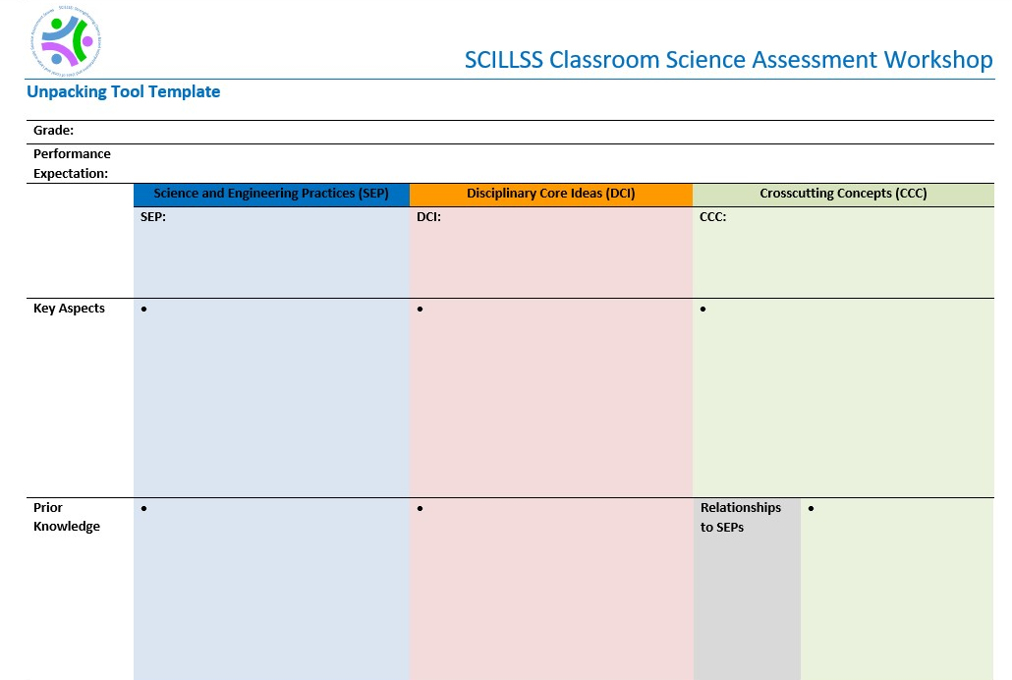
Unpacking Tool
Notes:
[Have participants work in small collaborative teams (4-5 participants) to select a PE for their grade level/band or domain. All team members must teach to the selected PE through their curriculum/instruction. Once they have selected a PE, prompt participants to begin completing the Unpacking Tool in their collaborative teams. Participants record their work in the provided Unpacking Tool template. Facilitators sit with each collaborative team to provide guidance and to support the discussion.]

Slide 49
Overview and Guided Activity: Purpose and Development of a Task Specifications Tool
(Part 1 – Knowledge, Skills, and Abilities)
[Presenter Name(s)]
1:30 p.m. – 2:00 p.m.

Slide 50
Identifying Assessment Task Specifications
Allows educators to translate the PE-specific unpacking of the three dimensions into assessment tasks
Allows educators to determine what counts as evidence for student learning
Helps educators develop assessment tasks that allow students opportunities to call upon, transfer, and apply learning that has occurred during instruction to new challenges, much the way a scientist or engineer would, in an assessment situation
Notes:
The purpose of developing the Task Specifications Tool is to define what constitutes evidence of three-dimensional science student learning and to define task specifications that will identify the task features that will elicit what students have indeed learned. In this Task Specifications Tool, we are condensing some of those key steps in principled-design that will result in a task that will elicit the evidence you need as educators to get your fingers on the pulse of where kids are. Where do they have an understanding? Where are there gaps in their learning?
There are some key things the task specifications are intended to achieve for you. They are going to allow you to translate the PE-specific unpacking of the three dimensions into assessment tasks. We want to help you think about what evidence is going to count and be demonstrable of student learning that has occurred. And we want to make sure that these tasks allow students opportunities to call upon and transfer what has been taught. We don’t necessarily want to identically replicate what has been done in instruction; however, we want to create tasks that are accessible to the student because it is part of their educational experience and is going to give them the opportunity to transfer what they know and demonstrate what they know and can do in a new or related scenario. In the real world, that’s what scientists and engineers do; we similarly want students to maintain an interest in learning through science and be able to think the way a scientist or engineer would to solve a problem or find a phenomenon.
We would expect that the way in which we develop tasks are familiar to students; so as an example, if you’ve never asked students to use data to develop a graph and interpret data from that graph to answer a question, and that is the task you’ve developed, how do you expect students to do? Probably not well. They may know something about the content or phenomenon being assessed, but if they don’t have that skill, how can they transfer what has been taught and what they learned to the assessment task? We want to make sure students have some familiarity in the way in which they are being asked to demonstrate what they know and can do, and it allows them to transfer their level of understanding and sophistication of learning to this new or novel task or scenario.
We also want to make sure that the tasks will elicit the evidence we need by including the right questions, asked in the right way, to determine what students know and can do.

Slide 51
Assessment Task Specifications Tool
Identifies key elements needed to be addressed by task developers to develop meaningful and interpretable assessment tasks
Template for documenting task specifications
Notes:
Through the Task Specifications Tool, we need to consider as task developers those key elements of a task that are going to provide interpretable evidence. As task designers you have to make a number of decisions based on what you understand about the PE, what you have unpacked about it, and what you know about the evidence that must be produced by students to demonstrate their understanding of the PE or an aspect of the PE. There are a collection of elements that are in these task specifications that are going to lead to that task that you need to best evaluate student learning.
The assessment Task Specifications Tool has multiple elements, but what we are moving closer to is identifying the key elements that need to be addressed by you as task developers to develop meaningful and interpretable assessment tasks.

Slide 52
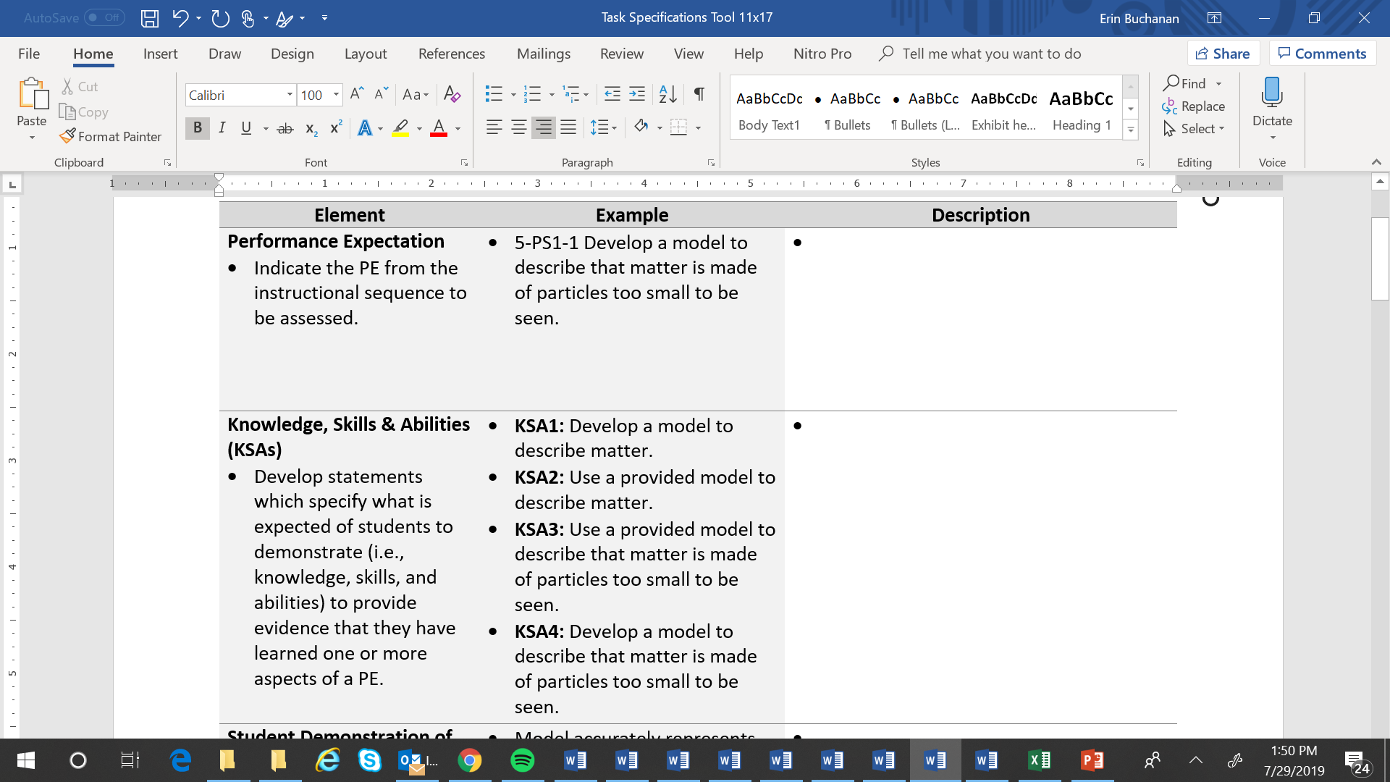
Assessment Task Specifications Tool
Synthesize the key aspects of the dimensions, both independently and collectively, from the Unpacking Tool to craft the KSA statements
The statements should represent a range of KSAs that collectively meet the expectations of the PE
Some KSAs might be more discrete, simplistic, and one-dimensional while others might be more comprehensive, complex, and multi-dimensional
Educators can select one or more KSAs from this “menu of options” for measurement by an assessment task
Notes:
The Task Specifications Tool has multiple components. Here we will look at each element, a description of what that element is [in the left column], and then we have an example [middle column.] After we go through these two particular elements, we are going to work with you and have you generate ideas that will align to these elements. Facilitators will work with each group and will record your thinking in your Task Specifications Tool.
Element: Performance Expectation
The first element is pretty straight-forward, and we already have it done, because we want to indicate the PE for which we are developing the Task Specifications Tool. It might seem like a “moot” point, but we are always coming back to it. It is the focus of what we are doing. From a single task specification tool, we can generate multiple tasks. The unpacking document that you worked on previously is like a palate of knowledge, skills, and abilities that you can select from to design tasks that measure exactly what you need to know during a point in time during your instruction. We want to make sure everything is aligned to the PE.
Element: Knowledge, Skills, and Abilities (KSAs)
Next are the knowledge, skills, and abilities (KSAs). The purpose of the KSAs is to identify the focus of the PE. Each of these statements specifies what it is that students are expected to demonstrate to provide the evidence that they have learned one or more aspects of the PE. That PE is dense. Your unpacking documents are quite lengthy when you analyzed each of those dimensions. Therefore, when you develop the KSAs, they can go across multiple aspects of the PE, but they don’t all have to be at the level, or grain size, of the PE.
The NGSS present KSAs that we haven’t taught before. There is new content here that we need to understand well. When we break down a PE, we want to think about what KSAs (knowledge, skills, and abilities) are represented by the PE. KSAs are a combination of aspects of the PE that you can pull apart from the PE statement. One PE may have three to six KSAs depending on how dense or packed it is with respect to the DCI’s or the SEP or the CCCs; when you make decisions about those KSAs, it could be that your assessment task is just going to address a single KSA. Is it ever appropriate just to measure a DCI? Maybe it’s driven by what's in the PE; perhaps one KSA is more of a DCI, or maybe it’s across a couple of dimensions and includes a SEP or a CCC. The KSAs can be graduated. They can address an aspect of the PE. As tasks become more graduated and complex, we would expect to see them address more KSAs associated with that PE. These KSAs can be things that you measure midway through or even a quarter of the way through instruction just to make sure your students are on track. The KSAs are also your opportunity to put back together some aspects of the multiple dimensions that you teased apart in the unpacking. KSA is kind of like the “junior” PE and the demonstration is “what are they doing?”
Some of the KSAs might be more discrete; they may just look at a particular dimension rather than more than one dimension. You will select one or more KSAs from this menu of options for measurement by the assessment task. As we’ve said, this tool can be used to generate multiple tasks depending on what it is you need to know. Everything aligns back to the PE, but you will decide based on your instructional sequence, and the list of KSAs that are developed, what it is you want to measure at a particular time. All of the KSAs might vary in their complexity, whether it is descriptive or generative in terms of cognitive complexity, and you might focus on one KSA or more than one KSA when you develop your task. You are creating a palate or menu of options. Regardless of how you select them, we know that they are aligned to that PE.
Grade 5 Example
You will notice in the grade 5 example the PE is fairly simple and not as dense. You’ll notice that not all PEs are created equal. Some are more complex than others, and some have a broad range of representation of the dimensions. Going through the exercise of unpacking the PEs really gives you a solid understanding of how they are differentiated regarding how they are different in their complexity. Many of the PEs are more dense as you progress in the grade levels because we see a progression in the sophistication of science and the students are building on what they have known and are using it to demonstrate higher learning.
We have a few examples here. The PE in focus requires students to “Develop a model to describe that matter is made of particles too small to be seen.” What are some aspects of that PE that we could identify and that we would need to collect evidence against? Students could “develop a model to describe matter,” “use a provided model to describe matter,” “use a provided model to describe that matter is made of particles too small to be seen,” and “develop a model to describe that matter is made of particles too small to be seen.” In these statements you can see some combinations of the SEPs and DCIs and possibly the CCCs. We are combining information from the unpacking document to define the focus, or the “what” of the PE, that we want to be the focus of assessment.
There is an opportunity here. If you look at the KSA list 1-4, you could specify two levels of a task here, one harder than the other. If the focus is providing students a model and asking them to describe, that’s probably an easier task than having them generate and develop a model, so you could get at the PE with levels of difficulty should you choose to specify it that way, but you wouldn’t be able to identify that until you complete the Task Specifications Tool. The KSAs will help you determine the desired complexity of the task.
When you are generating these, we are not expecting you to create that hierarchy, but rather getting your ideas down is the most important thing. You don’t have to order your KSAs in a particular way. The level of complexity of the task could be differentiated by cognitive process using the list of KSAs.
To draft your KSAs, follow two steps:
Synthesize the key aspects of the dimensions which you have already done in your Unpacking Tool.
Use those to build statements that represent a range of KSAs that range in complexity to meet the expectations of the PE.

Slide 53
Guiding Questions for Completing the
KSAs for the Task Specifications Tool
What ideas and skills are associated with a PE?
What is that the task/items are intended to measure that will determine what the tasks should evidence the task will illicit?
What KSAs are necessary for students to demonstrate in a task that reflect understanding of PE?
Are the KSAs consistent with the expectation of the indicated PE/standard?
Are the KSAs consistent with the key aspects indicated in the Unpacking Tool?
Notes:
[Review the guiding questions for completing the KSAs in the Task Specifications Tool with the participants. These guiding questions are also included in the Facilitator Guidance to Support Activities.]

Slide 54
Strategies for Completing the KSAs for the Task Specifications Tool
Use the following strategies to complete the Task Specifications Tool:
  Consider the number of KSAs that are required to address the breadth and the dimensions represented in the PE/standard.
  Consider if the specificity and range of the KSAs is sufficient to support the development of multiple tasks and items within a task.
  Consider how the KSA(s) support the development and consideration for how students will demonstrate learning.
  Consider how assessing the KSA(s) will elicit sufficient evidence of student learning to make appropriate inferences about that learning.
Notes:
[Review the strategies for completing the KSAs in the Task Specifications Tool with the participants. These strategies are also included in the Facilitator Guidance to Support Activities.]

Slide 55
Collaborative Teams:
Develop Task Specifications Tool
(Part 1 – Knowledge, Skills, and Abilities)
[Presenter Name(s)]
2:00 p.m. – 2:30 p.m.

Slide 56
Guided Activity
In your collaborative teams, collectively brainstorm possible KSAs for a selected performance expectation.
Facilitators will provide guidance and will record ideas in the Task Specifications Tool.
Notes:
[Have participants work in small collaborative teams (4-5 participants) to complete the first two elements (PE, KSAs) in their Task Specifications Tool. Facilitators sit with each collaborative team to provide guidance and to support the discussion. Facilitators can also serve as recorders and can offer to document the group decisions in the Task Specifications Tool.]

Slide 57
Overview and Guided Activity: Purpose and Development of a Task Specifications Tool
(Part 2 – Student Demonstrations of Learning and Work Products)
[Presenter Name(s)]
2:30 p.m. – 3:00 p.m.

Slide 58
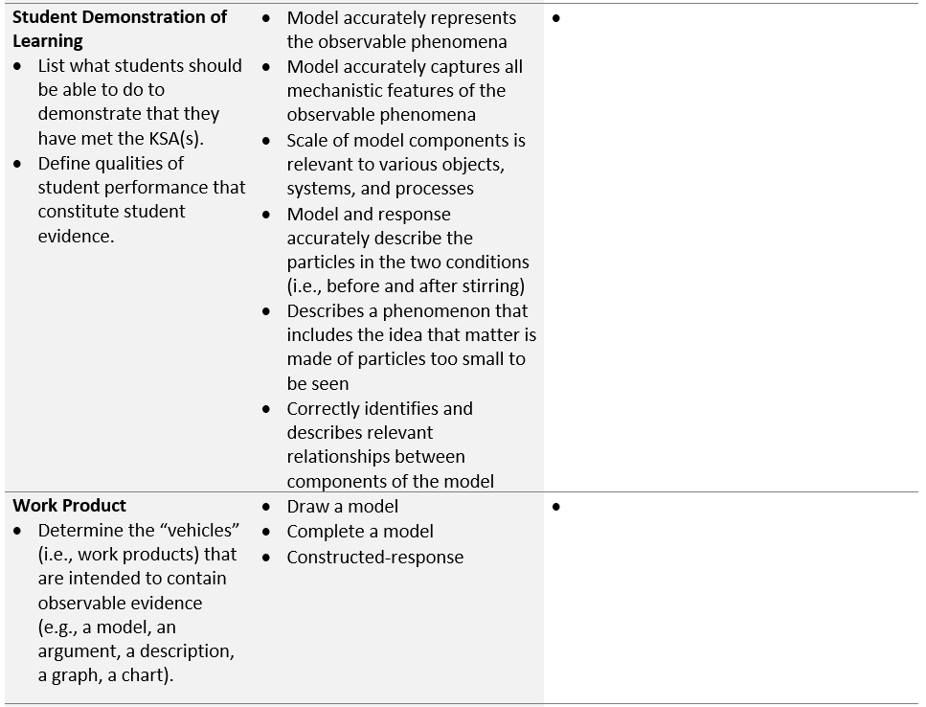
Assessment Task Specifications Tool
For each KSA, identify the types of performances that provide evidence that students have met the KSA
Example:
KSA1: Develop a model to describe matter.
Model accurately represents the observable phenomena.
Model accurately captures all mechanistic features of the observable phenomena.
Scale of model components is relevant to various objects, systems, and processes
Describe the work products (i.e., item types, situations, stimuli) that will allow students to fully demonstrate the KSA(s)
Educators can pick from this “menu of options” to select a work product or combination of work products appropriate for measuring the KSA(s)
Notes:
For the next two elements of the Task Specifications Tool, you’ll complete the Student Demonstration of Learning and Work Product.
Element: Student Demonstration of Learning
For this element, you’ll want to think carefully about the evidence students will need to demonstrate for each of the KSAs you’ve created. Create a list of what students should be able to do to demonstrate that they have met the KSAs. In this list, you’ll want to clearly define the qualities of student performance that constitute student evidence. For example, for KSA1: Develop a model to describe matter, students will need to demonstrate that they can 1) model accurately to represent the observable phenomena, 2) model accurately to capture all mechanistic features of the observable phenomena, and 3) show that the scale of the model components is relevant to the various objects, systems, and processes.
To complete this section, focus on the evidence that will need to be produced by the tasks and the criteria that will need to be included in the scoring rubric to appropriately measure students’ performance of the KSAs.
Element: Work Product
For the work product, you’ll want to think about the “vehicles” that are intended to contain observable evidence. This could include item types, situations, or stimuli that will allow students to demonstrate their learning of the KSAs. Educators can pick from this “menu of options” to select a work product or combinations of work products appropriate for measuring the KSAs.

Slide 59
Guiding Questions for Completing the SDLs and WPs for the Task Specifications Tool
What types of performances will provide evidence that students have learned the KSA(s)?
How will students demonstrate their learning? What type of responses or artifacts will students produce?
What are the ways in which students will provide evidence of their learning?
How does the evidence reflect the selected KSA(s)?
What are the kinds of behaviors and performances that show what students should know and be able to do after instruction?
What are the items, situations or stimuli that will elicit evidence of student learning?
Notes:
[Review the guiding questions for completing the SDLs and WPs in the Task Specifications Tool with the participants. These guiding questions are also included in the Facilitator Guidance to Support Activities.]

Slide 60
Strategies for Completing the SDLs and WPs for the Task Specifications Tool
Use the following strategies to complete the Task Specifications Tool:
  Review the KSA element to gain a complete understanding of what is expected of students to demonstrate to provide evidence that they have learned one or more aspects of a PE.
  Consider how the type of evidence elicited by the SDLs and WPs ensure that educators can make accurate inferences about student competencies.
  Consider and evaluate the types and variation of the “vehicles” (i.e., work products) that are intended to contain observable evidence (e.g., a model, an argument, a description, a graph, a chart).
  Consider how the SDLS and WPs with respect to the assessed KSA(s) will inform educator actions either to 1) continue with the instructional sequence as planned; or 2) adjust the design, delivery, and sequence of instruction.
  Consider how the SDLs and WPs will inform instructional decisions made at the individual student level, for a small group of students, or at the class level.
  Consider how the creation of the task is aligned to specific aspect(s) of the PE to be assessed and support the other design choices about what information is presented to a student, how it is presented, how the examinee interacts with the tasks, and how responses are provided.
Notes:
[Review the strategies for completing the SDLs and WPs in the Task Specifications Tool with the participants. These strategies are also included in the Facilitator Guidance to Support Activities.]

Slide 61
Collaborative Teams:
Develop Task Specifications Tool
(Part 2 – Student Demonstrations of Learning and Work Products)
[Presenter Name(s)]
3:00 p.m. – 3:30 p.m.

Slide 62
Guided Activity
As a whole group, we will collectively brainstorm possible Student Demonstrations of Learning and Work Products for a selected performance expectation.
Facilitators will record ideas in the Task Specifications Tool.
Notes:
[Have participants work in small collaborative teams (4-5 participants) to complete the next two elements (Student Demonstration of Learning, Work Product) in their Task Specifications Tool. Facilitators sit with each collaborative team to provide guidance and to support the discussion. Facilitators can also serve as recorders and can offer to document the group decisions in the Task Specifications Tool.]

Slide 63
Overview and Guided Activity: Purpose and Development of a Task Specifications Tool
(Part 3 – Task Features, Variable Features, and Assessment Boundaries)
[Presenter Name(s)]
3:30 p.m. – 4:00 p.m.

Slide 64
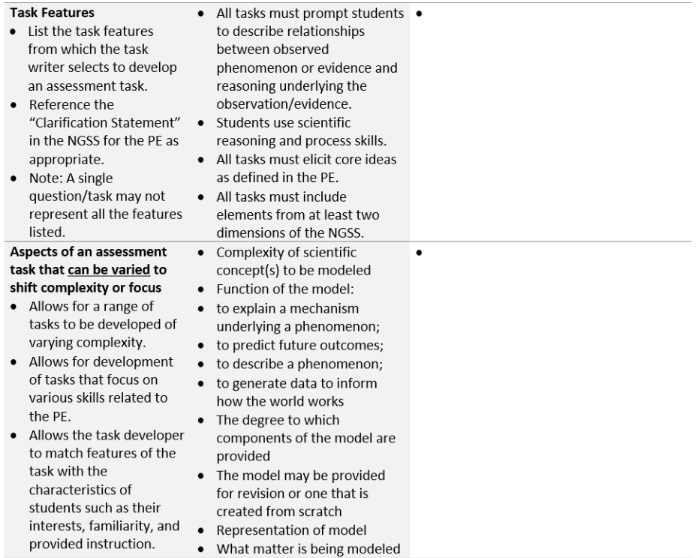
Assessment Task Specifications Tool
Determine the necessary features of the assessment tasks that would be necessary to appropriately measure one or more of the KSAs.
Task features can influence the design of the task in terms of structure, content, and complexity.
Educators can pick from this “menu of options” to select those features necessary for measuring the KSA(s).
Consider the range of KSAs related to the PE that could be measured by an assessment task. How might tasks vary in complexity or focus to address these different KSAs? How might tasks vary to appropriately address characteristics of students, including their interests, cultural identity, familiarity, and prior instruction?
Educators can pick from this “menu of options” to select features appropriate to the KSA(s) and the student population.
Notes:
Element: Task Features
What are task features? These are necessary features of the assessment tasks that would be necessary to appropriately measure one or more of the KSAs. The task designer needs to be able to describe the features of the tasks that need to be evident in any of the products that students are creating and needs to make design decisions informed by the clarification statement in the NGSS PE, as appropriate. We want to ensure that when we are developing these tasks, we are not asking students to do things that exceed the expectation of the PE and we want to make sure too that the task features that we are building into these tasks allow us to determine what a student knows about the measured content; these features may also indicate to us what students do not know. It is important to note too that a single question within a task may not represent all of the task features listed, so it is kind of an amalgam. If you look across the KSAs and the student demonstration of learning and the work product, consider what task features would cover the range of those elements of your task specification. Keep in mind, however, that not all of them are applied to every task.
Element: Aspects of an assessment task that can be varied to shift complexity or focus
The next element, “Aspects of an assessment task that can be varied to shift complexity or focus,” can be thought of in regard to the construction of a test. Generally, all standards, even with respect to the PEs, are not created equally and all items on a test are not created equally with respect to their complexity. By the nature of the standard, some skills or knowledge are more complex or less complex than others. Therefore, it is appropriate then based on what is being measured that the actual assessment has some variation in its complexity. When you are thinking about what it is you are going to measure, you can address that in this aspect or in this element or task feature. For example, to vary the complexity of a task, you can opt to provide a model to a student for revision, or you might require students to create their own model. You could also choose to vary the components of the model provided to the student to alter the complexity of the item.

Slide 65
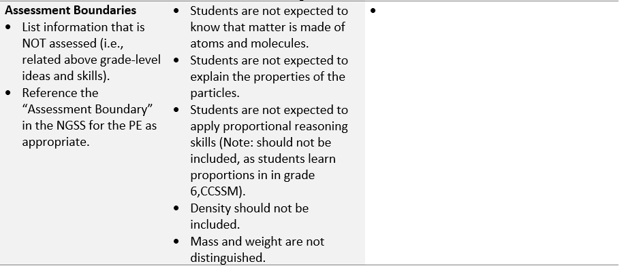
Assessment Task Specifications Tool
Determine the above grade-level ideas and skills for the KSAs/PE by referencing the above grade/band standards and NGSS Appendix F progressions charts.
Notes:
Element: Assessment Boundaries
Lastly, we will talk about assessment boundaries. It is not only important to think about what we are measuring, we also want to think about what is not assessed. With regard to the PEs, many of them have assessment boundaries. For this element, list the information that is not assessed (i.e., related above grade-level knowledge and skills). You may want to reference the “Assessment Boundary” in the NGSS for the PE as appropriate.

Slide 66
Guiding Questions for Completing the TFs, VFs, and ABs for the Task Specifications Tool
What are the features of task situations that allow students to demonstrate the degree to which expectations have been met?
What features allow for a range of tasks to be developed at varying levels of complexity which in turn can affect the difficulty of the task?
What features allow for a variation in the focus of the task?
What are features of any assessment task that are required to appropriately measure one or more of the KSAs?
What type of information will be presented and what is the order of presentation?
What is fixed and what can vary?
What features should be included to address the characteristics of students such as their interests, familiarity, and provided instruction?
What information should not be assessed (i.e., related above grade-level ideas and skills)?
Notes:
[Review the guiding questions for completing the TFs, VFs, and ABs in the Task Specifications Tool with the participants. These guiding questions are also included in the Facilitator Guidance to Support Activities.]

Slide 67
Strategies for Completing the TFs, VFs, and ABs for the Task Specifications Tool
Use the following strategies to complete the Task Specifications Tool:
  Consider the range and completeness of the task features from which the task writer selects to develop tasks that align to the KSA(s) targeted for assessment.
  Consider how specific task features will be represented in a single question/task as each may not represent all the features listed.
  Consider the combination of these elements to vary the complexity or focus of the item.
  Consider the phenomenon or problem situation that will be included in a scenario or context.
  Consider the reading level, the amount of reading, the use of graphics, symbols, and equations, etc.
  Reference the “Clarification Statement” in the NGSS for the PE as appropriate.
  Review the “Assessment Boundaries” in the NGSS/standards.
Notes:
[Review the strategies for completing the TFs, VFs and ABs in the Task Specifications Tool with the participants. These strategies are also included in the Facilitator Guidance to Support Activities.]

Slide 68
Collaborative Teams:
Develop Task Specifications Tool
(Part 3 – Task Features, Variable Features, and Assessment Boundaries)
[Presenter Name(s)]
4:00 p.m. – 4:30 p.m.

Slide 69
Guided Activity
As a whole group, we will collectively brainstorm possible Task Features, Variable Features, and Assessment Boundaries for a selected performance expectation.
Facilitators will record ideas in the Task Specifications Tool.
Notes:
[Have participants work in small collaborative teams (4-5 participants) to complete the next three elements (Task Features, Aspects of an assessment task that can be varied to shift complexity or focus (Variable Features), and Assessment Boundaries) in their Task Specifications Tool. Facilitators sit with each collaborative team to provide guidance and to support the discussion. Facilitators can also serve as recorders and can offer to document the group decisions in the Task Specifications Tool.]

Slide 70
Adjourn
4:30 p.m.

Slide 71
Strengthening Claims-based Interpretations and Uses of Local and Large-scale Science Assessment Scores
(SCILLSS)
SCILLSS Classroom Science Assessment Workshop
DAY 2

Slide 72
Welcome, Agenda Overview, and Questions
[Presenter Name(s)]
9:00 a.m. – 9:30 a.m.
Notes:
[Address questions from participants and review the agenda for Day 2]

Slide 73
Agenda
Day 2 Morning
8:00 am – 9:00 am | Breakfast (if applicable)
9:00 am – 9:30 am | Welcome / Agenda Overview / Questions | Presenter(s)
9:30 am – 10:00 am | Overview of Task Development | Presenter(s)
10:00 am – 11:00 am | Breakout Activity and Discussion: Evaluation and Comparison of Grade 8 Science Tasks | Team Facilitators
11:00 am – 11:30 am | Collaborative Teams: Review of Example Task Ideas | Team Facilitators
11:30 am – 12:30 pm | Working Lunch / Collaborative Teams: Draft Task and Revisit Tools
Notes:
[Read and explain the Day 2 Morning Agenda using the facilitator’s process agenda as guidance.]

Slide 74
Agenda
Day 2 Afternoon
12:30 pm – 2:00 pm | Collaborative Teams: Draft Task and Revisit Tools | Team Facilitators
2:00 pm – 2:30 pm | Overview of Rubric and Exemplar Response Development | Presenter(s)
2:30 pm – 4:15 pm | Collaborative Teams: Draft Rubric and Exemplar Response | Team Facilitators
4:15 pm – 4:30 pm | Group Share and Adjourn | Presenter(s)
Notes:
[Read and explain the Day 2 Afternoon Agenda using the facilitator’s process agenda as guidance.]

Slide 75
Overview of Task Development
[Presenter Name(s)]
9:30 a.m. – 10:00 a.m.

Slide 76
Classroom-based Assessment Tasks
Enable educators to get their fingers on the pulse of individual students, groups of students, and/or the entire class as to where they are in their science learning and collect evidence to ultimately inform instruction
Must elicit evidence related to students’ integration of knowledge of DCIs, engagement with SEPs, and facility with building connections across ideas
Provide an indication of the student’s current understanding of the selected KSAs as set forth in the Task Specifications Tool
May include multiple parts, questions, or prompts connected to a phenomenon or problem-solving context or event
Notes:
We want to develop tasks that elicit the evidence of what students know and can do and how they are integrating these multiple dimensions across the core ideas, the practices, and the crosscutting concepts. The tasks we are creating are for use in the classroom; they are not for large-scale assessments. These tasks will help you to evaluate if your student or all of your students are utilizing what you have taught them, and if they are able to demonstrate those KSAs back to you in a meaningful fashion across the dimensions rather than just regurgitating facts.
The Task Specifications Tool provides a lot of information gleaned from the unpacking that you can use to create tasks. The tasks can range from a couple of interrelated choices and types of questions with supports to a project based on tasks that requires using multiple skills, data, and graphs and sources of information or patterns.
That’s the beauty of this tool; you can go from small to large, from shallow to deep, but it’s all intentional. You can justify the evidence, gather the evidence, make inferences about what students know and can do, and make judgments about your own instruction and how you can adjust it to improve learning.

Slide 77
Criteria for Evaluating Tasks
Achieve Task Screener
Criterion A
Criterion B
Criterion C
Criterion D
Phenomena- and problem- focused
Sense- making using the dimensions
Equitable and fair to all students
Right stakeholders, right information
Notes:
According to the Achieve task screener, there are four criteria we want to see in our assessments. Each criterion comes with a set of indicators to look for in a task.
Phenomena and problem-focused. The first criterion of the task screener emphasizes the importance of a high-quality scenario that focuses on phenomena or problems. If we want students to show us that they can use their science ideas and practices to figure things out, we need to give them something to figure out. The scenario should:
Be puzzling and/or intriguing to students
Be explainable using the targeted dimensions and KSAs for the task
Make the task matter. Relevance is related to, but not the same thing as, interest. Tasks should be authentic locally, globally, or universally and students should care about the outcome
Make the task authentic and purposeful from the student perspective. Scenarios should be compelling enough to motivate a wide range of students
Sensemaking using the dimensions. As students figure out a phenomenon or solve a phenomenon-based problem, they must be drawing on multiple dimensions. Application of the DCI without a SEP or CCC is rote recall. Trying to use a SEP or CCC without the other dimensions results in losing the context that makes science science. The task should require:
Use of reasoning to sense-make about phenomena or problems
Demonstration of KSAs for the targeted dimensions (SEPs, CCCs, DCIs)
Integration of multiple dimensions
Opportunities for students to make their thinking visible
Equitable and fair. Providing all students with access to the tasks, including through the use of multiple points of entry and multiple types of supports, is critical, but just one part of ensuring that tasks are fair and equitable. Student agency and interest must also be engaged, making science relevant to them and their lives. The task should provide:
Ways for students to make connections of meaningful local, global, or universal relevance
Multiple modes for students to respond
Content that is accessible, appropriate, and cognitively demanding for all learners
An opportunity to build upon student interest and confidence in science
Content that reflects students’ opportunity to learn
Information that is scientifically accurate
Right stakeholders, right information. All tasks must have an intended purpose or use. A task doesn’t exist in isolation, but rather is meant to produce evidence about student learning so that someone can do something with that evidence. Tasks must be designed with a purpose in mind and clearly connect evidence to use. The task should:
Assess what it is intended to assess, and support the purpose for which it is intended
Elicit student artifacts that provide evidence of how well students can use the targeted dimensions together to reason about phenomena and design problems
Include supporting materials (answer keys, rubrics, scoring guidelines) that are clear and connected to the targeted KSAs
Include prompts and directions that provide sufficient guidance for administration for both teachers and students

Slide 78
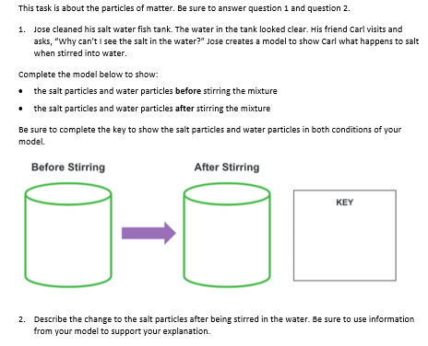
Example Classroom-based Task
Anticipatory set
Reminder to student
Task context/stimulus
Prompt/question and student directions
Provided model and key templates
Prompt/question and student directions
Notes:
These tasks may include multiple parts, questions, or prompts connected to a phenomenon or problem-solving context or event. With this in mind, consider this grade 5 exemplar task. This task is designed to align with the PE: “Develop a model which shows that matter is too small to be seen.”
Notice that this task has a particular structure beginning with the anticipatory set which is designed to remind the student of the scientific focus. It gets the students to begin thinking about what the task is about and generating their prior knowledge. There is the stimulus which provides context for the task the student is to complete. The stimulus does not need to be very lengthy. Again, remember, this is fifth grade, so we are asking something that is engaging to the student and not too outrageous or too scientific. This is something a fifth grader can grasp and understand. There is a prompt and a question for the student and, in this case, a model template has also been provided for the student. The model template is not required. This may be a place where you don’t want to provide a template because you want the student to come up with his or her own model. The intention of this model is to describe how the friend explains to the other friend why the salt seems to disappear.
Another point to keep in mind is that the language in the item is at or below grade level. You want to make sure that the language presented is not over grade level or overly complex. Sometimes you may find that domain-specific language may be above grade-level, but if it is a term commonly used in your classroom and is one with which students are familiar, you want to use this language because we want to support science learning.
When creating the elements of these tasks keep in mind that the “load” of the work should be carried by the student as they compete the task. When designing the context and anticipatory set, etc., ask yourself, what is important? What information is essential for students to know in order to get them to start thinking the way we want them to think? These questions may result in variations in the amount and type of front loading that is included in the task.

Slide 79
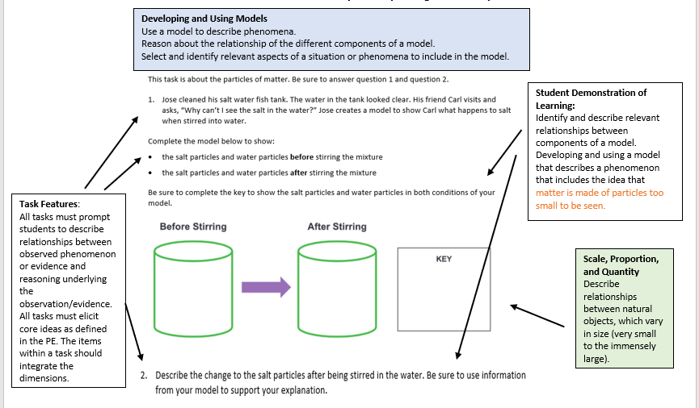
Notes:
On this slide, we annotate the characteristics of the task. In the boxes, we capture elements from the Unpacking and the Task Specifications Tools to show how the tools were used to design the task. This is a way to verify that the tools designed to be used for this task were indeed used.

Slide 80
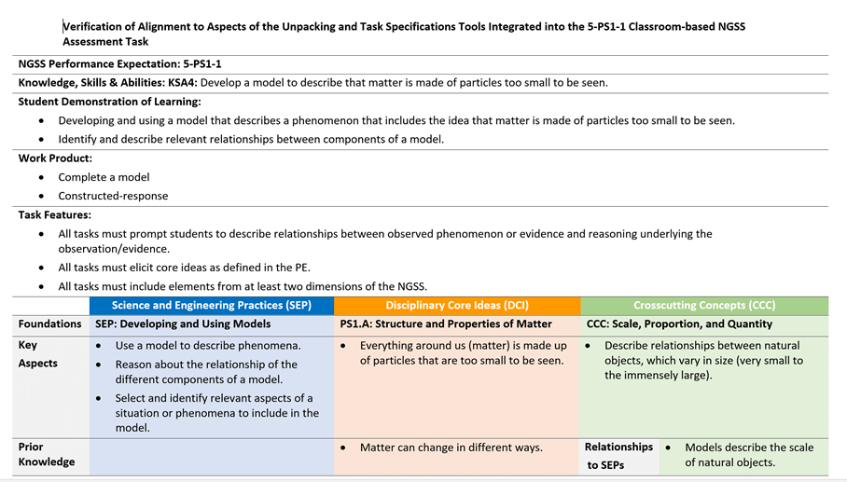
Verification of Task Alignment
Notes:
Here is another model for verifying that the tools designed to create the tasks were indeed used to create them. After you develop your task in your collaborative groups, you will use the Verification of Task Alignment Tool to demonstrate which elements from the Unpacking Tool and Task Specifications Tool are the focus of the task. For example, you will need to determine which KSA or set of KSAs your task measures. What are the expectations of learning you expect students to demonstrate when they complete this task, and what vehicles, or work products, are students asked to use to demonstrate that learning? These elements of the task will need to be carefully considered once you’ve designed your task.

Slide 81
Guiding Questions for Development of the Classroom Assessment Task
Based on the assessed KSA(s) and the required collection of student evidence, does the task include/need to include multiple parts, questions, or prompts connected to a phenomenon or problem-solving context or event?
How will students demonstrate their knowledge, skills and abilities?
What background information (anticipatory set) is necessary to remind the student of the scientific focus and gets the students to begin thinking about what the task is about and generating their prior knowledge?
What is an appropriate stimulus/context upon which the items within the task are based?
Notes:
[Review the guiding questions for development of the classroom assessment task with the participants. These guiding questions are also included in the Facilitator Guidance to Support Activities.]

Slide 82
Strategies for Development of the Classroom Assessment Task
Use the following strategies to develop your classroom assessment task:
  Integrate the information within and across the assessment development tools to design a task by considering and identifying:
  The key aspects addressed by the SEP, DCI, and CCC (Unpacking Tool);
  The elicited prior knowledge (Unpacking Tool);
  The relationship between the identified CCC and the SEPs (Unpacking Tool);
  The KSA(s) from which the task is developed (Task Specifications Tool);
  The production of responses that allow students to demonstrate learning of the PE (Task Specifications Tool);
  The attention to required task features (Task Specifications Tool);
  The student evidence to be collected (Classroom-based Assessment Task); and
  The full range of student understanding from low to high levels of competency.
Notes:
[Review the strategies for development of the classroom assessment task with the participants. These strategies are also included in the Facilitator Guidance to Support Activities.]

Slide 83
Strategies for Development of the Classroom Assessment Task, Cont.
Use the following strategies to develop your classroom assessment task:
  Confirm that the task includes a prompt and a question for the student to respond. In some cases, a model template is provided for the student, but is not required. This may be a place where educators do not want to provide a template because they want the student to come up with his or her own model.
  Ensure task language is at- or below- grade level. Sometimes domain-specific language may be above grade-level, but if it is a term commonly used in classrooms and is one with which students are familiar, using this language might be appropriate to support science learning.
  Remember that the “load” of the work should be carried by the student as they compete the task. These questions may result in variations in the amount and type of front-loading that is included in the task.
Notes:
[Review the strategies for development of the classroom assessment task with the participants. These strategies are also included in the Facilitator Guidance to Support Activities.]

Slide 84
Comments and Questions
Notes:
[Pause for comments and questions from participants.]

Slide 85
Breakout Activity and Discussion: Comparison of Grade 8 Science Tasks
[Presenter Name(s)]
10:00 a.m. – 11:00 a.m.

Slide 86
Activity/Discussion (60 minutes)
Review the SCILLSS Grade 8 Student Task and SCILLSS Grade 8 Task Administration Guide.
Review the Example Grade 8 Science Unit Quiz.
Evaluate, compare, and contrast (i.e., similarities and differences) the two science assessments based on the presented criteria for high-quality science assessments:
  intentional design
  phenomena and problem-focused
  sensemaking using the dimensions
  equitable and fair
  right stakeholders, right information.
Record your observations on the provided Task Comparison Review Worksheet
Plan to share your responses with the larger group.
Notes:
[Facilitators in each grade-level/band group walk participants through the SCILLSS Grade 8 Student Task, SCILLSS Grade 8 Task Administration Guide, and Example Grade 8 Science Unit Quiz. Following the walk-through, participants will have an opportunity to evaluate, compare/contrast, and discuss the tasks in greater detail using the Task Comparison Review Worksheet. Each small group will record their discussion notes on the provided worksheet to support sharing responses with the larger group.]

Slide 87
Review Criteria
Do the items in the task reflect an intentional design based on the assessed knowledge, skills, and abilities?
Are the items in the task driven by a high-quality scenario that focuses on phenomena or problems?
Does completing the task require students to use reasoning and integration of the three dimensions (SEP, CCC, DCI)?
Are the items fair and equitable?
Do the items provide evidence/artifacts that can be used by educators to make inferences about student learning that in turn can inform adjustments to planning and instruction and provide feedback to students?
Notes:
[Explain the review criteria to participants.]

Slide 88
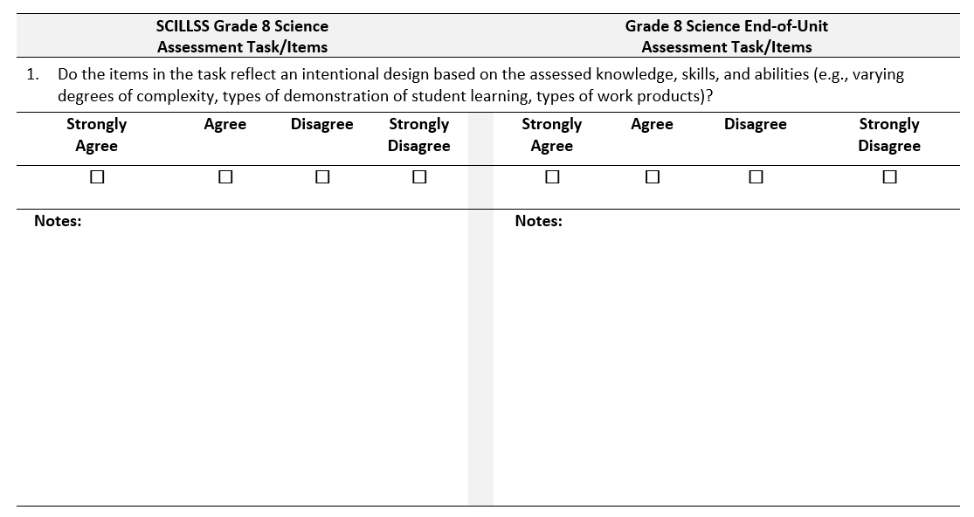
Task Comparison Review Worksheet
Notes:
[Introduce and explain the Task Comparison Review Worksheet to participants.]

Slide 89

Break
Notes:
[Recommended morning break.]

Slide 90
Collaborative Teams: Review Example Task Ideas
[Presenter Name(s)]
11:00 a.m. – 11:30 a.m.
Notes:
[Facilitators will guide grade level/band teams through the example task ideas for the targeted PE using the completed unpacking and Task Specifications Tools and facilitate discussions about the quality of the task ideas. Collaborative teams might begin to brainstorm task ideas for their selected PE time permitting.]

Slide 91
Review Activity
Review the example task ideas for your grade or grade band:
  Grade 5: 5-ESS1-2
  Middle School: MS-PS3-1
  High School: HS-ESS2-5 & HS-LS4-5
Consider the suggested phenomena, scenarios and contexts provided.
  Do they require students to “sense-make” and figure out a problem?
  Are they engaging, relevant, and accessible to a wide range of students?
Notes:
[Have participants work in small collaborative teams (4-5 participants) to review and discuss the sample task ideas for the targeted PEs. Facilitators sit with each collaborative team to provide guidance and to support the discussion. Collaborative teams might begin to brainstorm task ideas for their group’s selected PE, time permitting.]

Slide 92

Discussion
Are there any questions before we develop tasks?
Notes:
[Pause to ask participants if they have any questions before working in their collaborative groups to develop their tasks.]

Slide 93

Working Lunch
11:30 a.m. – 12:30 p.m.
Notes:
[Facilitators will guide grade level/band teams to develop the task for their selected PE using the completed Unpacking and Task Specifications Tools. Collaborative teams will populate the Task Development Tool (slide 96) as they develop their task. Facilitators will guide teams to consider revisions to the Unpacking and Task Specifications Tools as they work on their task. Participants begin drafting the task in their grade-level teams.]

Slide 94
Collaborative Teams: Draft Task and Revisit Tools
[Presenter Name(s)]
12:30 p.m. – 2:00 p.m.
Notes:
[Facilitators will guide grade level/band teams to develop the task for their selected PE using the completed Unpacking and Task Specifications Tools. Collaborative teams will populate the Task Development Tool (slide 96) as they develop their task. Facilitators will guide teams to consider revisions to the Unpacking and Task Specifications Tools as they work on their task. Participants begin drafting the task in their grade-level teams.]

Slide 95
Draft and Review of Task Activity
Utilize the Task Development Tool to draft the task.
Draft the task for your grade or grade band while reviewing your completed design tools.
Verify the task questions/items to elicit student evidence for the selected KSA(s) are aligned to the content of the Unpacking Tool and the Task Specifications Tool.
Notes:
[Have participants work in small collaborative teams (4-5 participants) to draft a task utilizing their completed Unpacking Tool and Task Specifications Tool. Emphasize that strong alignment to these tools is necessary to ensure the development of a task that will produce the necessary evidence to evaluate students’ knowledge, skills, and abilities of the selected KSA(s). Facilitators sit with each collaborative team to provide guidance and to support the production of the task. Facilitators can also serve as recorders and can offer to document the group decisions in the Task Development Tool.

Slide 96
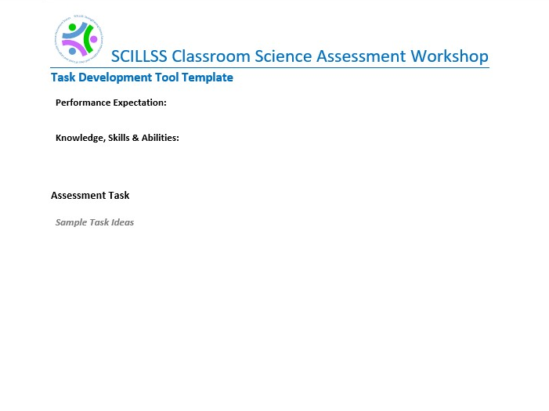

Slide 97
Overview of Rubric and Exemplar Response Development
[Presenter Name(s)]
2:00 p.m. – 2:30 p.m.

Slide 98
Rubrics
Define the criteria that educators use to interpret and evaluate student evidence of learning
Include descriptors for each question or prompt in the assessment task that describe the full range of student understanding from low to high levels of competency
The type of evidence gathered may vary from situation to situation
Notes:
The next thing we will begin conceptualizing as we began to develop this task is the scoring rubric.
Will the task elicit a potential range of student responses that you can utilize to get good information? Sometimes evaluating the response to one multiple choice item with options A, B, C, D does not really tell you much as an educator about what students actually understand.
The goal of doing these classroom-based assessments along your instructional sequence is to get your finger on the pulse of what kids know and can do. Therefore, when designing these assessments it is important that there are enough criteria in the rubric to properly evaluate what students understand and where they still need support. The rubric makes this beneficial because educators have the ability to look across the rubric and see specific areas where students might be performing well or might be struggling. The rubric needs to allow an educator to be able to question and determine how to shape instructional decisions from the students’ performance.
Though the task of designing a rubric can seem daunting, remember that you have your tools. Look back at your Unpacking Tool and Task Specifications Tool. These are going to be key supports to inform your design of the rubric in such a way that it garners for you (and the students) the right information about that they know and can do.
The primary intention for these rubrics is not necessarily to grade or to provide an evaluation, but rather to assess where students are in their learning and understanding and decide what, how, and with whom differentiation is needed in instruction. This is not to say that this cannot be graded, but the intent is to encourage formative thinking.

Slide 99
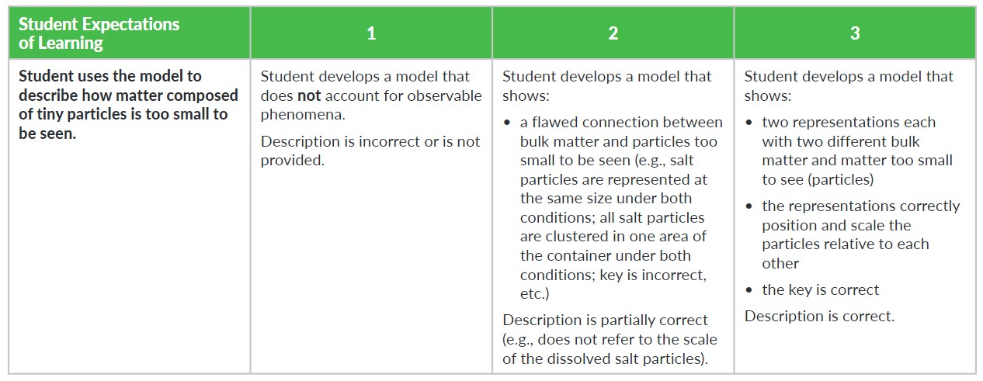
Example Classroom-based Task Rubric
Student demonstration of knowledge, skill, and/or ability
Rating scale
Statement of Student Expectation of Learning
Evaluative criteria of student’s model
Evaluative criteria of student’s explanation of the model
Notes:
There are several different ways to craft or develop a rubric. Maybe a task has several items or questions. You could make a rubric that is used to score each question within a task. You could create a rubric that describes the full range of items and considers responses to the task as a whole. There are different types of rubrics that you could develop with different degrees of content and it has to do too with the intended purpose and use of your task. What is it that you want to understand about your students?
There are different types and degrees of evidence that you’ll need to think about as you are designing a rubric for your task. It is not intended that these rubrics are developed to provide a grade for students. They are designed to be tools for you as educators to determine how you might adapt or improve instruction. The numbers across the top of the rubric are really just intended to create different categories so you know which students completed the task according to the provided criteria. The intent of the categories are to help you categorize students to understand generally how your class is performing across those levels. This will allow you to differentiate your instruction based on how many students fall into each category indicated on the rubric. Where do I need to adjust my instruction in response to student performance of the criteria in the rubric?

Slide 100
Guiding Questions for Development of the Task Rubric
What is it that you want to understand about your students? What evidence do you need for students to demonstrate what they know and can do?
Where would you need to adjust your instruction in response to student performance of the criteria in the rubric?
How might you differentiate your instruction based on how many students fall into each category indicated on the rubric?
Notes:
[Review the guiding questions for development of the task rubric with the participants. These guiding questions are also included in the Facilitator Guidance to Support Activities.]

Slide 101
Strategies for Development of the Task Rubric
Use the following strategies to develop your task rubric:
  Remember the rubric is designed to be a tool for educators to determine how they might adapt or improve instruction.
  Consider what evidence educators would need to categorize students to know which students completed the task according to the provided criteria. This will help provide insight into generally how their classes are performing.
Notes:
[Review the strategies for development of the task rubric with the participants. These strategies are also included in the Facilitator Guidance to Support Activities.]

Slide 102
Student Exemplars
A high-level response is scientifically accurate, complete and coherent, and consistent with the type of student evidence expected.
A low-level response may include misconceptions, is incomplete, and is not consistent with the type of evidence expected.
Student responses should yield accurate inferences about students’ KSAs that inform educator actions either to:
  Continue with the instructional sequence as planned; or
  Adjust the design, delivery, and sequence of instruction.
Notes:
Creating student exemplars is an exercise to assess the grade-appropriateness of the task and to consider how a student at the targeted grade or age might respond. Student exemplars demonstrate examples of high-quality student performance. Exemplar responses should be considered age- and grade-appropriate. We want to make sure that a high-level response is scientifically accurate, complete and coherent, and consistent with the type of student evidence expected. A low-level response may include misconceptions, be incomplete, or not consistent with the type of evidence expected.

Slide 103
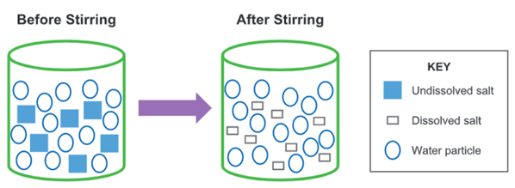
Student Exemplar: Model and Key
Selects and identifies relevant aspects of the context in the model
Shows relationships between water and dissolved salt particles, which vary in size
Includes relevant components and labels to represent understanding of the system
Notes:
This slide shows the annotated elements of an exemplar response. Students do not necessarily have to verbalize their findings. Completing a model can be just as informative, if not differently informative to students constructing written responses.
Again, walking you through the anatomy of the exemplar task, here you have, “the student selects and identifies relevant aspects of the context in the model.” The exemplar response should reflect what it is you want to see in the response. You can also see from this exemplar that it shows the scale between water and dissolved salt particles since they vary in size. Also, looking at the key, you can see that it includes relevant components and labels to represent understanding of the system.

Slide 104
Student Exemplar: Explanation
“The model shows that the salt particles dissolve. They break into smaller pieces after they are stirred into water. The salt particles are still in the water, but you can’t see them. That’s because they got so small.”
Uses the model to describe how matter composed of tiny particles too small to be seen can
account for observable phenomena (e.g., salt dissolving into water).
Notes:
Here is an example of a constructed response, or a brief explanation, which shows another type of exemplar response. In this response, the student would be able to describe how matter composed of tiny particles too small to be seen can account for observable phenomena. The elements of the exemplar response should reflect the evidence you are attempting to elicit from the students.

Slide 105
Guiding Questions for Development of the Student Exemplar
How would you expect a student at the targeted grade level or age might respond?
What evidence is required in the response for a student to demonstrate his or her science learning?
Notes:
[Review the guiding questions for development of the student exemplar with the participants. These guiding questions are also included in the Facilitator Guidance to Support Activities.]

Slide 106
Strategies for Development of the
Student Exemplar
Use the following strategies to develop your student exemplar:
  Consider what a typical, correct response would be from a student at the targeted grade or age.
  Remember that the language should be age- and grade-appropriate.
  Remember that a high-level response is scientifically accurate, complete and coherent, and consistent with the type of student evidence expected.
Notes:
[Review the strategies for development of the task rubric with the participants. These strategies are also included in the Facilitator Guidance to Support Activities.]

Slide 107
Comments and Questions
Notes:
[Pause for comments and questions from participants.]

Slide 108
Collaborative Teams: Draft Rubric and Exemplar Response
[Presenter Name(s)]
2:30 p.m. – 4:15 p.m.
Notes:
[Facilitators guide their group in the development of the task rubric and exemplar responses. Facilitators begin printing each group’s draft Unpacking Tool, Task Specifications Tool, Task Development Tool, and Rubric Development Tool in preparation for the cross-group review. Teams make any necessary adjustments to their completed Unpacking Tool and Task Specifications Tool as they develop their task rubric and exemplar responses.]

Slide 109
Rubric Development
Consider all ways in which student evidence of learning is collected in the task and ensure that each is represented in the rubric
Ensure that the full range of student understanding is represented based on the type of expected evidence from low to high levels of competency:
  A high-level response is scientifically accurate, complete and coherent, and consistent with the type.
  A low-level response may include misconceptions, is incomplete, and is not accurate.
Notes:
[Facilitators continue to guide grade level/band teams to develop the rubrics for their targeted PE using the guidance and example rubric in the presentation (slides 98-101). Collaborative teams will populate the Rubric Development Tool Template. Facilitators will guide teams to consider revisions to the rubric as they work on its development. Participants begin drafting the rubric in their grade-level teams.]

Slide 110
Rubric Development
Determine if the evaluation of the task as represented in the rubric will be organized by:
  The assessed dimension (SEP, DCI, CCC)
  Each of the questions/items
  Holistic statements that address all of the assessed dimensions, questions, and items (NOTE: This approach might present challenges with respect to identifying student strengths, weaknesses or misconceptions to inform instructional decision making)
Determine the rating scale required to evaluate the full range of student performance (e.g., 0-3)
Ensure the evaluation of student evidence against the criteria stated in the rubric yields accurate inferences about student understanding and competency with respect to the assessed KSAs
Notes:
[Facilitators continue to guide grade level/band teams to develop the rubrics for their targeted PE using the guidance and example rubric in the presentation (slides 98-101). Collaborative teams will populate the Rubric Development Tool Template. Facilitators will guide teams to consider revisions to the rubric as they work on its development. Participants begin drafting the rubric in their grade-level teams.]

Slide 111
Exemplar Development
Consider what a high-quality and a low-quality response would include based on the question(s) and the expected evidence
Consider for a given grade level or grade span the expected level of language use, from vocabulary and syntax to the development and organization of ideas
Ensure that the exemplars would yield accurate inferences about students’ KSAs that inform educator actions either to:
  Continue with the instructional sequence as planned; or
  Adjust the design, delivery, and sequence of instruction.
Notes:
[Facilitators will guide grade level/band teams to develop the a high- and a low-level exemplar for their targeted PE using the guidance and example exemplar in the presentation (slides 102-106). Collaborative teams will populate the Rubric Development Tool. Facilitators will guide teams to consider revisions to exemplars as they work on its development. Participants begin drafting the exemplars in their grade-level teams.]

Slide 112
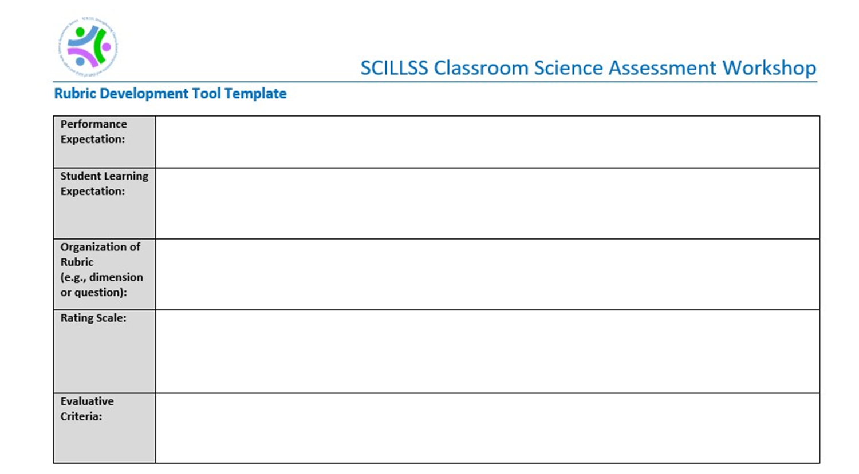
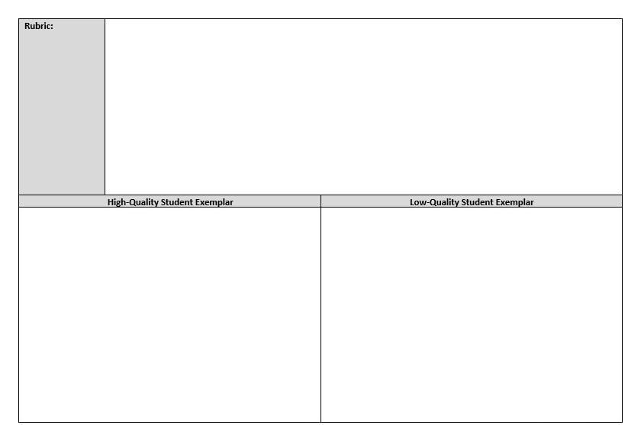
Notes:
[Participants will use the Rubric Development Tool Template to draft exemplars in their grade-level teams.]

Slide 113
Group Share and Adjourn
4:15 p.m. – 4:30 p.m.
Notes:
[Facilitators and participants will reflect on the Day 2 progress and adjourn.]

Slide 114
Strengthening Claims-based Interpretations and Uses of Local and Large-scale Science Assessment Scores
(SCILLSS)
SCILLSS Classroom Science Assessment Workshop
DAY 3

Slide 115
Welcome, Agenda Overview, and Questions
[Presenter Name(s)]
9:00 a.m. – 9:30 a.m.
Notes:
[Address questions from participants and review the agenda for Day 3]

Slide 116
Agenda
Day 3 Morning
8:00 am – 9:00 am | Breakfast (if applicable)
9:00 am – 9:30 am | Welcome / Agenda Overview / Questions | Presenter(s)
9:30 am – 10:30 am | Collaborative Teams: Finalize Tools, Task, Rubric, and Exemplar Response for Cross-Group Review | Presenter(s)
10:30 am – 12:00 pm | Cross-Group Review and Revision of Tools, Tasks, and Rubrics | Team Facilitators
Notes:
[Read and explain the Day 3 Morning Agenda using the facilitator’s process agenda as guidance.]

Slide 117
Agenda
Day 3 Afternoon
12:00 pm – 1:00 pm | Working Lunch / Collaborative Teams: Revision of Tools, Tasks, and Rubrics
1:00 pm – 2:30 pm | Collaborative Teams: Revision of Tools, Tasks, and Rubrics | Team Facilitators
2:30 pm – 3:45 pm | Verification of Task Alignment Activity | Team Facilitators
3:45 pm – 4:15 pm | Group Share: Lessons Learned and Key Takeaways | Team Facilitators
4:15 pm – 4:30 pm | Complete Meeting Evaluations | Presenter(s)
4:30 pm | Adjourn
Notes:
[Read and explain the Day 3 Afternoon Agenda using the facilitator’s process agenda as guidance.]

Slide 118
Collaborative Teams: Finalize Tools, Task, Rubric, and Exemplar Responses for Cross-Group Review
[Presenter Name(s)]
9:30 a.m. – 10:30 a.m.

Slide 119

Review and finalize your collaborative team’s tools, task, rubric, and exemplar responses for cross-group review

Slide 120
Cross-Group Review of Tools, Tasks, and Rubrics
[Presenter Name(s)]
10:30 a.m. – 12:00 p.m.

Slide 121
Review Steps
Review the Unpacking Tool, Task Specifications Tool, task, rubric and exemplar responses at the other grade level (i.e., grade 5 reviews task for MS).
Using the task review worksheet, respond whether you strongly agree, agree, disagree, or strongly disagree with each statement as it pertains to each task.
Provide any additional feedback, notes, or guidance on the worksheets for each criterion.
Submit the worksheet to your group facilitator.
Facilitators will provide the completed worksheets to each group to use to revise its task.
Notes:
[Each collaborative grade level/band team reviews another group’s task. Teams spend an hour and 30 minutes evaluating the task using the Science Classroom Assessment Task Development and Review Worksheet. Once the teams have completed their reviews, one person from each team travels to the group that is reviewing and evaluating their task. As the traveling educator, s/he listens to and records the feedback for his or her group’s task and also fields questions from the reviewers regarding the thinking and rationales behind the design of the task. Once feedback is shared and recorded, the traveling educator returns to his or her group and shares the results of the other group’s review. The group then applies revisions to the task based on the reviewers’ feedback.
Suggestion: The elementary group(s) can review the middle school groups’ tasks; the middle school group(s) can review the high school groups’ tasks; and the high school group(s) can review the elementary groups’ tasks. You can also opt to have groups from the same grade band review each other’s tasks (e.g., a middle school group trades tasks with another middle school group).]

Slide 122
Review Criteria
Check each item to determine alignment to KSAs and task specifications
Check that the items require students to demonstrate understanding of the grade-appropriate elements of the SEPs, CCCs, and DCIs
Check that the items require students to use SEPs, CCC, and/or DCIs to interpret evidence and/or models to make, evaluate, support, and/or refute claims about a phenomenon or problem
Check prompts and scenarios in relation to equity and language issues
Check rubrics to ensure alignment to KSAs and task specifications
Notes:
[Explain the review criteria to participants.]

Slide 123
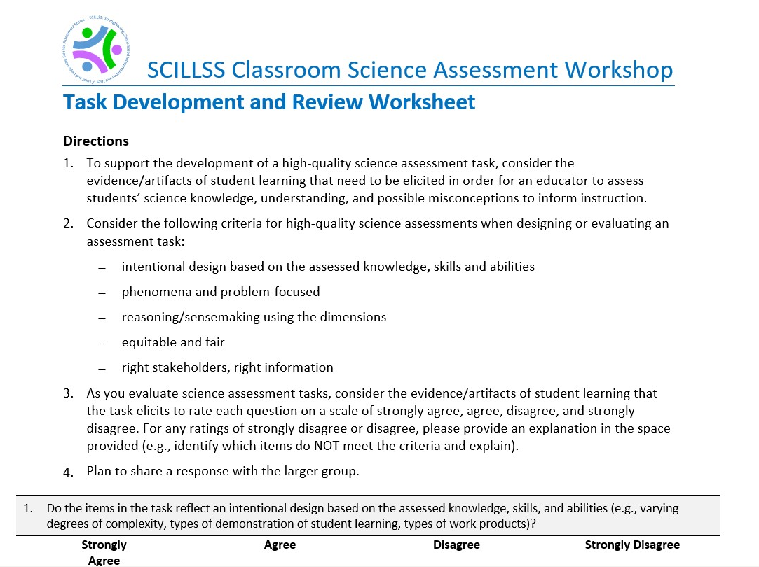
Review Worksheet
Notes:
[Introduce the Science Classroom Assessment Task Development and Review Worksheet. Each collaborative group will capture their collective feedback for the other group’s task.]

Slide 124
Working Lunch
12:00 p.m. – 1:00 p.m.
Notes:
[Working lunch. Facilitators will guide teams to consider revisions to the Unpacking and Task Specifications Tools, tasks, rubrics and student exemplars based on feedback from the cross-group reviews. Facilitators will ensure that final drafts of the materials are completed and posted to the file sharing platform.]

Slide 125
Collaborative Teams: Revision of Tools, Tasks, and Rubrics
[Presenter Name(s)]
1:00 p.m. – 2:30 p.m.

Slide 126

Review the peer feedback and revise your collaborative team’s tools, task, rubric, and exemplar responses
This Photo by Unknown Author is licensed under CC BY-SA

Slide 127
Verification of Task Alignment Activity
[Presenter Name(s)]
2:30 p.m. – 3:45 p.m.

Slide 128
Verification of Alignment
Verify the alignment of the task to elements of the Unpacking Tool and Task Specifications Tool
Examine and trace all of the features, components, and characteristics of the task to elicit student evidence back to the Unpacking and Task Specifications Tools for the selected KSA(s)
Revise the task or possibly revise the design tools as appropriate
  Remember, the work of developing the tools and task is intended to be an iterative process in which alignment is critical; this may require revision or modification to the tools or the task
Notes:
[Facilitators will guide grade level/band teams to complete the Verification of Task Alignment Tool for their targeted PE. Collaborative teams will populate the verification tool. Facilitators will guide teams to consider revisions to their tools, tasks, rubrics and exemplar responses, as necessary.]

Slide 129
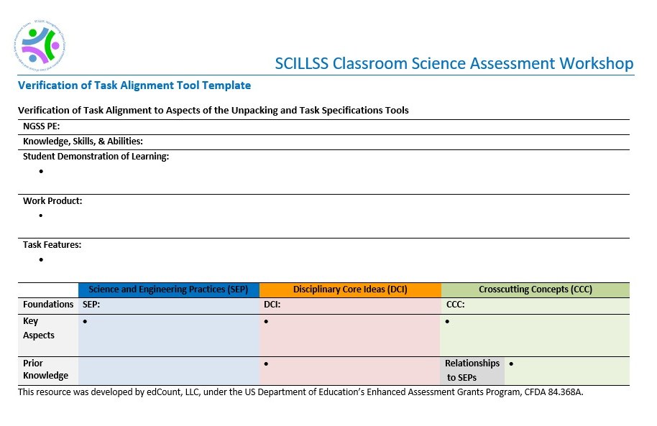
Notes:
[Participants will use the Verification of Alignment Tool to show the alignment of the task to elements of the Unpacking Tool and Task Specifications Tool.]

Slide 130
Group Share: Lessons Learned and Key Takeaways
[Presenter Name(s)]
3:45 p.m. – 4:15 p.m.

Slide 131
Discussion
What questions do you have about the tools and the task development process?
What were particular challenges that you faced?
What benefits do you see from the process?
Notes:
[Facilitators lead a large-group discussion to share commendations, challenges, questions, and recommendations regarding the principled-design process and accompanying tools.]

Slide 132
Complete Meeting Evaluations
[Presenter Name(s)]
4:15 p.m. – 4:30 p.m.
Notes:
[Participants complete meeting evaluations.]

Slide 133
This presentation was developed with funding from the U.S. Department of Education under Enhanced Assessment Grants Program CFDA 84.368A. The contents do not necessarily represent the policy of the U.S. Department of Education, and no assumption of endorsement by the Federal government should be made.
All rights reserved. Any or all portions of this document may be reproduced and distributed without prior permission, provided the source is cited as: Strengthening Claims-based Interpretations and Uses of Local and Large-scale Science Assessment Scores Project (SCILLSS). (2020). SCILLSS Classroom Science Assessment Workshop Presentation. Lincoln, NE: Nebraska Department of Education.

