Slide 1
Strengthening Claims-based Interpretations and Uses of Local and Large-scale Science Assessment Scores
(SCILLSS)
Advancing Multidimensional Science Assessment Design for Large-scale and Classroom Use
2020 NCME Annual Conference
August 21, 2020

Slide 2
SCILLSS Project Overview
Liz Summers, Ph.D.
Executive Vice President, edCount, LLC
Notes:
Liz

Slide 3
About SCILLSS
Strengthening Claims-based Interpretations and Uses of Local and Large-scale Science Assessment Scores
One of two projects funded by the US Department of Education’s Enhanced Assessment Instruments Grant Program (EAG), announced in December 2016
Four-year timeline (April 2017 – December 2020)
Collaborative partnership including three states, four organizations, and 10 expert panel members
Nebraska is the grantee and lead state; Montana and Wyoming are partner states
Notes:
The Strengthening Claims-based Interpretations and Uses of Local and Large-scale Science Assessment Scores (SCILLSS) project is funded by the US Department of Education’s Enhanced Assessment Instruments Grant Program. As lead state and grantee, the Nebraska Department of Education is working in collaboration with two other state education agencies, Wyoming and Montana, along with four organizations, and a technical advisory panel of 10 experts that contribute an essential combination of expertise in principled-design, measurement, assessment literacy, and classroom practices to support the implementation of this project.

Slide 4
SCILLSS Project Goals
Create a science assessment design model that establishes alignment with three-dimensional science standards by eliciting common construct definitions that drive curriculum, instruction, and assessment
Strengthen a shared knowledge base among instruction and assessment stakeholders for using principled-design approaches to create and evaluate science assessments that generate meaningful and useful scores
Establish a means for state and local educators to connect statewide assessment results with local assessments and instruction in a coherent, standards-based system
Notes:
SCILLSS has 3 overarching project goals. We intend to create a science assessment design model that establishes alignment with three-dimensional standards by eliciting common construct definitions that drive curriculum, instruction, and assessment; strengthen a shared knowledge base among stakeholders for using principled-design approaches to create and evaluate quality science assessments that generate meaningful and useful scores. We further intend to establish a way for states to connect statewide assessment results with local assessments and instruction in a coherent, standards-based system.
Each of our three states has a strong commitment to local assessment. As such, we hope to capitalize on that relationship between the local and statewide summative assessment systems to improve the way in which we vision science assessment.

Slide 5
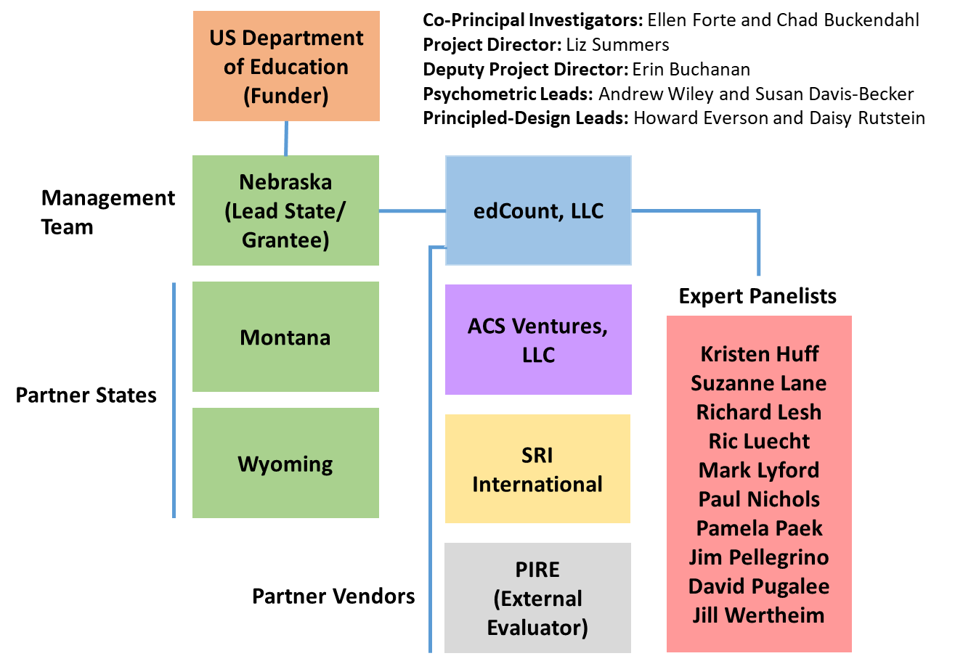
SCILLSS Partner States, Organizations, and Staff
Notes:
The SCILLSS project includes three partner states and four partner organizations. NE is the lead SCILLSS state along with MT and WY. edCount serves as the primary contractor to NE and the other organizations serve as subcontractors to edCount.

Slide 6
Assessment of Student Learning
Formative assessment, embedded within instructional flow
Student learning in relation to goals and expectations
Interim and benchmarks assessments
Annual assessments
Notes:
This graphic conceptually helps people to understand how our project outcomes are connected and how they help to build toward our goal of helping states and districts use principled-design to establish coherence within their standards-based system. This graphic displays a series of concentric circles. The dark blue center circle is representative of student learning in relation to the goals and expectations. Each additional circle as shown in the lighter blues moving outward show the various types of assessments that are used within the CIA system. Most proximal to student learning is formative assessment, which is embedded in the instructional flow and which educators can use to make immediate and ongoing adjustments to their teaching to improve student learning. Next you have your interim and benchmark assessments and then your annual assessments. While these assessments may serve different purposes and uses and are in some cases more distant from when learning takes place, the idea is that all these assessments in this system are based on common construct definitions and are complementary in their measurement of what we expect students to know and be able to do in a domain.

Slide 7
SCILLSS Resources and Student Learning
SCILLSS Goal 1, Coherence: Establish a means for states to strengthen the meaning of statewide science assessment results and to connect those results with local science curriculum, instruction, and assessment
SCILLSS Goal 2, Support Implementation of Principled-Design: Strengthen the knowledge base and experience among stakeholders in using principled-design approaches to create and evaluate quality science assessments that generate meaningful and useful scores
Student learning in relation to goals and expectations
Interim and other classroom assessments
  Guide to Developing
  Three-Dimensional Science Tasks for Classroom Assessments
  Purpose: To guide implementation of principled-approaches for developing three-dimensional tasks aligned to NGSS-like standards for use within classrooms
  Audience: Local educators and administrators
  Format: Guidebook; templates; tasks; exemplars
  Professional Learning Sessions on Using a Principled Approach to Designing Classroom Assessment Tasks
  Purpose: To support local educators in applying principled-design in the development of classroom assessment tasks that link to curriculum and instruction
  Audience: Local educators and administrators
  Format: Workbook; templates; PPT slides; guiding questions
Annual assessments
SCILLSS
  Guide to Developing
  Three-Dimensional Science Tasks for
  Large-Scale Assessments
  Purpose: To guide implementation of principled-approaches for developing three-dimensional tasks aligned to NGSS-like standards for large-scale science assessments
  Audience: State administrators; vendors
  Format: Guidebook; templates; tasks; exemplars
resources
  A Principled-Design Approach to Creating PLDs and Building
  Score Scales
  Purpose: To explain how and why to develop PLDs and score scales using a principled-design approach
  Audience: State and local educators; vendors
  Format: White paper
Assessment Fundamentals
  Self-Evaluation Protocols
  Purpose: To support educators in evaluating the quality of the assessments in their assessment systems
  Audience: State and local educators; vendors
  Format: Protocol
  Assessment Literacy Workbook
  Purpose: To strengthen educators’ understanding of and ability to make good decisions about assessments
  Audience: State and local educators; vendors
  Format: Digital workbook
Theory of Action Principles
Assessment systems are developed such that they can inform improvements to curriculum and instruction
Assessments are equitable, accessible, and culturally relevant for widest range of students
Educators use student performance data appropriately to monitor progress toward CCR and to inform teaching
State assessments connect coherently to local C-I-A in a way that provides comprehensive coverage of the standards
Stakeholders collaborate to effectively coordinate alignment of
C-I-A systems
Notes:
Expanding on this graphic a bit more, you can see our SCILLSS deliverables and how they relate to the model of assessment tied to student learning. Each color-coded section is representative of a different area or focus of our work. These resources very clearly align to and support our project goals articulated at the top of the graphic. We’ve completed or are currently working on all of these deliverables, and current drafts are posted to the project website.

Slide 8
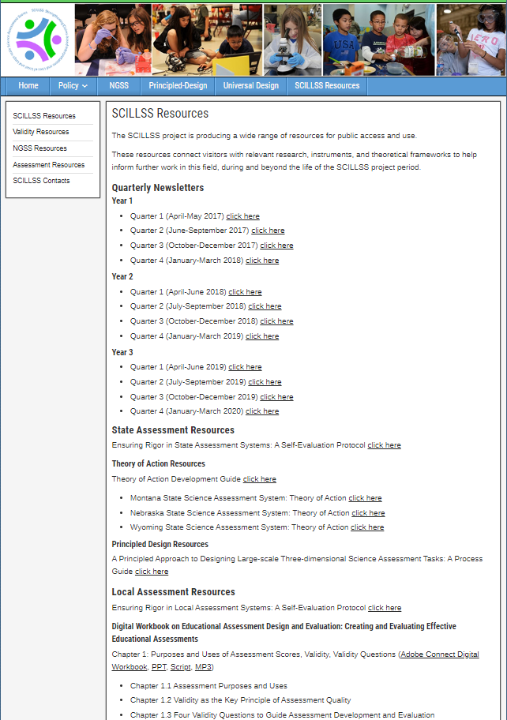
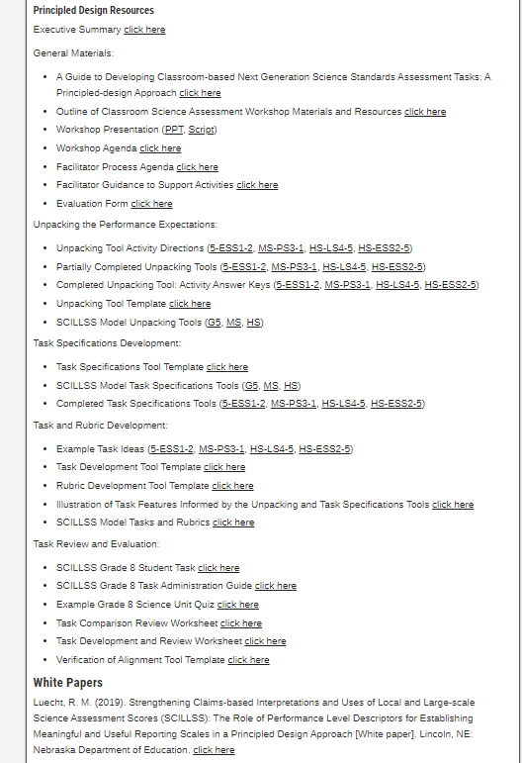
SCILLSS Resources
https://www.scillsspartners.org/scillss-resources/

Slide 9
Local and State Self-Evaluation Protocols, and Digital Workbook on Educational Assessment Design and Evaluation
Erin Buchanan, M.A.
Senior Associate, edCount, LLC
Notes:
Ellen

Slide 10
Overview of the Local and State Self-Evaluation Protocols
Notes:
Bill and Char

Slide 11
Self-Evaluation Protocols Purpose
The local and state self-evaluation protocols are frameworks to support state and local educators in reflecting upon and evaluating the assessments they use.
Local or District | State
Designed to focus on assessments that districts or schools require Usually used for lower-stakes decisions Curriculum reviews Malleable instructional decisions Monitoring student progress proximally | Focused on large-scale assessments required statewide Some assessments have high stakes Accountability for students Accountability for educators Accountability for schools, districts, programs
Notes:
Ellen

Slide 12
Self-Evaluation Protocols Audience
The self-evaluation protocols are intended for a specific audience:
State and district administrators who may be— Instructional leaders Content specialists Assessment specialists Decision-makers regarding state or local assessments These educational leaders will strengthen their assessment literacy by building their knowledge base, understanding the nuances of validity and reliability, and applying their knowledge in the evaluation of their own systems.
Notes:
Ellen

Slide 13
Self-Evaluation Protocols
Goals and objectives
  Identify intended use(s) of test scores
  Foster an internal dialogue to clarify the goals and intended uses of an assessment program
  Evaluate whether given test interpretations are appropriate
  Identify gaps in assessment programs
  Identify overlap across multiple assessment programs
Notes:
Ellen

Slide 14
Self-Evaluation Protocols Structure
4 Steps
Articulate
Articulate your current and planned needs for assessment scores and data
Identify
Identify all current and planned assessments
Gather
Gather and evaluate the evidence for each assessment
Review
Review the evidence across assessments
Notes:
Ellen

Slide 15
Articulate Current Needs
What is the purpose of the given assessment and how will it be used?
What are the stakes associated with your assessment?
  Low stakes – Instructional guidance
  High stakes – Evaluate programs or services
What questions are you trying to answer about student achievement?
What information is provided from your assessment and how does it address your questions about student achievement?
  Is there additional information that the assessment could provide to help address these questions?
Notes:
Ellen

Slide 16
Identify Current Assessments
Gather all current and planned assessments
Assessments can be organized multiple ways
  All assessments within a grade level
  All assessments within a given content area
Identify areas where overlap in information has occurred
Identify areas where a gap appears to exist
Notes:
Ellen

Slide 17
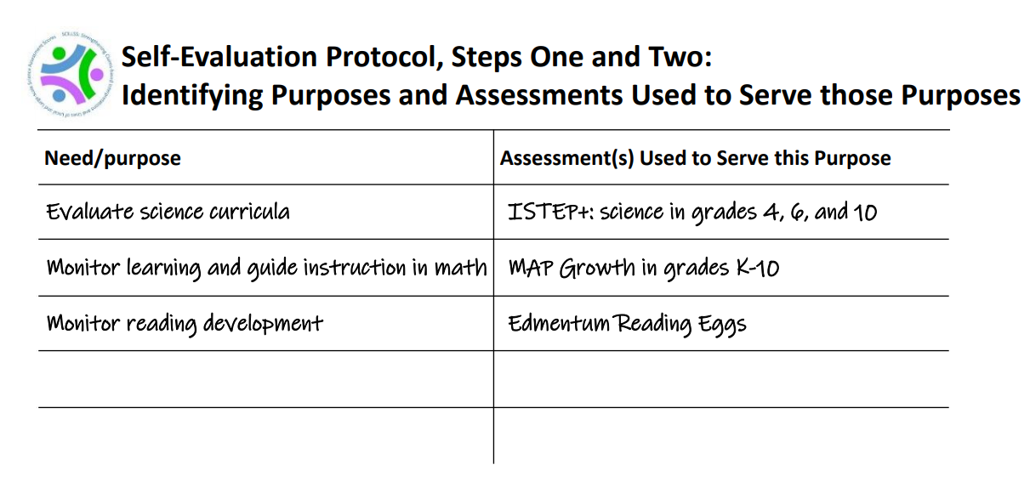

Slide 18
Gather and Evaluate Validity Evidence
FOUR FUNDAMENTAL VALIDITY QUESTIONS
To what extent does the assessment as designed capture the knowledge and skills defined in the target domain?
To what extent does the assessment as implemented yield scores that are comparable across students, sites, time, forms?
To what extent are students able to demonstrate what they know and can do in relation to the target knowledge and skills on the test in a manner that can be recognized and accurately scored?
To what extent does the test yield information that can be and is used appropriately within a system to achieve specific goals?
Construct Coherence
Comparability
Fairness and Accessibility
Consequences
Notes:
Ellen
Across the entire project, we will aim to keep these 4 fundamental validity questions in mind, using these to guide our process and deliverable development. We feel if we work to keep content coherence, comparability, accessibility and fairness, as well as consequences in mind throughout this project, then our products will be generalizable an usable to a wide variety of states and systems across the Nation. We are excited to work on this project with all of our partners and make available our lessons learned in re-envisioning science assessment.

Slide 19
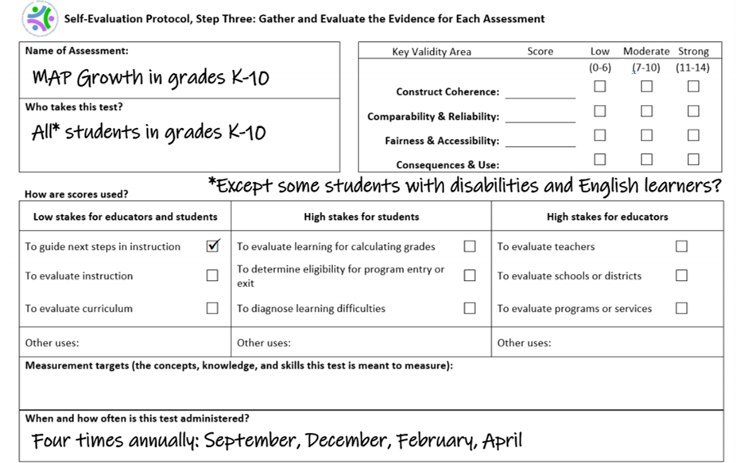

Slide 20
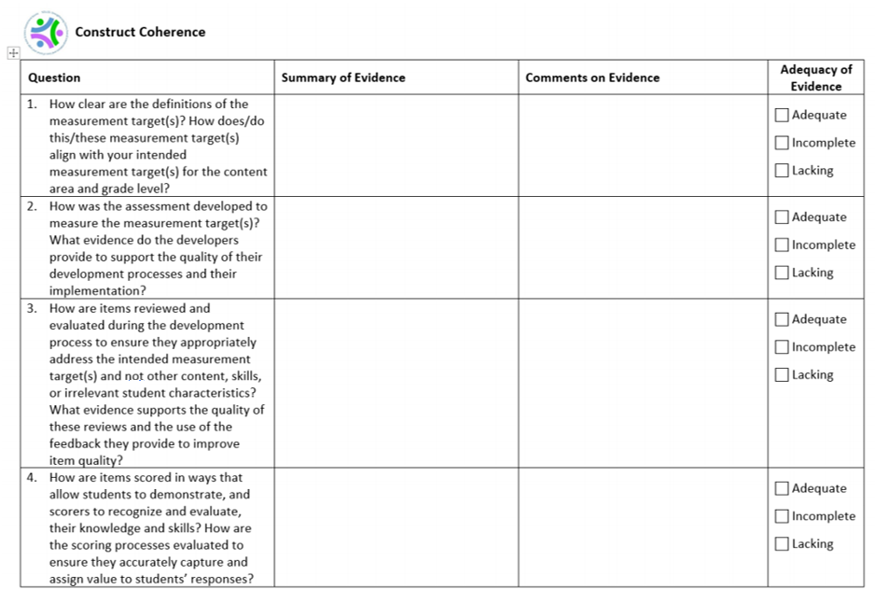

Slide 21
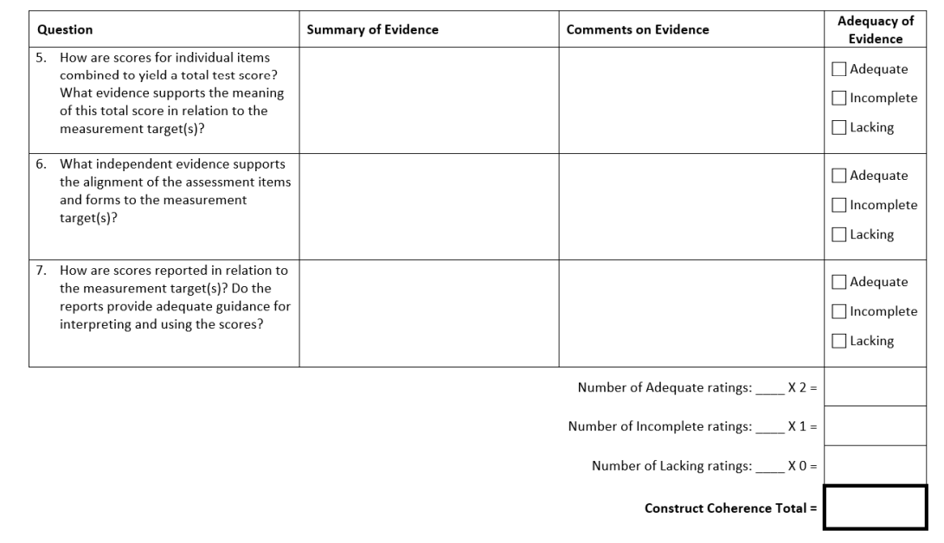

Slide 22
Review and Evaluate your Current Assessment Program
Review each assessment’s purpose and use
Identify areas with adequate evidence for test scores
Identify areas where the degree of data available is either incomplete or lacking
Notes:
Ellen

Slide 23
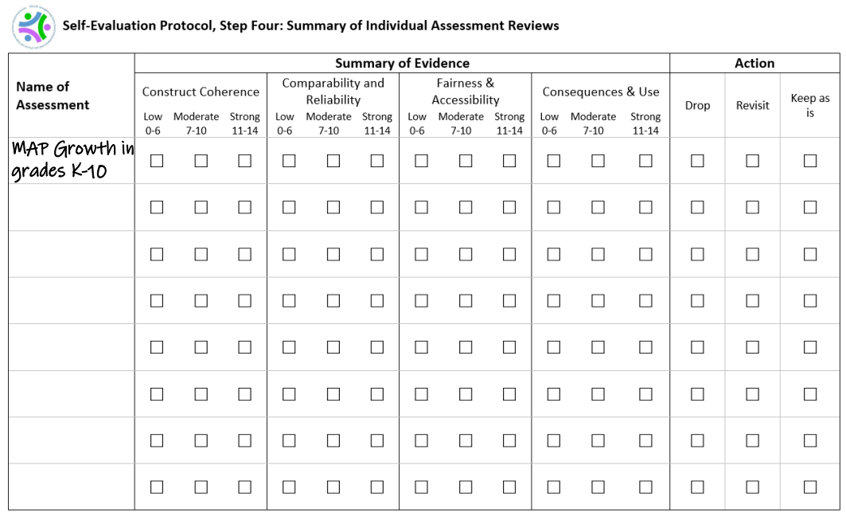

Slide 24
Overview of the Digital Workbook on Educational Assessment Design and Evaluation
Notes:
Bill and Char

Slide 25
Digital Workbook Purpose
Inform state and local educators and other stakeholders on the purposes of assessments;
Ensure a common understanding of the purposes and uses of assessment scores, and how those purposes and uses guide decisions about test design and evaluation;
Complement the needs assessment by providing background information and resources for educators to grow their knowledge about foundational assessment topics; and
Address construct coherence, comparability, fairness and accessibility, and consequences.

Slide 26
Digital Workbook Audience
State and district administrators who may be—
  Instructional leaders
  Content specialists
  Assessment specialists
  Decision-makers regarding state or local assessments
  Responsible for implementing state and local self-evaluation protocols
These educational leaders will strengthen their assessment literacy by building their knowledge base, understanding the nuances of validity and reliability, and applying their knowledge in the evaluation of their own systems.

Slide 27
Digital Workbook Series Organizing
Principles
Validity Questions
Phases of the Test Life Cycle
Construct Coherence
Design and Development
Administration
Scoring
Analysis
Reporting
Use of Scores
Comparability
Validity
Fairness & Accessibility
Consequences
Notes:
Construct Coherence: To what extent do the test scores reflect the knowledge and skills we’re intending to measure, for example, those defined in the academic content standards?
Comparability: To what extent are the test scores reliable and consistent in meaning across all forms, students, test sites, and time?
Fairness and Accessibility: To what extent does the test allow all students to demonstrate what they know and can do?
Consequences: To what extent are the test scores used appropriately to achieve specific goals?

Slide 28
Digital Workbook Series Chapters
Chapter 1 | Overview: Definition of validity, validity evidence, and the assessment life cycle (design and development, administration, scoring, analysis, reporting, use of scores)
Chapter 2 | Construct Coherence: To what extent do the test scores reflect the knowledge and skills we’re intending to measure, for example, those defined in the academic content standards?
Chapter 3 | Comparability: To what extent are the test scores reliable and consistent in meaning across all students, classes, and schools?
Chapter 4 | Fairness and Accessibility: To what extent does the test allow all students to demonstrate what they know and can do?
Chapter 5 | Consequences: To what extent are the test scores used appropriately to achieve specific goals?

Slide 29
Topics Covered in Chapters One and Two
Purposes and Uses of Assessment Scores, Validity, Validity Questions
Chapter 1.1: Assessment Purposes and Uses
Chapter 1.2: Validity as the Key Principle of Assessment Quality
Chapter 1.3: Four Validity Questions to Guide Assessment Development and Evaluation
  Construct Coherence
  Comparability
  Fairness and Accessibility
  Consequences
Chapter 1.4: Summary and Next Steps
Construct Coherence
Chapter 2.1: Review of Key Concepts from Chapter 1
Chapter 2.2: The Concept of Construct Coherence
Chapter 2.3: Validity Questions Related to Construct Coherence
Notes:
Ellen
Examples of Construct Coherence Questions:
What are you intending to measure with this test? (What are the measurement targets?)
How was the assessment developed to measure these measurement targets?
How were items reviewed and evaluated during the development process to ensure they appropriately address the intended measurement targets and not other content, skills, or irrelevant student characteristics?
How are items scored in ways that allow students to demonstrate, and scorers to recognize and evaluate, their knowledge and skills? How are the scoring processes evaluated to ensure they accurately capture and assign value to students’ responses?
How are scores for individual items combined to yield a total test score? What evidence supports the meaning of this total score in relation to the measurement target(s)? How do items contribute to subscores and what evidence supports the meaning of these subscores?
What independent evidence supports the alignment of the assessment items and forms to the measurement targets?
How are scores reported in relation to the measurement targets? Do the reports provide adequate guidance for interpreting and using the scores?

Slide 30
Topics Covered in Chapters Three through Five
Comparability
Chapter 3.1: Review of Key Concepts from Chapters 1 and 2
Chapter 3.2: What is Comparability and Why is it Important?
Chapter 3.3: What is Reliability/Precision and Why is it Important?
Chapter 3.4: Validity Questions Related to Comparability and Reliability/Precision
Fairness and Accessibility
Chapter 4.1: Review of Key Concepts from Chapters 1, 2, and 3
Chapter 4.2: What is Fairness and Accessibility and Why is it Important?
Chapter 4.3: Validity Questions Related to Fairness and Accessibility
Consequences Associated with Testing
Chapter 5.1: Review of Key Concepts from Chapters 1, 2, 3, and 4
Chapter 5.2: Consequences Associated with Testing
Chapter 5.3: Validity Questions Related to Consequences
Notes:
Ellen
Examples of Comparability Questions
How is the assessment designed to support comparability of scores across forms and formats?
How is the assessment designed and administered to support comparable score interpretations across students, sites (classrooms, schools, districts, states), and time?
How are student responses scored such that scores accurately reflect students’ knowledge and skills across variations in test forms, formats, sites, scorers, and time?
How are score scales created and test forms equated to support appropriate comparisons of scores across forms, formats, and time?
To what extent are different groups of students who take a test in different sites or at different times comparable?
How are scores reported in ways that support appropriate interpretations about comparability and disrupt inappropriate comparability interpretations?
What evidence supports the appropriate use of the scores in making comparisons across students, sites, forms, formats, and time?
Examples of Fairness and Accessibility Questions
How were the needs of all students addressed during assessment development? How were the assessment questions developed to ensure that scores reflect the intended measurement targets and not student characteristics or contexts that are irrelevant to the measurement targets?
How were the needs of students with disabilities addressed during assessment development?
How were the needs of English learners addressed during assessment development?
How are students with disabilities able to demonstrate their knowledge and skills through the availability and use of any necessary accommodations? What evidence supports the selection of accommodations as well as their use of these accommodations at the time of testing?
How are English learners able to demonstrate their knowledge and skills through the availability and use of any necessary accommodations? What evidence supports the selection of accommodations as well as their use of these accommodations at the time of testing?
How are students’ responses scored in ways that reflect only the construct-relevant aspects of those responses? What evidence supports the minimization of construct-irrelevant influences on students’ responses?
What evidence supports the interpretation and use of students’ scores in relation to their learning opportunities?
Examples of Consequences Questions
Are the items and content of the test consistent with the standards being measured to ensure appropriate uses?
How is the assessment developed, administered, scored, and reported in ways that deter and limit instances of inappropriate uses by students, teachers, or administrators? What evidence supports the implementation and effectiveness of these efforts?
What evidence is available to support the use of test scores across the entire score scale and all performance levels?
How are the scores from the assessment intended to be used as described by the test developers and how are they used by your state or local district? How well do these uses align? If your state or local district is using test scores for purposes other than those for which the test developers intended, what evidence supports those uses?
If assessment scores are associated with recommendations for instruction or other interventions for individual students, groups of students, or the whole-class, what evidence supports such interpretations and uses of these scores? What tools and resources are available to educators for evaluating and implementing these recommendations?
If assessment scores are associated with high stakes decisions for teachers, administrators, schools, or other entities or individuals, what evidence supports such interpretations and uses of these scores?
How are scores reported to students and parents in ways that support their understanding of the scores and any associated recommendations or decisions?

Slide 31
Overview of the SCILLSS Principled-design Approach
Daisy Rutstein, Ph.D.
Principal Researcher, Education Division, SRI International
Notes:
Dais

Slide 32
Assessment: A Process of Reasoning from Evidence
Cognition-model of how students represent knowledge
Observations-tasks or situations that allow us to observe students’ performance
Interpretation-method of making sense of the data
Inference-judging what students know and can do
Cognition
Inferences
Observations
Interpretation
Notes:
In pursuing a new form of multi-dimensional science assessment, it is important to remember that assessment is a system composed of these three interconnected elements—cognition, observation, and interpretation—and that assessments function within a larger system of curriculum, instruction, and assessment.
A model of how students represent knowledge and develop competence in the subject domain (cognition);
Tasks or situations that allow one to observe students’ performance (observation);
An interpretation method for drawing inferences from the performance evidence thus obtained (interpretation).
The Assessment Triangle rests on cognition, defined as a “theory or set of beliefs about how students represent knowledge and develop competence in a subject domain” (National Research Council, 2001, p. 44).
For the NGSS, the cognition to be assessed consists of the practices, the crosscutting concepts, and the disciplinary core ideas as they are integrated in the performance expectations.

Slide 33
If
Then scores may reflect…
And may be used…
Constructs are well-defined
what students know and can do
to build and deliver instruction aligned with academic expectations
Construct definitions are shared across the system
to monitor or track student progress
or
The system is well-designed
what students have learned this year/ in this course;
for school accountability decisions and program evaluation
The system is well-implemented

Slide 34
Standards-Based Assessment and Accountability Model
Content Standards
Curriculum and Instruction
Evaluation and Accountability
Performance Standards
Assessment
Standards define expectations for student learning
Curricula and assessments are interpretations of the standards
Evaluation and accountability rely on the meaning of scores
Without clear alignment among standards, curricula, and assessment the model falls apart

Slide 35

Coherence is Key
Notes:
Radically changing one of these elements and not the others runs the risk of producing an incoherent system. All of the elements and how they interrelate must be considered together.
Thus, designing an assessment is a process in which every decision should be considered in light of each of these three elements.
The evidence-centered design approach, developed by Mislevy and colleagues (see, e.g., Almond et al., 2002; Mislevy, 2007; Mislevy et al., 2002; Steinberg et al., 2003), is one framework for developing assessments that takes into account the logic embedded in the assessment triangle and closely follows the evidentiary reasoning logic spelled out by the NRC assessment triangle.
Recall, evidence that test content reflects the concepts that were meant to be measured is one of the critical sources of information necessary to support valid interpretations of test scores (AERA, APA, and NCME, 2014).
Alignment is about coherent connections across various aspects within and across a system (Forte, 2013a, 2013b).

Slide 36
Principled-design Development Purpose
What is a principled-design development process?
  Guide to the development of a task that focuses the developer on the purpose of the assessment and the information required in order to design tasks that meet this purpose
Why do we use a principled-design development process?
  Highlight the design decisions that need to be made in the process in order to develop tasks with valid and reliable inferences
  Articulate a replicable and scalable design process that states and other organizations can use to develop state summative and classroom-embedded three-dimensional science assessments
How have we used this process?
  Developed a sample set of exemplary resources to demonstrate the outcomes of the process for the development of state summative and classroom-embedded three-dimensional science assessments
Notes:
The process is replicable and scalable

Slide 37
Evidence-Centered Design (ECD)
Formal, multiple-layered framework for assessment development based on Messick’s (1994) guiding questions:
What complex of knowledge, skills, or other attributes should be assessed?
What behaviors or performances should reveal those constructs?
What tasks or situations should elicit those behaviors?

Slide 38
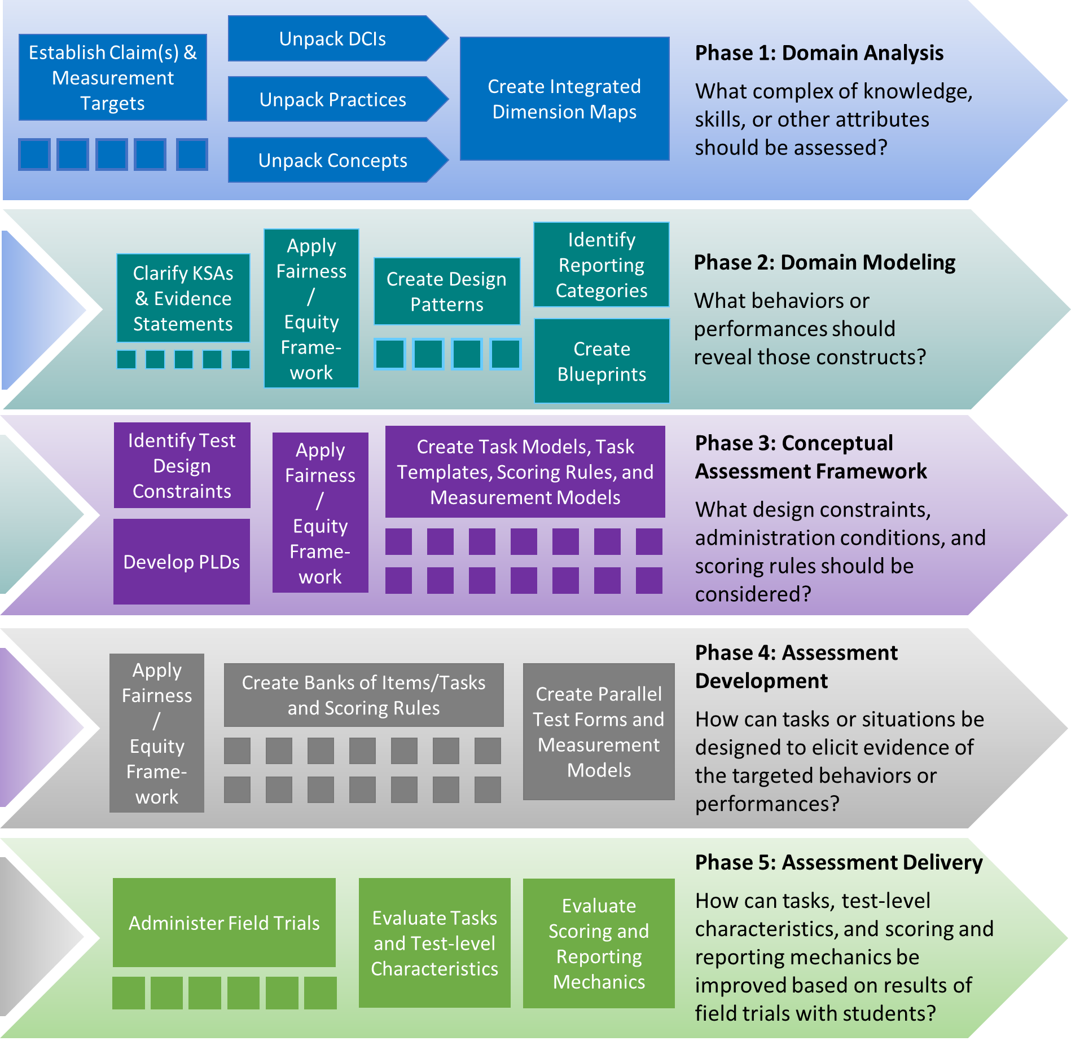
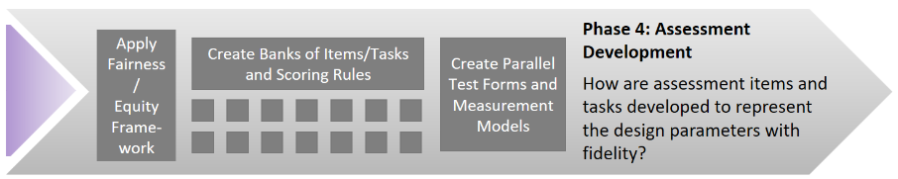
Iterative Five-phase Principled-design Process
Notes:
This slide includes animation
The application of ECD is an iterative process and is often thought of as layers.
Domain Analysis – lay out the domain of the assessment – look at research, standards, - NGSS, NAEP, NRC reports
Domain modeling – start narrowing the field down – what do you want to measure, at a high level what does measurement look like
CAF – start bringing in more specific constraints related to the assessment – format, time, how many and what type of activities or items do you want – what should they measure,
Assessment implementation – authoring tasks, finalizing rubrics, producing the test forms, or technological environment
Assessment Delivery – having students interact with the tasks.
ECD often thought of as layers
Domain Analysis – lay out the domain of the assessment – look at research, standards, - NGSS, NAEP, NRC reports
Domain modeling – start narrowing the field down – what do you want to measure, at a high level what does measurement look like
CAF – start bringing in more specific constraints related to the assessment – format, time, how many and what type of activities or items do you want – what should they measure,
Assessment implementation – authoring tasks, finalizing rubrics, producing the test forms, or technological environment
Assessment Delivery – having students interact with the tasks.
A few key notes here:
These layers are not done in isolation
Many different people contribute at all layers of the process: content experts, assessment experts, UDL experts,
Document, document, document

Slide 39
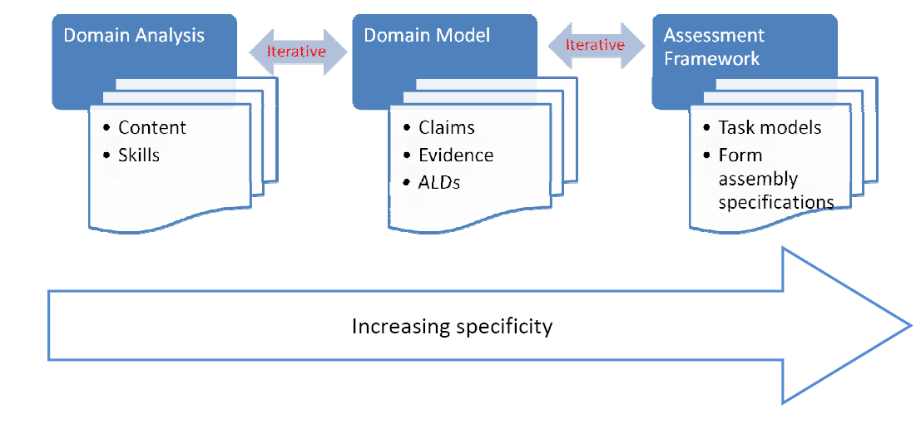
Three Critical Design Phases
Representations of the three dimensions in the NGSS
Articulation of how the construct should manifest in the assessment
Task models → items
Items → tests
Adapted from Huff, Steinberg, & Matts, 2010

Slide 40
Principled-design State Summative
Phases and Elements
Phase | State Summative Elements (Grades 5, 8, 11)
Domain Analysis | Overall Claim Measurement Targets Elaborated (Unpacked) Dimensions Integrated Dimension Maps
Domain Modeling | Design Patterns
Task Conceptualization | Task Templates Task Specifications Item Specifications
Assessment Development | Tasks Scoring Rubrics/Scoring Notes
Notes:
Key goal of our project is to articulate a replicable and scalable principled-design process that state and local educators can use to develop three-dimensional science assessment tasks.
Not developing an assessment. Focus on “how” by articulating a clear design process, and providing sample materials that demonstrate the outcomes of that process.
Four key development phases (sample set of exemplary resources are provided in columns 2 and 3. State and classroom elements build from these same four phases, but you’ll notice that the classroom elements are less in number. Streamlined the design process to lessen the burden on teachers. We know they have constraints such as time and resources, so we tried to adapt the state process/tools to make the work more manageable and relevant to educators.
These materials are posted to the project website, and we’ll be taking a deeper dive into the process and the resulting resources throughout our two day meeting.

Slide 41
Phase 1: Domain Analysis
Resources:
Goal:
  To obtain a deep understanding of the performance expectation (PE) and its components
  To provide information on how students engage with the different components
  To provide information on the boundaries of student performance
Claim(s)
Measurement Targets
Elaborated Dimensions
Integrated Dimension Maps
State Summative Assessment

Slide 42
Claim
Relates to expected student learning
Represents and supports an assessment argument
Links to forms of evidence
Explores the question:
“What warrants the claim?”
State Summative Assessment
Notes:
An assessment argument can be represented by a claim about student learning that is supported by observable and defensible evidence relevant to the intended use of the assessment (Huff et al., 2010).
A claim must be linked to the forms of evidence that would provide support for the claim.
The question, “What warrants the claim?” must be explored.

Slide 43
Measurement Targets
Statements that provide descriptions of the performance defined in the claim
Measurement targets are grade- and bundle-specific.
Contribute to consistent learning targets, coherent results, consistent judgments of competence, and curriculum, instruction, and assessment alignment
For SCILLSS, the NGSS Example Bundles were utilized as a way of organizing the standards for the development of the measurement targets.
State Summative Assessment
Notes:
Measurement targets are statements that provide descriptions of the performance defined in the claim. Measurement targets are grade specific and bundle specific.
By writing the Measurement Targets in accordance with the NGSS Bundles, the summative assessment results will be consistent with the more detailed understanding of learning underlying classroom instruction and assessment.
As long as the underlying models and targets of learning are consistent, the assessment results at different levels of the system will complement each other rather than promote conflicting goals for learning and contradictory judgments about student competence.
A bundle is a group of performance expectations that have been brought together to organize instruction.
The NGSS PEs are not intended to be taught or assessed one-at-a-time, or in isolation.
Therefore, one helpful approach to beginning the translation of the NGSS into curriculum and instruction is to “bundle” standards together, arranging them in groups for instruction.
Bundles of standards can be helpful to show connections between ideas, facilitate phenomenon-driven instruction, and promote efficient use of instructional time.

Slide 44
Elaborated Dimensions
Elaboration of the NGSS dimensions is completed during domain analysis in which:
  Substantive information is gathered about the domain of interest that will have implications for assessment; and
  The construction of learning performances are informed to describe the knowledge that students need to demonstrate as they progress toward achieving the measurement target expectations.
  Elaborations articulate clear expectations, appropriate assessment boundaries, required background knowledge, and student challenges and misconceptions.
State Summative Assessment

Slide 45
Integrated Dimension Maps
Integrated Dimension Maps are visual representations of the DCIs, SEPs, and CCCs.
  Highlight how the different dimensions are integrated with each other
  Highlight what pieces should be assessed together, and what pieces can be assessed separately
State Summative Assessment
Notes:
The maps are visual representations that describe the essential disciplinary core idea relationships and link them to aspects of the targeted crosscutting concepts and science practices (or to closely related crosscutting concepts and practices as identified by the unpacking process)

Slide 46
Phase 2: Domain Modeling and Phase 3: Conceptual Assessment Framework
Resources:
Goal:
  To clearly lay out the assessment argument
    What will be covered?
    What will not be covered?
    How will students demonstrate their knowledge?
    What do tasks look like?
Design Patterns
Task Templates
Task and Item Specifications
State Summative Assessment

Slide 47
Design Patterns
Before developing assessment tasks, a design pattern must be specified (Mislevy & Haertel, 2006) for each learning performance.
The design patterns serve to complete the documentation of the assessment argument connecting task designs to performance expectations.
Identify:
  Focal knowledge, skills, and abilities (fKSAs)
  Observations (i.e., evidence) to support inference
  Features of task situations that elicit target KSAs
Guide planning for the key elements of the task models in the conceptual assessment framework
State Summative Assessment
Notes:
The design patterns (DPs) describe task features that are necessary to elicit evidence of student proficiency.
The DPs:
1. identify the focal knowledge, skills, and abilities (fKSAs) for each learning performance.
Specifically, they identify focal KSAs representing the specific performance constructs that are to be assessed
Additional KSAs are also identified that are needed to respond to the task, but are not assessed by the task.
2. Articulate the observations or evidence required to support an inference about the student’s knowledge and skills
3. Note that they do NOT provide a concrete design or implementation of an assessment task, rather the DP is the “roadmap” to development of the Task Template, that ultimately leads to defining the work products (the items or tasks), in light of the identified fKSAs, observations, and task features.

Slide 48
Task Template
The task template is a tool to support writing families of tasks that includes specific details of materials and task settings in the assessment implementation phase.
The contents:
  Are informed by the design pattern,
  Are used to inform task and item development,
  May differ for different needs and assessment development processes,
  Can vary with respect to specificity.
Allows for multiple items or tasks to be developed based on the template
State Summative Assessment
Notes:
The template level is still general enough that there can be multiple tasks that are generated from the same template.
It provides a guide for how to generate tasks, as well as score them, but also specifies which variables can be changed while still providing information regarding the student model.
Basically, it is not specific enough for an item or task specification, but item/task specifications may be obtained from the task template by making choices and filling in fields of the template.

Slide 49
Task Specifications
The integration of Phase 2 and Phase 3 provides the rationale for the formulation and content of task specifications.
The task specifications define for task developers the key components of the task needed to ensure that the evidence of student learning collected and evaluated is consistent with the fKSAs represented by the PEs.
Identifies for a selected fKSA:
  The decisions needed to be made to elicit evidence of student competency;
  Variable features that inform design decisions to evoke that evidence;
  Aspects of the assessment situation that may be varied;
  The responses or artifacts the students will produce that, subsequently, will be used in the evaluation (scoring) procedures; and
  The task context (i.e., phenomena, design problems).
State Summative Assessment

Slide 50
Item Specifications
Utilization of the task and item specifications leads to a determination of the item-response formats required to elicit necessary evidence of student competency of the targeted fKSA.
The item specifications provide information to create an item(s) that will provide some of the necessary evidence with respect to a selected fKSA.
Identifies:
  A rationale of what the student will do to demonstrate competency of a targeted fKSA;
  Construct-relevant vocabulary;
  Allowable stimulus materials (e.g., data tables, animation), item type, and “model” stem; and
  The nature of the response options (e.g., Distractors may include…).
State Summative Assessment

Slide 51
Phase 4: Assessment Development
Resources:
Goal:
  To develop tasks and rubrics that are aligned to the assessment argument
  To describe the evidence of student learning to be elicited by the tasks
State Summative Assessment Tasks
State Summative Assessment
Scoring Rubrics / Scoring Notes

Slide 52
State Summative Assessment Tasks
A SCILLSS task is envisioned as a set of three or more items of varying types linked with a common stimulus.
A task stimulus consists of passages, graphs, models, figures, diagrams, data tables, etc.
The number of items associated with a task is dependent on the number and nature of the fKSAs and PEs it is written to measure.
The number of dimensions addressed by each item is also variable.
Tasks are designed to assess students along a range of proficiency and across an appropriate range of cognitive complexity.
State Summative Assessment

Slide 53
Grade 5 SCILLSS Conceptual Assessment Framework Hierarchy
Grade 5 NGSS Topic Model
Bundle 1 - Physical and Chemical Changes
5-ESS1-1
5-ESS1-2
Bundle 2 - Matter and Energy in Ecosystems
5-PS1-1, 5-PS1-2
5-PS1-3, 5-PS1-4
Bundle 4 - Stars and the Solar System
5-PS1-1, 5-PS2-1
5-ESS2-1, 5-ESS2-2
5-ESS3-1
5-PS1-1, 5-PS3-1
5-LS1-1, 5-LS2-1
Bundle 3 - Earth's Major Systems
Measurement Target 1
Measurement Target 2
Measurement Target 3
Measurement Target 4
Focal KSA 5.1a
Focal KSA 5.1b
Focal KSA 5.1c
Focal KSA 5.1d
Task Sets
Task Sets
Task Sets
Task Sets
Grade 5 Claim: Students demonstrate a sophisticated understanding of the core ideas and applications of practices and crosscutting concepts in the disciplines of science.
State Summative Assessment
Notes:
The SCILLSS Conceptual Assessment Framework hierarchy is a pathway that entails multiple, interconnected components that leads to NGSS multi-dimensional task and item development. It can be used by task developers to understand the derivation of the content for the tasks and items.
The architecture of the SCILLSS Conceptual Assessment Framework hierarchy begins with a grade specific, “NGSS Topic Model.”
A bundle is a group of NGSS PEs arranged together to create the endpoints for units of instruction.
A grade-specific claim is derived from the complete set of bundles associated with a grade-specific topic model.
A measurement target is derived from the sum of a bundle’s PEs.
A set of grade-specific fKSAs are developed that align to the expectations of each measurement target. Together, the complete set of fKSAs (not shown) represents the competencies expected of students to develop as they progress towards mastery of each grade’s NGSS PEs.
Note a SCILLSS task specification is developed to address a single fKSA. Therefore, a set of task specifications needs to be written to address the breadth of each measurement target. Each task specification results in and is supported by item specifications, which address the aspects of a PE as related to the measurement target

Slide 54
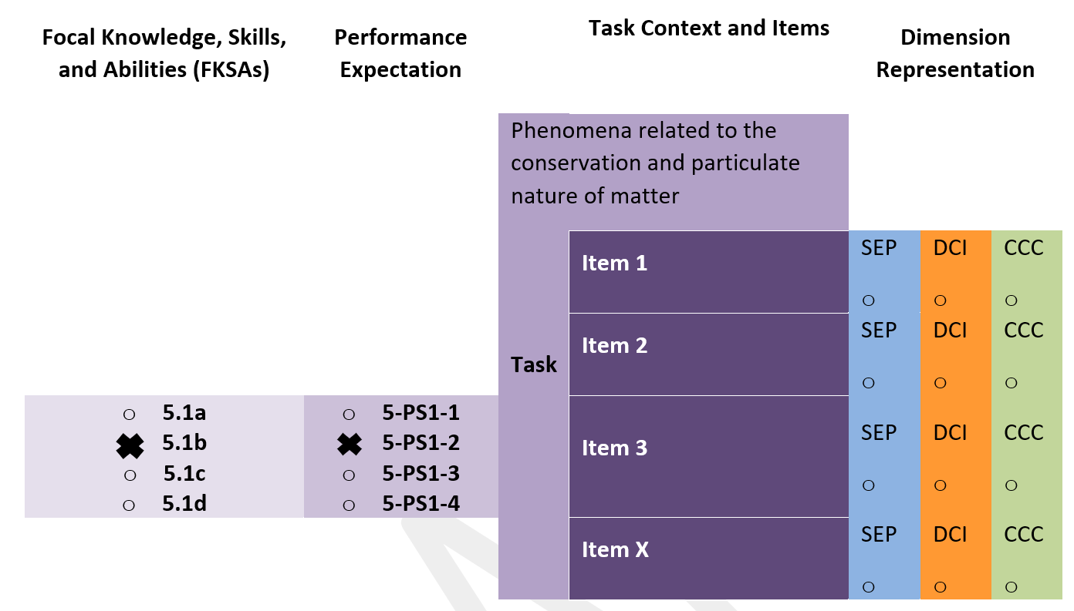
Sample Task Map
State Summative Assessment
Notes:
A science assessment task map and sample grade 5 item were developed to show how the SCILLSS principled-design approach was used to develop a set of replicable assessment development tools, which can be scaled to address the unique characteristics and contexts of states’ assessment systems and how the SCILLSS assessment framework can be implemented for the purpose of development of NGSS-aligned large-scale summative assessment tasks.
The sample task map is developed to align with the grade 5 measurement target 1, “Students are able to investigate and interpret data to draw or support conclusions about the structure and properties of matter, including whether or not matter is conserved, and to identify materials and mixtures based upon their properties or results of a reaction”.
The task, when taken in its entirety, is intended to achieve multi-dimensional alignment to the targeted fKSA. Tasks, inclusive of all their associated items are intended to align at the PE and dimension (SEP, DCI, and CCC) levels. Tasks are also intended to align to one or more NGSS Evidence Statement(s) associated with the target PE(s). The NGSS Evidence Statements were written to describe student evidence at a single proficiency level and to cover a range of cognitive complexity.
An assessment task should be designed to assess students along a range of proficiency and across an appropriate range of cognitive complexity. The number of items associated with a task is dependent on the number and nature of the fKSAs and PEs it is written to measure. The number of dimensions addressed by each item also varies. Some of the items within the task may have multiple parts. This allows for more complex interactions and deeper thinking and allows for the demonstration of SEPs and CCCs by the student

Slide 55
Concluding Remarks
Having common and explicit design patterns and task templates enhances the instructional validity of assessment as well as the evidentiary value of tasks.
Utilizing our principled-design process, item writers can see the tasks they create as addressing the same underlying science, in terms of common fKSAs, Characteristics Features of Tasks, and Potential Observable features of students’ performances.
Different choices about Additional KSAs, Variable Features of Tasks, and Work Products are required in order to meet the varying constraints and purposes of different assessment contexts.
Notes:
As we continue with the SCILLSS project we will further refine our understanding of the roles of alignment, elaborations, design patterns and task templates, as well as identify novel ways in which ECD can be leveraged, in helping improve the validity and efficiency of a three-dimensional, large-scale, science assessment development process.

Slide 56
Developing Classroom Science Assessment Tasks Using a Principled-design Approach
Charlene Turner, B.A.
Senior Associate, edCount, LLC
Notes:
Howard and Charlene

Slide 57
Principled-design State Summative and Classroom Phases and Elements
Phase | State Summative Elements (Grades 5, 8, 11)
Domain Analysis | Overall Claim Measurement Targets Elaborated (Unpacked) Dimensions Integrated Dimension Maps
Domain Modeling | Design Patterns
Task Conceptualization | Task Templates Task Specifications Item Specifications
Assessment Development | Tasks Scoring Rubrics/Scoring Notes
Classroom Elements (Grades 5, 8, 11)
Unpacking Tool
Task Specifications Tool
Tasks Scoring Rubrics/Scoring Notes
Notes:
Animated Slide
Charlene – shift focus to explain how our large-scale work and design process translates for district-level and classroom use.

Slide 58
Phase 1: Domain Analysis
Resources:
Goal:
  To obtain a deep understanding of the performance expectation (PE) and its components
  To provide information on how students engage with the different components
  To provide information on the boundaries of student performance
Claim(s)
Measurement Targets
Elaborated Dimensions
Integrated Dimension Maps
State Summative Assessment
Classroom-based Assessment
Unpacked Dimensions
Notes:
Animated slide

Slide 59
Unpacking the Dimensions
Provides a clear focus for what is to be measured and helps educators to plan for assessment
Ensures educators who are designing NGSS-aligned tasks have a clear and deep understanding of each of the dimensions represented in a PE prior to beginning task development
Classroom-based Assessment
Notes:
Key Ideas
Unpacking the dimensions of each PE provides a clear focus for what is to be measured and helps teachers to plan for assessment.
The unpacking tool requires you to think critically about the three dimensions of the PEs and what they really mean.
The Unpacking Tool can be a bit time intensive, but the benefit is that once you have done it, you have it. It remains a living document and can be used as a reference or resource that you could share within a building.

Slide 60
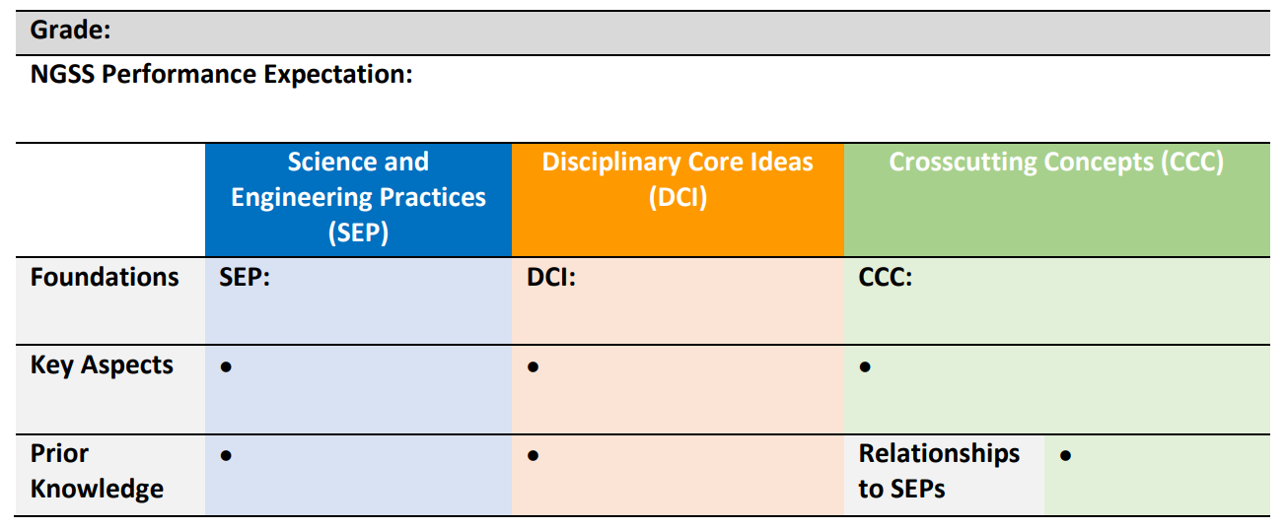
Unpacking the Dimensions of a
Performance Expectation Tool
Provides guidance for unpacking a PE
Template for documenting unpacking
Classroom-based Assessment

Slide 61
Components of the Unpacking Tool
Key aspects are the underlying concepts that support each dimension of the PE and represent knowledge necessary for understanding or investigating more complex ideas and solving problems.
Prior knowledge refers to the background knowledge that is expected of students to develop an understanding of the SEP and DCI.
Relationships between the CCC and the SEP is included since when students are performing a SEP, they are often addressing one of the CCCs.
Classroom-based Assessment

Slide 62
Unpacking Tool for 5-PS1-1
Grade: 5
NGSS Performance Expectation: 5-PS1-1 Develop a model to describe that matter is made of particles too small to be seen. [Clarification Statement: Examples of evidence supporting a model could include adding air to expand a basketball, compressing air in a syringe, dissolving sugar in water, and evaporating salt water.] [Assessment Boundary: Assessment does not include the atomic-scale mechanism of evaporation and condensation or defining the unseen particles.]
 | Science and Engineering Practices (SEP) | Disciplinary Core Ideas (DCI) | Crosscutting Concepts (CCC)
Foundations | SEP: Developing and Using Models Use models to describe phenomena. | PS1.A: Structure and Properties of Matter Matter of any type can be subdivided into particles that are too small to see, but even then, the matter still exists and can be detected by other means. A model showing that gases are made from matter particles that are too small to see and are moving freely around in space can explain many observations, including the inflation and shape of a balloon and the effects of air on larger particles or objects. | CCC: Scale, Proportion, and Quantity Natural objects exist from the very small to the immensely large.
Notes:
For this particular task students are expected to develop a model to describe that matter is made up of particles too small to be seen. The NGSS PE is listed, which includes its clarification statement in red, and each of the dimensions associated with the PE are provided in the color-coded foundations boxes below the PE.

Slide 63
Unpacking Tool for 5-PS1-1
Grade: 5
NGSS Performance Expectation: 5-PS1-1 Develop a model to describe that matter is made of particles too small to be seen. [Clarification Statement: Examples of evidence supporting a model could include adding air to expand a basketball, compressing air in a syringe, dissolving sugar in water, and evaporating salt water.] [Assessment Boundary: Assessment does not include the atomic-scale mechanism of evaporation and condensation or defining the unseen particles.]
 | Disciplinary Core Ideas (DCI)
Foundations | PS1.A: Structure and Properties of Matter Matter of any type can be subdivided into particles that are too small to see, but even then, the matter still exists and can be detected by other means. A model showing that gases are made from matter particles that are too small to see and are moving freely around in space can explain many observations, including the inflation and shape of a balloon and the effects of air on larger particles or objects.
Key Aspects | Everything around us (matter) is made up of particles that are too small to be seen. Matter that cannot be seen can be detected in other ways. Gas (air) has mass and takes up space. Gas (air) particles, which are too small to be seen, can affect larger particles and objects. Gas particles, which freely move around in space, until they hit a material that keeps them from moving further, thus trapping the gas (e.g., air inflating a basketball, an expanding balloon).
Prior Knowledge | Matter is anything that occupies space and has mass. Matter can change in different ways.
Notes:
In this portion of the unpacking tool, we begin “teasing apart” the disciplinary core idea. Essentially, what you see is that the bullets unpack the DCI concepts from PS1.A. [Review bulleted list with participants.]
The prior knowledge describes the DCI concepts students are expected to have from prior learning experiences to develop an understanding of the SEP and DCI. [Review bulleted list with participants.]

Slide 64
Unpacking Tool for 5-PS1-1
Grade: 5
NGSS Performance Expectation: 5-PS1-1 Develop a model to describe that matter is made of particles too small to be seen. [Clarification Statement: Examples of evidence supporting a model could include adding air to expand a basketball, compressing air in a syringe, dissolving sugar in water, and evaporating salt water.] [Assessment Boundary: Assessment does not include the atomic-scale mechanism of evaporation and condensation or defining the unseen particles.]
 | Science and Engineering Practices (SEP)
Foundations | SEP: Developing and Using Models Use models to describe phenomena.
Key Aspects | Identify components of the model. Use a model to reason about a phenomenon. Reason about the relationship of the different components of a model. Select and identify relevant aspects of a situation or phenomena to include in the model.
Prior Knowledge | Knowledge that a model contains elements (observable and unobservable) that represent specific aspects of real-world phenomena Knowledge that models are used to help explain or predict phenomena
Notes:
In this portion of the unpacking tool, we begin “teasing apart” the science and engineering practice. Essentially, what you see is that the bullets unpack the practices from PS1.A. What you are doing in the key aspects area is answering “what does it mean” to develop a model? [Review bulleted list with participants.]
The prior knowledge describes the prior knowledge students are expected to have from prior learning experiences to be able to, in this instance, understand how to develop a model. [Review bulleted list with participants.]

Slide 65
Unpacking Tool for 5-PS1-1
Grade: 5
NGSS Performance Expectation: 5-PS1-1 Develop a model to describe that matter is made of particles too small to be seen. [Clarification Statement: Examples of evidence supporting a model could include adding air to expand a basketball, compressing air in a syringe, dissolving sugar in water, and evaporating salt water.] [Assessment Boundary: Assessment does not include the atomic-scale mechanism of evaporation and condensation or defining the unseen particles.]
 | Crosscutting Concepts (CCC)
Foundations | CCC: Scale, Proportion, and Quantity Natural objects exist from the very small to the immensely large.
Key Aspects | Understand the units used to measure and compare quantities. Describe relationships between natural objects which vary in size (very small to the immensely large). Understanding of scale involves not only understanding systems and processes vary in size, time span, and energy, but also different mechanisms operate at different scales.
Relationships to SEPs | Models describe the scale of natural objects. Data analysis serves to demonstrate the relative magnitude of some properties or processes. Calculate proportions correctly and measure accurately for valid results.
Notes:
In this portion of the unpacking tool, we begin “teasing apart” the crosscutting concept. Essentially, what you see is that the bullets unpack the crosscutting concept from PS1.A. [Review bulleted list with participants.]
The relationships to SEPs describes the connection between the CCC and the practice. The CCC Scale, Proportion, and Quantity is an essential consideration when deciding how to develop a model (SEP) to describe a phenomenon. To demonstrate their ability to develop a model, students understand . . . [Review bulleted list with participants.]

Slide 66
Resources for Unpacking
A Framework for K-12 Science Education: Practices, Crosscutting Concepts, and Core Ideas
State Science Content Standards
The NGSS
NGSS Appendices E, F, and G
NGSS Evidence Statements
Notes:
A selection of resources to support unpacking the PEs to identify “Key Aspects” and “Prior Knowledge” includes the Framework, the NGSS, and NGSS Appendices E: Disciplinary Core Ideas, F: Science and Engineering Practices, and G: Crosscutting Concepts (i.e., progressions).
[Walk participants through the NGSS appendices to illustrate the progressions charts and how they can be used to identify prior knowledge.]

Slide 67
Phase 2: Domain Modeling and Phase 3: Conceptual Assessment Framework
Resources:
Goal:
  To clearly lay out the assessment argument
    What will be covered?
    What will not be covered?
    How will students demonstrate their knowledge?
    What do tasks look like?
Design Patterns
Task Templates
Task and Item Specifications
State Summative Assessment
Classroom-based Assessment
Task Specifications
Notes:
Animated slide

Slide 68
Identifying Assessment Task Specifications
Allows educators to translate the PE-specific unpacking of the three dimensions into assessment tasks
Allows educators to determine what counts as evidence for student learning
Helps educators develop assessment tasks that allow students opportunities to call upon, transfer, and apply learning that has occurred during instruction to new challenges, much the way a scientist or engineer would, in an assessment situation
Classroom-based Assessment

Slide 69
Assessment Task Specifications Tool
Identifies key elements needed to be addressed by task developers to develop meaningful and interpretable assessment tasks
Template for documenting task specifications
Classroom-based Assessment

Slide 70
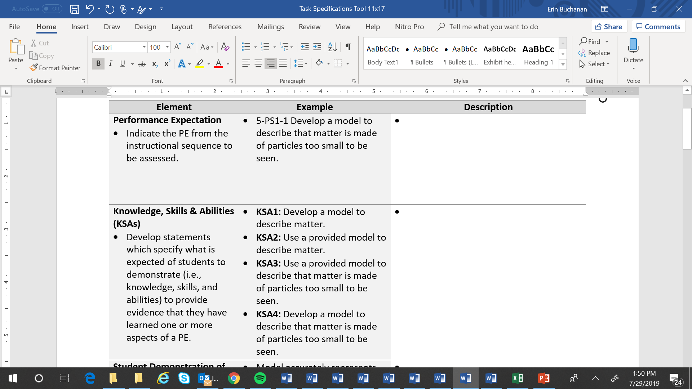
Assessment Task Specifications Tool
Classroom-based Assessment
Notes:
Element: Performance Expectation
The first element is pretty straight-forward, and we already have it done, because we want to indicate the PE for which we are developing the task specifications tool. It might seem like a “mute” point, but we are always coming back to it. It is the focus of what we are doing. From a single task specifications tool, we can generate multiple tasks. The unpacking document that you worked on previously is like a palate of knowledge, skills, and abilities that you can select from to design tasks that measure exactly what you need to know during a point in time during your instruction. We want to make sure everything is aligned to the PE.
Element: Knowledge, Skills, and Abilities (KSAs)
Next are the Knowledge, skills, and abilities (KSAs). The purpose of the KSAs is to identify the focus of the PE. Each of these statements specifies what it is that students are expected to demonstrate to provide the evidence that they have learned one or more aspects of the PE. That PE is dense. Your unpacking documents are quite lengthy when you analyzed each of those dimensions. Therefore, when you develop the KSAs, they can go across multiple aspects of the PE, but they don’t all have to be at the level, or grain size, of the PE.
NGSS-like standards present KSAs that we haven’t taught before. There is new content here that we need to understand well. When we break down a PE, we want to think about what KSAs (knowledge, skills, and abilities) are represented by the PE. KSAs are a combination of aspects of the PE that you can pull apart from the PE statement. One PE may have three to six KSAs depending on how dense or packed it is with respect to the DCI’s or the SEP or the CCCs; when you make decisions about those KSAs, it could be that your assessment task is just going to address a single KSA. Is it ever appropriate just to measure a DCI? Maybe it’s driven by what's in the PE; perhaps one KSA is more of a DCI, or maybe it’s across a couple of dimensions and includes a SEP or a CCC. The KSAs can be graduated. They can address an aspect of the PE. As tasks become more graduated and complex, we would expect to see them address more KSAs and KSAs associated with that PE. These KSAs can be things that you measure midway through or even a quarter of the way through instruction just to make sure your students are on track. The KSAs are also your opportunity to put back together some aspects of the multiple dimensions that you teased apart in the unpacking. KSA is kind of like the “junior” PE and the demonstration is “what are they doing?”
Some of the KSAs might be more discrete; they may just look at a particular dimension rather than more than one dimension. You will select one or more KSAs from this menu of options for measurement by the assessment task. As we’ve said, this tool can be used to generate multiple tasks depending on what it is you need to know. Everything aligns back to the PE, but you will decide based on your instructional sequence, and the list of KSAs that are developed, what it is you want to measure at a particular time. All of the KSAs might vary in their complexity, whether it is descriptive or generative in terms of cognitive complexity, and you might focus on one KSA or more than one KSA when you develop your task. You are creating a palate or menu of options. Regardless of how you select them, we know that they are aligned to that PE.

Slide 71
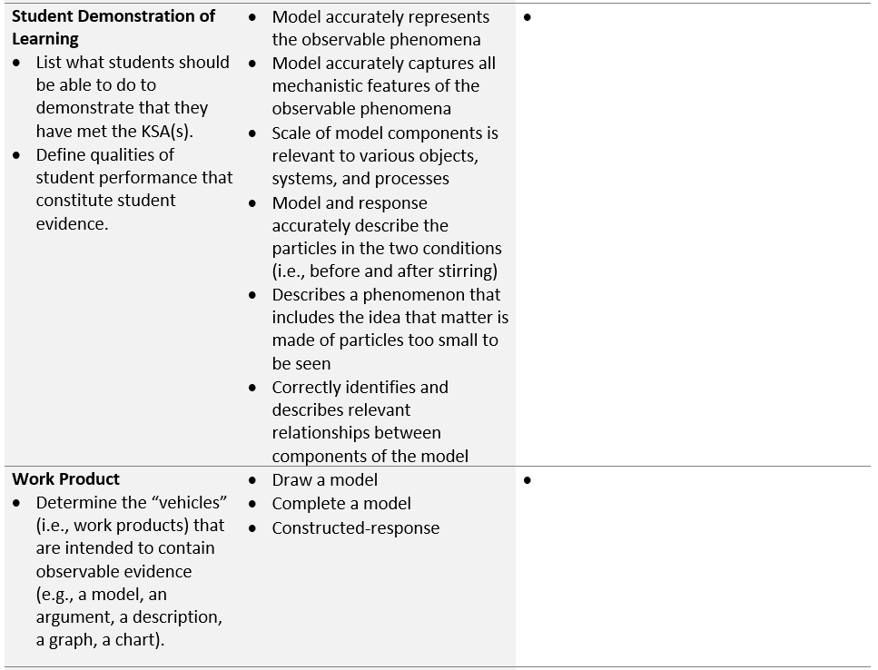
Assessment Task Specifications Tool
Classroom-based Assessment
Notes:
For the next two elements of the task specifications tool, you’ll complete the Student Demonstration of Learning and Work Product.
Element: Student Demonstration of Learning
For this element, you’ll want to think carefully about the evidence students will need to demonstrate for each of the KSAs you’ve created. Create a list of what students should be able to do to demonstrate that they have met the KSAs. In this list, you’ll want to clearly define the qualities of student performance that constitute student evidence. For example, for KSA1: Develop a model to describe matter, students will need to demonstrate that they can 1) model accurately to represent the observable phenomena, 2) model accurately to capture all mechanistic features of the observable phenomena, and 3) show that the scale of the model components is relevant to the various objects, systems, and processes.
To complete this section, focus on the evidence that will need to be produced by the tasks and the criteria that will need to be included in the scoring rubric to appropriately measure students’ performance of the KSAs.
Element: Work Product
For the work product, you’ll want to think about the “vehicles” that are intended to contain observable evidence. This could include item types, situations, or stimuli that will allow students to demonstrate their learning of the KSAs. Educators can pick from this “menu of options” to select a work product or combinations of work products appropriate for measuring the KSAs.

Slide 72
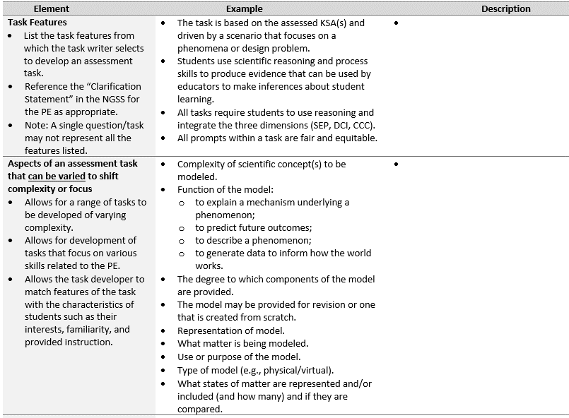
Assessment Task Specifications Tool
Classroom-based Assessment
Notes:
Element: Task Features
What are task features? These are necessary features of the assessment tasks that would be necessary to appropriately measure one or more of the KSAs. The task designer needs to be able to describe the features of the tasks that need to be evident in any of the products that students are creating and needs to make design decisions informed by the clarification statement in the NGSS PE, as appropriate. We want to ensure that when we are developing these tasks, we are not asking students to do things that exceed the expectation of the PE and we want to make sure too that the task features that we are building into these tasks allow us to determine what a student knows about the measured content; these features may also indicate to us what students do not know. It is important to note too that a single question within a task may not represent all the task features listed, so it is kind of an amalgam. If you look across the KSAs and the student demonstration of learning and the work product, consider what task features would cover the range of those elements of your task specification. Keep in mind, however, that not all of them are applied to every task.
Element: Aspects of an assessment task that can be varied to shift complexity or focus
The next element, “Aspects of an assessment task that can be varied to shift complexity or focus,” can be thought of in regard to the construction of a test. Generally, all standards, even with respect to the PEs, are not created equally and all items on a test are not created equally with respect to their complexity. By the nature of the standard, some skills or knowledge are more complex or less complex than others. Therefore, it is appropriate then based on what is being measured that the actual assessment has some variation in its complexity. When you are thinking about what it is you are going to measure, you can address that in this aspect or in this element or task feature. For example, to vary the complexity of a task, you can opt to provide a model to a student for revision, or you might require students to create their own model. You could also choose to vary the components of the model provided to the student to alter the complexity of the item.

Slide 73
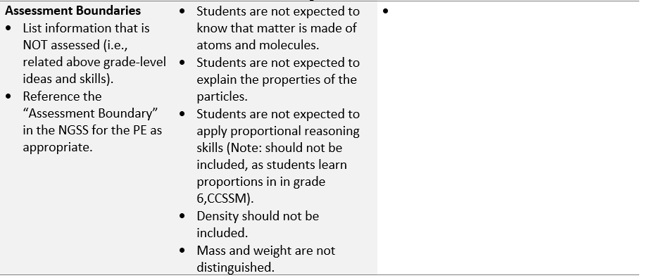
Assessment Task Specifications Tool
Classroom-based Assessment
Notes:
Element: Assessment Boundaries
Lastly, we will talk about assessment boundaries. It is not only important to think about what we are measuring, we also want to think about what is not assessed. With regard to the PEs, many of them have assessment boundaries. For this element, list the information that is not assessed (i.e., related above grade-level knowledge and skills). You may want to reference the “Assessment Boundary” in the NGSS for the PE as appropriate.

Slide 74
Resources for Task Specifications
A Framework for K-12 Science Education: Practices, Crosscutting Concepts, and Core Ideas
State Science Content Standards
The NGSS
NGSS Appendices E, F, and G
NGSS Evidence Statements
Notes:
A selection of resources to support unpacking the PEs to identify “Key Aspects” and “Prior Knowledge” includes the Framework, the NGSS, and NGSS Appendices E: Disciplinary Core Ideas, F: Science and Engineering Practices, and G: Crosscutting Concepts (i.e., progressions).

Slide 75
Phase 4: Assessment Development
Resources:
State Summative Assessment Tasks
State Summative Assessment
Scoring Rubrics / Scoring Notes
Goal:
  To develop tasks and rubrics that are aligned to the assessment argument
  To describe the evidence of student learning to be elicited by the tasks
Classroom-based Assessment
Classroom-based Assessment Tasks
Scoring Rubrics / Scoring Notes

Slide 76
Classroom-based Assessment Tasks
Enable educators to get their fingers on the pulse of individual students, groups of students, and/or the entire class as to where they are in their science learning and collect evidence to ultimately inform instruction
Must elicit evidence related to students’ integration of knowledge of DCIs, engagement with SEPs, and facility with building connections across ideas
Provide an indication of students’ current understanding of the selected KSAs as set forth in the Task Specifications Tool
May include multiple parts, questions, or prompts connected to a phenomenon or problem-solving context or event
Classroom-based Assessment

Slide 77
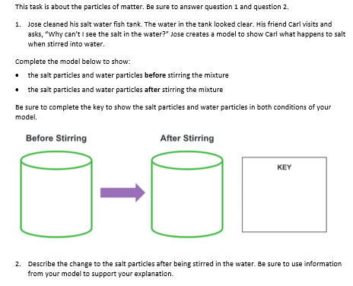
Example Classroom-based Task
Anticipatory set
Reminder to student
Task context/stimulus
Prompt/question and student directions
Provided model and key templates
Prompt/question and student directions
Classroom-based Assessment

Slide 78
Classroom-based Task Rubrics
A tool to help educators get their fingers on the pulse of what kids know and can do along an implemented instructional pathway
Define the criteria that educators use to interpret and evaluate student evidence of learning to properly evaluate what students understand and where they still need support
Include descriptors for each prompt in the assessment task that describe the full range of student understanding from low to high levels of competency and to determine specific areas where students might be performing well or might be struggling
Allow educators to question and determine how to shape instructional decisions based on students’ performance to improve student learning
Notes:
The next thing we will begin conceptualizing as we began to develop this task is the scoring rubric.
Will the task elicit a potential range of student responses that you can utilize to get good information? Sometimes evaluating the response to one multiple choice item with options A, B, C, D does not really tell you much as an educator about what students actually understand.
The goal of doing these classroom-based assessments along your instructional sequence is to get your finger on the pulse of what kids know and can do. Therefore, when designing these assessments it is important that there are enough criteria in the rubric to properly evaluate what students understand and where they still need support. The rubric makes this beneficial because educators have the ability to look across the rubric and see specific areas where students might be performing well or might be struggling. The rubric needs to allow an educator to be able to question and determine how to shape instructional decisions from the students’ performance.
Though the task of designing a rubric can seem daunting, remember that you have your tools. Look back at your Unpacking Tool and Task Specifications Tool. These are going to be key supports to inform your design of the rubric in such a way that it garners for you (and the students) the right information about that they know and can do.
The primary intention for these rubrics is not necessarily to grade or to provide an evaluation, but rather to assess where students are in their learning and understanding and decide what, how, and with whom differentiation is needed in instruction. This is not to say that this cannot be graded, but the intent is to encourage formative thinking.

Slide 79
Classroom-based Task Rubric
Consider all ways in which student evidence of learning is collected in the task and ensure that each is represented in the rubric
Reflects/addresses the type of evidence gathered which will likely vary from prompt to prompt based on the assessed KSA(s)
Ensures that the full range of student understanding is represented based on the type of expected evidence from low to high levels of competency:
  A high-level response is scientifically accurate, complete and coherent, and consistent with the type.
  A low-level response may include misconceptions, is incomplete, and is not accurate.
Supports meaningful interpretability and utility by educators
Notes:
[Facilitators continue to guide grade level/band teams to develop the rubrics for their targeted PI using the guidance and example rubric in the presentation. Collaborative teams will populate the Rubric Development Tool Template. Facilitators will guide teams to consider revisions to the rubric as they work on its development. Participants begin drafting the rubric in their grade-level teams.]

Slide 80
Grade 5 Example Classroom-based Task Rubric
Rating scale
Prompt | 0 | 1 | 2 | 3
1 | No response or a response not related to the prompt (e.g., off topic; student writes, “I don’t know.”). | Model does not show two representations each with two different bulk matter and matter too small to see (particles) or representations in the correct position and scale relative to each other. The key is incorrect. | Model shows a flawed connection between bulk matter and particles too small to be seen or a flawed connection between the representations’ correct position and scale relative to each other. The key is partially correct. | Model shows two representations each with two different bulk matter and matter too small to be seen (particles) and shows representations in correct position and scale relative to each other. The key is correct.
2 | No response or a response not related to the prompt (i.e., off topic; student writes, “I don’t know.”). | The description is incorrect. | The description is partially correct. | The description is correct.
Response criteria for each score point
Response criteria for student’s model
Response criteria for student’s explanation of the model
Notes:
There are several different ways to craft or develop a rubric. Maybe a task has several items or questions. You could make a rubric that is used to score each question within a task. You could create a rubric that describes the full range of items and considers responses to the task as a whole. There are different types of rubrics that you could develop with different degrees of content and it has to do too with the intended purpose and use of your task. What is it that you want to understand about your students?
There are different types and degrees of evidence that you’ll need to think about as you are designing a rubric for your task. It is not intended that these rubrics are developed to provide a grade for students. They are designed to be tools for you as educators to determine how you might adapt or improve instruction. The numbers across the top of the rubric are really just intended to create different categories so you know which students completed the task according to the provided criteria. The intent of the categories are to help you categorize students to understand generally how your class is performing across those levels. This will allow you to differentiate your instruction based on how many students fall into each category indicated on the rubric. Where do I need to adjust my instruction in response to student performance of the criteria in the rubric?

Slide 81
Grade 8 Example Classroom-based Task Rubric
Dimension | 0 | 1 | 2 | 3
Develop and use a phenomena to describe a model | No response or a response not related to the science and engineering practice. | Model does not make sense of the phenomena and does not indicate relationships between components. | Model describes the phenomenon, including a limited number of relevant components and describes some of the relationships between components. | Model makes sense of the phenomenon by describing relative components including sound waves, materials through which the waves are transmitted; the results of the interaction of the wave and the materials; and source of the wave.
Structures can be designed to serve particular functions by taking into account properties of different materials, and how materials can be shaped and used. | No response or a response not related to the crosscutting concepts. | Model shows misunderstanding of the properties of the materials. | Model is used to interpret part of the context. | Model is used to accurately describe why materials with certain properties are well-suited for particular functions.
A sound wave needs a medium through which it is transmitted. | No response or a response not related to the disciplinary core idea. | Response includes major misunderstandings or show how sound travels or demonstrate little understanding of how sound travels. | Response partially describes how sound travels. | Response accurately and fully describes how sound waves interact with different materials.
Rating scale
Response criteria for student model
Response criteria for each score point
Response criteria for student explanation of model
Notes:
There are several different ways to craft or develop a rubric. Maybe a task has several items or questions. You could make a rubric that is used to score each question within a task. You could create a rubric that describes the full range of items and considers responses to the task as a whole. There are different types of rubrics that you could develop with different degrees of content and it has to do too with the intended purpose and use of your task. What is it that you want to understand about your students?
There are different types and degrees of evidence that you’ll need to think about as you are designing a rubric for your task. It is not intended that these rubrics are developed to provide a grade for students. They are designed to be tools for you as educators to determine how you might adapt or improve instruction. The numbers across the top of the rubric are really just intended to create different categories so you know which students completed the task according to the provided criteria. The intent of the categories are to help you categorize students to understand generally how your class is performing across those levels. This will allow you to differentiate your instruction based on how many students fall into each category indicated on the rubric. Where do I need to adjust my instruction in response to student performance of the criteria in the rubric?

Slide 82
Student Exemplars
A 3-point exemplar response is:
  scientifically accurate
  complete
  coherent
  consistent with the type of student evidence expected as described in the rubric
A 3-point exemplar response represents a high-quality response that provides evidence that students have demonstrated the knowledge, skills, and abilities (KSAs) assessed by the prompt.
A high-quality exemplar response supports the evaluation of the rubric, for example, by differentiating a score point of 3 from a score point of 2.
Notes:
Creating student exemplars is an exercise to assess the grade-appropriateness of the task and to consider how a student at the targeted grade or age might respond. Student exemplars demonstrate examples of high-quality student performance. Exemplar responses should be considered age- and grade-appropriate. We want to make sure that a high-level response is scientifically accurate, complete and coherent, and consistent with the type of student evidence expected. A low-level response may include misconceptions, be incomplete, or not consistent with the type of evidence expected.
A low-level response may include misconceptions, is incomplete, and is not consistent with the type of evidence expected.

Slide 83
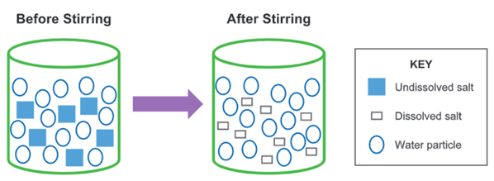
Student Exemplar: Model and Key
Selects and identifies relevant aspects of the context in the model
Shows relationships between water and dissolved salt particles, which vary in size
Includes relevant components and labels to represent understanding of the system
Classroom-based Assessment

Slide 84
Student Exemplar: Explanation
“The model shows that the salt particles dissolve. They break into smaller pieces after they are stirred into water. The salt particles are still in the water, but you can’t see them. That’s because they got so small.”
Uses the model to describe how matter composed of tiny particles too small to be seen can
account for observable phenomena (e.g., salt dissolving into water).
Classroom-based Assessment

Slide 85
Principled Design from a State and Local Perspective
Rhonda True, M.A.
Enhanced Assessment Grant Coordinator, Nebraska Department of Education
Notes:
Howard and Charlene

Slide 86
State Perspective – Nebraska
Nebraska is utilizing the principled-design approach to develop science assessments in our system.
NE theory of action calls for curriculum, instruction, and assessment designed for Nebraska College and Career Ready Standards to be implemented systemically and systematically.
Benefits:
    provides coherence in science assessment system
    leads to instructional shifts by teachers
    grows assessment literacy of teachers
    results in valid high-quality tasks with meaningful scores

Slide 87
Coherence in Our Assessment System
Using SCILLSS resources and doing professional learning across the state
  Growing understanding of principled-design approach
  Leading teachers to the instructional shifts
edCount leading 2020 summer assessment development for formative tasks
  Using tools and templates focused on PAD
  NWEA and NDE collaborating and participating
Scale-up processes and procedures from summer 2020 workshops to the summative 2021 development workshops

Slide 88
Professional Learning in Nebraska:
Focus on Principled-Design
Summer 2020
  Shift in focus from summative to formative classroom science assessment development due to pandemic
  Teachers use principled-design approach, tools, and templates
  Teachers develop 24 classroom tasks for both grade 5 and grade 8 that span the breadth of the NE science standards
Summer 2021
  Summative task development
  Teachers utilize principled-design
  Teachers are familiar with the process, tools, and templates from classroom formative workshops

Slide 89
Local Support for Principled-Design
Local science teacher associations support and champion the process, tools, and templates.
  Nebraska Association of Teachers of Science (NATS)
  Two-day pop-up workshop January 2019
  50 educators and professional developers
  Classroom tasks developed at grade 5, 8 and HS Life and Earth Sciences
Nebraska Educational Service Units (ESUs) lead regional professional learning

Slide 90
Classroom Pilot Tasks
Teachers’ comments about the experience
  The assessments were of great quality.
  Writing a constructed response was hard for many of my students, so I need to provide more instruction and opportunities for my students to write in science.
  I plan to use these results as a way to reteach the misconceptions I saw.
  Time to learn this process is a factor.
  I will be more deliberate about teaching students how to use claims/evidence/reasoning model of communication.
  I will be more explicit about teaching 5th grade students how to respond to these type of prompts.
  The writing was overwhelming to some students, so they gave up.

Slide 91

Comments and Questions
Notes:
All

Slide 92
Contact Information
Liz Summers, Ph.D.
Executive Vice President
edCount, LLC
lsummers@edCount.com
Erin Buchanan, M.A.
Senior Associate
edCount, LLC
ebuchanan@edCount.com
Charlene Turner, B.A.
Senior Associate
edCount, LLC
cturner@edCount.com
Daisy Rutstein, Ph.D.
Principal Researcher
Education Division, SRI International
daisy.rutstein@sri.com
Rhonda True, M.A.
Enhanced Assessment Grant Coordinator
Nebraska Department of Education
rhonda.true@nebraska.gov
Notes:
All

Slide 93
References
Almond, R.G., Steinberg, L.S., & Mislevy, R.J. (2002). Enhancing the design and delivery of assessment systems: A four-process architecture. Journal of Technology, Learning, and Assessment, 1(5).
American Educational Research Association (AERA), the American Psychological Association (APA), and the National Council on Measurement in Education (NCME) Joint Committee on Standards for Educational and Psychological Testing. (2014). Standards for educational and psychological testing. Washington DC: AERA.
Forte, E. (2013a). Re-conceptualizing alignment in the evidence-centered design context. Paper presented at the Annual Meeting of the American Educational Research Association, San Francisco, CA.
Forte, E. (2013b). Evaluating alignment for assessments developed using evidence- centered design. Paper presented at the Annual Meeting of the National Council on Measurement in Education, San Francisco, CA.
Huff, K., Steinberg, L., & Matts, T. (2010). The promises and challenges of implementing evidence-centered design in large-scale assessment. Applied Measurement in Education, 23(4), 310-324.
Messick, S. (1994). The interplay of evidence and consequences in the validation of performance assessments. Educational Researcher, 23(2), 13-23.

Slide 94
References
Mislevy R. (2007). Validity by design. Educational Researcher, 36(8), 463-469.
Mislevy, R. J., & Haertel, G. (2006). Implications of evidence-centered design for educational assessment. Educational Measurement: Issues and Practice, 25, 6-20.
Mislevy, R.J., Steinberg, L.S., & Almond, R.G. (2002). On the structure of educational assessments. Measurement: Interdisciplinary Research and Perspectives, 1, 3-67.
NGSS Lead States. (2013). Appendix E – Progressions Within the Next Generation Science Standards. Next Generation Science Standards: For States, By States. Washington, DC: The National Academies Press.
National Research Council. (2001). Knowing what students know: The science and design of educational assessment. Committee on the Foundations of Assessment. Pellegrino, J., Chudowsky, N., and Glaser, R., editors. Board on Testing and Assessment, Center for Education, Division of Behavioral and Social Sciences and Education. Washington DC: National Academy Press.
National Research Council. (2006). Systems for State Science Assessment. Committee on Test Design for K–12 Science Achievement. M.R. Wilson and M.W. Bertenthal, eds. Board on Testing and Assessment, Center for Education, Division of Behavioral and Social Sciences and Education. Washington, DC: The National Academies Press.
National Research Council. (2012). A Framework for K-12 Science Education: Practices, Crosscutting Concepts, and Core Ideas. Committee on a Conceptual Framework for New K-12 Science Education Standards. Board on Science Education, Division of Behavioral and Social Sciences and Education, Washington, DC: The National Academies Press.

Slide 95
References
National Research Council. (2014). Developing Assessments for the Next generations o Science Standards. Committee on a Conceptual Framework for New K-12 Science Education Standards. Board on Science Education, Division of Behavioral and Social Sciences and Education, Washington, DC: The National Academies Press.
Pellegrino, J. W. (2018). Assessing Science Learning: Some of the Complexities & Challenges [PowerPoint Slides].
Steinberg, L. S., Mislevy, R. J., Almond, R. G., Baird, A. B., Cahallan, C., DiBello, L. V., et al. (2003). Introduction to the Biomass project: An illustration of evidence-centered assessment design and delivery capability (CSE Technical Report 609). Los Angeles: National Center for Research on Evaluation, Standards, and Student Testing (CRESST), Center for the Study of Evaluation, UCLA.

