Slide 1
Designing High-Quality Three-Dimensional Science Assessments for Classroom Use
Chapter 2: Unpacking the NGSS Performance Expectations
Module 2.1: Overview of the Purpose of Unpacking
This digital workbook on designing high quality three-dimensional science assessment tasks for classroom use was developed by edCount, LLC, under
Enhanced Assessment Grants Program, CFDA 84.368A.
Notes:
Welcome to the second of four chapters in a digital workbook on designing high-quality three-dimensional science assessment tasks for classroom use. This workbook is intended to help educators design and evaluate high-quality classroom science assessment tasks that provide meaningful information about what students know and can do in science.
This digital workbook was developed by edCount, LLC, under the US Department of Education’s Enhanced Assessment Grants Program, CFDA 84.368A.

Slide 2


Module 2.1:
Overview of the Purpose of Unpacking
2
Notes:
Chapter 2 of this workbook includes a series of six modules. Together, these six modules provide an in-depth exploration of the first phase of principled assessment design: development of the unpacking tool. In this chapter, we describe how to systematically unpack a performance expectation or indicator into its multiple components to develop a clear and deep understanding of each dimension and the boundaries of what can be assessed. We provide opportunities for you to engage in interactive activities and explore and use our design template to complete your own unpacking of a three-dimensional science standard.
We begin this chapter with Module 2.1. In this module, we provide a brief orientation to the Next Generation Science Standards and describe the purposes for unpacking the NGSS dimensions. In later modules, we describe the elements of the unpacking tool and offer resources, key strategies, and guiding questions for completing the unpacking process.

Slide 3
Module 2.1 Outcomes
Next Generation Science Standards
Unpacking the Dimensions
Next Generation Science Standards
To review the Next Generation Science Standards and the three dimensions:
Science and Engineering Practices (SEPs)
Disciplinary Core Ideas (DCIs)
Crosscutting Concepts (CCCs)
Unpacking the Dimensions
To comprehend the purpose of unpacking the dimensions of a performance expectation and how it facilitates deeper understanding of each dimension
Notes:
In this module, you begin your journey into the first phase of principled assessment design. By understanding the structure of the Next Generation Science Standards and how these standards have shifted the nature of science teaching and learning, and by recognizing the purpose for unpacking the dimensions of the NGSS as a key step in a principled assessment design process, you will be well-equipped to begin developing your own high-quality classroom assessment tasks that provide meaningful information about students’ science learning.

Slide 4



An Introduction
To The NGSS
Created by Steve Figurelli
Pause the presentation and view the video, “An Introduction To The NGSS” in the Web Links pod!
"Rubik cube" by theilr is licensed with CC BY-SA 2.0 (https://creativecommons.org/licenses/by-sa/2.0/).
Notes:
This short video, “An Introduction To The NGSS,” provides an overview of the three dimensions of the Next Generation Science Standards. Listen for what has motivated the development of these three-dimensional science standards and how they have shifted the nature of science teaching and learning. Please pause the presentation to view the short video. A link to the video is provided in the Web Links pod.

Slide 5


Defining Terms: Performance Expectation
Performance expectation (PE) refers to statements that describe activities and outcomes that students are expected to achieve in order to demonstrate their ability to understand and apply the knowledge described in the disciplinary core ideas.
They specify what students should know, understand, and be able to do and illustrate how students engage in science practices to develop a better understanding of the essential knowledge.
The performance expectations set the learning goals for students, but do not describe how students get there.
(National Research Council, 2012, p. 218) ​
Notes:
Teaching the dimensions in isolation will no longer work. In the service of deeper understanding and more sophisticated science learning, instruction must be based on standards that promote the integration and application of knowledge of disciplinary core ideas and crosscutting concepts while engaging in a science or engineering practice.
Performance expectation, or PE, refers to statements that describe activities and outcomes that students are expected to achieve in order to demonstrate their ability to understand and apply the knowledge described in the disciplinary core ideas. They specify what students should know, understand, and be able to do and illustrate how students engage in a science practice to develop a better understanding of the essential knowledge.
PEs set the learning goals for students but do not describe how students get there. They do not dictate curriculum or how to teach, nor do they dictate the materials or resources used to guide instruction. Rather, the PEs are three-dimensional learning expectations that provide the link between curriculum, instruction, and assessment. They represent what educators aim to teach students, and what students should be able to do by the end of instruction.
With appropriate learning experiences aligned to the PEs, students’ conceptual knowledge increases in depth and sophistication, as does their use of the practices.

Slide 6
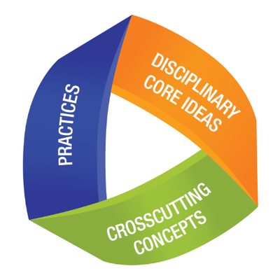
The Three Dimensions
Describe core ideas in the science disciplines
Describe behaviors scientists and engineers engage in
Describe concepts linking the different disciplines of science
Notes:
The NGSS performance expectations incorporate three important dimensions—science and engineering practices, disciplinary core ideas, and crosscutting concepts. Together, these dimensions promote classroom learning experiences that help students stimulate interest in and develop a cohesive understanding of science over time. Students actively engage in the practices to deepen their understanding of crosscutting concepts and disciplinary core ideas.
Let’s take a closer look at each dimension:
The science and engineering practices allow students to apply their knowledge of crosscutting concepts and disciplinary core ideas through inquiry, investigation, design, and development. The practical application of these practices helps students understand the relevance and importance of science, technology, engineering, and mathematics, or STEM, to real-world challenges.
The disciplinary core ideas are the key ideas that have widespread significance and impact on the four science and engineering disciplines. These core ideas anchor K–12 curriculum, instruction, and assessment in the foundational elements of science and engineering.
The crosscutting concepts encourage students to make connections between four science and engineering disciplines—Life Sciences, Physical Sciences, Earth and Space Sciences, and Engineering, Technology and Applications of Science—and develop a scientifically-based worldview. These concepts are applicable across all four disciplines and include, for example, cause and effect, proportion and quantity, and energy and matter.

Slide 7
Why unpack the dimensions of a performance expectation?
Unpacking the PE informs the design of a task
To provide a clear focus for what is to be measured and what constitutes evidence of student learning
To provide information on the boundaries of student performance
To design tasks that effectively measure students’ deeper and more sophisticated science understandings and practices
To plan and implement a coherent system of curriculum, instruction and assessment
Notes:
Educators need to have a clear vision for which science PEs, or indicators, they will teach and assess and a deep understanding of the nature, complexity, and sophistication of the three-dimensional PEs. An unpacking tool is a design tool that provides a clear focus for what is to be measured and what constitutes evidence of student learning. It helps educators obtain a deep understanding of the PE and its measurable aspects prior to task development.
The unpacking tool also helps educators describe the boundaries of student performance. By boundaries, we mean the foundational prior knowledge or performances that students should have attained in a previous grade, as well as the advanced knowledge or performances that fall outside the boundaries of the PE for the targeted grade level or span.
By determining the measurable aspects of each dimension of the PE, as well as the boundaries of student performance, educators gain an understanding of what constitutes evidence of student learning and the types of tasks that need to be developed to illustrate that learning. As a result, they can design tasks that effectively measure students’ deeper and more sophisticated science understandings and practices.
Just as we might find the area of a cube by determining the area of each square and adding them together, we explicate the PE by breaking it into its components, knowing that to reach our end goal of designing coherent, NGSS-aligned curriculum, instruction, and assessment requires that we combine those components in an integrated way. By pulling the dimensions apart, we better understand the expectations for student learning, how the dimensions are interconnected, and how they must be integrated into high-quality three-dimensional instruction.
Unpacking informs the design and content of tasks by providing a clear focus of what is to be measured and not measured within and across the three dimensions.

Slide 8

Resources and Additional Information
Notes:
Finally, we offer additional resources that may be helpful to anyone interested in learning more about the concepts presented in this module. A glossary of terms and our reference list follow.
Thank you for your engagement in this second chapter of the SCILLSS digital workbook on designing high quality three-dimensional science assessment tasks for classroom use.

Slide 9
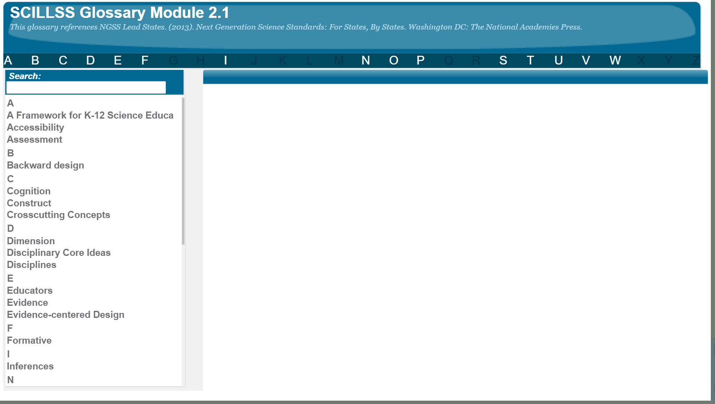
SCILLSS Glossary
Please refer to the SCILLSS Glossary for operational definitions of terms used.

Slide 10
Resources
In the Web Links pod, you can find the following resources:
An Introduction To The NGSS Created by Steve Figurelli
A Framework for K-12 Science Education
Next Generation Science Standards

Slide 11
References
National Research Council. (2012). A Framework for K-12 Science Education: Practices, Crosscutting Concepts, and Core Ideas. Washington, DC: The National Academies Press. https://doi.org/10.17226/13165.

