Slide 1
Designing High-Quality Three-Dimensional Science Assessments for Classroom Use
Chapter 2: Unpacking the NGSS Performance Expectations
Module 2.4: Resources for Unpacking
This digital workbook on designing high quality three-dimensional science assessment tasks for classroom use was developed by edCount, LLC, under
Enhanced Assessment Grants Program, CFDA 84.368A.
Notes:
Welcome to the second of four chapters in a digital workbook on designing high-quality three-dimensional science assessment tasks for classroom use. This workbook is intended to help educators design and evaluate high-quality classroom science assessment tasks that provide meaningful information about what students know and can do in science.
This digital workbook was developed by edCount, LLC, under the US Department of Education’s Enhanced Assessment Grants Program, CFDA 84.368A.

Slide 2


Module 2.4: Resources for Unpacking
Notes:
Chapter 2 of this workbook includes a series of six modules. Together, these six modules provide an in-depth exploration of the first phase of principled assessment design: development of the unpacking tool. In this chapter, we describe how to systematically unpack a performance expectation or indicator into its multiple components to develop a clear and deep understanding of each dimension and the boundaries of what can be assessed. We provide opportunities for you to engage in interactive activities and explore and use our design template to complete your own unpacking of a three-dimensional science standard.
In this module, Module 2.4, we present and describe the resources available to support the unpacking process. In later modules, Modules 2.5 and 2.6, we provide specific guidance for completing the unpacking tool and offer an interactive activity to evaluate the quality of an existing unpacking tool and to illustrate the importance and benefits of reviewing and continually refining the tool.

Slide 3
Module 2.4 Outcomes
Overview of Resources
Overview of Resources
To develop an understanding of the key resources for unpacking three-dimensional science standards, including:
Professional Expertise
A Framework for K-12 Science Education
NGSS/State Science Standards
Progressions
Evidence Statements
Notes:
In Module 2.4, we review key resources for unpacking a performance expectation, or indicator, and discuss how you can use your professional expertise as a science educator along with each of these resources to assist in the completion of an unpacking tool.

Slide 4
Resources for Unpacking
Professional Expertise
NGSS Evidence Statements
NGSS/State Science Standards
A Framework for K-12 Science Education
NGSS Progressions (the Appendices)
Notes:
Various resources are available to assist you with the unpacking process. We provide these resources in the Web Links pod and Resources pod for your reference during or following your completion of this module.
First, your professional expertise is invaluable. You are likely already well-versed in the NGSS or your state science standards, and you have first-hand experience implementing curriculum and instruction aligned to those standards. You also have a deep understanding of your students. You can bring to bear past experiences, including your observations of students’ knowledge, skills, and abilities before, during, and after instruction and your knowledge of how students learn science and acquire understanding over time. This experience will be helpful for defining the key aspects and prior knowledge of each dimension as well as the relationships between the CCC and SEP for the targeted PE.
However, it’s important to note that in addition to your expertise as an educator, you also have a wealth of information at your fingertips to assist with unpacking. As we take a closer look at the Framework and the NGSS PEs, evidence statements, and progressions, you’ll see how these resources can serve as the foundation for unpacking. There is no need to reinvent the wheel or to rely solely on your professional expertise when engaging in this work. Rather, our intent is to demonstrate how you can use your professional expertise in combination with these existing resources. Your scientific knowledge and your experience as a science educator and documentation such as the Framework and the NGSS PEs, evidence statements, and progressions can together provide useful information to support your unpacking.
Let’s first look at the Framework as a resource for building on your knowledge and expertise as it relates to the NGSS and how it is a critical resource that supports the development of the unpacking tool.

Slide 5
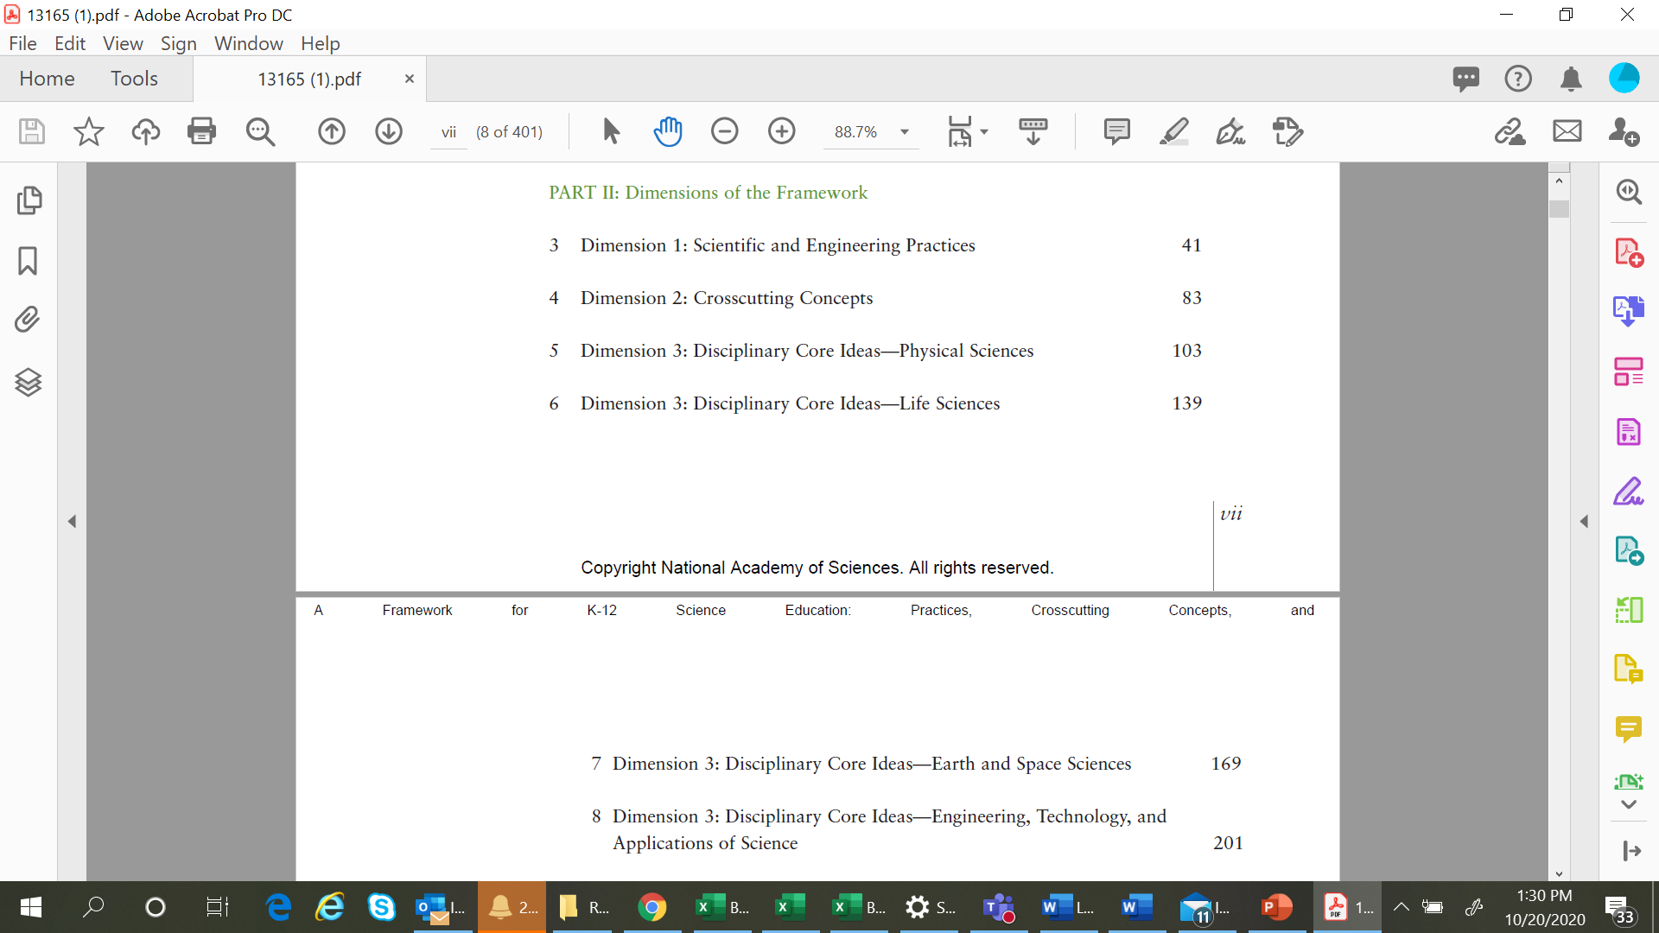
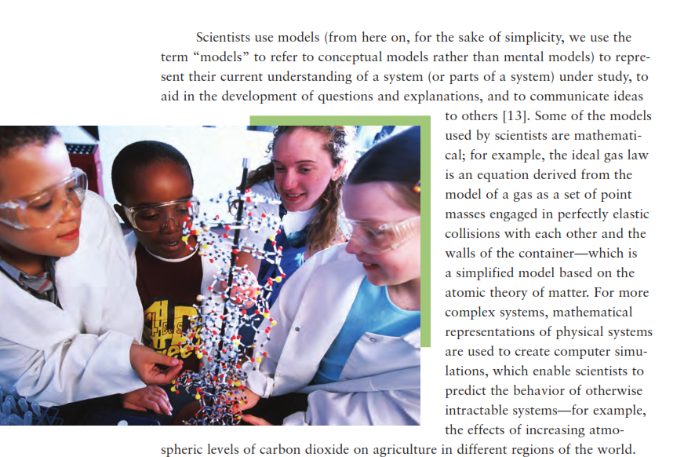
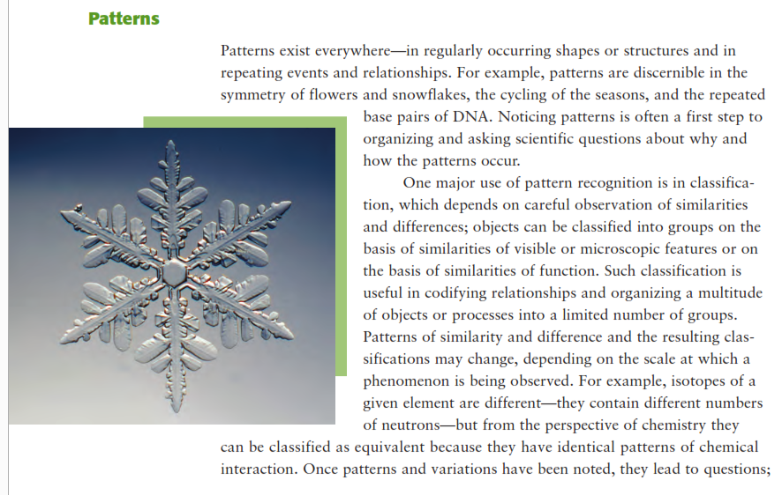
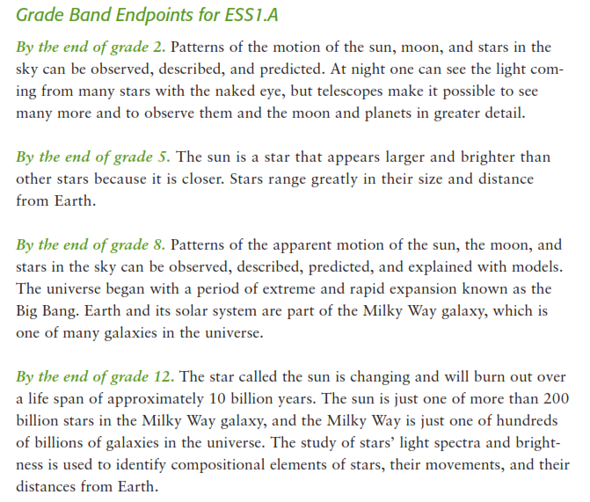
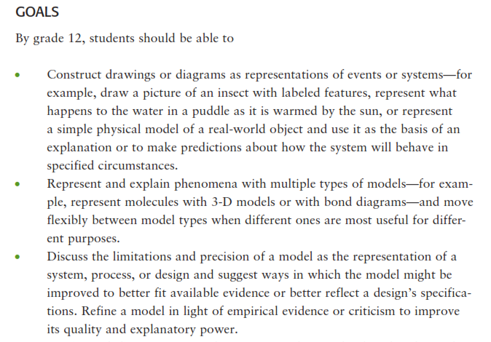
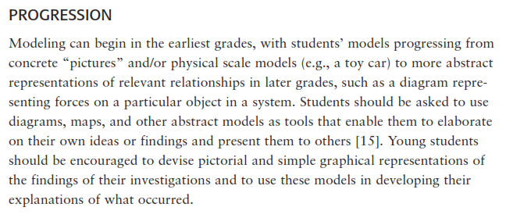
A Framework for K-12 Science Education
Notes:
A Framework for K–12 Science Education represents the initial step in a process to create new standards in K–12 science education—a common set of Next Generation Science Standards. This framework builds on the strong foundation of previous studies that sought to identify and describe the major ideas for K–12 science education. The Framework highlights the power of integrating the ideas of science with engagement in the practices of science and is designed to build students’ proficiency and appreciation for science throughout a K–12 educational experience.
The overarching goal of the Framework is to ensure that by the end of 12th grade, all students have some appreciation of the beauty and wonder of science; possess sufficient knowledge of science and engineering to engage in public discussions on related issues; are careful consumers of scientific and technological information related to their everyday lives; are able to continue to learn about science outside school; and have the skills to enter careers of their choice, including (but not limited to) careers in science, engineering, and technology.
Part two of the Framework explicates the dimensions—the SEPs, CCCs, and the disciplinary-related DCIs—by stressing the importance of developing students’ knowledge related to the dimensions, including detailed descriptions of each of the eight practices, the seven CCCs, and their value across the sciences and in engineering, and the DCIs organized by the disciplines of Life Sciences, Physical Sciences, Earth and Space Sciences, and Engineering, Technology and Applications of Science. In addition, part two of the Framework also describes grade 12 goals, the progression of the dimensions across K–12, or grade-band endpoints.
For our purposes, as we explore the multiple resources that will support your efforts to develop an unpacking tool and to highlight examples from these resources, we focus on a middle school NGSS PE, MS-ESS1-1: Develop and use a model of the Earth-sun-moon system to describe the cyclic patterns of lunar phases, eclipses of the sun and moon, and seasons.
Let’s look at the information provided in the Framework related to the SEP, Developing and Using Models, as it pertains to MS-ESS1-1. The Framework defines and describes how conceptual models allow scientists and engineers to better visualize and understand a phenomenon under investigation to develop a possible solution to a design problem. The Framework also includes the goals related to this SEP, which are to be met by grade 12, and how modeling progresses from the earliest grades.
Related to Patterns, the Framework provides a definition and examples of the crosscutting concept followed by a description of the progression beginning with young children through the upper elementary grades to middle and high school.
This is then followed by the DCIs, organized by discipline. We feature Earth and Space Science, ESS1.A and ESS1.B, as it relates to the PE MS-ESS1-1. The Framework describes the core ideas and how they progress across grade levels as grade band endpoints.
Now, let’s take a deeper dive into the architecture of the NGSS standards and how the NGSS appendices will support the development of the unpacking tool using the same middle school PE, MS-ESS1-1.

Slide 6
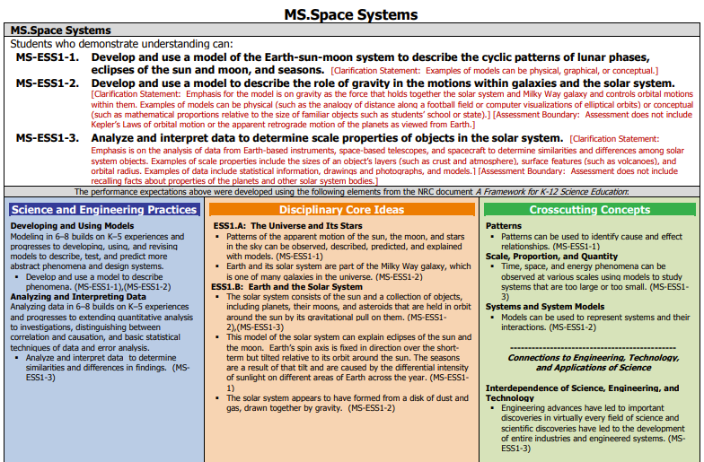
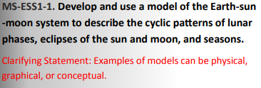
Topic Arrangements of the NGSS Standards
Notes:
At the beginning of the NGSS development process, to eliminate potential redundancy, seek an appropriate grain size, and seek natural connections among the DCIs identified within the Framework, the writers arranged the DCIs into topics around which to develop the standards.
This topical arrangement includes the foundation boxes, which indicate the related DCIs, SEPs, and CCCs, which address the set of PEs related to Space Systems.
Please pause the presentation to review the set of PEs and each PE’s corresponding statements in the foundation boxes. Note the statements specific to MS-ESS1-1 are circled and that in some instances, a statement may be associated with more than one PE, for example, as shown for the SEP, Developing and Using Models.
As shown here, states may have created NGSS-aligned science standards and organized the content of standards using unique formatting, coding systems, and organization of the content.
Please pause the presentation to review these three examples of state NGSS-aligned science standards. Consider your state’s science standards and how they may be similar or different in their formatting, coding system, and organization as compared to the NGSS.

Slide 7
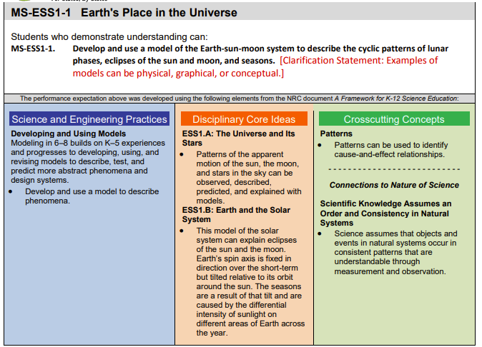
NGSS Evidence Statements
Notes:
On the next two slides, we examine another helpful resource for unpacking: the NGSS Evidence Statements. This slide shows the PE MS-ESS1-1 and its dimensions for which a set of evidence statements are provided. Before we review the evidence statements for this PE on the next slide, let’s get further oriented to the PE and its dimensions.
For a given sub-idea related to a topic, in this instance, Earth’s Place in the Universe, a single PE is indicated. The PE is stated in the context of what students can do to demonstrate understanding. This is followed by the foundation boxes, which identify the specific SEP, DCI or DCIs, and CCC aligned to this PE.
Please pause the presentation to review this PE and the content in the foundation boxes. Resume the presentation when you are ready to advance to the next slide and see the evidence statements for this PE.

Slide 8
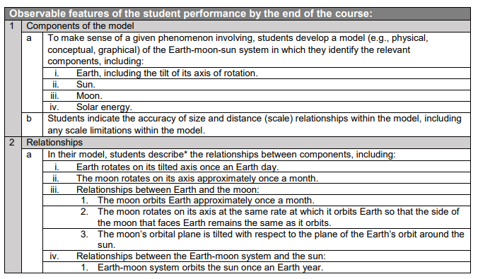
NGSS Evidence Statements
Notes:
NGSS Evidence Statements provide educators with additional detail on what students should know and be able to do to demonstrate understanding of a PE. The evidence statements are observable and measurable components that articulate how students can use the practice to demonstrate their understanding of the DCI, or DCIs, through the lens of the CCC, and thus, demonstrate proficiency on each PE. The evidence statements do this by clarifying: 1) how the three dimensions could be assessed together, rather than in independent units; 2) the underlying knowledge required for each DCI; 3) the detailed approaches to science and engineering practices; and 4) how crosscutting concepts might be used to deepen content- and practice-driven learning.
The science and engineering practices are used as the organizing structure for the evidence statements. Keep in mind that this does not mean that the practices are more important than the other dimensions. The proper integration of practices makes students’ thinking visible and provides an avenue for students to demonstrate full proficiency in a practice.
Note that the evidence statements are not created to be used as curriculum, nor prescribe the context through which the PEs are taught and assessed, or the sequence of PEs during instruction.
This slide shows a sample of the evidence statements for the PE, MS-ESS1-1. The full set of evidence statements for this PE is available in the Web Links pod. Please pause the presentation to access and familiarize yourself with the evidence statements for this PE. How are the dimensions represented and organized within the evidence statements? How do the evidence statements explicate the components of the model and the relationships and connections that demonstrate the observable features of student performance?

Slide 9
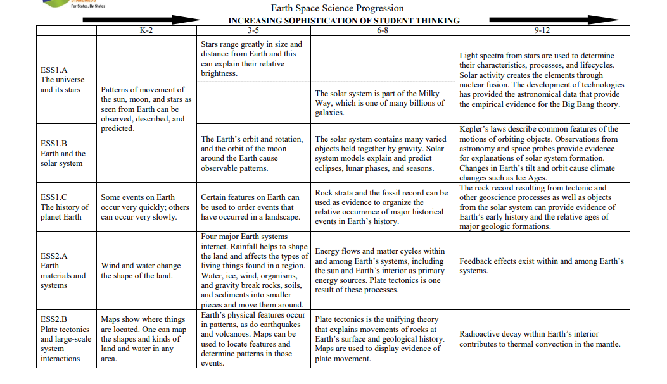
Appendix E. Disciplinary Core Idea Progressions
Notes:
Let’s shift gears and look at an additional set of resources, the NGSS appendices. We begin with an excerpt from Appendix E. Disciplinary Core Idea Progressions. The Framework describes the progression of disciplinary core ideas in the grade band endpoints. These grade band endpoints reflect an increase in students’ understanding of the disciplinary core ideas as they progress from one grade band to the next. Some of the sub-ideas within the disciplinary core ideas overlap significantly. You will notice there is not always a clear division between those ideas, so several progressions are divided among more than one sub-idea.
For the Earth Space Science Progression, the 6–8 grade band includes two sub-ideas: ESS1.A: The universe and its stars and ESS1.B: Earth and the solar system. They build on knowledge acquired at the 3–5 grade band that the sun is a star that appears larger and brighter than other stars because it is closer, stars range greatly in size and distance from the Earth and that this can explain their relative brightness, and the Earth’s orbit and rotation and the orbit of the moon around the Earth cause observable patterns (the Framework, NRC, 2012, p. 174). At the end of the 6–8 grade band, we want students to have a more sophisticated understanding of the solar system, including that patterns of the apparent motion of the sun, the moon, and stars in the sky can be observed, described, predicted, and explained with models (the Framework, NRC, 2012, p. 174), that Earth and its solar system, consisting of the sun and a collection of objects that are held in orbit around the sun by its gravitational pull on them (the Framework, NRC, 2012, p. 176), are part of the Milky Way Galaxy, and that this model of the solar system can explain tides, eclipses of the sun and the moon, and the motion of the planets in the sky relative to the stars (the Framework, NRC, 2012, p. 174).
As you unpack your selected PE, you can rely on Appendix E to help identify the key aspects, prior knowledge, and boundaries for assessment by looking carefully within and across the grade band progressions. For example, the progression at the 3–5 grade band provides information that should be considered prior knowledge for grades 6–8 students. Similarly, the progression at grades 9–12 provides ideas for what could be considered advanced knowledge or understanding and outside of the boundaries for assessment for grades 6–8 students.
The intent of the DCI progressions is not to promote separating the DCIs from the other two dimensions. Similarly, by engaging in the unpacking of a PE, we are not promoting teaching and assessing student learning of one dimension, separate from the other two. Our intent is instead to explicate the PE by breaking it into its components, knowing that to reach our end goal of designing coherent, NGSS-aligned curriculum, instruction, and assessment requires that we combine those components in an integrated way. By pulling the dimensions apart, we better understand the expectations for student learning, how the dimensions are interconnected, and how they must be integrated into high-quality three-dimensional instruction and assessment tasks. Unpacking informs the design and content of tasks by providing a clear focus of what is to be measured and not measured within and across the three dimensions

Slide 10
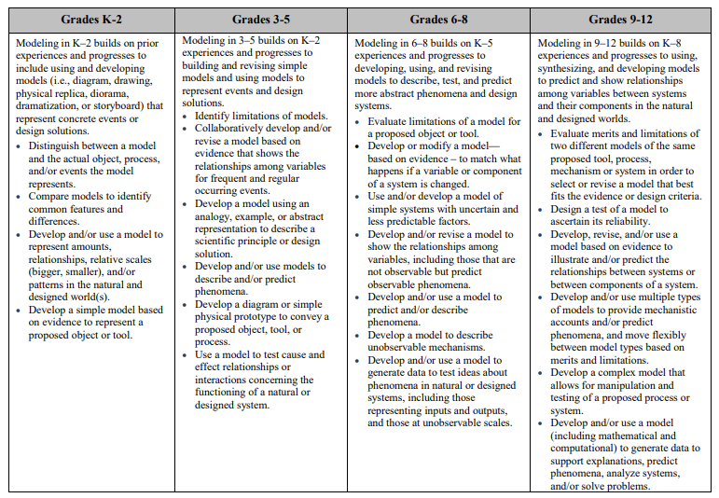
Appendix F. Science and Engineering Practices
Practice 2 Developing and Using Models
Notes:
The Framework specifies that each performance expectation must combine a relevant practice of science or engineering with a disciplinary core idea and crosscutting concept appropriate for students of the designated grade level. Engaging in the practices of science helps students understand how scientific knowledge develops and can lead students to an appreciation of the range of approaches that are used to investigate, model, and explain the world as scientists and engineers would.
Appendix F. Science and Engineering Practices includes the eight practices of science and engineering that the Framework identifies as essential for all students to learn. It describes how grade band expectations expand on the previous grade band’s experiences and progress to build a more sophisticated understanding of the SEP.
Here is an excerpt from Appendix F specific to Developing and Using Models for the PE, MS-ESS1-1. Cross-referenced with the progression of understanding for this SEP in the Framework, students in grades 6–8 should be using more sophisticated types of models, which is highly dependent on prior knowledge and skills and on their understanding of the system being modeled. This will lead students to develop a level of facility in constructing and applying appropriate models (the Framework, NRC, 2012, pp. 58-59). Note as compared to grades 3–5, where students are building and revising simple models and using models to represent events and design solutions, in grades 6–8, students are developing, using, and revising models to describe, test, and predict more abstract phenomena and design systems.
As you unpack your selected PE, you can rely on Appendix F to help identify the key aspects, prior knowledge, and boundaries for assessment by looking carefully within and across the grade band progressions. For example, the progression at the 3–5 grade band provides information that should be considered prior knowledge for grades 6–8 students. Similarly, the progression at grades 9–12 provides ideas for what could be considered advanced knowledge or understanding and outside of the boundaries for assessment for grades 6–8 students.

Slide 11
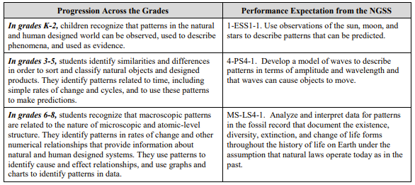
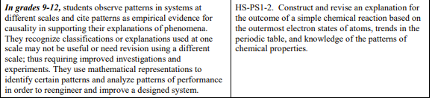
Appendix G. Crosscutting Concepts
CCC 1. Patterns
Notes:
Crosscutting concepts have value because they provide students with connections and intellectual tools that are related across the differing areas of disciplinary content and can enrich their application of practices and their understanding of core ideas (the Framework, NRC, 2012, p. 233). They bridge disciplinary boundaries, uniting core ideas throughout the fields of science and engineering.
Appendix G. Crosscutting Concepts provides a brief summary of how each crosscutting concept increases in complexity and sophistication across the grades as envisioned in the Framework and provides examples of PEs to illustrate how these concepts play out in the NGSS.
Here is an excerpt from Appendix G specific to Patterns, which is highlighted for the PE, MS-ESS1-1. For each grade band, the way students observe and use patterns becomes increasingly sophisticated. Cross-referenced with the progression of understanding for this CCC in the Framework, students in grades 6–8 relate patterns to microscopic and atomic-level structure; for example, they may note that chemical molecules contain particular ratios of different atoms. This more sophisticated understanding of patterns is born out of earlier learning in which students in upper elementary grades are analyzing patterns in rate of change, such as the growth rate of plants under different conditions (the Framework, NRC, 2012, pp. 86-87).
As you unpack your selected PE, you can rely on Appendix G to help identify the key aspects, prior knowledge, and boundaries for assessment by looking carefully within and across the grade band progressions. Again, the progression at the 3–5 grade band provides information that should be considered prior knowledge for grades 6–8 students. Similarly, the progression at grades 9–12 provides ideas for what could be considered advanced knowledge or understanding and outside of the boundaries for assessment for grades 6–8 students.

Slide 12

Resources and Additional Information
Notes:
Finally, we offer additional resources that may be helpful to anyone interested in learning more about the concepts presented in this module. A glossary of terms and our reference list follow.
Thank you for your engagement in this second chapter of the SCILLSS digital workbook on designing high-quality three-dimensional science assessment tasks for classroom use.

Slide 13
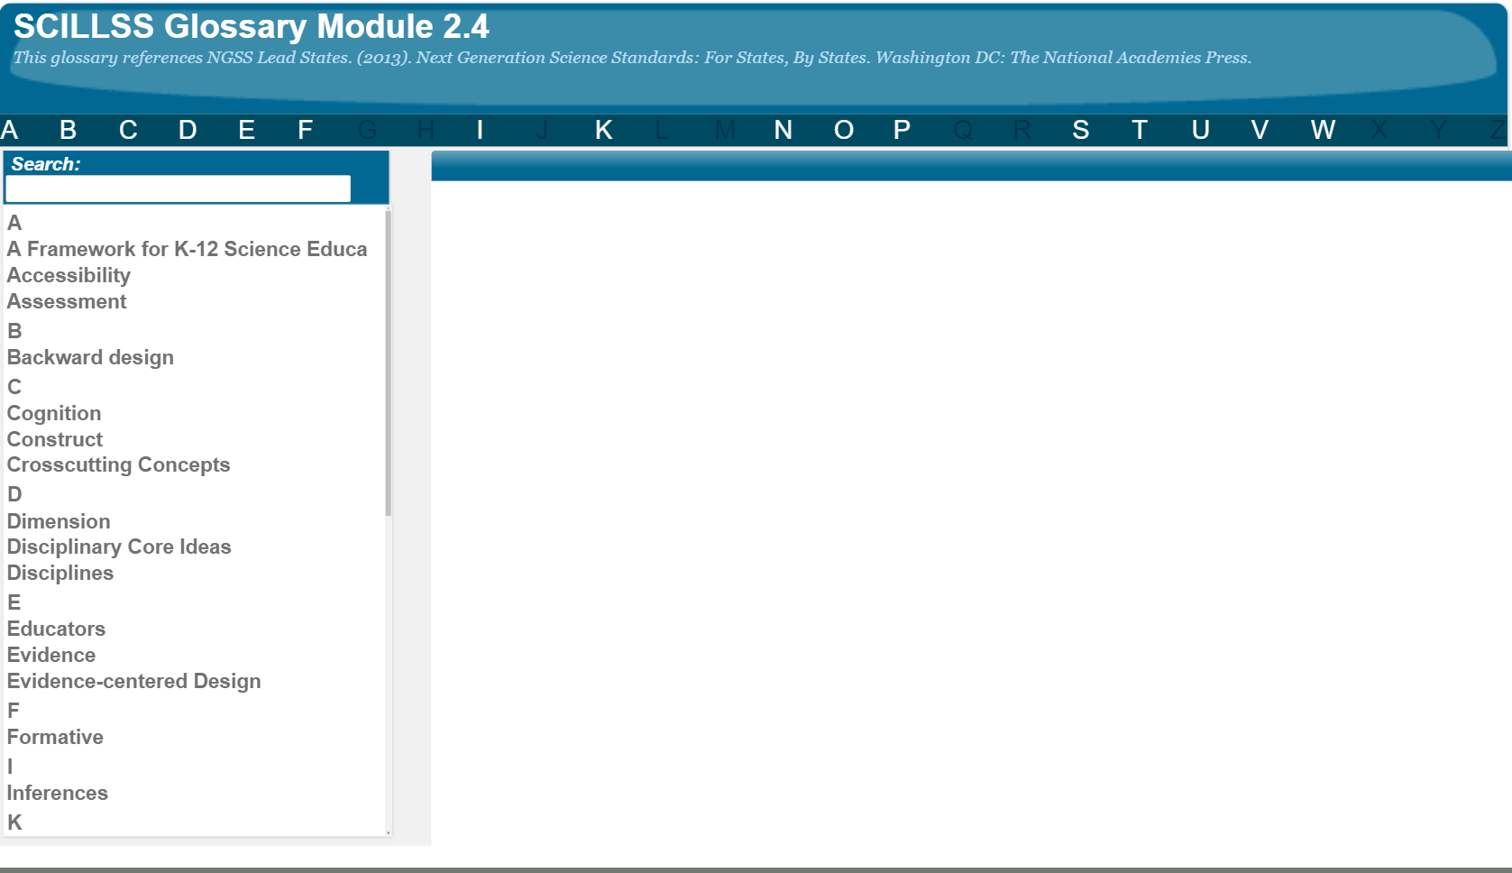
SCILLSS Glossary
Please refer to the SCILLSS Glossary for operational definitions of terms used.

Slide 14
Resources
In the Web Links pod, you can find the following resources:
A Framework for K-12 Science Education
Next Generation Science Standards
NGSS Evidence Statements
MS-ESS1-1 Evidence Statements
Appendix E: Disciplinary Core Idea Progressions
Appendix F: Science and Engineering Practices
Appendix G: Crosscutting Concepts
In the Resources pod, you can find the following resources:
NGSS Topic Arrangements of the Next Generation Science Standards

Slide 15
References
National Research Council. (2012). A Framework for K-12 Science Education: Practices, Crosscutting Concepts, and Core Ideas. Washington, DC: The National Academies Press. https://doi.org/10.17226/13165.

