Slide 1
Designing High-Quality Three-Dimensional Science Assessments for Classroom Use
Chapter 2: Unpacking the NGSS Performance Expectations
Module 2.5: Guidance for Completing the Unpacking Tool
This digital workbook on designing high quality three-dimensional science assessment tasks for classroom use was developed by edCount, LLC, under
Enhanced Assessment Grants Program, CFDA 84.368A.
Notes:
Welcome to the second of four chapters in a digital workbook on designing high-quality three-dimensional science assessment tasks for classroom use. This workbook is intended to help educators design and evaluate high-quality classroom science assessment tasks that provide meaningful information about what students know and can do in science.
This digital workbook was developed by edCount, LLC, under the US Department of Education’s Enhanced Assessment Grants Program, CFDA 84.368A.

Slide 2


Module 2.5: Guidance for Completing the Unpacking Tool
2
Notes:
Chapter 2 of this workbook includes a series of six modules. Together, these six modules provide an in-depth exploration of the first phase of principled assessment design: development of the unpacking tool. In this chapter, we describe how to systematically unpack a performance expectation or indicator into its multiple components to develop a clear and deep understanding of each dimension and the boundaries of what can be assessed. We provide opportunities for you to engage in interactive activities and explore and use our design template to complete your own unpacking of a three-dimensional science standard.
In this module, Module 2.5, we offer key strategies, guiding questions, and instructions for completing the unpacking process.

Slide 3
Module 2.5 Outcomes
Unpacking Tool Template
Unpacking Tool Template
To provide key considerations and strategies for developing an unpacking tool and to support engagement in the first phase of principled assessment design by developing an unpacking tool
Notes:
In the previous Chapter 2 modules, we explored the Next Generation Science Standards, including the PEs, dimensions, and evidence statements. We introduced the Unpacking Tool Template and described its elements—the key aspects, prior knowledge, and relationships between the CCC and SEP. You engaged in an interactive sorting activity to gain a deeper understanding of the dimensions and these elements of the unpacking tool. In the previous modules, we also explored the resources available to support the unpacking process.
You are nearly ready to start developing your own unpacking tool. But before you do, we have some important tips, strategies, and guiding questions to guide your work. By completing Module 2.5, you will have the tools you need to engage in the first phase of principled assessment design and develop your own unpacking tool.

Slide 4
Getting Started
Gather key resources
  A Framework for K-12 Science Education
  State Science Standards
  The NGSS
  NGSS Evidence Statements
  NGSS Appendices E, F, and G
  Unpacking Tool Template
Complete the foundation boxes in Unpacking Tool Template
Begin unpacking the dimension elements
Notes:
Let’s roll up our sleeves and get started. First, you’ll want to gather some key resources. As we shared in previous modules, unpacking a performance expectation can require referencing many documents and resources. Some key documents to start with include the Framework, State Science Standards, the NGSS, NGSS Evidence Statements, NGSS Appendices E, F, and G, and the Unpacking Tool Template. These resources are provided in the Web Links pod, and the Unpacking Tool Template is available for download in the Resources pod. As you access these materials, think about the easiest way to reference these documents. Some people find it easiest to use paper versions, and some prefer electronic.
Once you’ve gathered the necessary resources, select the performance expectation to unpack and populate the foundation boxes of the Unpacking Tool Template. Whether you are using the NGSS PEs and dimension elements or using other statements of student expectations and associated elements based on your state standards, complete the foundation box with the elements you will unpack.
Next, you will begin unpacking the dimensions into their key aspects, prior knowledge, and relationships between the CCC and SEP.

Slide 5
Getting Started—Unpacking the Elements
SEPs
Consider prior knowledge
DCIs
Identify the major concepts
Consider prior knowledge
CCCs
Describe essential features
Think about the components of the practice
Consider intersections of CCC and SEP
Notes:
The unpacking tool requires you to think critically about the three dimensions of the PE and what they really mean. What is it about your students that you want to understand related to each dimension? What does it mean for students to really engage with and understand the dimension?
Before you begin unpacking each dimension, refer to the NGSS foundation boxes to identify the SEP, DCI or DCIs, and CCC for the selected PE.
When unpacking the SEP, consider what it means to “do” the practice. What are its essential components? What knowledge and skills do students need to use in order to show that they can perform the practice?
When unpacking the DCI or DCIs, identify the intended meaning of the core idea. Is there one idea or several ideas in the statement? What scientific language or domain-specific words are used? Consider what knowledge and skills you expect students to have mastery of already.
When unpacking the CCC, ask yourself, “What are the key aspects of the CCC? How does the SEP interconnect with the CCC?”

Slide 6
Guiding Questions for Completing the Unpacking Tool
What are the key aspects, or the knowledge and skills, associated with each dimension of the PE?
What science learning would you expect students to have acquired in previous grades or through previous instruction with respect to the three dimensions of the assessed PE?
Notes:
As you engage in the process, ask yourself these important questions:
What are the key aspects, the knowledge and skills, associated with each dimension of the PE, and what science learning would you expect students to have acquired in previous grades or through previous instruction with respect to the three dimensions of the assessed PE?

Slide 7
Strategies for Completing the Unpacking Tool
Use the following strategies to complete the unpacking tool:
  Use all of the suggested resources and your knowledge and experience.
  Individually examine the CCC, SEP, and DCI or DCIs and ask what the expectations within those dimensions mean.
  Think about each dimension separately to ensure that when the dimensions are brought back together, they are all reflected in the assessment task.
  Identify the key aspects within each of the three dimensions that are represented in the PE, but may not be explicitly stated.
Notes:
Let’s review some strategies to support your unpacking. As we discussed previously, there are many resources you can use in combination with your professional expertise. Using these resources, focus on each dimension one at a time. Individually examine the CCC, SEP, and DCI or DCIs and ask what the expectations within those dimensions mean. By thinking about the dimensions separately, you can ensure that when you bring them back together, they are all reflected in the assessment task.
Also, when you think about the key aspects of each dimension, remember to consider not only what is explicit in the PE, but also those expectations that are not entirely explicit. What are those key aspects that are more inherent or implicit in the PE? These are the underlying concepts that represent knowledge necessary for understanding or investigating more complex ideas and solving problems.

Slide 8
Strategies for Completing the Unpacking Tool, Cont.
Use the following strategies to complete the unpacking tool:
  Consider the prior knowledge or the background knowledge that is expected of students to develop an understanding of the SEP and DCI(s).
  Consider the relationships between the CCC and the SEP. When students are performing a SEP, they are often addressing one of the CCCs.
Notes:
Finally, consider the prior knowledge or the background knowledge that is expected of students to develop an understanding of the SEP and DCI or DCIs. Also, consider the relationships between the CCC and the SEP. When students are performing a SEP, they are often addressing one of the CCCs. For example, the CCC Scale, Proportion, and Quantity is an essential consideration when deciding how to develop a model to describe a phenomenon.

Slide 9

Unpacking Tool Development
Ready to start unpacking?
Access these grade or grade-band specific documents:
  Next Generation Science Standards
  NGSS Evidence Statements
  NGSS Appendices E, F, and G
  Unpacking Tool Template
  SCILLSS Model Unpacking Tools for Grade 5, Middle School, and High School
  Guidance to Complete Activities—Unpacking Tool
Complete the unpacking tool for your grade or grade band independently, with a partner, or in a small group.
Notes:
As you engage in the work of unpacking either independently, with a partner, or in a small group, we encourage you to notate your use of the resources directly in your Unpacking Tool Template. This will allow you to track your thinking and document how you have specifically used the resources to develop the tool. Where did you find the information? What is your justification for saying something is prior knowledge? Perhaps, in Appendix G of the crosscutting concepts progressions, you found a statement at the 3–5 grade band that is prerequisite or prior knowledge for the middle school PE you are unpacking. By notating the source of the prior knowledge, you can document and defend how you came to that determination.
Also, remember that the Framework is a foundational resource as it sets forth a vision for education in the sciences and engineering in which students, over multiple years of school, actively engage in scientific and engineering practices and apply crosscutting concepts to deepen their understanding of the core ideas in these fields (the Framework, p. 8-9). Further, it describes each of the dimensions in terms of its intent and use and provides narratives that define the expectations by grade 12 goals, the progression of the dimensions across K–12, or grade-band endpoints. This information can help ground your thinking about how you define the key aspects, prior knowledge, and relationships among the CCC and SEP as you complete the Unpacking Tool Template. You also have access to the NGSS Evidence Statements, which provide additional detail on what students should know and be able to do to demonstrate understanding of a PE and help to pull apart the PE. We encourage you to rely on your content knowledge and experience in combination with these resources.
To further help with your unpacking, refer to the Guidance to Complete Activities for the Unpacking Tool located in the Resources pod for download. This document offers some additional key aspects, guiding questions, and strategies to support you with your unpacking. We also provide completed unpacking tools at the elementary, middle, and high school grade bands. Refer to these models as examples of what the outcomes of this process might look like.

Slide 10

Resources and Additional Information
Notes:
Finally, we offer additional resources that may be helpful to anyone interested in learning more about the concepts presented in this module. A glossary of terms and our reference list follow.
Thank you for your engagement in this second chapter of the SCILLSS digital workbook on designing high-quality three-dimensional science assessment tasks for classroom use.

Slide 11
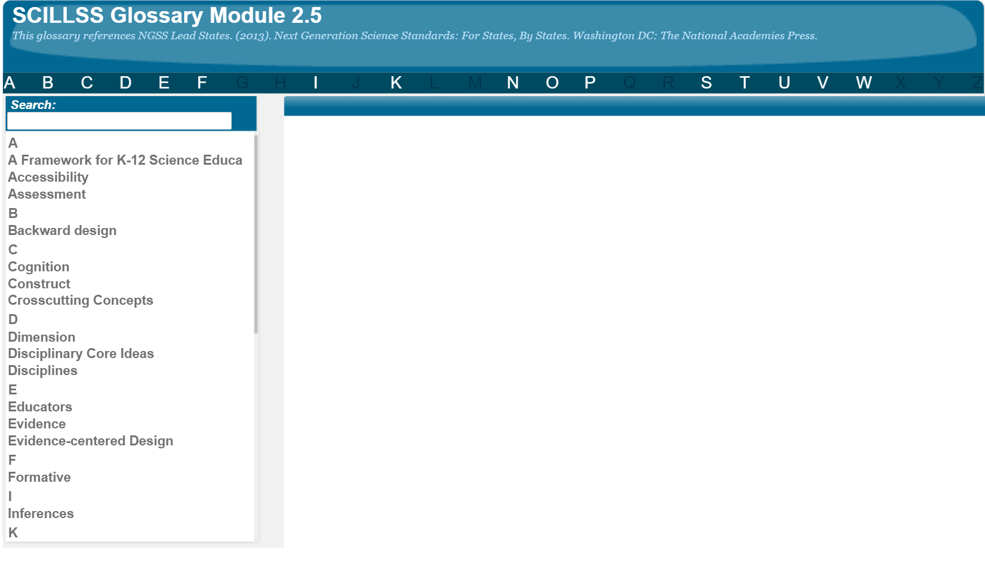
SCILLSS Glossary
Please refer to the SCILLSS Glossary for operational definitions of terms used.

Slide 12
Resources
In the Web Links pod, you can find the following resources:
A Framework for K-12 Science Education
Next Generation Science Standards
NGSS Evidence Statements
Appendix E: Disciplinary Core Idea Progressions
Appendix F: Science and Engineering Practices Progressions
Appendix G: Crosscutting Concepts Progressions
In the Resources pod, you can find the following resources:
Unpacking Tool Template
Guidance to Complete Activities—Unpacking Tool
SCILLSS Model Unpacking Tools

Slide 13
References
National Research Council. (2012). A Framework for K-12 Science Education: Practices, Crosscutting Concepts, and Core Ideas. Washington, DC: The National Academies Press. https://doi.org/10.17226/13165.

