Slide 1
Designing High-Quality Three-Dimensional Science Assessments for Classroom Use
Chapter 1: Introduction to Principled Assessment Design
Module 1.3: Phases of Principled Assessment Design: A Backward Design Approach
This digital workbook on designing high-quality three-dimensional science assessment tasks for classroom use was developed by edCount, LLC, under
Enhanced Assessment Grants Program, CFDA 84.368A.
Notes:
Welcome to the first of four chapters in a digital workbook on designing high-quality three-dimensional science assessment tasks for classroom use. This workbook is intended to help educators design and evaluate high-quality classroom science assessment tasks that provide meaningful information about what students know and can do in science.
This digital workbook was developed by edCount, LLC, under the US Department of Education’s Enhanced Assessment Grants Program, CFDA 84.368A.

Slide 2
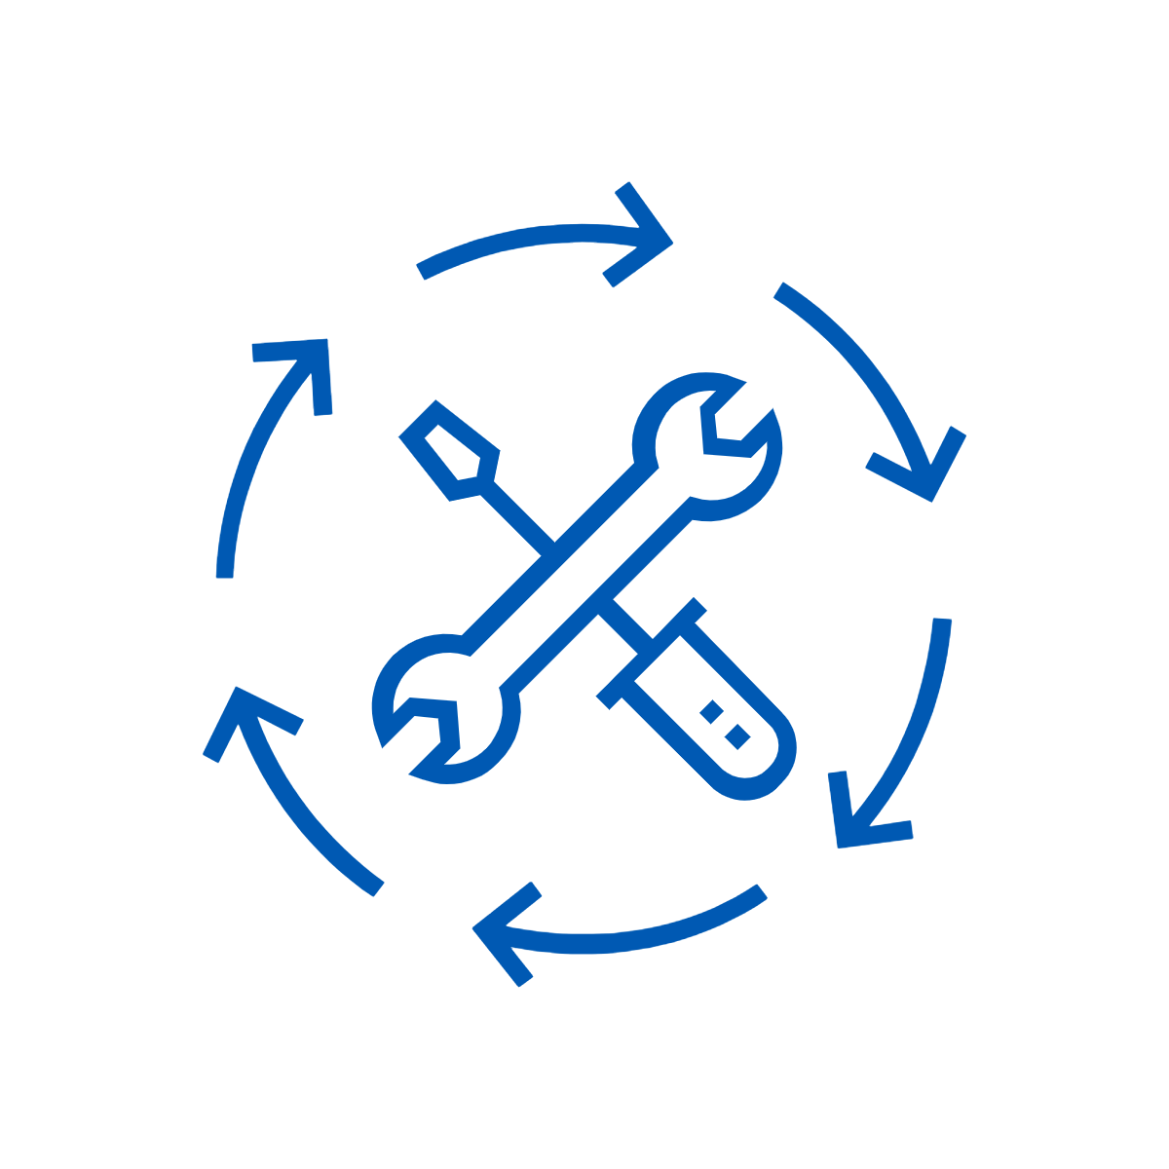

Module 1.3:
Phases of Principled Assessment Design: A Backward Design Approach
2
Notes:
Chapter 1 of this workbook includes a series of three modules. Module 1.1 focuses on classroom-based assessments, their relationship to other forms of assessment, and their purposes and uses in a standards-based system of curriculum, instruction, and assessment. Modules 1.2 and 1.3 introduce principled-assessment design, a backward design approach for developing three-dimensional tasks aligned to the Next Generation Science Standards (NGSS) for use within classrooms.
In these Chapter 1 modules, we lay the groundwork for educators to engage in intentional assessment design by considering the purposes and uses of classroom assessments and the types of tasks and situations that elicit evidence that supports meaningful interpretations of students’ science learning.

Slide 3
Module 1.3 Outcomes
Principled Assessment Design
To understand the key tenets of principled assessment design and its connection to backward design
Principled Assessment Design
Phases of Principled
Assessment Design
To introduce the four phases of principled assessment design:
Phase 1: Unpacking Tool
Phase 2: Task Specifications Tool
Phase 3: Task, Rubrics, and Exemplars
Phase 4: Task Administration
Phases of Principled Assessment Design
Purpose and Benefits of
the Phases
To understand the purposes and benefits of each phase of principled assessment design
Purpose and Benefits of the Phases
Notes:
Module 1.3 introduces the four phases of principled assessment design and describes the purpose and benefits of each phase. The module also describes principled assessment design as a form of backward design in which the development of tasks begins with the end goals for student learning in mind.
At the conclusion of this module, it is our intention that you understand the key tenets of principled assessment design, the connection between backward design and principled assessment design, and the four phases of principled assessment design, including their purposes and benefits.

Slide 4


Defining Terms: Task
A task is a set of interrelated questions, or prompts, organized around a common scenario, phenomenon, or design problem that collectively measures and supports inferences about students' three-dimensional science learning as described in a given performance expectation or indicator.
Notes:
A task is a set of interrelated questions, or prompts, organized around a common scenario, phenomenon, or design problem that collectively measures and supports inferences about students’ three-dimensional science learning as described in a given performance expectation or indicator.

Slide 5
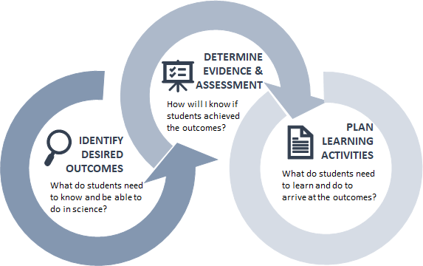
Defining Terms: Backward Design
Backward design is a method of designing an educational curriculum starting with the end goals for students in mind.
Source: Adapted from Wiggins, G.P. & McTighe, J. (2005).
Notes:
Backward design is a method of designing an educational curriculum starting with the end goals for students in mind. Before we can determine forms of assessment and the evidence that needs to be collected, and before we can design learning activities, we must first understand what it is we expect students to know and be able to do in science. As Stephen R. Covey states in his book, The Seven Habits of Highly Effective People, “To begin with the end in mind means to start with a clear understanding of your destination. It means to know where you're going so that you better understand where you are now so that the steps you take are always in the right direction.”

Slide 6

Educator Pathway to Utilizing Backward Design
Select a three-dimensional science standard and determine expected student learning outcomes
Build understanding of the dimensions and science background knowledge
Create high-quality assessments that elicit evidence of student learning
Administer assessments and use results to inform and adjust instruction
Plan for instruction for ALL students using effective teaching practices
Notes:
The educator pathway to utilizing backward design allows for the development and use of assessments and instruction in the service of learning. As we discussed in the previous slide, learning is the motivator for the entire process, and collecting evidence which demonstrates learning is the only way we, as educators, can know that learning has occurred.
Each NGSS performance expectation combines a science or engineering practice, disciplinary core idea, and crosscutting concept into a single statement of what is to be taught and assessed at a grade level or grade band. Educators need to have a clear vision for which standards they will teach and assess and a deep understanding of the nature, complexity, and sophistication of the three-dimensional science standards.
This deep understanding then leads to determining what constitutes evidence of student learning and the types of tasks that need to be developed to illustrate that learning. Tasks need to be developed in the service of deeper and more sophisticated science understandings and practices.
Educators then plan for instruction and the use of effective teaching practices that promote accessibility and engagement for all students as they integrate and demonstrate their understanding of the three dimensions. Providing teaching and learning experiences in this way ensures that assessments will yield meaningful information that helps educators put their finger on the pulse of where students are in their science learning.
Consequently, having this meaningful assessment information allows educators to make meaningful and defensible adjustments to instruction.

Slide 7

Backward Design Meets Principled Design
Principled assessment design is a form of backward design that considers three key questions:
3. What tasks or situations should elicit those products that can be teacher-scored across a range of student abilities?
1. What knowledge, skills, and abilities (KSAs) can be assessed for a selected three-dimensional science performance expectation?
2. What student products (what students produce in a task) can provide evidence of learning the selected KSAs?
Notes:
There are different types of principled design approaches. Our approach focuses on evidence and is based on Messick’s 1994 work on evidence-centered design. Our approach asks three key questions:
The first question focuses on what you want to say and what you want to know about your students. It might be one thing, or it might be multiple things. You should consider each of the things you want students to know.
The second question refers to the evidence model. This is where you think about the kind of evidence that you need to collect. What do you need to see your students do? What do you need to hear them say? How can your students demonstrate what they know and can do?
Then the third question asks, “What tasks and situations would provide that evidence?” What do you want to be presented back to you? What do students need to produce that would give you the evidence you need? What do you do with the evidence? How do you score it, and what does it tell you about your students?
Think about your evidence model; if you know what you want to see the students do, how can you create tasks that give students the opportunity to do that?
Each of these questions aligns to a phase in the process of classroom task development. The process, derived from Messick’s five-phased approach, is streamlined into four phases for the purpose of supporting educators in their development and implementation of classroom-based assessment tasks.
On the next slide, we will begin to introduce and share the purpose and benefits of each phase of principled design. We will also introduce the design tools associated with each phase.

Slide 8
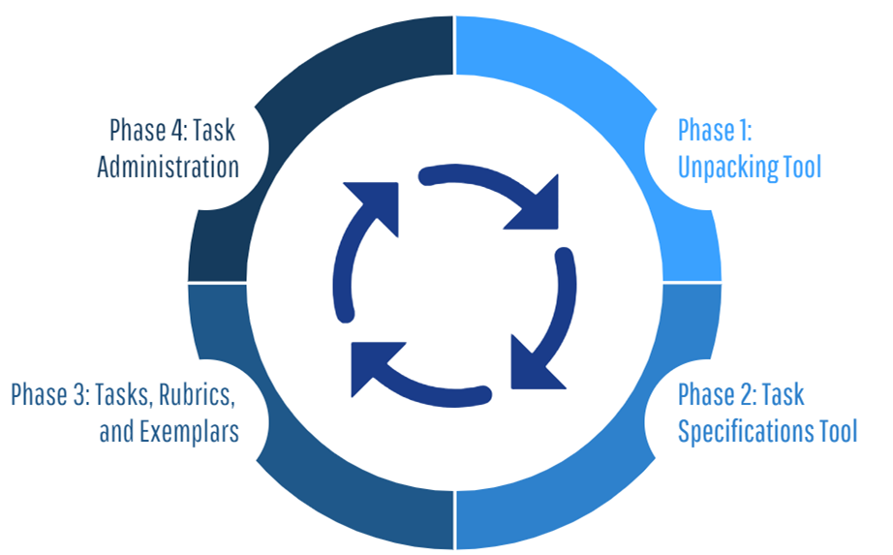
Phases of Principled Assessment Design
Notes:
Traditional assessment strategies may not yield enough evidence of students’ abilities to use scientific practice, think critically, and communicate ideas as intended by the Framework and the NGSS. For educators to effectively implement assessment as part of their pedagogy, they need a manageable process—a principled assessment design process—and a reasonable number of design tools for creating tasks and collecting and scoring student performance.
We present a four-phase intentional approach, referred to as a principled assessment design, that begins with the end in mind.
Phase 1: Development of the Unpacking Tool focuses on what the standard, or performance expectation, means. What should a student know and be able to do? What are the requirements of students and what are you trying to measure?
Phase 2: Development of the Task Specifications Tool considers the many possible ways the construct could be measured. What are the possible things you want to say about your students? What evidence needs to be gathered? What are the characteristic features of tasks? How will students demonstrate their learning? What work products will they produce? In this phase, the task designer is still not thinking about this in the context of a particular task but is developing a palette of design options and task features that can be used to assess the construct in a variety of ways.
Phase 3: Development of the Task and Rubric involves the creation of the task, rubric, and student exemplars. Which task features and work products from the task specifications tool will elicit the appropriate evidence to support valid inferences about students’ ability to explain phenomena or design solutions to problems? What are the constraints for administering the task? For example, let’s say you have 10 minutes to administer a task during a lesson or instructional sequence; you will need to think about what is feasible to administer to students within that time period.
Phase 4: Task Administration includes the administration and evaluation of the task and the purposeful use of the results. What does the evaluation of student evidence show about students’ knowledge, skills, and abilities? What does it reveal about their misconceptions or gaps in learning? How well can students transfer their learning to new contexts? Based on what the evidence yields, what instructional decisions will you make? Do students need reteaching or are they ready for new learning.

Slide 9
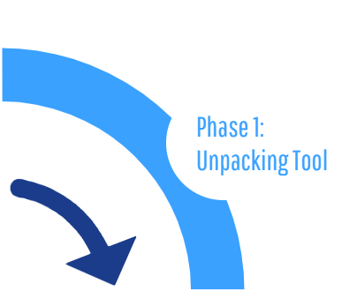
The Pathway to Principled Assessment Design: Phase 1
Why unpack a NGSS performance expectation
or state science standard?
To provide a clear focus for what is to be measured and to help educators plan for assessment​
To obtain a clear and deep understanding of the PE and its underlying concepts that support each dimension
To provide information on how students engage with key aspects within and across the dimensions
To provide information on the boundaries of student performance
Notes:
Phase 1 includes the Unpacking Tool—a design tool that provides a clear focus for what is to be measured and helps educators plan for assessment. The Unpacking Tool provides a systematic approach to unpacking a performance expectation or indicator into its multiple components to ensure educators who are designing NGSS-aligned tasks have a clear and deep understanding of each dimension prior to beginning task development. This, in turn, allows educators to gain an understanding of how students might engage with the different key aspects of each of the dimensions, and to importantly define the boundaries of what can be assessed. What can be expected with respect to students’ prior knowledge? What science content is considered above grade level? These are all critical aspects of assessment development. The Unpacking Tool enables you to define and make meaning of “the what” of assessment!

Slide 10
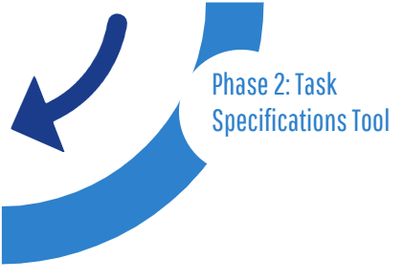
The Pathway to Principled Assessment Design: Phase 2
Why define multiple elements of a Task Specifications Tool ?
To clearly lay out the assessment argument
To translate the unpacking of the dimensions into elements of the assessment tasks
To identify what will be covered
To identify what will not be covered
To define how knowledge is demonstrated by the student
Notes:
Phase 2 includes the Task Specifications Tool—a design tool that allows educators to translate the unpacking of the three dimensions of a specific performance expectation into assessment tasks. Task specifications allow educators to determine what counts as evidence for student learning. The Task Specifications Tool is intended to help educators develop assessment tasks that allow students opportunities to call upon, transfer, and apply learning that has occurred during instruction to new challenges, much the way a scientist or engineer would, in an assessment situation. The Task Specifications Tool enables you to define “the how” of assessment!

Slide 11
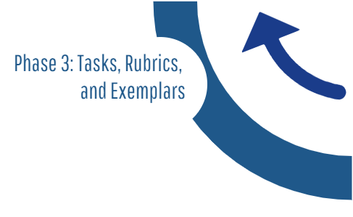
The Pathway to Principled Assessment Design: Phase 3
Why is the creation of high-quality tasks,
interpretable rubrics, and exemplars essential?
To engage a wide range of students with authentic, real-world contexts and phenomena or design problems
To provide students with opportunities to transfer and apply their knowledge using reasoning and integration of the dimensions
To promote accessibility for all learners through questions that are fair and equitable
To ensure alignment to the assessment argument and the intended purpose
To provide evidence that can be used by educators to make consistent and accurate inferences about students' learning
Notes:
Phase 3 includes the design of the task, rubric, and student exemplars. High-quality tasks make students’ thinking visible. They promote accessibility for all learners through questions that are fair and equitable. They engage a wide range of students with authentic, real-world contexts and phenomena or design problems. These NGSS-aligned tasks are multi-dimensional; they elicit evidence related to students’ ability to integrate their knowledge of DCIs while engaging in the scientific practices and building connections across ideas (CCCs) and they provide opportunities for students to transfer and apply their knowledge to new or novel contexts.
An important step in this process is considering how you are going to score the task; therefore, the scoring rubric is developed at the same time as the task. The rubric helps to highlight what you’re measuring with the task and helps to evaluate whether the task allows students to provide evidence that they have attained the intended learning outcomes. A well-written rubric ensures that the full range of student understanding is represented based on the type of expected evidence from low to high levels of competency. It also supports meaningful interpretability and utility by educators.
This phase also involves the development of student exemplars. Student exemplars are models of student performance that illustrate the qualities of a high-level response that is scientifically accurate, complete, and coherent.
Phase 3 enables you to combine the “what” and the “how” to create high quality tasks that elicit evidence to support valid inferences about what your students know and can do in science.

Slide 12
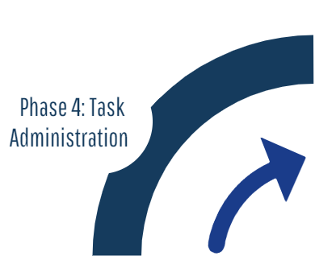
The Pathway to Principled Assessment Design: Phase 4
What are the intended outcomes of task administration?
To determine what instructional adjustments are necessary, where reteaching may need to occur OR if new instruction can be planned to improve student learning
To determine students' science understanding, misunderstandings or misconceptions based on observation, data, and student products
To determine where students’ science knowledge is incorrect, incomplete, or influenced by misconception
Notes:
Phase 4 includes the administration and evaluation of the task and the purposeful use of the results. In this phase, educators determine when to assess. This decision is born out of observing students during science investigations, monitoring student-generated questions and problem-solving strategies, and when evidence of student learning is needed along the educational pathway. Assessments might be administered prior to instruction, within a unit, or after a single or multiple units of instruction.
Educators must also determine how to evaluate and use the results. Following the administration of the task and the application of the rubric and comparison of student responses or work products to the student exemplars, educators will have the necessary information to make informed decisions about when and how instruction may need to be adjusted for individual students, groups of students, or the whole class.

Slide 13
Concluding Remarks
Know the standard well to define what is taught and what is assessed. Curriculum, instruction, and assessment should be built from the same goals for student learning.
Different assessments have different purposes. Think intentionally about how to plan and use assessments at key points throughout an instructional sequence.
Assessment tasks must elicit the “right” evidence that can be used by educators to make consistent and accurate inferences about students' learning.
Principled design promotes accessibility and engagement for all learners through questions that are fair and equitable, and tasks that are framed in authentic, real-world contexts and phenomena or design problems.
Creating assessments using principled design is an iterative, backward design process that begins with the end goals for students in mind.
Notes:
Take a moment to read and reflect on these concluding remarks. Think about one aspect of principled design that might help to improve your practice as an educator. How might your school or district benefit from principled design? Is there one aspect that stands out as particularly salient or interesting?
Defining the nature of student understanding and developing ways to assess their learning utilizing a principled-design approach is challenging, but achievable. This is where the payoff occurs for all of your intentional and hard work. Your investment in principled design, your increasing facility with this process, and the way in which you now approach assessment development, beginning with the end goals in mind, will allow you to consistently develop assessments that are coherent with your standards, curriculum, and instruction. And the tools that you have developed and the decisions you have made to design high-quality assessment tasks will result in meaningful information about student learning that will directly inform your teaching.
In Chapter 2, join us as we take a deep dive into Phase 1: Development of the Unpacking Tool. Engage in interactive activities and explore and use our design template to complete your own unpacking of a three-dimensional science standard. Learn first-hand how to systematically unpack a performance expectation or indicator into its multiple components and develop a clear and deep understanding of each dimension and the boundaries of what can be assessed.

Slide 14


Resources and Additional Information
Notes:
Finally, we offer additional resources that may be helpful to anyone interested in learning more about the concepts presented in this module. A glossary of terms and our reference list follow.
Thank you for your engagement in this first chapter of the SCILLSS digital workbook on designing high-quality three-dimensional science assessment tasks for classroom use.

Slide 15
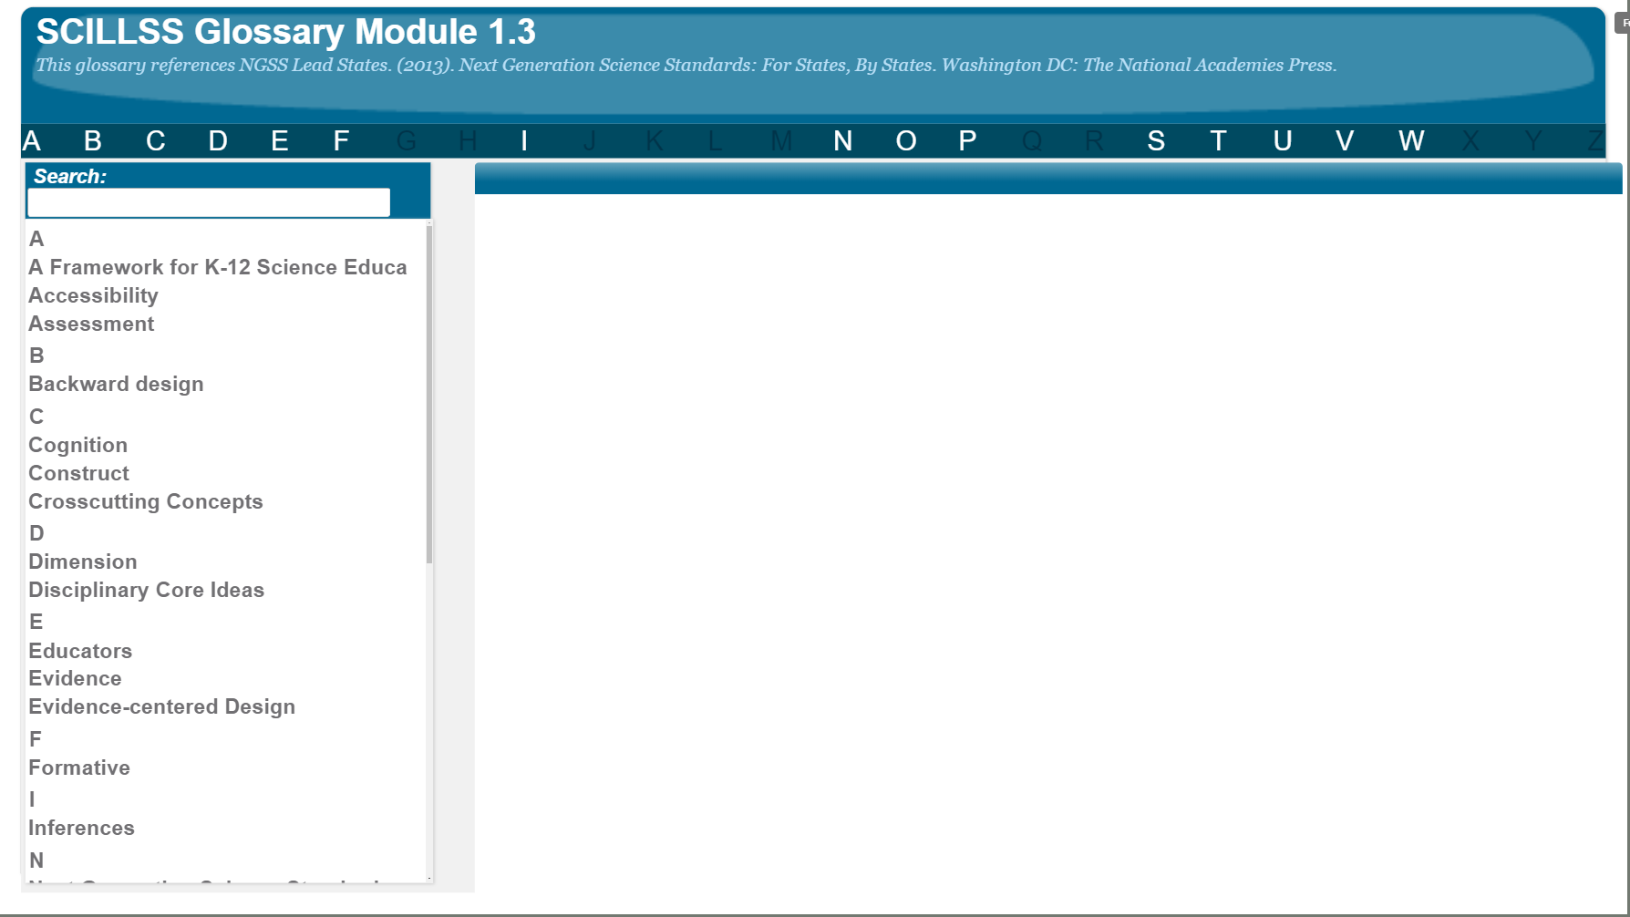
SCILLSS Glossary
Please refer to the SCILLSS Glossary for operational definitions of terms used.

Slide 16
Web Links
In the web links pod, you can find the following resources:
A Framework for K-12 Science Education
Next Generation Science Standards

Slide 17
References
Covey, Stephen R. (2004). The 7 habits of highly effective people: restoring the character ethic. New York, NY: Free Press.
Messick, S. (1994). The interplay of evidence and consequences in the validation of performance assessments. Educational Researcher, 23(2), 13-23.
Mislevy, R. J., & Riconscente, M. M. (2006). Evidence-centered assessment design: Layers, concepts, and terminology. In S. Downing & T. Haladyna (Eds.), Handbook of Test Development (pp. 61-90). Mahwah, NJ: Erlbaum.
Wiggins, G.P. & McTighe, J. (2005). Understanding by design. Alexandria, VA: Association for Supervision and Curriculum Development.

