Slide 1
Designing High- Quality Three-Dimensional Science Assessments for Classroom Use
Chapter 3: Development of the Task Specifications Tool
Module 3.1: Overview of the Purpose of the Task Specifications Tool
This digital workbook on designing high quality three-dimensional science assessment tasks for classroom use was developed by edCount, LLC, under
Enhanced Assessment Grants Program, CFDA 84.368A.
Notes:
Welcome to the third of four chapters in a digital workbook on designing high-quality three-dimensional science assessment tasks for classroom use. This workbook is intended to help educators design and evaluate tasks that provide meaningful information about what students know and can do in science.
This digital workbook was developed by edCount, LLC, under the US Department of Education’s Enhanced Assessment Grants Program, CFDA 84.368A.

Slide 2


Module 3.1:
Overview of the Purpose of Developing Task Specifications
2
Notes:
Chapter 3 of this workbook includes a series of six modules. Together these six modules provide an in-depth exploration of the second phase of principled assessment design: development of the task specifications tool. In this chapter, we focus on translating the unpacking of the three dimensions of a specific performance expectation, or indicator, into assessment tasks using a task specifications tool. We provide opportunities for you to engage in interactive activities and explore and use our design template to complete your own task specifications tool for a three-dimensional standard.
We begin this chapter with Module 3.1. In this module, we provide an orientation to the role of sensemaking in three-dimensional science tasks to explain and investigate phenomena and engineering design problems. We also share the purpose and benefits of completing a task specifications tool. In later modules, we offer completed task specifications tools at the elementary, middle, and high school grade bands to illustrate the outcomes of the process as well as resources, key strategies, and guiding questions for completing a task specifications tool.

Slide 3
Module 3.1 Outcomes
The Role of Sensemaking
Developing Task Specifications
The Role of Sensemaking
To understand the role of sensemaking to explain phenomena and design solutions to problems in NGSS-aligned curriculum, instruction, and assessment
Developing Task Specifications
To review the purpose and benefits of a task specifications tool template in the principled assessment design process
Notes:
In this module, Module 3.1, we begin to think about the second phase of principled assessment design by understanding the role of sensemaking in considering what we want to say about students and how specific features of tasks can help to elicit the right evidence to support those claims. We explain how the development of a task specifications tool can offer a palette, or menu, of design options to choose from during task development. This process is a key step in a principled assessment design process and will equip you with the information you need to develop high-quality classroom assessment tasks that provide meaningful information about students’ science learning.

Slide 4


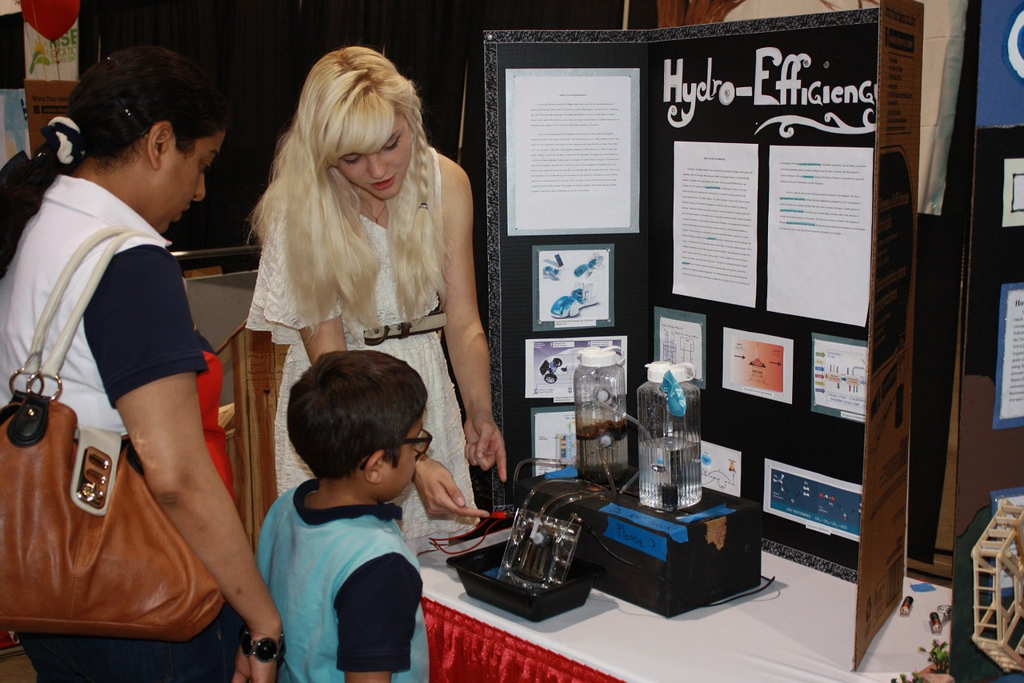
Defining Terms: Phenomena
& Designing Solutions
Phenomena are observable events that occur in the universe and that we can use our science knowledge to explain or predict (NGSS Lead States, 2013).
"science fair: what puts the 'pop' in popcorn" by woodleywonderworks is licensed with CC BY 2.0.
Engineering Design Problems are complex problems that reflect real-world human needs.
Designing solutions to problems is a systematic process that involves defining the problem, then generating, testing, and improving solutions (NSTA, n.d.).
4
echitabil-știință-curios-educaţie-648905 is licensed under Pixabay.
Notes:
Phenomena and engineering design problems are the contexts or lens by which all students should be given the opportunity to explore and demonstrate what they know and can do in science. Phenomena are observable events that occur in the universe and that we can use our science knowledge to explain or predict. Engineering design problems are complex problems that reflect real-world human needs. Designing solutions to these problems requires a systematic process that involves defining the problem, then generating, testing, and improving solutions.

Slide 5


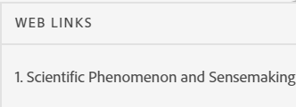
Scientific Phenomenon and Sensemaking — Paul Andersen, Bozeman Science
Pause the presentation and view the video, “Scientific Phenomenon and Sensemaking” in the Web Links pod!
This Photo by Unknown Author is licensed under CC BY-SA
Notes:
This short video, “Scientific Phenomenon and Sensemaking,” explores how scientific phenomenon and sensemaking can be used to drive inquiry for instruction. While viewing the video, think about the role of phenomena and sensemaking in your science instruction. What role do they currently have in your assessment practices? Consider why phenomena and sensemaking are important elements for designing instruction and assessment that meet the vision for K–12 science education espoused in the National Research Council’s (NRC) A Framework for K-12 Science Education (Framework; NRC, 2012).
Please pause the presentation to view the short video. A link to the video is provided in the Web Links pod.

Slide 6

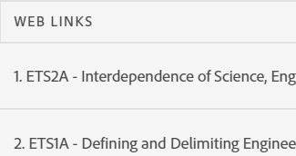
Engineering Design Problems—Paul Andersen, Bozeman Science
Pause the presentation and view the two videos, “ETS2A - Interdependence of Science, Engineering and Technology,” and “ETS1A - Defining and Delimiting Engineering Problems” in the Web Links pod!
6
This Pixabay photo by Pavlofox is free for commercial use.
Notes:
Quality science education includes both learning how scientific knowledge is acquired and how scientific explanations are developed, as well as how science is utilized, in particular through the engineering design process (the Framework, p. 201).
Here are two short videos by Paul Andersen from Bozeman Science that explore the interdependence of science, engineering, and technology and the role of the engineering design process in science education. While viewing the videos, consider how you demonstrate these connections between science and engineering in your classroom. Consider how your students apply their scientific knowledge to engage in systematic and iterative approaches to designing objects, processes, and systems to meet human needs and wants.
Please pause the presentation to view these short videos. Links to the videos are provided in the Web Links pod.

Slide 7

The Role of Sensemaking
Students should be able to apply the scientific ideas in appropriate contexts to explain natural phenomena or design solutions to problems that may have several acceptable solutions.
Students should be able to construct evidence-based arguments that support these ideas or that refute alternate and commonly held naïve conceptions.
Assessments should provide opportunities for students to apply their developing science knowledge to explain phenomena or design solutions to real-world problems.
If the design of instruction is organized around phenomena and design problems, the development and design of a formative assessment has to be closely aligned to instruction.
Scenario-based tasks must address the set of scientific phenomena/design problems studied in the classroom.
Notes:
The model of student learning that educators use in curriculum and instruction should be the SAME model used for classroom formative assessments and summative end-of-unit/course assessments. Both instruction and assessment should provide opportunities for students to apply their developing science knowledge to explain phenomena or design solutions to real-world problems. If the design of instruction is organized around phenomena and design solutions, the development and design of a formative assessment have to be closely aligned to instruction. Thus, scenario-based tasks must address the set of scientific phenomena studied in the classroom.
The phenomena or design problems introduced in classroom assessments have to be carefully chosen to provide a context in which students become engaged. These phenomena or design problems provide a mechanism for students to apply and explain the science ideas they are observing and learning or to create solutions as evidence of their science learning.

Slide 8


Continuing the Journey . . .
Phase 1: Unpacking Tool
Phase 2: Task Specifications Tool
Phase 3: Task, Rubric, and Exemplars
to Principled Assessment Design
Notes:
Let’s reflect on where we are in our journey to principled assessment design. First, congratulations for completing chapters 1 and 2 of this digital workbook on designing high-quality three-dimensional science assessment tasks for classroom use. At this point in the process, you have likely completed your in-depth exploration of the first phase of principled assessment design: development of the unpacking tool. Hopefully, you have completed your own unpacking tool by systematically unpacking a performance expectation, or indicator, into its multiple components to develop a clear and deep understanding of each dimension and the boundaries of what can be assessed.
You are now ready to embark on the next phase of principled assessment design, development of the task specifications tool. In this chapter, we will consider the many possible ways the construct could be measured. What are the possible things you want to say about your students? What evidence needs to be gathered? How will students demonstrate their learning? What work products will they produce? What are the characteristic features of tasks? In this phase, the task designer is still not thinking about this in the context of a particular task but is developing a palette of design options and task features that can be used to assess the construct in a variety of ways.

Slide 9

What is a Task Specifications Tool?
To create a task, the task writer must define the aspect(s) of the PE to be assessed and make design choices about what information is presented to a student, how it is presented, how the student interacts with the tasks, and how responses are provided.
The Task Specifications Tool is a fillable template that provides key design considerations for the task writer that are needed to develop purposeful assessment tasks.
9
Notes:
We begin with a definition of a task specifications tool. The task specifications tool is a fillable template that provides key design considerations for the task writer that are needed to develop purposeful assessment tasks. This tool, which is the basis for task development, flows directly from the unpacking tool, which provides further guidance on the interpretation of the three dimensions of a PE and how they can be assessed.
To create a task, the task writer must define the aspect(s) of the PE to be assessed and make design choices about what information is presented to a student, how it is measured, how the student interacts with the tasks, and how responses are provided.

Slide 10

Why Develop a Task Specifications Tool?
To translate the PE-specific unpacking of the three dimensions into assessment tasks
To determine what counts as evidence for student learning
To develop assessment tasks that allow students opportunities to call upon, transfer, and apply learning that has occurred during instruction to new challenges, much the way a scientist or engineer would, in an assessment situation
To identify key elements needed to be addressed by task developers to develop meaningful and interpretable assessment tasks
To document detailed task specifications for current and future use
10
Notes:
The task specifications tool is a design tool that allows educators to translate the PE-specific unpacking of the three dimensions into assessment tasks and determine what counts as evidence for student learning. The task specifications tool is intended to help educators develop assessment tasks that allow students opportunities to call upon, transfer, and apply learning that has occurred during instruction to new challenges, much the way a scientist or engineer would, in an assessment situation. The task specifications tool enables you to define “the how” of assessment by considering the evidence requirements and how they shape the design of assessment tasks for students to demonstrate what they have learned.
Based on the instructional sequence and which components of the PE(s) have been taught, educators can determine when to assess and what to assess. These decisions are born out of observing students during science investigations, monitoring student-generated questions and problem-solving strategies, and determining when student evidence is needed to inform the direction of the instructional sequence. To create a task, you must define the aspect(s) of the PE to be assessed and make design choices about what information is presented to a student, how it is presented, how the student interacts with the tasks, and how responses are provided.
In the next module, Module 3.2, we will engage more deeply in the elements of the task specifications tool and how they relate to what is being measured. We will walk you through a model task specifications tool and provide additional completed samples across grade bands so that you can understand the outcomes of this phase of the process.

Slide 11

Resources and Additional Information
Notes:
Finally, we offer additional resources that may be helpful to anyone interested in learning more about the concepts presented in this module. A glossary of terms and our reference list follow.
Thank you for your engagement in this third chapter of the SCILLSS digital workbook on designing high-quality three-dimensional science assessment tasks for classroom use.

Slide 12
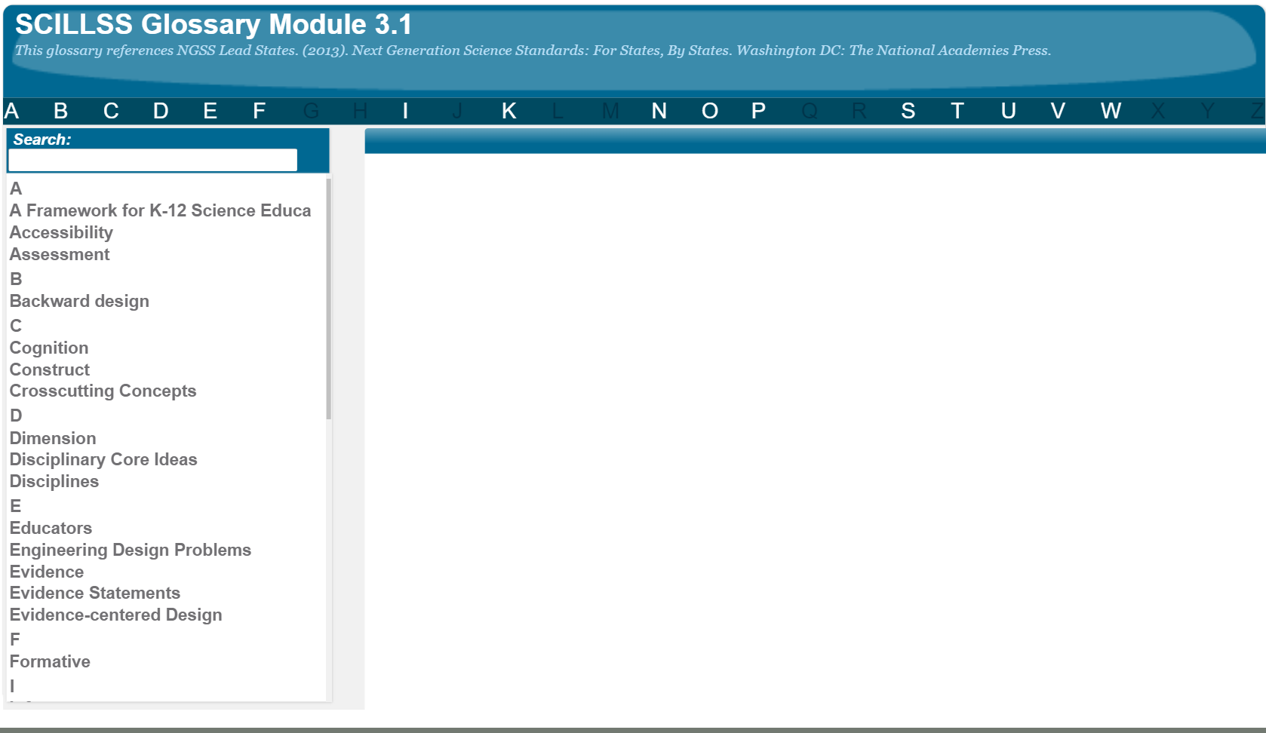
SCILLSS Glossary
Please refer to the SCILLSS Glossary for operational definitions of terms used.

Slide 13
Resources
In the Web Links pod, you can find the following resources:
Scientific Phenomenon and Sensemaking, by Paul Andersen
ETS2A – Interdependence of Science, Engineering and Technology, by Paul Andersen
ETS1A – Defining and Delimiting Engineering Problems, by Paul Andersen
A Framework for K-12 Science Education
Next Generation Science Standards

Slide 14
References
National Research Council. (2012). A Framework for K-12 Science Education: Practices, Crosscutting Concepts, and Core Ideas. Washington, DC: The National Academies Press. https://doi.org/10.17226/13165.
National Science Teaching Association. (n.d.). Science and Engineering Practice of Constructing Explanations and Designing Solutions. Retrieved from https://ngss.nsta.org/practices.aspx?id=6
NGSS Lead States. (2013). Glossary. Retrieved from https://www.nextgenscience.org/glossary.

