Slide 1
Designing High-Quality Three-Dimensional Science Assessments for Classroom Use
Chapter 3: Development of the Task Specifications Tool
Module 3.2: Task Specifications Tool Template
This digital workbook on designing high quality three-dimensional science assessment tasks for classroom use was developed by edCount, LLC, under
Enhanced Assessment Grants Program, CFDA 84.368A.
1
Notes:
Welcome to the third of four chapters in a digital workbook on designing high-quality three-dimensional science assessment tasks for classroom use. This workbook is intended to help educators design and evaluate tasks that provide meaningful information about what students know and can do in science.
This digital workbook was developed by edCount, LLC, under the US Department of Education’s Enhanced Assessment Grants Program, CFDA 84.368A.

Slide 2


Module 3.2:
Task Specifications Tool Template
2
Notes:
Chapter 3 of this workbook includes a series of six modules. Together these six modules provide an in-depth exploration of the second phase of principled assessment design: development of the task specifications tool. In this chapter, we focus on translating the unpacking of the three dimensions of a specific performance expectation, or indicator, into assessment tasks using a task specifications tool. We provide opportunities for you to engage in interactive activities and explore and use our design template to complete your own task specifications tool for a three-dimensional standard.
In this module, Module 3.2, we articulate the process for engaging in intentional assessment design by considering the elements of the task specifications tool. We also begin to consider the situations that will elicit evidence to support meaningful interpretations of students’ science learning. In later modules, we offer resources, key strategies, and guiding questions for completing a task specifications tool.

Slide 3
Module 3.2 Outcomes
Task Specifications
Tool Template
Task Specifications Tool Template
To understand the elements of the task specifications tool template (Performance Expectation; Knowledge, Skills, & Abilities (KSAs); Student Demonstrations of Learning, Work Products; Task Features; Aspects of an assessment task that can be varied; and Assessment Boundaries) and how they relate to what is being measured
Notes:
In Module 3.2, our intent is to help you more deeply understand and distinguish between the various components of the task specifications tool so that you can recognize these elements and understand how they relate to task development and what is being measured. We will walk you through a model task specifications tool and provide additional completed samples across grade bands so that you can understand the outcomes of the process.

Slide 4
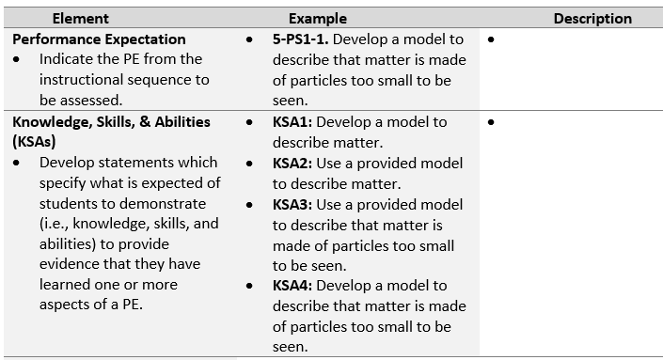
Assessment Task Specifications Tool
Synthesize the key aspects of the dimensions, both independently and collectively, from the unpacking tool to craft the KSA statements.
The statements should represent a range of KSAs that collectively meet the expectations of the PE.
Some KSAs might be more discrete, simplistic, and one-dimensional while others might be more comprehensive, complex, and multi-dimensional.
Educators can select one or more KSAs from this “menu of options” for measurement by an assessment task.
Notes:
As we begin development of the task specifications tool, we must translate the key aspects and prior knowledge of the three dimensions of a PE from the unpacking tool into a palette of design choices. Intentional design choices define what information is presented to a student, how it is presented, how the student interacts with the tasks, and how responses are provided. Let’s explore the types and nature of these design choices by reviewing the various elements of the task specifications tool. In the next few slides, we will introduce and define each element in the left column and provide one or more examples of the element in the middle column.
The first element is straight-forward, and we already have it completed. We indicate the PE for which we are developing the task specifications tool. It might seem like a “moot” point, but we are always coming back to it. It is the focus of our work. Every aspect of the task specifications tool must align to the PE. In this example, the grade 5 PE is 5-PS1-1: Develop a model to describe that matter is made of particles too small to be seen.
Next are the Knowledge, Skills, and Abilities (KSAs). The purpose of the KSAs is to identify the focus of the PE. Each of these statements specifies what it is that students are expected to demonstrate to provide the evidence that they have learned one or more aspects of the PE. Remember, NGSS-like standards may present KSAs that we haven’t taught before. There is new content here that we need to understand well. We must carefully analyze and synthesize the key aspects of the dimensions, both independently and collectively, from the unpacking tool to craft the KSA statements.
Each PE that you unpack will likely be very dense. Your unpacking documents will probably be quite lengthy when you are finished analyzing each of the dimensions. As a result, one PE may have three to six KSAs depending on how dense or packed it is with respect to the DCIs or the SEPs or the CCCs. When you develop the KSAs, they can also represent multiple aspects of the PE, but they don’t all have to be at the level, or grain size, of the PE. Some of the KSAs might be more discrete; they may just look at a particular dimension rather than more than one dimension. For example, one KSA may reflect more of a DCI while another KSA represents two dimensions and includes a SEP or a CCC. It’s important to understand that KSAs are graduated in their depth and breadth. However, together, these statements collectively meet the expectations of the PE.
Let’s consider for a moment the purpose of KSAs and how they inform task development. As a task designer, you will select one or more KSAs from this menu of options for measurement by the assessment task. You may decide that your assessment task is just going to address a single KSA or a small aspect of the PE. As tasks become more graduated and complex, we would expect to see them address more KSAs associated with that PE. These KSAs can represent science learning that you measure midway through or even a quarter of the way through instruction just to make sure your students are on track. The KSAs are also your opportunity to put back together some aspects of the multiple dimensions that you teased apart in the unpacking.
You will notice in the grade 5 example the PE is fairly simple and not as dense. You’ll notice that not all PEs are created equal. Some are more complex than others, and some have a broad range of representation of the dimensions. Going through the exercise of unpacking the PEs really gives you a solid understanding of how they vary in their complexity. Performance expectations become increasingly dense across grade levels because of the progression in the sophistication of science and the expectations for students to build on what they know and use it to demonstrate higher learning.
Let’s review several examples of KSAs developed for 5-PS1-1: Develop a model to describe that matter is made of particles too small to be seen. What are some aspects of this PE that we could identify and that we would need to collect evidence against? Students could “develop a model to describe matter,” “use a provided model to describe matter,” “use a provided model to describe that matter is made of particles too small to be seen,” or “develop a model to describe that matter is made of particles too small to be seen.” In these statements, you can see some combinations of the SEPs and DCIs and possibly the CCCs. We are combining information from the unpacking document to define the focus, or the “what,” of the PE to be measured by the assessment task.
There is an opportunity here. If you look at the list of KSAs, you could specify two levels of a task, one more complex than the other. If the focus is providing students a model and asking them to describe that model, that’s probably an easier task than having them generate and develop a model. Therefore, you could address the PE with varying levels of complexity should you choose to design it that way. The KSAs will help you determine the desired complexity of the task based on your purpose for assessing students at a given point in time during instruction.
When generating the KSAs, we are not expecting you to create them as a hierarchy of less complex to more complex. Rather, what is most important is that you get your ideas down and ensure that all aspects of the PE—the breadth and depth of each dimension—are represented.
To draft your KSAs, follow two steps. First, synthesize the key aspects of the dimensions, which you have already defined in your unpacking tool; then, use those key aspects to build statements that represent a range of KSAs that vary in complexity to meet the expectations of the PE.

Slide 5
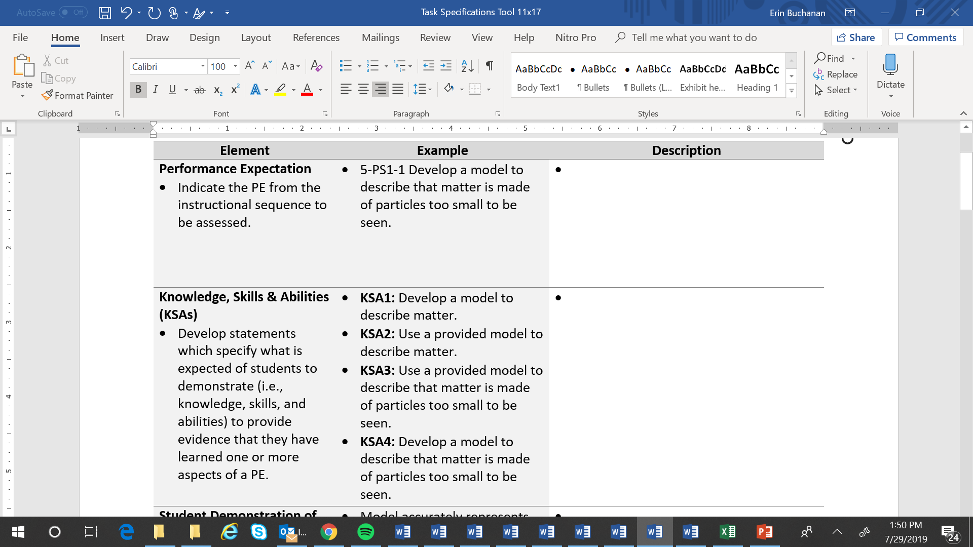
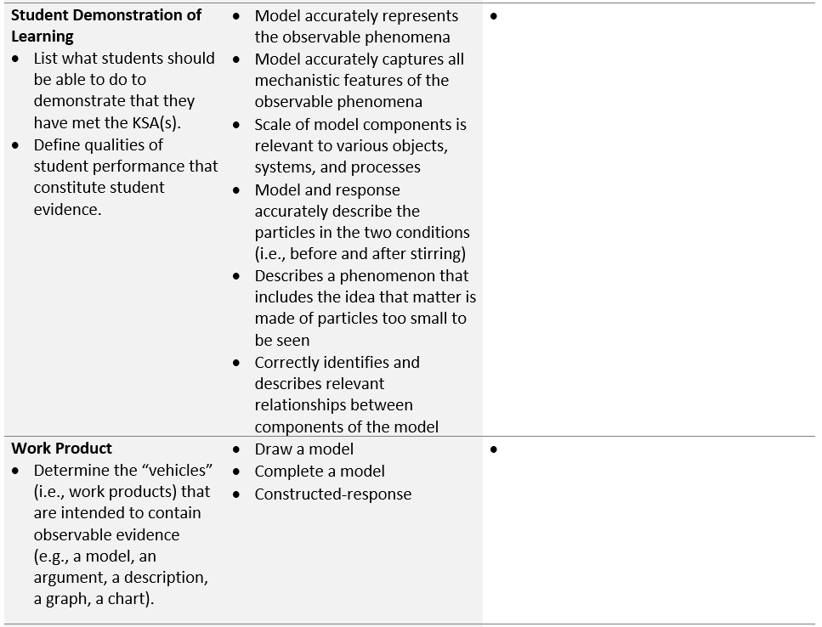
Assessment Task Specifications Tool
For each KSA, identify the types of performances that provide evidence that students have met the KSA.
Example:
KSA1: Develop a model to describe matter
Model accurately represents the observable phenomena
Model accurately captures all mechanistic features of the observable phenomena
Scale of model components is relevant to various objects, systems, and processes
Describe the work products (i.e., item types, situations, stimuli) that will allow students to fully demonstrate the KSA(s).
Educators can pick from this “menu of options” to select a work product or a combination of work products appropriate for measuring the KSA(s).
5
Notes:
For the next two elements of the task specifications tool, you will complete the Student Demonstration of Learning and Work Product.
For the student demonstration of learning, you will want to think carefully about the evidence students will need to demonstrate for each of the KSAs you have generated. Create a list of what students should be able to do to demonstrate that they have met the KSAs. In this list, clearly define the qualities of student performance that constitute student evidence. For example, for KSA1: Develop a model to describe matter, students will need to demonstrate that they can model accurately to represent the observable phenomena, model accurately to capture all mechanistic features of the observable phenomena, and show that the scale of the model components is relevant to the various objects, systems, and processes. To complete this section, focus on the evidence that the tasks must elicit and the criteria for accuracy and completeness that will need to be included in the scoring rubric to appropriately measure students’ performance of the KSAs.
For the work product, you’ll want to think about the “vehicles” that are intended to contain observable evidence. This could include item types, situations, or stimuli such as an incomplete diagram or chart , or data tables that will allow students to demonstrate their learning of the KSAs. Educators can pick from this “menu of options” to select a work product or a combination of work products appropriate for measuring the KSAs.

Slide 6
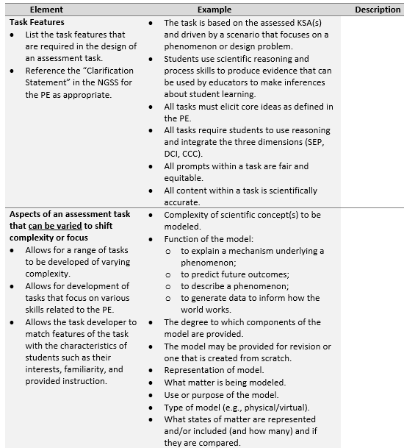
Assessment Task Specifications Tool
Determine the necessary features of the assessment tasks that would be necessary to appropriately measure one or more of the KSAs.
Task features influence the design of the task in terms of structure, content, and complexity.
Consider the range of KSAs related to the PE that could be measured by an assessment task. How might tasks vary in complexity or focus to address these different KSAs? How might tasks vary to appropriately address characteristics of students, including their interests, cultural identity, familiarity, and prior instruction?
Educators can pick from this “menu of options” to select features appropriate to the KSA(s) and the student population.
6
Notes:
The next element in the task specifications tool is Task Features. Task features are features of the assessment tasks that are necessary to appropriately measure one or more of the KSAs. For example, we would expect that for the grade 5 PE, 5-PS1-1: Develop a model to describe that matter is made of particles too small to be seen, tasks would be driven by a scenario that focuses on a phenomenon or design problem, would require students to use scientific reasoning and process skills to integrate the three dimensions, and would be fair and equitable for all students. When we are defining these task features, we need to ensure that our design choices allow us to determine what students know about the measured content as well as what students do not know. Similarly, we also want to make sure that these task features do not promote the design of tasks that go outside the boundaries of student learning for a given PE. In some instances, a clarification statement that accompanies the PE provides information such as examples and areas of emphasis that assist in defining the parameters of what students should know and be able to do.
The next element, “Aspects of an assessment task that can be varied to shift complexity or focus,” prompts a task designer to consider the range of complexity and focus of items within a task to address various aspects of a PE. By the nature of the PE, some knowledge or skills are more complex or less complex than others. Therefore, based on what is being measured, it is appropriate that the actual task has some variation in its complexity. For example, to vary the complexity and focus of a task, you can opt to provide a model to a student for revision, or you might require students to create their own model. You could also choose to vary the components of the model provided to the student to alter the complexity of the item.
This is also a key place within the task specifications tool to consider and address accessibility. As an educator, you are deeply familiar with your students, their interests, cultural identity, and prior instruction. It is important to consider how aspects of the assessment task can be shifted to promote access, relevancy, and engagement for your students. For example, you might select a phenomenon or design problem that is particularly relevant to students’ everyday lives or their cultural identity within the community. You may also consider students’ familiarity and prior experience with the types of work products that might be included within an assessment task.

Slide 7
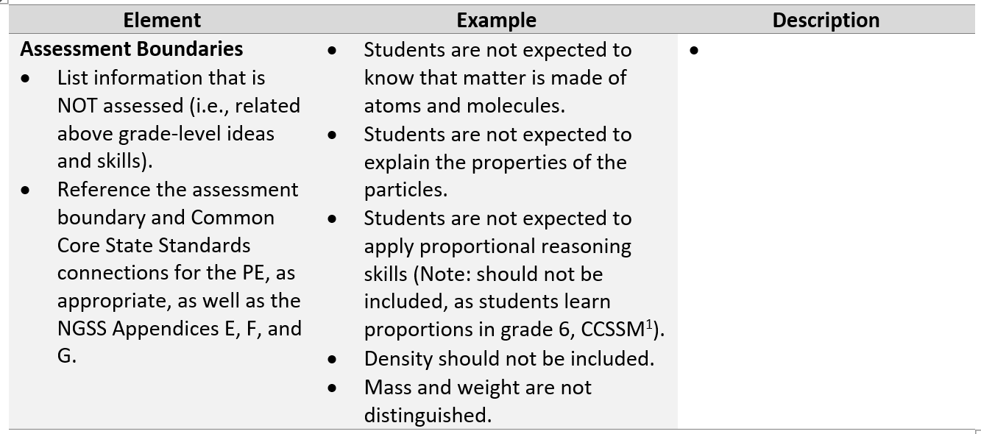
Assessment Task Specifications Tool
Determine the assessment boundaries for the KSAs/PE by referencing the below and above grade/band standards and NGSS Appendices E, F, and G progressions charts.
¹National Governors Association Center for Best Practices, Council of Chief State School Officers. (2010). Common Core State Standards for Mathematics. Washington DC: Author.
Notes:
Lastly, let’s talk about Assessment Boundaries. It is important to not only think about what we are measuring, but also what is not assessed. Many PEs include assessment boundaries that clarify information that is not assessed, such as related above grade-level knowledge and skills. Another strategy for identifying assessment boundaries is to examine PEs with related science ideas to identify how the PEs are distinct from one another in terms of how and to what extent the DCIs, SEPs, and CCCs are addressed. What might appear as an explicit skill in one PE may be intentionally absent from another. This comparison helps to define the boundaries of what might or might not be measured for a given PE.
Regarding the grade 5 PE, 5-PS1-1: Develop a model to describe that matter is made of particles too small to be seen, the assessment boundary states that assessment “does not include the atomic-scale mechanism of evaporation and condensation or defining the unseen particles.” This information, in combination with the NGSS Appendices E, F, and G and the Common Core State Standards Connections for mathematics, leads us to understand the assessment boundaries for grade 5 students. Students are not expected to know that matter is made of atoms and molecules, explain the properties of particles, or apply proportional reasoning skills. Tasks would also not require students to understand density or to distinguish mass and weight.

Slide 8
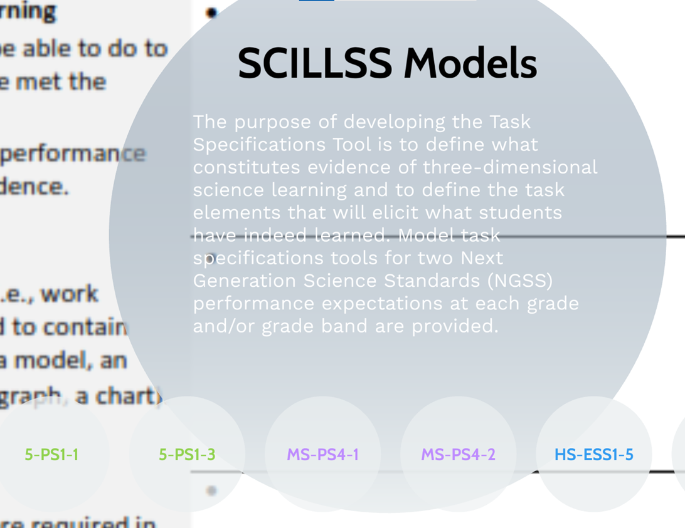
Task Specifications Tools by Grade Band
For additional examples of completed task specifications tools at the elementary, middle, and high school grade bands, click on the Prezi Interactive Task Specification Tool Resource in the Web Links pod.
Notes:
For additional examples of completed task specifications tools at the elementary, middle, and high school grade bands, click on the Prezi Interactive Task Specifications Tool Resource in the Web Links pod.

Slide 9


Check for Understanding
Here is an example of a student demonstration of learning: “The model and response accurately describe the particles in the two conditions (i.e., before and after stirring).”
Assessment boundaries help to ensure that the task does not ask students to do things that exceed the expectations of the PE.
For each new task developed to measure one or more aspects of a PE, a task developer creates a task specifications tool.
A KSA can be one-dimensional (i.e., addressing a DCI) or multi-dimensional (i.e., combining a DCI, SEP and/or CCC) depending on the nature of the PE.
The task developer must ensure that each task measures the full breadth and depth of the PE to elicit meaningful and useful assessment information.
True? or False?
False! While the set of KSAs collectively address the full breadth and depth of the PE, educators can choose to measure one or more aspects of the PE at any point in time during the instructional sequence.
True! Some KSAs might be more discrete, simplistic, and one-dimensional while others might be more comprehensive, complex, and multi-dimensional. Each task can be designed to measure one or a combination of KSAs.
True! By referencing various NGSS resources, a task writer can ensure that the task features do not fall outside the boundaries of what students should know and be able to do.
True! This statement identifies the types of performances, including the accuracy and completeness of the response, that provide evidence that students have met the targeted KSA.
False! Once developed, a task specifications tool can be used to create a range of tasks aligned to a targeted PE.
Notes:
As we near the end of this module, let’s pause to check for understanding by considering whether a series of provided statements are either true or false.
Here is the first statement: “For each new task developed to measure one or more aspects of a PE, a task developer creates a task specifications tool.” Is this true or false?
You guessed it! This statement is false. Once developed, a task specifications tool can be used to create a range of tasks aligned to a targeted PE.
Let’s consider the next statement: “The task developer must ensure that each task measures the full breadth and depth of the PE to elicit meaningful and useful assessment information.” True or false?
This statement is false. While the set of KSAs collectively address the full breadth and depth of the PE, educators can choose to measure one or more aspects of the PE at any point in time during the instructional sequence.
Here is another statement: “A KSA can be one-dimensional (i.e., addressing a DCI) or multi-dimensional (i.e., combining a DCI, SEP, and/or CCC) depending on the nature of the PE.” Is this true or false?
That’s correct! This statement is true. Some KSAs might be more discrete, simplistic, and one-dimensional, while others might be more comprehensive, complex, and multi-dimensional. Each task can be designed to measure one or a combination of KSAs. What is key is that the collection of items or prompts within a task requires reasoning and sense-making using the three dimensions.
Let’s consider the next statement: Here is an example of a student demonstration of learning: “The model and response accurately describe the particles in the two conditions (i.e., before and after stirring).” True or false?
This statement is true because it identifies the types of performances that provide evidence that students have met the targeted KSA: Develop a model to describe that matter is made of particles too small to be seen.”
Here is our last statement: “Assessment boundaries help to ensure that the task does not ask students to do things that exceed the expectations of the PE.” True or false?
This statement is also true. By referencing the clarification statement, assessment boundary, and Common Core State Standards connections for the PE as well as NGSS Appendices E, F, and G, a task writer can ensure that the task features do not fall outside the boundaries of what students should know and be able to do.

Slide 10
Concluding Remarks
The task specifications tool provides a palette of options for determining what students know and can do.
The task specifications tool requires you to think about the possible ways you can uncover evidence of student performance.
The inherent choice and flexibility of the task specifications tool and variable features allow educators to develop tasks that vary in complexity, focus, and sophistication.
The same task specifications tool can be used to create multiple tasks that measure the same or different knowledge, skills, and abilities.
Your task specifications tool should be continually refined and revised.
Notes:
Like the unpacking tool, the task specifications tool can be a bit time-intensive, but it has long-lasting benefits. It remains a living, foundational document that can be used within a classroom, building, or district to create a suite of assessment tasks aligned to a performance expectation. Individual classroom educators or teams of educators collaborating in the design of common building or district assessments can revisit and refine the task specifications tool over time as they further reflect on and understand what students are expected to know and be able to do in science. Regardless of who uses the tool and for what purpose, it provides a means for educators to translate the PE-specific unpacking of the three dimensions into assessment tasks and to determine what counts as evidence for student learning. The task specifications tool provides an important set of considerations for the task designer when developing classroom-based assessment tasks.
Take a moment to read and reflect on these concluding remarks. Think about how the elements of the task specifications tool provide a menu of options that a task writer could select from to design a variety of tasks that align to a PE but range in complexity, focus, or sophistication. Consider why engaging in the development of a task specifications tool is an important and useful phase in the principled-design process and how the tool contributes to the design of high-quality, multi-dimensional classroom assessment tasks.
In the next module, Module 3.3, we offer a guided activity to engage more deeply in the elements of the task specifications tool. We will examine a series of statements from a completed task specifications tool and sort the statements into the appropriate element of the tool. This activity will provide practice differentiating between the various elements of the tool, including the KSAs, student demonstrations of learning, work products, task features, aspects of the assessment task that can be varied to shift complexity or focus, and assessment boundaries.

Slide 11

Resources and Additional Information
Notes:
Finally, we offer additional resources that may be helpful to anyone interested in learning more about the concepts presented in this module. A glossary of terms and our reference list follow.
Thank you for your engagement in this third chapter of the SCILLSS digital workbook on designing high quality three-dimensional science assessment tasks for classroom use.

Slide 12
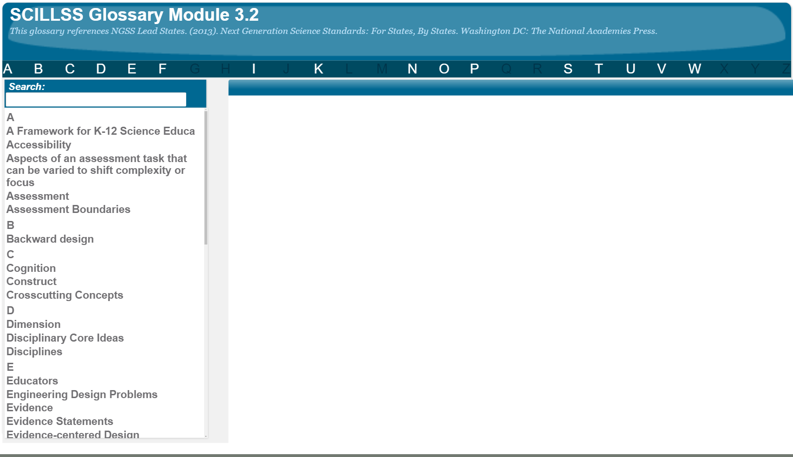
SCILLSS Glossary
Please refer to the SCILLSS Glossary for operational definitions of terms used.

Slide 13
Resources
In the Web Links pod, you can find the following resources:
A Framework for K-12 Science Education
Next Generation Science Standards
NGSS Evidence Statements
Appendix E: Disciplinary Core Idea Progressions
Appendix F: Science and Engineering Practices
Appendix G: Crosscutting Concepts
SCILLSS Model Task Specifications Tools Prezi
In the Resources pod, you can find the following resources:
SCILLSS Model Task Specification Tools

Slide 14
References
NGSS Lead States. (2013). Next Generation Science Standards: For States, By States. Washington DC: The National Academies Press.
National Governors Association Center for Best Practices, Council of Chief State School Officers. (2010). Common Core State Standards for Mathematics. Washington DC: Author.

