Slide 1
Designing High-Quality Three-Dimensional Science Assessments for Classroom Use
Chapter 3: Development of the Task Specifications Tool
Module 3.3: Guided Activity: Sorting Elements of a Task Specifications Tool
This digital workbook on designing high quality three-dimensional science assessment tasks for classroom use was developed by edCount, LLC, under
Enhanced Assessment Grants Program, CFDA 84.368A.
Notes:
Welcome to the third of four chapters in a digital workbook on designing high-quality three-dimensional science assessment tasks for classroom use. This workbook is intended to help educators design and evaluate tasks that provide meaningful information about what students know and can do in science.
This digital workbook was developed by edCount, LLC, under the US Department of Education’s Enhanced Assessment Grants Program, CFDA 84.368A.

Slide 2


Module 3.3: Guided Activity: Sorting the Elements of a
Task Specifications Tool
2
Notes:
Chapter 3 of this workbook includes a series of six modules. Together these six modules provide an in-depth exploration of the second phase of principled assessment design: development of the task specifications tool. In this chapter, we focus on translating the unpacking of the three dimensions of a specific performance expectation, or indicator, into assessment tasks using a task specifications tool. We provide opportunities for you to engage in interactive activities and explore and use our design template to complete your own task specifications tool for a three-dimensional standard.
In this module, Module 3.3, we invite you to engage in a guided activity to identify the content that exemplifies the various elements of a task specifications tool. By completing this activity, our hope is that you will be more deeply grounded in the elements of the tool and, thus, better prepared to complete your own task specifications tool. In later modules, we provide resources, key strategies, and guiding questions to support the process for defining the elements.

Slide 3
Module 3.3 Outcomes
Task Specifications Tool Template
Task Specifications Tool Template
To promote deeper understanding of the elements of a task specifications tool by providing a practice opportunity to distinguish between the various elements
Notes:
During this guided activity, we will examine statements from a completed high school task specifications tool. For each statement, we will identify whether it refers to the element student demonstration of learning or work products OR task features or variable features. Once we’ve identified the appropriate element, we will provide an explanation of the placement of each statement in that element. This activity is designed to help you become better acquainted with and grounded in the various elements of the task specifications tool.

Slide 4
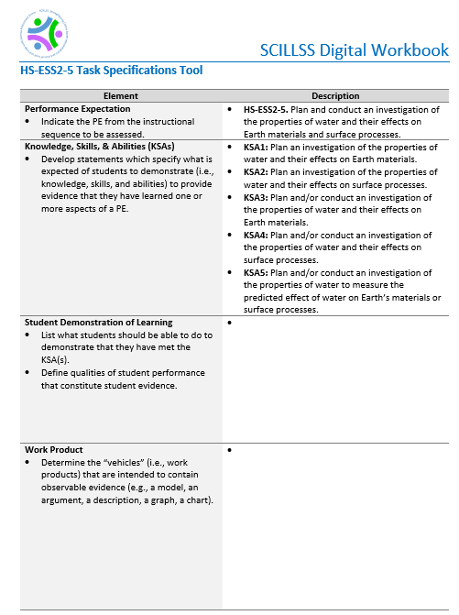
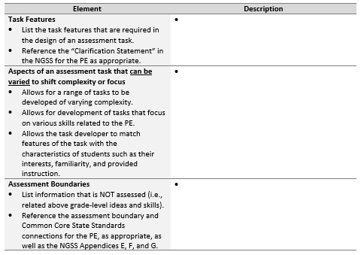
Complete a Task Specifications Tool
Notes:
For this activity, we focus on the high school performance expectation, HS-ESS2-5: Plan and conduct an investigation of the properties of water and their effects on Earth materials and surface processes.
If you reference the elements, you will notice that a description for each is provided. Before we begin our sorting activity, take a moment to consider the content that would be consistent with these descriptions. How would students demonstrate their learning? What should students be able to do to demonstrate they have met the KSAs? What task features are required across all tasks? For example, consider ways in which all students will have access to the task or that the science must be accurate. What aspects of an assessment task can be varied? For example, how can a range of tasks of varying complexity be developed, or how can a task be developed to address students’ interests and familiarity based on provided instruction?
Please pause the presentation to consider these questions. We invite you to refer to the Framework, NGSS, and NGSS appendices in the Resources pod for additional information about this performance expectation. When you feel well-oriented to the PE and its dimensions, resume the presentation to begin the activity.

Slide 5

Sorting Elements of the Task Specifications Tool
Student Demonstration of Learning and
Work Products
5
Notes:
Now that you are well acquainted with the elements of the task specifications tool and the performance expectation, let’s begin our activity by sorting provided statements based on the elements they exemplify. We will focus first on the elements, student demonstration of learning and work products.

Slide 6
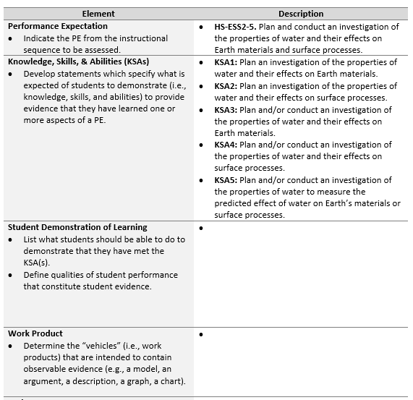
Develops a logical investigation plan and accurately describes the data that will be collected and the evidence to be derived from the data (i.e., properties of water, effect of the properties of water (e.g., energy transfer, mechanical effects, chemical effects))
Accurately and completely plans and conducts an investigation that provides evidence of the connection between the properties of water and their effects on Earth materials and/or surface processes
Correctly describes how the data collected in an investigation will be relevant to determining the effect of water on Earth materials and/or surface processes
Correctly evaluates the accuracy and precision of the collected data
Description of steps for a planned investigation
Laboratory demonstration
Record of observations
Short response
Constructed-response
6
Notes:
As discussed previously, the task specifications tool is a design tool that helps educators to translate the PE-specific unpacking of the three dimensions into assessment tasks. They help educators to determine what counts as evidence for student learning and to develop assessment tasks that allow students opportunities to call upon, transfer, and apply learning that has occurred during instruction to new challenges, much the way a scientist or engineer would, in an assessment situation. In addition, defining the elements of the task specifications tool for a PE provides a clear focus for assessment and helps educators establish coherence between curriculum, instruction, and assessment.
In this guided activity, you will consider how to define two of the elements for the high school PE, HS-ESS2-5: Plan and conduct an investigation of the properties of water and their effects on Earth materials and surface processes. We will analyze and sort several statements to determine where they belong in the task specifications tool. For each statement, you will determine the element that it best exemplifies, whether it is a student demonstration of learning or work product.
Before we walk through the steps to complete this guided activity, take a moment to review this partially completed task specifications tool. Carefully read the knowledge, skills, and abilities (KSAs), which specify what is expected of students to demonstrate and which identify the evidence that must be collected through the assessment tasks. Review the definitions of each element in the left column. Then, read and consider the placement of each presented statement in the task specifications tool. As you sort the statements, begin to think about the distinctions between the elements of the tool.
Alright. Let’s walk through an example of the steps to complete this guided activity. Multiple statements will appear one at a time at the right of the screen. First, consider to which element it aligns—student demonstration of learning or work product. You will be prompted to repeat these steps for each presented statement.
A brief pause is provided between each statement to allow time for your consideration. If you need additional time, please pause and resume the presentation as needed. Thanks!
Let’s get started.
Here is the first statement: Description of steps for a planned investigation. Student demonstration of learning or work product?
This statement relates to the element, work product.
Here is the next statement: Accurately and completely plans and conducts an investigation that provides evidence of the connection between the properties of water and their effects on Earth materials and/or surface processes. Student demonstration of learning or work product?
This statement relates to the element student demonstration of learning.
Here is the next statement: Record of observations. Student demonstration of learning or work product?
This statement relates to the element, work product.
Here is the next statement: Constructed-response. Student demonstration of learning or work product?
This statement relates to the element, work product.
Here is the next statement: Correctly describes how the data collected in an investigation will be relevant to determining the effect of water on Earth materials and/or surface processes. Student demonstration of learning or work product?
This statement relates to the element, student demonstration of learning.
Here is another statement: Develops a logical investigation plan and accurately describes the data that will be collected and the evidence to be derived from the data (i.e., properties of water, effect of the properties of water (e.g., energy transfer, mechanical effects, chemical effects)). Student demonstration of learning or work product?
This statement relates to the element, student demonstration of learning.
Here is another statement: Short response. Student demonstration of learning or work product?
This statement relates to the element, work product.
Here is the next statement: Correctly evaluates the accuracy and precision of the collected data. Student demonstration of learning or work product?
This statement relates to the element, student demonstration of learning.
Here is the last statement: Laboratory demonstration. Student demonstration of learning or work product?
This statement relates to the element, work product.
From this activity, you likely recognize how the statements describing the student demonstrations of learning are different from the descriptions of the work products. The student demonstrations of learning describe the expectations for student performance in terms of accuracy, completeness, and sophistication, while the work products indicate the “vehicles” that contain observable evidence and support accurate inferences about student learning.
Let’s continue this guided activity by examining two more elements of the task specifications tool.

Slide 7
Sorting Elements of the Task Specifications Tool
Task Features and
Aspects of an assessment task that can be varied to shift complexity or focus
7
Notes:
Now that you are well acquainted with the student demonstration of learning and work product elements of the task specifications tool, let’s continue this sorting activity by focusing on the next two elements, task features and aspects of an assessment task that can be varied to shift complexity or focus of the tool.

Slide 8
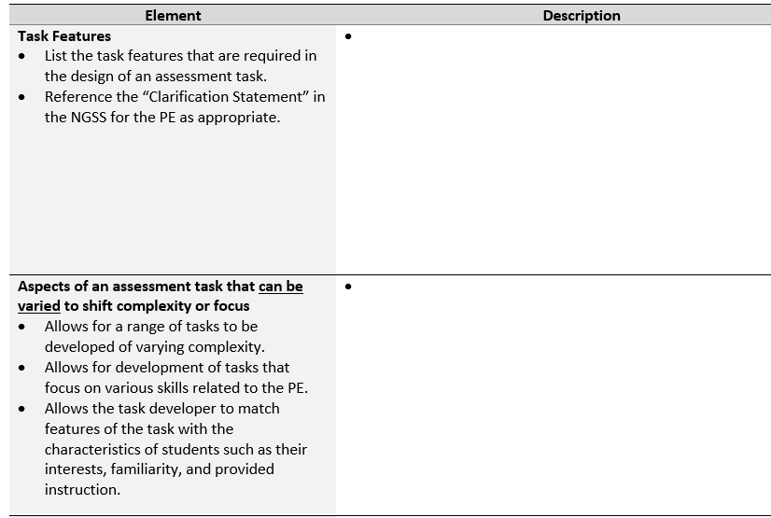
Prompt students to describe the effect of physical processes (e.g., the hydrologic cycle) which result in an observed phenomenon (e.g., cave formation) and support the connection with evidence that can be obtained through investigation
Provide evidence that can be used to make accurate inferences about student learning
Number and complexity of scientific concept(s) to be investigated
A high-quality scenario that focuses on a phenomenon or a design problem
Number and type of effects of water on Earth’s materials or surface processes
Require scientific reasoning and process skills
Elicit core ideas as defined in the PE
Amount of data and complexity of data
Various chemical effects of water on Earth’s materials
Connections between hydrological and rock cycles
Number and type of properties of water
Engaging and relevant
Accurate science content
8
Notes:
In this next portion of the guided activity, again, you will consider how to define two of the elements for the high school PE, HS-ESS2-5: Plan and conduct an investigation of the properties of water and their effects on Earth materials and surface processes. We will analyze and sort several statements to determine where they belong in the task specifications tool. For each statement, you will determine the element that it best exemplifies, whether it is task features or aspects of an assessment task that can be varied to shift complexity or focus.
Here is the first statement: Prompt students to describe the effect of physical processes (e.g., the hydrologic cycle) which result in an observed phenomenon (e.g., cave formation) and support the connection with evidence that can be obtained through investigation. Task features or aspects of an assessment task that can be varied to shift complexity or focus?
This statement relates to the element, task features.
Here is the next statement: Number and complexity of scientific concept(s) to be investigated. Task features or aspects of an assessment task that can be varied to shift complexity or focus?
This statement relates to the element, aspects of an assessment task that can be varied to shift complexity or focus.
Here is the next statement: Provide evidence that can be used to make accurate inferences about student learning. Task features or aspects of an assessment task that can be varied to shift complexity or focus?
This statement relates to the element, task features.
Here is another statement: Require scientific reasoning and process skills. Task features or aspects of an assessment task that can be varied to shift complexity or focus?
This statement relates to the element, task features.
Here is the next statement: Connections between hydrological and rock cycles. Task features or aspects of an assessment task that can be varied to shift complexity or focus?
This statement relates to the element, aspects of an assessment task that can be varied to shift complexity or focus.
Here is the next statement: Amount of data and complexity of data. Task features or aspects of an assessment task that can be varied to shift complexity or focus?
This statement relates to the element, aspects of an assessment task that can be varied to shift complexity or focus.
Here is another statement: Elicit core ideas as defined in the PE. Task features or aspects of an assessment task that can be varied to shift complexity or focus?
This statement relates to the element, task features.
Here is another statement: Various chemical effects of water on Earth’s materials. Task features or aspects of an assessment task that can be varied to shift complexity or focus?
This statement relates to the element, aspects of an assessment task that can be varied to shift complexity or focus.
Here is the next statement: A high-quality scenario that focuses on a phenomenon or a design problem. Task features or aspects of an assessment task that can be varied to shift complexity or focus?
This statement relates to the element, task features.
Here is the next statement: Accurate science content. Task features or aspects of an assessment task that can be varied to shift complexity or focus?
This statement relates to the element, task features.
Here is another statement: Number and type of properties of water. Task features or aspects of an assessment task that can be varied to shift complexity or focus?
This statement relates to the element, aspects of an assessment task that can be varied to shift complexity or focus.
Here is the next statement: Number and type of effects of water on Earth’s materials or surface processes. Task features or aspects of an assessment task that can be varied to shift complexity or focus?
This statement relates to the element, aspects of an assessment task that can be varied to shift complexity or focus.
Here is the last statement: Engaging and relevant. Task features or aspects of an assessment task that can be varied to shift complexity or focus? This statement relates to the element, task features.
Note that for this activity, we did not include statements for the element, assessment boundaries. This element will be explored in a guided activity in Module 3.6.

Slide 9

You can practice sorting elements for another PE at grade 5, middle school, and high school by completing the independent sorting activities provided in the Resources pod!
This Photo by Unknown Author is licensed under CC BY-NC-ND
Notes:
Are you ready for additional practice analyzing and sorting the elements of the task specifications tool? If so, you’re in luck! Additional sorting activities at grade 5, middle school, and high school are available for download in the Resources pod. We encourage you to complete these activities independently, with a partner, or with a group of colleagues.

Slide 10
Concluding Remarks
Defining the elements of the task specifications tool becomes easier with practice.
Once you’ve identified the key elements, they can be used to create a variety of science tasks aligned to the targeted PE.
Notes:
Defining the task elements to develop assessment tasks for a PE is hard work, but the good news is that with more practice, it becomes easier, and you begin to create content that can be reused or modified to create a variety of science tasks aligned to the targeted PE.
Now that you have a deeper grounding in the task specifications tool, you are nearly ready to develop your own tool. Before you get started, however, we invite you to complete Module 3.4, Resources for Developing a Task Specifications Tool, where we explore the resources available and explain how they provide information to support defining the elements of the task specifications tool.

Slide 11

Resources and Additional Information
Notes:
Finally, we offer additional resources that may be helpful to anyone interested in learning more about the concepts presented in this module. A glossary of terms and our reference list follow.
Thank you for your engagement in this third chapter of the SCILLSS digital workbook on designing high-quality three-dimensional science assessment tasks for classroom use.

Slide 12
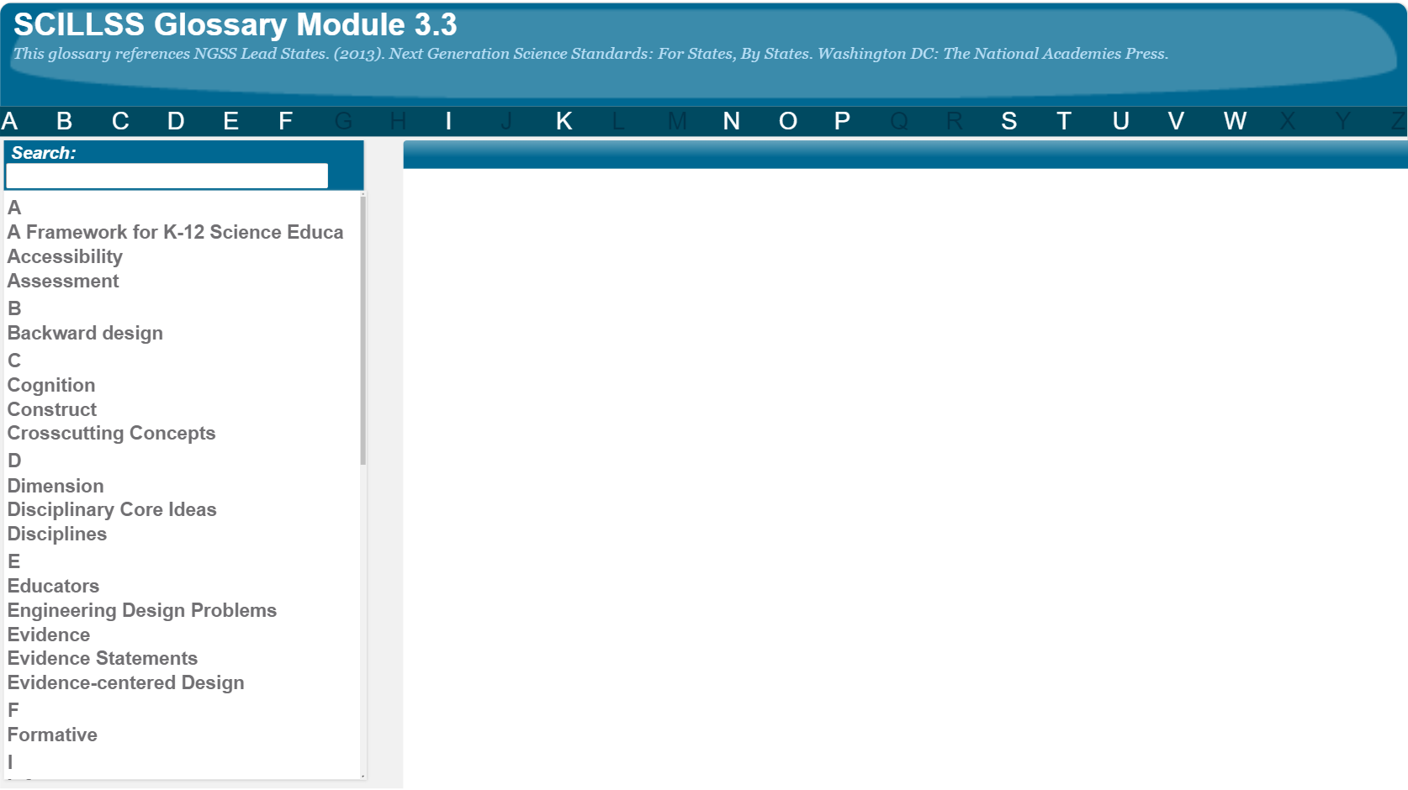
SCILLSS Glossary
Please refer to the SCILLSS Glossary for operational definitions of terms used.
12

Slide 13
Resources
In the Web Links pod, you can find the following resources:
A Framework for K-12 Science Education
Next Generation Science Standards
NGSS Evidence Statements
Appendix E: Disciplinary Core Idea Progressions
Appendix F: Science and Engineering Practices
Appendix G: Crosscutting Concepts
In the Resources pod, you can find the following resources:
Activity directions (5-ESS1-2, MS-PS3-1, HS-LS4-5)
Partially completed task specifications tools
(5-ESS1-2, MS-PS3-1, HS-LS4-5)
Completed task specifications tools—activity answers
(5-ESS1-2, MS-PS3-1, HS-LS4-5)

Slide 14
References
NGSS Lead States. (2013). Next Generation Science Standards: For States, By States. Washington DC: The National Academies Press.

