Slide 1
Designing High-Quality Three-Dimensional Science Assessments for Classroom Use
Chapter 3: Development of the Task Specifications Tool
Module 3.4: Resources for Developing a Task Specifications Tool
This digital workbook on designing high quality three-dimensional science assessment tasks for classroom use was developed by edCount, LLC, under
Enhanced Assessment Grants Program, CFDA 84.368A.
1
Notes:
Welcome to the third of four chapters in a digital workbook on designing high-quality three-dimensional science assessment tasks for classroom use. This workbook is intended to help educators design and evaluate high-quality classroom science assessment tasks that provide meaningful information about what students know and can do in science. This digital workbook was developed by edCount, LLC, under the US Department of Education’s Enhanced Assessment Grants Program, CFDA 84.368A.

Slide 2


Module 3.4: Resources for Developing a Task Specifications Tool
2
Notes:
Chapter 3 of this workbook includes a series of six modules. Together, these six modules provide an in-depth exploration of the second phase of principled assessment design: development of the task specifications tool. In this chapter, we describe how to define the content for multiple elements of this tool related to a performance expectation, or indicator to develop a clear and deep understanding of each element. We provide opportunities for you to engage in interactive activities and explore and use our design template to complete your own task specifications tool of a three-dimensional science standard.
In this module, Module 3.4, we present and describe the resources available to support defining the elements of the task specifications tool. In later modules, Modules 3.5 and 3.6, we provide specific guidance for completing the task specifications tool and offer an interactive activity to evaluate the quality of an existing task specifications tool and to illustrate the importance and benefits of reviewing and continually refining the tool.

Slide 3
Module 3.4 Outcomes
Unpacking Tool
Overview of Resources
The Role of the Unpacking Tool
To understand the role of the unpacking tool as a resource to complete the task specifications tool
Overview of Resources
To develop an understanding of how to use the unpacking tool and key resources for developing the task specifications tool, including:
Professional Expertise
A Framework for K-12 Science Education
NGSS/State Science Standards
NGSS Evidence Statements
NGSS Progressions (the Appendices)
Notes:
In Module 3.4, we review the role of the unpacking tool and other key resources for defining the elements of a task specifications tool for a PE, or indicator, and discuss how you can use your professional expertise as a science educator along with each of these resources to assist in the completion of a task specifications tool.

Slide 4
Resources for Development of the
Task Specifications Tool
Professional Expertise
NGSS Evidence Statements
NGSS/State Science Standards
A Framework for K-12 Science Education
NGSS Progressions (the Appendices)
Unpacking Tool
Notes:
Various resources are available to assist you with the development of the task specifications tool. We provide these resources in the Web Links pod and Resources pod for your reference during or following your completion of this module.
In Chapter 2 of this workbook, Unpacking the NGSS Performance Expectations, we discussed the role and the development of the unpacking tool. Utilization of this tool in which a PE is systematically “unpacked” into its multiple components to develop a clear and deep understanding of each dimension and the boundaries of what can be assessed is a key resource that guides and informs educators in defining the elements of the task specifications tool.
Your professional expertise is invaluable. You are likely already well-versed in the NGSS or your state science standards, and you have first-hand experience implementing curriculum and instruction aligned to those standards. You also have a deep understanding of your students. You can bring to bear past experiences, including your observations of students’ knowledge, skills, and abilities before, during, and after instruction and your knowledge of how students learn science and acquire understanding over time. This experience will be helpful for defining the elements of the task specifications tool.
However, it’s important to note that in addition to your expertise as an educator, you also have a wealth of information at your fingertips to assist with the task specifications tool. As we take a closer look at the Framework and the NGSS PEs, evidence statements, and progressions, you’ll see how these resources can serve as the foundation for defining the elements of the tool. There is no need to reinvent the wheel or to rely solely on your professional expertise when engaging in this work. Rather, our intent is to demonstrate how you can use your professional expertise in combination with these existing resources. Your scientific knowledge and your experience as a science educator and documentation such as the Framework and the NGSS PEs, evidence statements, and progressions can together provide useful information to support your work in phase two.
Let’s first look at the unpacking tool as a resource for defining the elements of the task specifications tool and understanding how tasks might be designed to elicit evidence of students’ sensemaking and integration of those dimensions.

Slide 5

Connecting the Phases of Principled Assessment Design
Phase 1: Unpacking Tool
Phase 2: Task Specifications Tool
Phase 3: Task, Rubric, and Exemplars
5
Notes:
Assessment of science learning requires educators to have a deep understanding of the multi-dimensional aspects of the PEs (Phase 1), the features and characteristics of three-dimensional classroom assessment tasks (Phase 2), and the development of assessment tasks that require students to revisit, extend, and apply their learning (Phase 3). These tasks must allow students to transfer the knowledge acquired during instruction and apply it in an assessment situation.
The task specifications tool—the basis for task development—flows directly from the unpacking tool, which provides guidance on the interpretation of the three dimensions of a PE and how they can be assessed. The task specifications tool assists educators in planning the intentional design of assessment tasks, which are meant to present a context or situation with which a student interacts, specify the form of a student’s response, and elicit information about a student’s knowledge, skills, and abilities. This is the backbone of what an educator can claim about what a student knows and can do and the observable evidence required to support those claims.
Use of a principled-design approach to develop three-dimensional assessment tasks can ensure that the evidence of student learning that is collected and evaluated is aligned to the PE and meets the intended purpose of the assessment. For teachers to effectively implement assessment as part of their pedagogy, they need both design tools: the unpacking tool and the task specifications tool. Using both design tools enables educators to create assessment tasks and scoring rubrics that support more complex and multi-dimensional assessments.
Please refer to the unpacking tool for HS-ESS2-5 in the Resources pod to consider how the work completed in Phase 1 can guide educators to make intentional decisions about the design and content of the tasks and evaluation of student responses.

Slide 6
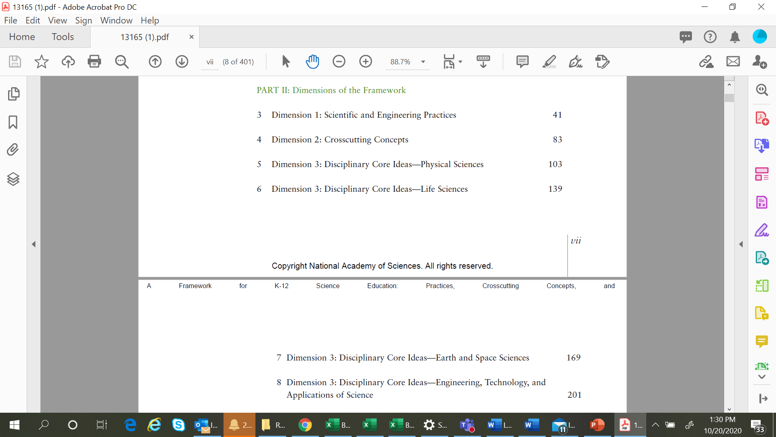
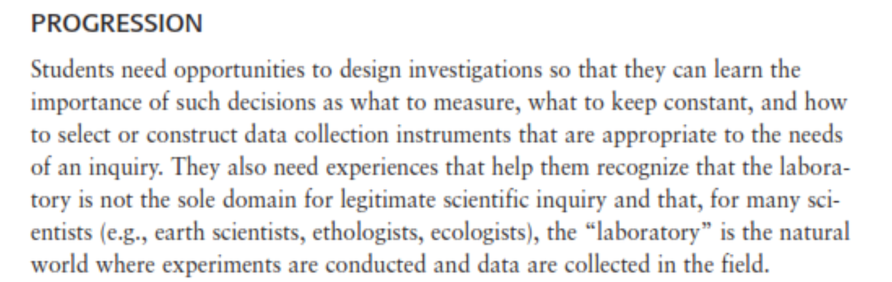
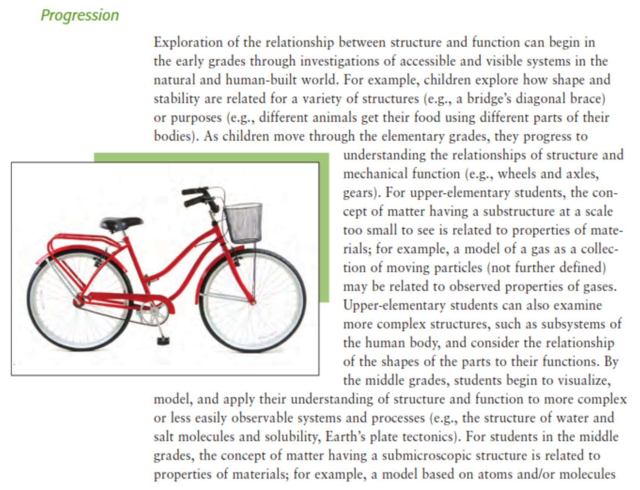
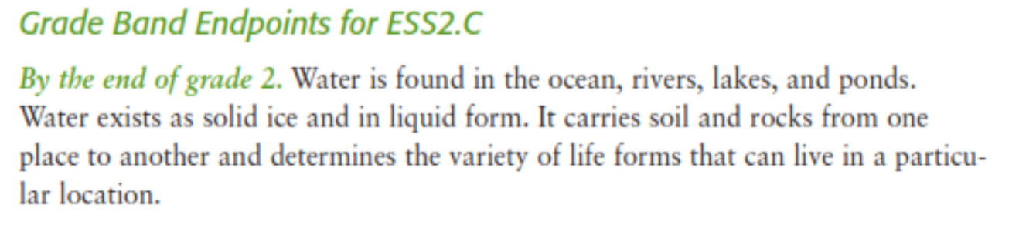
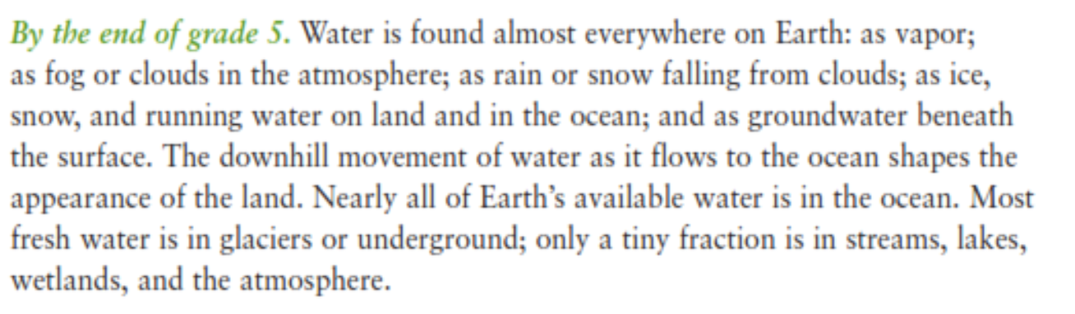
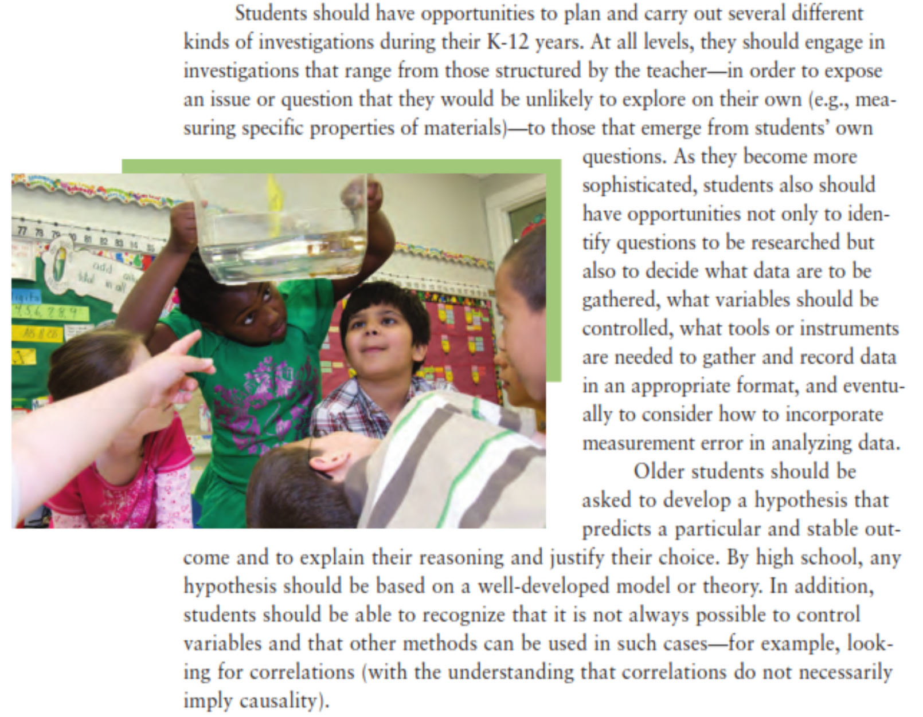
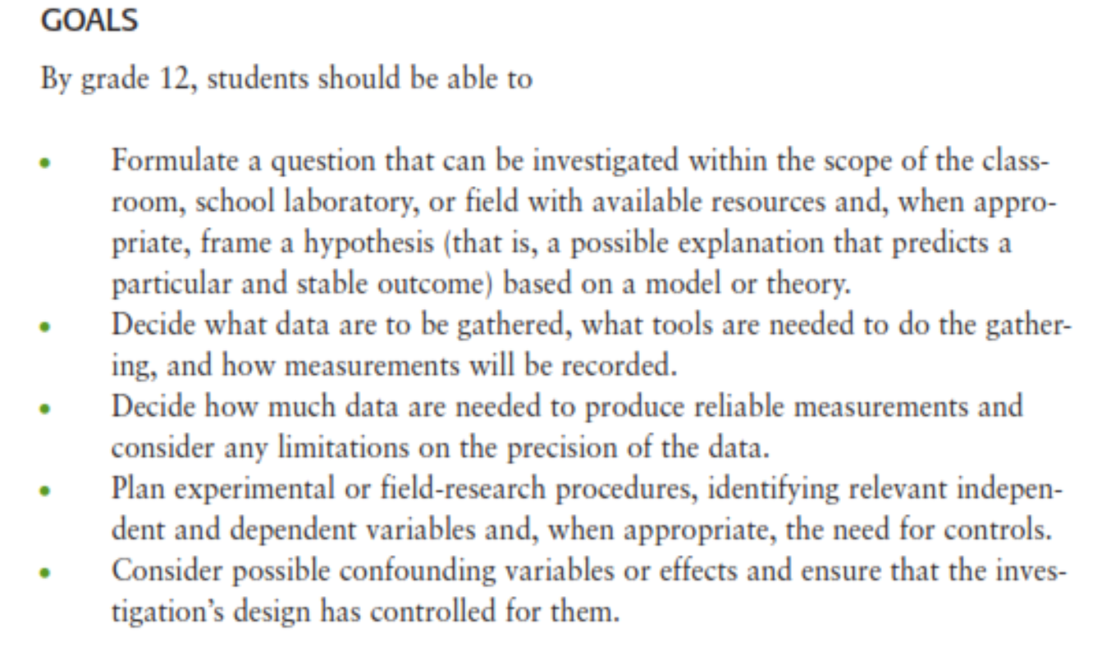
A Framework for K-12 Science Education
Notes:
A Framework for K–12 Science Education represents the initial step in a process to create new standards in K–12 science education—a common set of Next Generation Science Standards. This framework builds on the strong foundation of previous studies that sought to identify and describe the major ideas for K–12 science education. The Framework highlights the power of integrating the ideas of science with engagement in the practices of science and is designed to build students’ proficiency and appreciation for science throughout a K–12 educational experience.
The overarching goal of the Framework is to ensure that by the end of twelfth grade, all students have some appreciation of the beauty and wonder of science; possess sufficient knowledge of science and engineering to engage in public discussions on related issues; are careful consumers of scientific and technological information related to their everyday lives; are able to continue to learn about science outside school; and have the skills to enter careers of their choice, including (but not limited to) careers in science, engineering, and technology.
Part two of the Framework explicates the dimensions—the SEPs, CCCs, and the disciplinary-related DCIs—by stressing the importance of developing students’ knowledge related to the dimensions, including detailed descriptions of each of the eight practices, the seven CCCs, and their value across the sciences and in engineering, and the DCIs organized by the disciplines of Life Sciences, Physical Sciences, Earth and Space Sciences, and Engineering, Technology and Applications of Science. In addition, part two of the Framework also describes grade 12 goals, the progression of the dimensions across K–12, or grade-band endpoints.
For our purposes, as we explore the multiple resources that will support your efforts to develop a task specifications tool and to highlight examples from these resources, we focus on a high school NGSS PE, HS-ESS2-5: Plan and conduct an investigation of the properties of water and their effects on Earth materials and surface processes.
Let’s look at the information provided in the Framework related to the SEP, Planning and Carrying Out Investigations as it pertains to HS-ESS2-5. The Framework defines and describes how a major practice of scientists is planning and carrying out a systematic investigation, which requires the identification of what is to be recorded, and if applicable, what are to be treated as the dependent and independent variables. Observation and data collected from such work are used to test existing theories and explanations or to revise and develop new ones. In addition, engineers use investigation both to gain data essential for specifying design criteria or parameters and to test their designs. Like scientists, engineers must identify relevant variables, decide how they will be measured, and collect data for analysis. Their investigations help them to identify how effective, efficient, and durable their designs may be under a range of conditions (the Framework, NRC, 2012, p. 50).
The Framework also includes the goals related to this SEP, which are to be met by grade 12, and how they progress across the grades. If we examine the progression for planning and carrying out investigations, in the earliest grades, students learn to define the features to be investigated and how carrying out careful and systematic investigations leads to planning and carrying out several kinds of investigations. This includes deciding what data are to be gathered, what variables should be controlled, and what tools or instruments are needed. By high school, older students are expected to develop a hypothesis and explain their reasoning and justify their choice (the Framework, NRC, 2012, p. 61).
Related to Structure and Function, the Framework provides a definition and examples of the crosscutting concept followed by a description of the progression beginning with young children through the upper elementary grades to middle school and high school.
This is then followed by the DCIs, organized by discipline. We feature The Role of Water in Earth’s Surface Processes, ESS2-C, as it relates to the PE HS-ESS2-5. The Framework describes the core ideas and how they progress across grade levels as grade band endpoints.
Now, let’s take a deeper dive into the architecture of the NGSS and how the NGSS appendices will support the development of the task specifications tool using the same high school PE, ESS2-5.

Slide 7
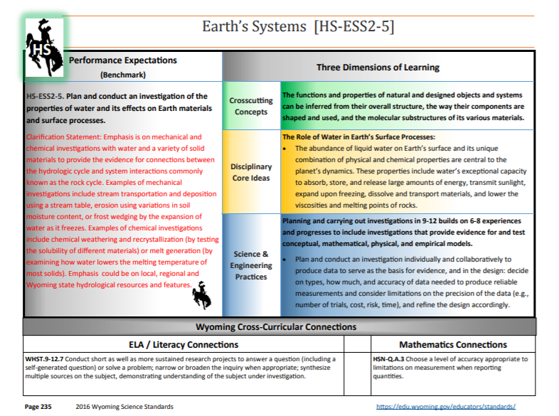
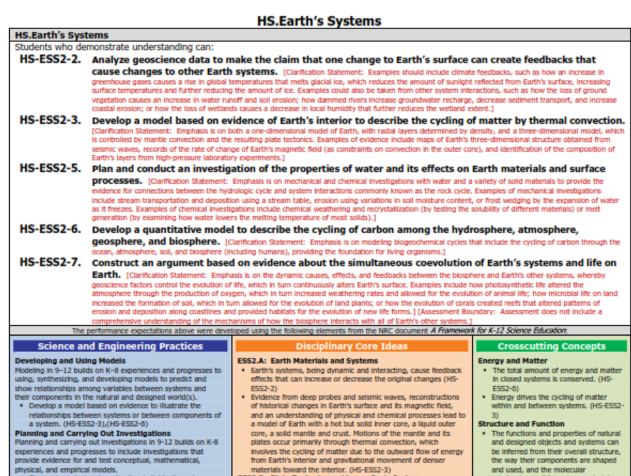
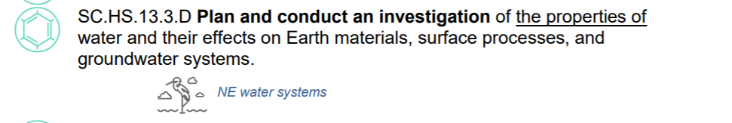
Topic Arrangements of the NGSS Standards
7
Notes:
the beginning of the NGSS development process, to eliminate potential redundancy, seek an appropriate grain size, and seek natural connections among the DCIs identified within the Framework, the writers arranged the DCIs into topics around which to develop the standards.
This topical arrangement includes the foundation boxes, which indicate the related DCIs, SEPs, and CCCs, which address the set of PEs related to Earth’s Systems.
Please pause the presentation to review the set of PEs and each PE’s corresponding statements in the foundation boxes. Note the statements specific to HS-ESS2-5 are circled for the SEP and CCC. For the full topical arrangement for Earth’s Systems, refer to the NGSS Topic Arrangements of the Next Generation Science Standards in the Resources pod.
As shown here, states may have created NGSS-aligned science standards and organized the content of standards using unique formatting, coding systems, and organization of the content.
Please pause the presentation to review these three examples of state NGSS-aligned science standards. Consider your state’s science standards and how they may be similar or different in their formatting, coding system, and organization as compared to the NGSS.

Slide 8
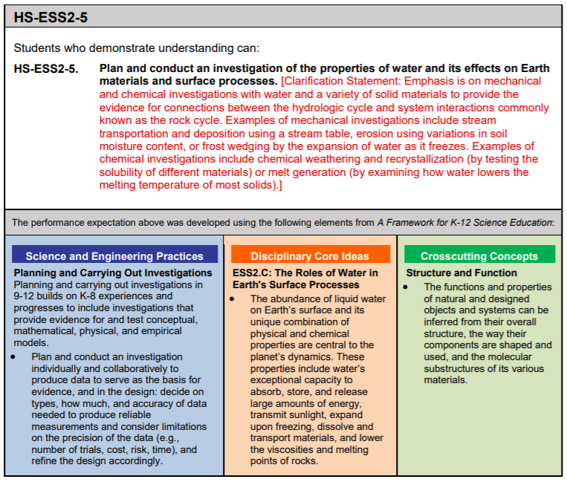
NGSS Evidence Statements
Notes:
In the next two slides, we examine another helpful resource for defining the elements of the task specifications tool: the NGSS Evidence Statements. This slide shows the PE, HS-ESS2-5, and its dimensions for which a set of evidence statements are provided. Before we review the evidence statements for this PE on the next slide, let’s get further oriented to the PE and its dimensions.
For a given sub-idea related to a topic, in this instance, Earth’s Systems, a single PE is indicated. The PE is stated in the context of what students can do to demonstrate understanding. This is followed by the foundation boxes, which identify the specific SEP, DCI or DCIs, and CCC aligned to this PE.
Please pause the presentation to review this PE and the content in the foundation boxes. Resume the presentation when you are ready to advance to the next slide and see the evidence statements for this PE.

Slide 9
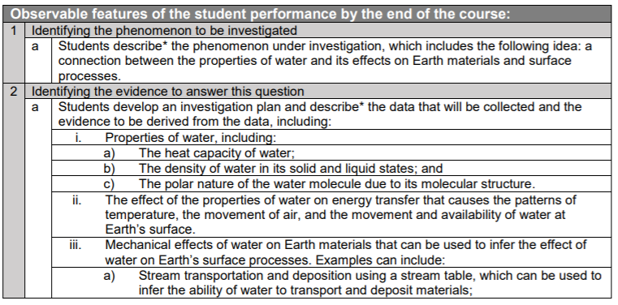
NGSS Evidence Statements
Notes:
NGSS Evidence Statements provide educators with additional detail on what students should know and be able to do to demonstrate understanding of a PE. The evidence statements are observable and measurable components that articulate how students can use the practice to demonstrate their understanding of the DCI or DCIs, through the lens of the CCC, and thus, demonstrate proficiency on each PE. The evidence statements do this by clarifying: 1) how the three dimensions could be assessed together, rather than in independent units; 2) the underlying knowledge required for each DCI; 3) the detailed approaches to science and engineering practices; and 4) how crosscutting concepts might be used to deepen content-and practice-driven learning.
The science and engineering practices are used as the organizing structure for the evidence statements. Keep in mind that this does not mean that the practices are more important than the other dimensions. The proper integration of practices makes students’ thinking visible and provides an avenue for students to demonstrate full proficiency in a practice.
Note that the evidence statements are not created to be used as curriculum, nor prescribe the context through which the PEs are taught and assessed, or the sequence of PEs during instruction.
This slide shows a sample of the evidence statements for the PE, HS-ESS2-5. The full set of evidence statements for this PE is available in the Web Links pod. Please pause the presentation to access and familiarize yourself with the evidence statements for this PE. How are the dimensions represented and organized within the evidence statements? How do the evidence statements explicate the relationships and connections among the dimensions that demonstrate the observable features of student performance?

Slide 10
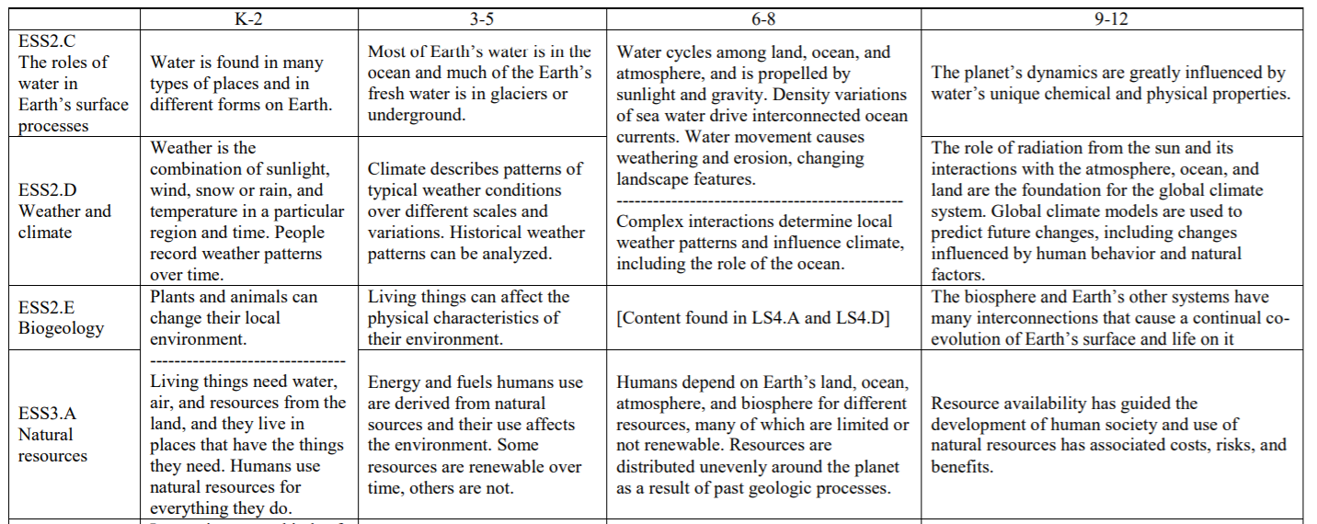
Appendix E. Disciplinary Core Idea Progressions
Notes:
Let’s shift gears and look at an additional set of resources, the NGSS appendices. We begin with an excerpt from Appendix E. Disciplinary Core Idea Progressions. The Framework describes the progression of disciplinary core ideas in the grade band endpoints. These grade band endpoints reflect an increase in students’ understanding of the disciplinary core ideas as they progress from one grade band to the next. Some of the sub-ideas within the disciplinary core ideas overlap significantly. You will notice there is not always a clear division between those ideas, so several progressions are divided among more than one sub-idea.
For the Earth’s Systems Progression, the 9–12 grade band includes one sub-idea: ESS1.C: The roles of water in Earth’s surface processes. It builds on knowledge acquired at the 6–8 grade band, including that water continually cycles among land, ocean, and atmosphere; global movements of water and its changes in form are propelled by sunlight and gravity, water movement causes weather and erosion, and complex patterns of movement of water are major determinants of local weather patterns (the Framework, NRC, 2012, p. 185).
As you define the elements of the task specifications tool for your selected PE, you can rely on Appendix E to help identify the KSAs, task features, such as including accurate science content, and assessment boundaries by looking carefully within and across the grade band progressions. For example, the progression at the 6–8 grade band provides information that should be considered prior knowledge for grades 9–12 students.

Slide 11
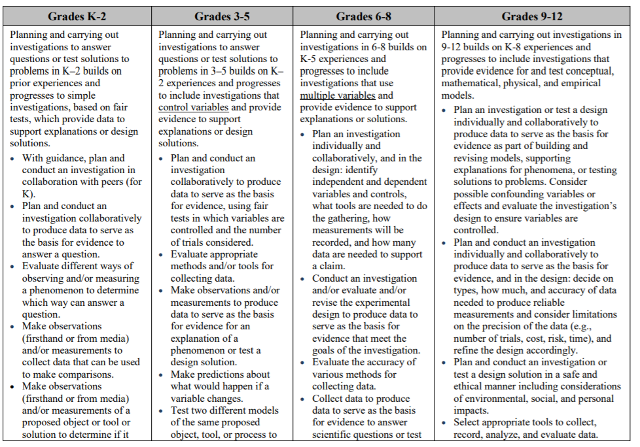
Appendix F. Science and Engineering Practices
Practice 3 Planning and Carrying Out Investigations
Notes:
The Framework specifies that each performance expectation must combine a relevant practice of science or engineering with a disciplinary core idea and crosscutting concept appropriate for students of the designated grade level. Engaging in the practices of science helps students understand how scientific knowledge develops and can lead students to an appreciation of the range of approaches that are used to investigate, model, and explain the world as scientists and engineers would.
Appendix F. Science and Engineering Practices includes the eight practices of science and engineering that the Framework identifies as essential for all students to learn. It describes how grade band expectations expand on the previous grade band’s experiences and progress to build a more sophisticated understanding of the SEP.
Here is an excerpt from Appendix F specific to Practice 3, Planning and Carrying Out Investigations, for HS-ESS2-5. Cross-referenced with the progression of understanding for this SEP in the Framework, students in grades 9–12 should understand that any hypothesis should be based on a well-developed model or theory and be able to recognize that it is not always possible to control variables and other methods can be used in such cases⎯for example, looking for correlations (with the understanding that correlations do not necessarily imply causality) (the Framework, NRC, 2012, p. 61).
Note as compared to grades 6–8, where students are planning and carrying out investigations that use multiple variables and provided evidence to support explanations or solutions, in grades 9–12, students are planning and carrying out investigations that provide evidence for and test conceptual, mathematics, physical, and empirical models.
As you define the elements of the task specifications tool for your selected PE, you can rely on Appendix F to help identify the KSAs, student demonstrations of learning, work products, and aspects that can be varied to shift complexity or focus of the task by looking carefully within and across the grade band progressions. For example, the progression at the 6–8 grade band provides information that should be considered prior knowledge for grades 9–12 students.

Slide 12
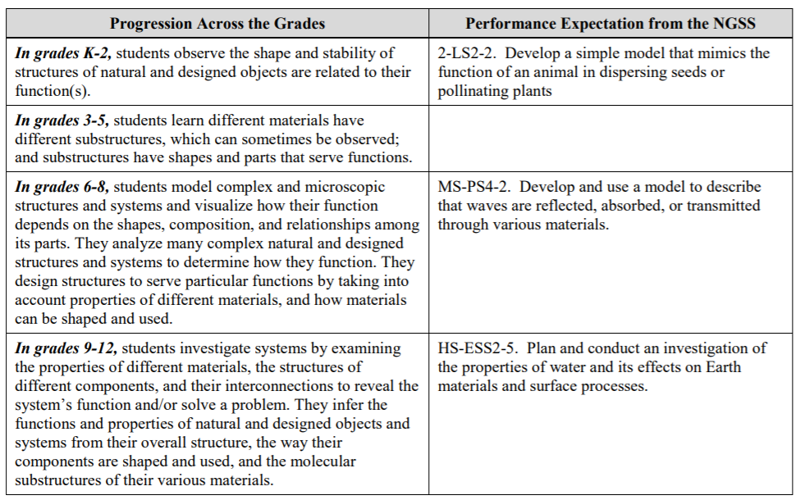
Appendix G. Crosscutting Concepts
CCC 6. Structure and Function
Notes:
Crosscutting concepts have value because they provide students with connections and intellectual tools that are related across the differing areas of disciplinary content and can enrich their application of practices and their understanding of core ideas (the Framework, NRC, 2012, p. 233). They bridge disciplinary boundaries, uniting core ideas throughout the fields of science and engineering.
Appendix G. Crosscutting Concepts provides a brief summary of how each crosscutting concept increases in complexity and sophistication across the grades as envisioned in the Framework and provides examples of PEs to illustrate how these concepts play out in the NGSS.
Here is an excerpt from Appendix G specific to CCC 6, Structure and Function, which is highlighted for the PE, HS-ESS2-5. For each grade band, the way students explore the relationship between structure and function becomes increasingly sophisticated. Cross-referenced with the progression of understanding for this CCC in the Framework, students in grades 9–12 begin to apply knowledge of this relationship when investigating phenomena that are unfamiliar to them, and they recognize that often the first step in deciphering how a system works is to examine in detail what it is made of and the shapes of its parts. Students also apply relationships between structure and function as critical elements of successful designs (the Framework, NRC, 2012, pp. 97–98).
As you define the elements of the task specifications tool for your selected PE, you can rely on Appendix G to help identify the KSAs, student demonstrations of learning, work products, and aspects that can be varied to shift complexity or focus of the task by looking carefully within and across the grade band progressions. Again, the progression at the 6–8 grade band provides information that should be considered prior knowledge for grades 9–12 students.

Slide 13

Resources and Additional Information
Notes:
Finally, we offer additional resources that may be helpful to anyone interested in learning more about the concepts presented in this module. A glossary of terms and our reference list follow.
Thank you for your engagement in this third chapter of the SCILLSS digital workbook on designing high-quality three-dimensional science assessment tasks for classroom use.

Slide 14
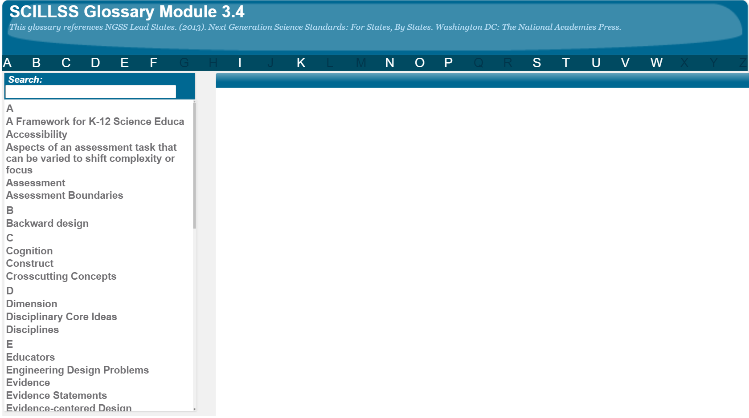
SCILLSS Glossary
Please refer to the SCILLSS Glossary for operational definitions of terms used.

Slide 15
Resources
In the Web Links pod, you can find the following resources:
A Framework for K-12 Science Education
Next Generation Science Standards
NGSS Topic Arrangements of the Next Generation Science Standards
NGSS Evidence Statements
HS-ESS2-5 Evidence Statements
Appendix E: Disciplinary Core Idea Progressions
Appendix F: Science and Engineering Practices
Appendix G: Crosscutting Concepts
In the Resources pod, you can find the following resources:
Unpacking tool for HS-ESS2-5
NGSS Topic Arrangements of the Next Generation Science Standards

Slide 16
References
National Research Council. (2012). A Framework for K-12 Science Education: Practices, Crosscutting Concepts, and Core Ideas. Washington, DC: The National Academies Press. https://doi.org/10.17226/13165.

