Slide 1
Designing High-Quality Three-Dimensional Science Assessments for Classroom Use
Chapter 3: Development of the Task Specifications Tool
Module 3.5: Guidance for Completing the Task Specifications Tool
This digital workbook on designing high quality three-dimensional science assessment tasks for classroom use was developed by edCount, LLC, under
Enhanced Assessment Grants Program, CFDA 84.368A.
Notes:
Welcome to the third of four chapters in a digital workbook on designing high-quality three-dimensional science assessment tasks for classroom use. This workbook is intended to help educators design and evaluate high-quality classroom science assessment tasks that provide meaningful information about what students know and can do in science.
This digital workbook was developed by edCount, LLC, under the US Department of Education’s Enhanced Assessment Grants Program, CFDA 84.368A.

Slide 2


Module 3.5: Guidance for Completing the Task Specifications Tool
2
Notes:
Chapter 3 of this workbook includes a series of six modules. Together these six modules provide an in-depth exploration of the second phase of principled assessment design: development of the task specifications tool. In this chapter, we focus on translating the unpacking of the three dimensions of a specific performance expectation, or indicator, into assessment tasks using a task specifications tool. We provide opportunities for you to engage in interactive activities and explore and use our design template to complete your own task specifications tool for a three-dimensional standard.
In this module, Module 3.5, we offer guiding questions, key strategies, and instructions for completing the process.

Slide 3
Module 3.5 Outcomes
Guidance for Completing the Task Specifications Tool
Guidance for Completing the Task Specifications Tool
To provide key considerations and strategies to complete the task specifications tool
Notes:
In the previous Chapter 3 modules, we explored the role of the task specifications tool and key resources for defining the elements of a task specifications tool for a PE, or indicator. We introduced the Task Specifications Tool Template and described its elements. You engaged in an interactive sorting activity to gain a deeper understanding of these elements of the task specifications tool. In the previous modules, we also explored the resources available to support defining the elements of the task specifications tool.
You are nearly ready to start developing your own task specifications tool. But before you do, we have some important tips, strategies, and guiding questions to guide your work. By completing Module 3.5, you will have the tools you need to engage in the second phase of principled assessment design and develop your own task specifications tool.

Slide 4
Getting Started
Gather key resources.
  A Framework for K-12 Science Education
  State Science Content Standards
  The NGSS
  NGSS Evidence Statements
  NGSS Appendices E, F, and G
  Unpacking Tool for the Selected PE
  Task Specifications Tool Template
Think critically about what is to be measured when determining the KSAs.
Begin defining the elements of the Task Specifications Tool Template.
Notes:
Let’s get to work. First, you’ll want to gather some key resources. As we shared in previous modules, drafting a task specifications tool for a performance expectation can require referencing many documents and resources. Some key documents to start with include the Framework, State Science Standards, the NGSS, NGSS Evidence Statements, NGSS Appendices E, F, and G, and the Unpacking Tool for the selected PE. These resources are provided in the Web Links pod. As you access these materials, think about the easiest way to reference these documents. Some people find it easiest to use paper versions, and some prefer electronic.
Once you’ve gathered the necessary resources, you are ready to analyze the key aspects and prior knowledge from your completed unpacking tool to define the Knowledge, Skills, and Abilities statements for the selected PE.

Slide 5
Getting Started—Defining the Elements
Knowledge, Skills, and Abilities
Student Demonstrations of Learning
Assessment Boundaries
Work Products
Aspects that can be varied
Task Features
Notes:
The task specifications tool identifies the information an educator needs to develop purposeful assessment tasks. To create a task, the educator must define the aspect(s) of the PE to be assessed and make design choices about what information is presented to a student, how it is presented, how the student interacts with the tasks, and how responses are provided.
The task specifications tool indicates the elements the educator considers to develop high-quality tasks, including:
the knowledge, skills, and abilities of the PE;
the kinds of behaviors and performances that show what students should be able to do after instruction;
the vehicles (e.g., a model, an argument, a description, a graph, a chart) that contain observable evidence of what students say, do, or make to produce evidence of their learning;
the features of task situations that allow students to demonstrate the degree to which expectations have been met;
the aspects of an assessment task that can be varied to shift complexity or focus; and
the information NOT assessed, such as related above grade-level ideas and skills.

Slide 6
Guiding Questions for Completing the
KSAs for the Task Specifications Tool
What ideas and skills are associated with a PE?
What aspects from “unpacking” the dimensions can be combined to represent a construct to be measured (i.e., KSAs)?
What KSAs are necessary for students to demonstrate in a task that reflect understanding of the PE?
Are the KSAs consistent with the expectation of the PE?
Are the KSAs consistent with the key aspects indicated in the unpacking tool?
Notes:
As you engage in the process to define the knowledge, skills, and abilities for the selected PE, ask yourself these important questions:
What ideas and skills are associated with a PE?
What aspects from “unpacking” the dimensions can be combined to represent a construct to be measured (i.e., KSAs)?
What KSAs are necessary for students to demonstrate in a task that reflect understanding of the PE?
Are the KSAs consistent with the expectation of the PE?
Are the KSAs consistent with the key aspects indicated in the unpacking tool?

Slide 7
Strategies for Completing the KSAs for the Task Specifications Tool
Use the following strategies to complete the Task Specifications Tool:
  Consider the number of KSAs that are required to address the breadth and the dimensions represented in the PE.
  Consider if the specificity and range of the KSAs is sufficient to support the development of multiple tasks and questions/prompts within a task.
  Consider how the KSAs support the development of tasks that reflect how students will demonstrate learning.
  Consider how assessing the KSAs elicits sufficient evidence to make appropriate inferences about students’ learning.
Notes:
Let’s review some strategies to support your work. As we discussed previously, there are many resources you can use in combination with your professional expertise. Using these resources, analyze the key aspects and prior knowledge statements from your unpacking tool and consider what knowledge, skills, and abilities are necessary to develop meaningful and interpretable assessment tasks that measure students’ science learning of the selected PE.
Also, remember to consider if the specificity and range of the set of KSAs is sufficient to address the PE as well as support the development of multiple questions within a task. Think about what you want to observe from a performance, product, process, constructed model, written explanation, etc., that will provide sufficient evidence of students’ learning.

Slide 8
Guiding Questions for Completing the SDLs and WPs for the Task Specifications Tool
What types of performances provide evidence that students have learned the KSAs?
How can students demonstrate their learning? What types of responses or artifacts should students produce?
What are the ways in which students can provide evidence of their learning (e.g., sense-making using the three dimensions)?
How does the evidence reflect the selected KSAs?
What are the kinds of behaviors and performances that show what students should know and be able to do after instruction?
What are the questions, prompts, or situations that elicit evidence of students’ learning?
Notes:
As you engage in the process to define the student demonstrations of learning and work products for the selected PE, ask yourself these important questions:
What types of performances provide evidence that students have learned the KSAs?
How can students demonstrate their learning? What types of responses or artifacts should students produce?
What are the ways in which students can provide evidence of their learning (e.g., sense-making using the three dimensions)?
How does the evidence reflect the selected KSAs?
What are the kinds of behaviors and performances that show what students should know and be able to do after instruction?
What are the questions, prompts, or situations that elicit evidence of students’ learning?

Slide 9
Strategies for Completing the SDLs and WPs for the Task Specifications Tool
Use the following strategies to complete the task specifications tool:
  Consider important design decisions such as what information is presented to students, how it is presented, how students interact with the tasks, and how responses are provided.
  Review the KSAs to gain a complete understanding of what students are expected to demonstrate to provide evidence that they have learned one or more aspects of a PE.
  Consider and evaluate the types and variations of “vehicles” (i.e., work products) that are intended to contain observable evidence (e.g., a model, an argument, a description, a graph, a chart).
  Consider how the evidence elicited by the SDLs and WPs ensure that educators can make accurate inferences about student competencies.
  Consider how the SDLs and WPs with respect to the assessed KSAs will inform educator actions either to 1) continue with the instructional sequence as planned; or 2) adjust the design, delivery, and sequence of instruction.
  Consider how the SDLs and WPs will inform instructional decisions made at the individual student level, for a small group of students, or at the class level.
Notes:
Let’s review some strategies to support your work. Please pause the presentation and take a moment to review this slide.
As you define the student demonstrations of learning and work products, consider important design decisions such as what information is presented to students, how it is presented, how students interact with the tasks, and how responses are provided.
For the student demonstrations of learning, think carefully about the evidence students should demonstrate for the selected KSA or KSAs. Create a list of what students should be able to do to demonstrate that they have met the KSAs. In this list, clearly define the qualities of student performance that constitute student evidence. For example, for a KSA that requires planning an investigation, students will need to demonstrate that they can develop a logical investigation plan, accurately describe the data that will be collected, and identify and interpret the evidence to be derived from the data.
For the work product, consider the types and variations of “vehicles” that are intended to contain observable evidence. This includes item types or situations that allow students to demonstrate their learning of the KSAs.
Ultimately, the student demonstrations of learning and work products must support you in making accurate inferences about students’ science learning. Also, what you learn about your students from the elicited evidence will inform your instructional decisions. Will you continue with the instructional sequence as planned? Or will you adjust the design, delivery, and sequence of instruction? If the latter, how might you make instructional decisions at the student level, for a small group of students, or at the class level?

Slide 10
Guiding Questions for Completing the TFs, Aspects of the task that can be varied, and ABs for the Task Specifications Tool
What are the features of task situations that allow students to demonstrate the degree to which expectations have been met?
What are features of any assessment task that are required/necessary to appropriately measure one or more of the KSAs?
What features allow for a range of tasks to be developed at varying levels of complexity, which, in turn, can affect the difficulty of the task?
What features allow for a variation in the focus of the task?
What features should be included and could be varied to address the characteristics of students, such as their interests, familiarity, and cultural identity, and their provided instruction?
What information should not be assessed (i.e., related above grade-level ideas and skills)?
Notes:
As you engage in the work of completing the task specifications tool, consider the task features that are necessary to measure the KSAs, how aspects of the task can be varied to shift complexity or focus, and the assessment boundaries to ensure that tasks are not designed to exceed the expectations of the PE.
Ask yourself these important questions:
What are the features of task situations that allow students to demonstrate the degree to which expectations have been met?
What are features of any assessment task that are required/necessary to appropriately measure one or more of the KSAs?
What features allow for a range of tasks to be developed at varying levels of complexity, which in turn can affect the difficulty of the task?
What features allow for a variation in the focus of the task?
What features should be included and could be varied to address the characteristics of students, such as their interests, familiarity, and cultural identity, and their provided instruction?
What information should not be assessed (i.e., related above grade-level ideas and skills)?

Slide 11
Strategies for Completing the TFs, Aspects of the task that can be varied, and ABs for the Task Specifications Tool
Use the following strategies to complete the Task Specifications Tool:
  Consider the necessary task features for addressing a KSA or KSAs for the selected PE.
  Consider the range of phenomena or design problems that might be included in a task scenario or context.
  Consider how to promote engagement regarding students’ interests, familiarity (e.g., local or regional topics, opportunities for instruction), and cultural identities.
  Consider the reading level, the amount of reading/text, the clarity and conciseness of the text, the use of graphics, symbols, and equations, etc., and how these each might be varied to ensure tasks are accessible to all students.
  Reference the “Clarification Statement” in the PE as appropriate.
  Review the “Assessment Boundaries” in the PE as appropriate.
Notes:
Let’s review some strategies to support your work. Please pause the presentation and take a moment to review this slide.
For the first element, task features, consider the necessary task features for addressing a KSA or KSAs for the selected PE.
Next, consider those aspects of an assessment task that can be varied to shift complexity or focus. For example, some variable aspects can be used to increase or decrease the complexity of a task. Remember, KSAs vary in their depth and breadth. Therefore, a task could include questions that reflect a range of complexity. One question might measure a KSA that is more discrete and less complex, while another question might address one or more KSAs that reflect all three-dimensions and require higher order reasoning and sense-making. For this element, also consider how tasks might vary to promote engagement and accessibility. An educator might select a topic or text of regional or cultural importance for a group of students. He or she might also consider how information is presented to students, such as through visual representations, videos, audio, and other multimedia, as well as the reading level and amount of text presented to students. Educators must think carefully about how to match aspects of tasks with the characteristics of their students through such considerations as their interests, familiarity, cultural identity, and previous instruction.
Finally, as you think about the features of the tasks that need to be evident in any of the products that students are creating, you want to ensure that when developing these tasks, you are not asking students to do things that exceed the expectation of the PE. By referencing the Assessment Boundaries of the PE, as appropriate, you can ensure that you are designing tasks that stay within the boundaries of grade-level or grade-band expectations.

Slide 12

Task Specifications Tool Development
Ready to develop the task specifications tool?
Access these grade or grade-band specific documents:
  Completed Unpacking Tool
  A Framework for K-12 Science Education
  Next Generation Science Standards
  NGSS Evidence Statements
  NGSS Appendices E, F, and G
  SCILLSS Model Task Specifications Tools
  Guidance to Complete Activities—Task Specifications Tool
  Task Specifications Tool Template
Complete the Task Specifications Tool for your grade or grade band independently, with a partner, or in a small group.
Notes:
As you engage in the work of defining the elements of a task specifications tool either independently, with a partner, or in a small group, we encourage you to refer to a variety of resources, including your unpacking tool for the selected PE, the NGSS resources, and the SCILLSS models, tools, and templates. Notating your use of these resources directly in your task specifications tool is a helpful strategy for tracking your thinking and documenting how you have specifically used the resources to develop the tool. We encourage you to rely on your content knowledge and experience in combination with these resources.
Also, remember that the Framework is a foundational resource as it sets forth a vision for education in the sciences and engineering in which students, over multiple years of school, actively engage in scientific and engineering practices and apply crosscutting concepts to deepen their understanding of the core ideas in these fields (the Framework, p. 8-9). Further, it describes each of the dimensions in terms of its intent and use and provides narratives that define the expectations by grade 12 goals, the progression of the dimensions across K–12, or grade-band endpoints.
For further support, download the Guidance to Complete Activities for the Task Specifications Tool located in the Resources pod. This document offers some additional key aspects, guiding questions, and strategies to support your work. We also provide completed task specifications tools at the elementary, middle, and high school grade bands. Refer to these models as examples of what the outcomes of this process might look like.

Slide 13

Resources and Additional Information
Notes:
Finally, we offer additional resources that may be helpful to anyone interested in learning more about the concepts presented in this module. A glossary of terms and our reference list follow.
Thank you for your engagement in this third chapter of the SCILLSS digital workbook on designing high-quality three-dimensional science assessment tasks for classroom use.

Slide 14
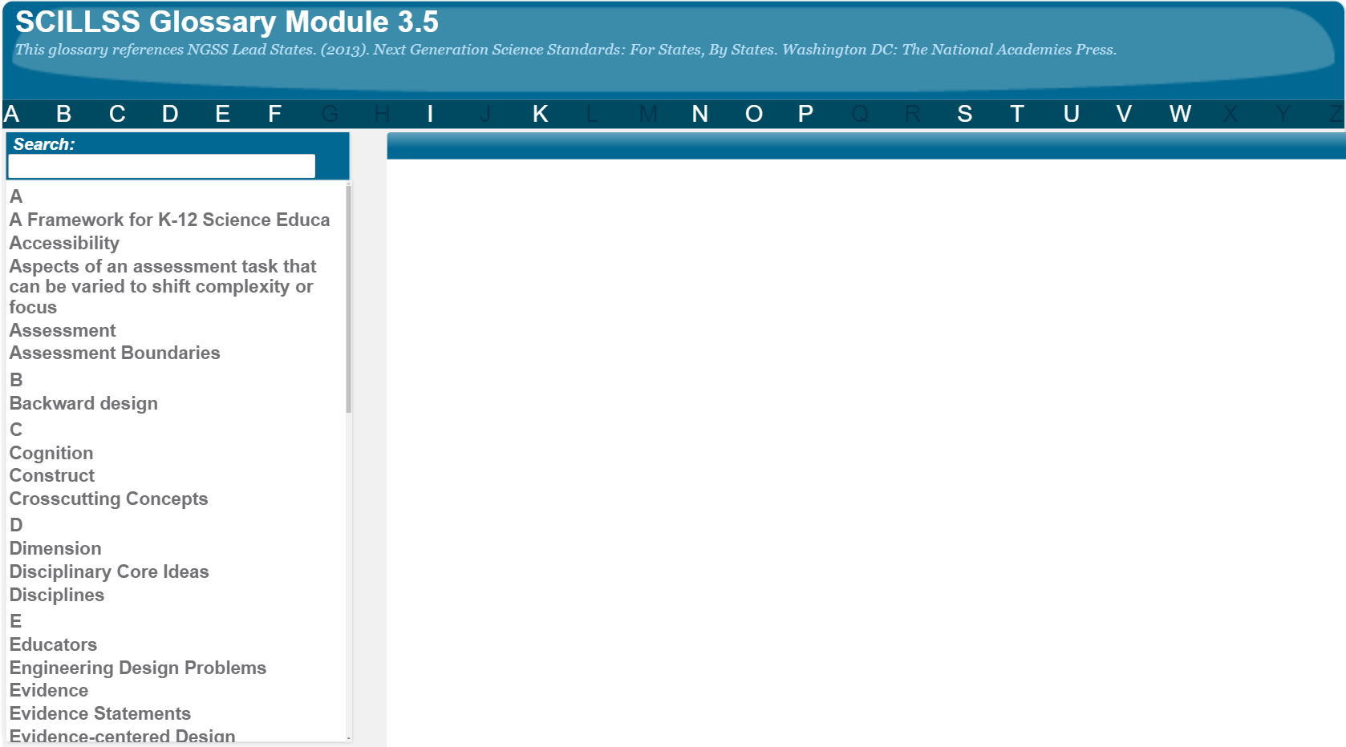
SCILLSS Glossary
Please refer to the SCILLSS Glossary for operational definitions of terms used.

Slide 15
Resources
In the Web Links pod, you can find the following resources:
A Framework for K-12 Science Education
Next Generation Science Standards
NGSS Evidence Statements
Appendix E: Disciplinary Core Idea Progressions
Appendix F: Science and Engineering Practices
Appendix G: Crosscutting Concepts
In the Resources pod, you can find the following resources:
Task Specifications Tool Template
Guidance to Complete Activities—Task Specifications Tool
SCILLSS Model Task Specifications Tools

Slide 16
References
National Research Council. (2012). A Framework for K-12 Science Education: Practices, Crosscutting Concepts, and Core Ideas. Washington, DC: The National Academies Press. https://doi.org/10.17226/13165.

