Slide 1
Designing High- Quality Three-Dimensional Science Assessments for Classroom Use
Chapter 4: Development of Tasks, Rubrics, and Exemplars
Module 4.2: Components and Models of High-Quality Classroom Assessment Tasks
This digital workbook on designing high quality three-dimensional science assessment tasks for classroom use was developed by edCount, LLC, under
Enhanced Assessment Grants Program, CFDA 84.368A.
Notes:
Welcome to the last of four chapters in a digital workbook on designing high-quality three-dimensional science assessment tasks for classroom use. This workbook is intended to help educators design and evaluate tasks that provide meaningful information about what students know and can do in science.
This digital workbook was developed by edCount, LLC, under the US Department of Education's Enhanced Assessment Grants Program, CFDA 84.368A.

Slide 2


Module 4.2: Components and Models of High-Quality Assessment Tasks
2
Notes:
Chapter 4 of this workbook includes a series of six modules. Together these six modules provide an in-depth exploration of the third phase of principled assessment design: development of tasks, rubrics, and exemplars. In this chapter, we focus on translating the unpacking of the three dimensions of a specific performance expectation or indicator and the design elements in the task specifications tool into an assessment task and rubric. We provide opportunities for you to engage in interactive activities and explore and use our design template to complete your own task and rubric, and learn how to apply scoring guidelines for a three-dimensional standard.
In this module, Module 4.2, we present the components of classroom science assessment tasks and provide models. In Module 4.3, we offer specific guidance and resources to support the development of high-quality science assessment tasks.

Slide 3
Module 4.2 Outcomes
Components of a Classroom Science Assessment Task
Model Classroom Science Tasks
Components of a Classroom Science Assessment Task
To understand the components, or parts, of a classroom science assessment task and the elements of the task template
Model Classroom Science Tasks
To understand the outcomes of phase 3 by reviewing a set of model classroom science assessment tasks at the elementary, middle, and high school grade bands
Notes:
In Module 4.2, our intent is to help you more deeply understand and distinguish between the various components of a classroom science assessment task so that you can recognize these elements and understand how they relate to what is being measured. We will show you the elements of the task template and walk you through a model high-quality task. We will also provide additional completed samples across grade bands to illustrate the outcomes of phase 3.

Slide 4
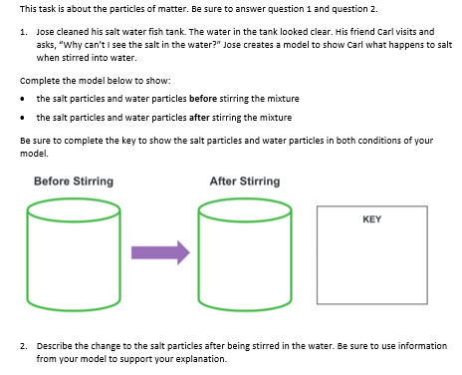
Components of a Classroom-based Task
5-PS1-1: Develop a model to describe that matter is made of particles too small to be seen.
Anticipatory set
Reminder to student
Task stimulus/context
Question/prompt and student directions
Provided model and key templates
Question/prompt and student directions
Notes:
High-quality science tasks include multiple components and features to produce evidence of student learning related to a phenomenon or design problem. This is an example grade 5 task aligned to NGSS PE, 5-PS1-1: Develop a model to describe that matter is made of particles too small to be seen.
Notice that this task has a particular structure beginning with an anticipatory set, which is designed to remind students of the scientific topic. Its purpose is to lead students to begin thinking about what the task is about and to elicit their prior knowledge. This is followed by the stimulus, which provides the scenario or context in which the phenomenon or design problem is embedded. In this example, a phenomenon is presented in a relatable, accessible scenario for fifth-grade students. The scenario, or task stimulus or context, does not need to be lengthy but does need to provide sufficient information for the student to be able to respond to the questions using their science knowledge related to the phenomenon. The scenario is followed by a series of questions or prompts and states any additional directions that students might need to generate complete responses to earn full credit. In this example, the first question allows students to sense-make through the integration of the three dimensions associated with this PE—the DCI, Structures and Properties, the SEP, Developing and Using Models, and the CCC, Scale, Proportion, and Quantity. The second question also requires students to reason or sense-make using multiple dimensions through the provision of a different item type, a constructed response, and a different response mode for students to use their model to explain their understanding that matter can be subdivided into particles that are too small to be seen, but even then, the matter still exists.
To support students' response, a model template is provided, which is a variable feature determined by the task designer to shift complexity or focus. A more complex task might ask students to create the model as well as complete the model. In this task, inclusion of a partially completed model—the provision of the two containers, the arrow, and the key—provides students with an idea of how Jose creates a model to show Carl what happens to salt when stirred in water. In addition, the directions prompt students to complete the key to show the salt particles and water particles in both conditions of the model. This supports students' understanding of how to respond to the question, what is required to respond fully, and that possibly, given that conditions before stirring and after stirring are included in the model, that there may be a change in the salt or water particles.
Another point to keep in mind is that the language in the item should be at or below grade level. You want to make sure that the language presented is not above grade level or overly complex. Ideas and concepts should be presented using clear and simple language to promote accessibility. You may find that domain-specific terms related to an assessed topic or phenomenon may be above grade-level, but if these terms are used during instruction and therefore are familiar to students, inclusion of domain-specific terms is appropriate both in the task and as an expectation of students' responses to demonstrate their science learning, the way a scientist would.
When designing tasks, be sure to consider the amount of time and the demand on students to respond fully to the questions. When stating the anticipatory set and designing the scenario, ask yourself, what is important? What information is necessary for students to know in order to get them thinking about what science knowledge is required to answer each question? Think about the number and type of questions required to obtain sufficient evidence to make accurate inferences about students' science learning and where they may have misunderstandings or misconceptions? What will you learn about your students that will guide instructional decisions?

Slide 5
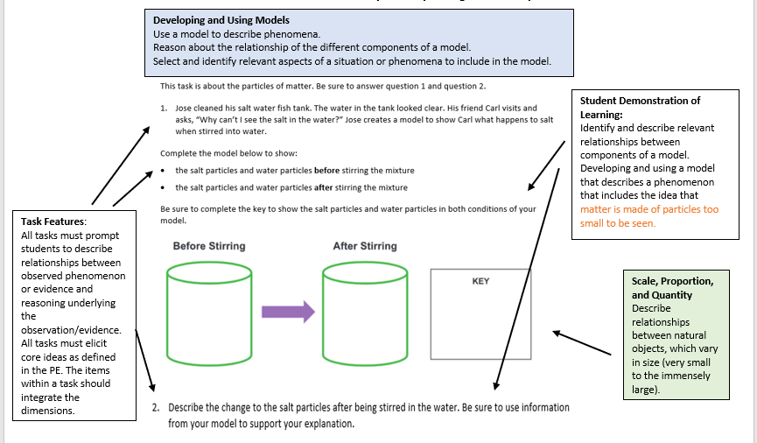
5-PS1-1: Develop a model to describe that matter is made of particles too small to be seen.
Notes:
On this slide, the multiple components and features of the task are annotated to illustrate the application and integration of the three dimensions based on PE, 5-PS1-1: Develop a model to describe that matter is made of particles too small to be seen. The content is derived from the palette of options provided in the associated unpacking tool and the task specifications tool for this PE.
An intentionally-designed task generates meaningful information about students' science learning by providing students opportunities to demonstrate what and how well they have learned the selected KSAs associated with a PE. To create a high-quality task, educators must consider and integrate the information within and across the assessment design tools, the unpacking tool and the tasks specifications tool, to design tasks that elicit the evidence or the right information to make accurate judgments about what students know and can do. Given that there are typically aspects of the SEPs, DCIs, and CCCs based on the selected KSAs that can be addressed in a task across a varying number of items, item types, and response modes, educators, as task designers, must determine those aspects using the palette of options provided by the design tools.
Take a moment to review the annotations associated with the task features, student demonstrations of learning, and the three dimensions—the DCI, Structures and Properties, the SEP, Developing and Using Models, and the CCC, Scale, Proportion, and Quantity. Consider how the task as a whole and the individual questions exemplify the application of the criteria required to design meaningful tasks that yield interpretable and useful information about student learning. Refer to the unpacking tool and tasks specifications tool for 5-PS1-1 in the Resources pod and the Achieve NGSS Task Screener in the Web Links pod to support your review.

Slide 6
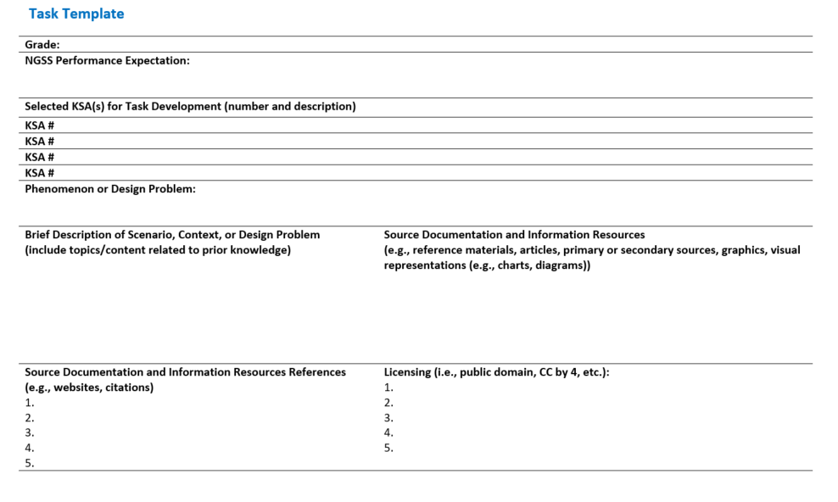
Task Template
Notes:
The next set of slides presents a task template that has sections dedicated to the multiple components of a task. The task template begins with a statement of the grade, topic, and NGSS PE or science standard, and the KSAs, which are the content documented first to define the measured constructs and to guide and ensure alignment to the purpose of the task. This information should reflect the measured construct as documented in the unpacking tool and task specifications tool.
Once you have indicated the KSA or KSAs to be measured and have carefully considered each of the dimensions aligned to the PE, consider a phenomenon or design problem that should be addressed in the scenario. Selection of a phenomenon or design problem allows you to further hone the task in a manner consistent with your purpose for assessing students' science learning. This also then supports design decisions related to creating a meaningful, engaging, and relevant scenario (or context) that addresses the defined phenomenon or design problem. Using the unpacking tool, topics or content related to prior knowledge should be documented. Remember, as a task designer, you need to understand the KSAs that students should have already learned and can be treated as prior knowledge. Think about ways these KSAs can be incorporated into the scenario to foster student comprehension and understanding of what is being measured.
Next, consider and record the types of sources of information that you will use in the scenario or that students read or interact with from which the questions are based. This could include articles, primary or secondary sources, photographs, graphs, charts, or diagrams. Be selective and only include information that is necessary for students to use and comprehend to respond to the questions. Accessibility and comprehensibility are promoted when you make intentional decisions about what and how much information is to be included in different parts of the task. Remember, information that you choose to include should directly support your goal of eliciting accurate and sufficient student evidence of science learning specific to the selected KSAs. To be able to return to these sources and use them in the task, as appropriate, document the websites or citations as well as the copyright and licensing terms associated with each informational resource.
This is a good place to remind you that by carefully documenting and citing your sources, and by considering the copyright and licensing terms for each source, you can avoid issues related to plagiarism. Make a habit of documenting sources for reference and then paraphrasing or rewriting the text, as necessary, to capture key information to include in your task.

Slide 7
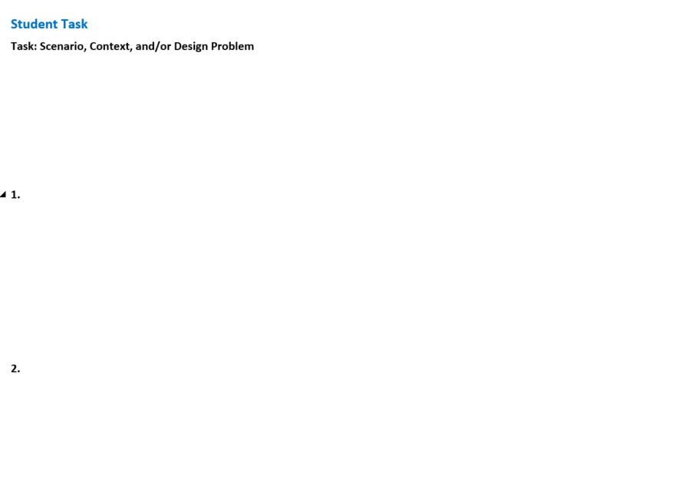
Task Template, Continued
Notes:
Once the construct is well defined, the topic or focus of the scenario is determined, and the sources of information have been selected, you are ready to write the scenario or context that will "house" the phenomenon or design problem followed by each question or prompt. Remember, a question may include additional sources of information and should include specific directions for students to be able to fully comprehend what is being measured and how to respond to the question to receive full credit. As we have shared, the questions should require students to sense-make about a phenomenon or design problem through their integration of the dimensions, reflect a range of complexity, and offer a variety of item types and response modes.
The Task Template is available for download in the Resources pod.

Slide 8
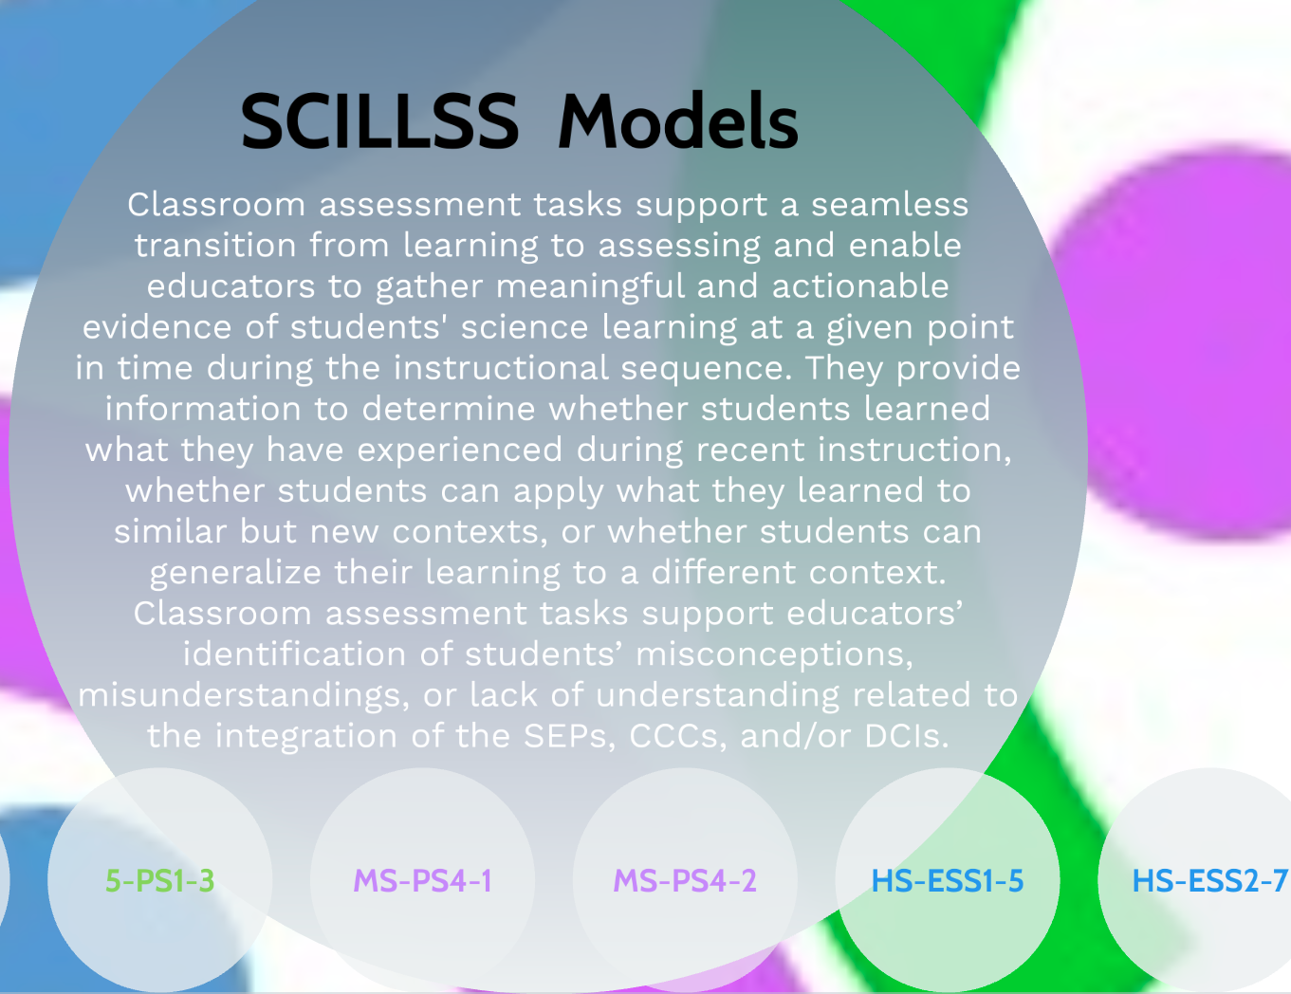

Model Tasks by Grade Band
For examples of completed tasks at the elementary, middle, and high school grade bands, click on the Prezi Interactive Tasks Resource in the Web Links pod.
Notes:
For examples of completed tasks at the elementary, middle, and high school grade bands, click on the Prezi Interactive Model Tasks Resource in the Web Links pod. These tasks are also available for download in the Resources pod.

Slide 9

Resources and Additional Information
Notes:
Finally, we offer additional resources that may be helpful to anyone interested in learning more about the concepts presented in this module. A glossary of terms and our reference list follow.
Thank you for your engagement in this fourth chapter of the SCILLSS digital workbook on designing high-quality three-dimensional science assessment tasks for classroom use.

Slide 10
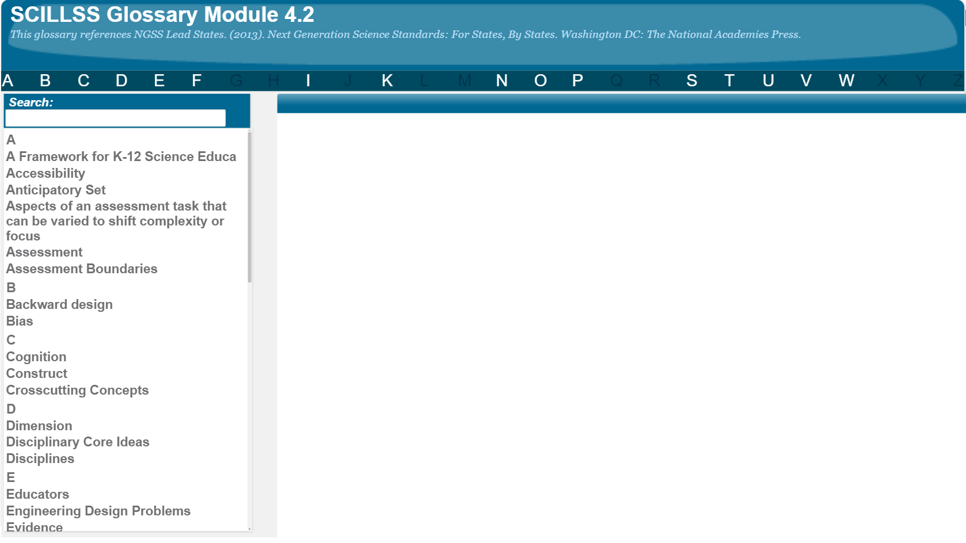
SCILLSS Glossary
Please refer to the SCILLSS Glossary for operational definitions of terms used.

Slide 11
Resources
In the Web Links pod, you can find the following resources:
A Framework for K-12 Science Education
NGSS Task Screener
Prezi Interactive Model Tasks
In the Resources pod, you can find the following resources:
Task Template
Unpacking Tool for 5-PS1-1
Task Specifications Tool for 5-PS1-1
SCILLSS Model Tasks at grade 5, middle school, and high school

Slide 12
References
National Research Council. (2012). A Framework for K-12 Science Education: Practices, Crosscutting Concepts, and Core Ideas. Washington, DC: The National Academies Press. https://doi.org/10.17226/13165.

