Slide 1
Designing High- Quality Three-Dimensional Science Assessments for Classroom Use
Chapter 4: Development of Tasks, Rubrics, and Exemplars
Module 4.3: Guidance and Resources for Task Development
This digital workbook on designing high quality three-dimensional science assessment tasks for classroom use was developed by edCount, LLC, under
Enhanced Assessment Grants Program, CFDA 84.368A.
Notes:
Welcome to the last of four chapters in a digital workbook on designing high-quality three-dimensional science assessment tasks for classroom use. This workbook is intended to help educators design and evaluate tasks that provide meaningful information about what students know and can do in science.
This digital workbook was developed by edCount, LLC, under the US Department of Education's Enhanced Assessment Grants Program, CFDA 84.368A.

Slide 2


Module 4.3: Guidance and Resources for Task Development
2
Notes:
Chapter 4 of this workbook includes a series of six modules. Together these six modules provide an in-depth exploration of the third phase of principled assessment design: development of tasks, rubrics, and exemplars. In this chapter, we focus on translating the unpacking of the three dimensions of a specific performance expectation or indicator and the design elements in the task specifications tool into an assessment task and rubric. We provide opportunities for you to engage in interactive activities and explore and use our design template to complete your own task and rubric, and learn how to apply scoring guidelines for a three-dimensional standard.
In this module, Module 4.3, we present and describe the resources available to support the development of high-quality assessment tasks and offer guiding questions, key strategies, and instructions for completing the process. In later modules, we provide specific guidance for developing and applying the scoring rubric to demonstrate the evidence required to show what students know and can do in science.

Slide 3
Module 4.3 Outcomes
Guidance and Resources for Task Development
Guidance and Resources for Task Development
To provide guiding questions, strategies, and resources for developing classroom science assessment tasks
Notes:
In the previous Chapter 4 modules, we explored the criteria and qualities of high-quality science assessment tasks for three-dimensional science standards. In Module 4.1, we shared information related to criteria and item writing guidelines to develop high-quality tasks. You engaged in interactive activities to gain a deeper understanding of each criterion and how together they provide the foundation for high-quality science assessment tasks. In Module 4.2, we provided a task template and discussed its component parts to guide you in the development of a task that is aligned to the purpose and selected KSAs based on a PE.
You are nearly ready to start developing your own formative science task. But before you do, we have some important tips, strategies, and guiding questions to guide your work. By completing Module 4.3, you will have the tools you need to engage in the third phase of principled assessment design and develop your own high-quality assessment task to get your thumb on the pulse of students ' science learning and to inform instructional decisions.

Slide 4
Guiding Questions for Development of Classroom Science Assessment Tasks
Based on the assessed KSA or KSAs and the required collection of student evidence, does the task include or need to include multiple parts, questions, or prompts connected to a phenomenon or problem-solving context or event?
How will students demonstrate their knowledge, skills, and abilities?
What is an appropriate anticipatory set and scenario upon which the questions/prompts within the task are based to remind the students of the scientific focus, elicit their prior knowledge, and get them to begin thinking about what the task is about?
What sources of information (i.e., articles, informational text, graphs, charts, models, etc.) are necessary for students to reference in order to respond to each question or prompt?
Notes:
To address the vision of the Framework, instructionally supportive classroom science tasks are needed that measure students' integrated, three-dimensional science learning. The focus of the tasks, and the nature of the knowledge, skills, and abilities that they target, are intended to measure students' understanding of how to explain phenomena or determine solutions to design problems following instruction. The accuracy and the sophistication of students' understanding are assessed through the collection of evidence of a carefully designed task based on the design tools—the unpacking tool and the task specifications tool.
These performances of student learning as measured by the questions across a task can be smaller in breadth than the performance expectation, often including an aspect—a KSA or a few KSAs—of the PE. As an educator, you can use these performances to determine where students are in their understanding of and ability to sense-make through the integration of selected key concepts in combination with the SEP and the CCC as taught and learned along a planned, instructional sequence. Once you know where each student is in his or her understanding, you are well-positioned to make decisions as to the readiness of individual students, groups of students, or the whole class to receive new instruction that builds on their acquired understanding.
To guide the development of a classroom science assessment, consider how these questions can be applied to support your design of high-quality tasks to measure students' science learning.
Based on the assessed KSA or KSAs and the required collection of student evidence, does the task include or need to include multiple parts, questions, or prompts connected to a phenomenon or problem-solving context or event?
How will students demonstrate their knowledge, skills, and abilities?
What is an appropriate anticipatory set and scenario upon which the questions or prompts within the task are based to remind the students of the scientific focus, elicit their prior knowledge, and get them to begin thinking about what the task is about?
What sources of information (i.e., articles, informational text, graphs, charts, models, etc.) are necessary for students to reference in order to respond to each question or prompt?

Slide 5
Strategies for Development of the Classroom Science Assessment Task
Use the following strategies to develop your classroom assessment task.
Integrate the information within and across the assessment development tools to design a task by considering and identifying:
The key aspects addressed by the SEP, DCI, and CCC
(Unpacking Tool)
The elicited prior knowledge
(Unpacking Tool)
The relationship between the identified CCC and the SEP
(Unpacking Tool)
The KSA(s) from which the task is developed
(Task Specifications Tool)
The production of responses that allow students to demonstrate learning of the KSA(s)
(Task Specifications Tool)
The attention to required task features
(Task Specifications Tool)
The student evidence to be collected
(Task Specifications Tool)
The full range of student understanding from low to high levels of competency
Notes:
We know that the Framework and the NGSS call for refocusing K–12 science instruction and require assessment of students' science learning that goes well beyond the recall of content, facts and science ideas, and vocabulary, and rather, provides evidence of three-dimensional science learning to explain phenomena or design solutions to design problems. So, what are some strategies to understand and apply to achieve new K-12 goals of science instruction as required by the NGSS and defined by the Framework?
As we highlight some key strategies, consider how you may have applied them in the past, how you are currently applying these strategies, and how you might more fully apply them to the creation of new tasks to measure students' multi-dimensional science learning. Let's first discuss strategies related to use of the unpacking tool and then discuss strategies related to the task specifications tool.
The unpacking tool is a design tool that provides a clear focus for what is to be measured and helps educators to plan for assessment. The unpacking tool provides a systematic approach to unpacking a performance expectation or indicator into its multiple components to ensure educators who are designing NGSS-aligned tasks have a clear and deep understanding of each dimension prior to beginning task development. The unpacking tool enables you to define and make meaning of "the what" of assessment! Use the unpacking tool to consider:
What are the key aspects addressed by each of the dimensions—the SEP, DCI, and CCC—and how do these aspects support defining the boundaries of what can be assessed?
What can be expected with respect to students' prior knowledge? By reviewing related PEs and the NGSS progressions, what can you reasonably expect students to have learned that can be elicited by the anticipatory set (identification of the topic or focus of the task), embedded in the scenario, and used by students to fully respond to questions?
What are the connections between the CCC and the SEP? When students are demonstrating use of a SEP to respond to a question, how is this in the service of the CCC? For example, the CCC Scale, Proportion, and Quantity is an essential consideration when deciding how to develop a model (SEP) to describe a phenomenon.
The task specifications tool is a design tool that allows educators to translate the unpacking of the three dimensions of a specific performance expectation into assessment tasks. Task specifications allow educators to determine what counts as evidence for student learning. The task specifications tool is intended to help educators develop assessment tasks that allow students opportunities to call upon, transfer, and apply learning that has occurred during instruction to new challenges, much the way a scientist or engineer would, in an assessment situation. The task specifications tool enables you to define "the how" of assessment! Use the tasks specifications tool to consider:
What is the focus of the PE? What are the KSAs aligned to the PE that identify what is expected of students to demonstrate to provide evidence they learned one or more aspects of the PE? Based on your purpose for assessing and where instruction has occurred, which KSAs will be addressed in a particular task?
How will students demonstrate their learning? What evidence will students need to demonstrate for each of the KSAs you selected for the task? How will students demonstrate that they have met the KSAs and what are the qualities of student performance, for example, accuracy and completeness, that constitute student evidence?
What task features are necessary or required to appropriately measure one or more of the KSAs? How will the task be driven by a scenario that focuses on a selected phenomenon or design problem? How will students be required to use scientific reasoning and process skills to produce evidence that leads to accurate inferences about student learning? How will science content be confirmed to ensure accuracy and grade-level appropriateness? How will all questions be fair and accessible—written with clear language that is concise and promotes comprehension?
How will the "right" evidence and sufficient evidence be collected based on the selected KSAs? What are the work products that are intended to contain observable evidence of students' understanding of the KSAs (for example, a model, a constructed response, a graphic, or a drawing)?
And in summary, how will the consideration and application of these strategies support the design of a task that includes a variety of questions, student work products, and student responses that allow students with varying levels of understanding, from low to high levels of competency, to demonstrate what they know and can do? Remember, the questions should not all be written at the same level of complexity. This is in order to be able to identify where students' understanding is accurate and complete for an aspect of the PE or selected KSAs and where students may have an inaccurate or incomplete understanding or misconceptions. Application of these strategies promotes fairness and accessibility and enables students to accurately interpret and respond to scenarios, questions, and expectations for demonstrating what they know and can do. That is the goal of administering high-quality, intentionally designed classroom science assessment tasks that provide clear and accurate information about student learning to inform your instruction.

Slide 6
Resources for Task Development and Evaluation
Are you developing a task? | Are you evaluating a task?
Here are some resources that you will need:
Completed unpacking tool Completed task specifications tool Task template SCILLSS model tasks Guidance to complete activities – High Quality Assessment Tasks Compilation of Existing Science Resources | Item Writing Review Worksheet Bias, Sensitivity, and Accessibility Review Worksheet Content Accuracy Review Worksheet Classroom Assessment Task Review Worksheet
Notes:
Whether you are developing a task or evaluating an existing task or a task you recently developed, you have a wealth of resources at your disposal to support your work.
If you are developing a task, be sure to access your completed unpacking tool and task specifications tool. Also, download the task template from the Resources pod to provide a structure for organizing your task and to ensure that you address the component parts of the task that are necessary to support students in providing complete, full credit responses. We encourage you to also reference the SCILLSS model tasks for examples of completed tasks developed using the same principled design process. We offer a guidance document with tips, guiding questions, and strategies for designing high-quality assessment tasks, and we have compiled a comprehensive list of existing science resources to support your selection of a phenomenon, design problem, primary and secondary sources, real-world data, and graphics to include in your task. These resources are available for download in the Resources pod.
Now let's suppose you are evaluating a task. Perhaps it is an existing task you have selected from a state or district assessment repository, and you need to determine if it addresses your intended purpose or use for assessing, or perhaps you recently completed the development of your own task, and you are ready to evaluate the alignment of your task to your design tools and ensure that your task is accessible and comprehensible to a wide range of students. We have provided a set of review worksheets in the Resources pod to support your review: the Item Writing Review Worksheet, Bias, Sensitivity, and Accessibility Review Worksheet, Content Accuracy Review Worksheet, and Classroom Assessment Task Review Worksheet. For more detailed information about the criteria included in these worksheets, refer to Module 4.1.

Slide 7

Resources and Additional Information
Notes:
Finally, we offer additional resources that may be helpful to anyone interested in learning more about the concepts presented in this module. A summary of resources, glossary of terms and our reference list follow.
Thank you for your engagement in this fourth chapter of the SCILLSS digital workbook on designing high-quality three-dimensional science assessment tasks for classroom use.

Slide 8
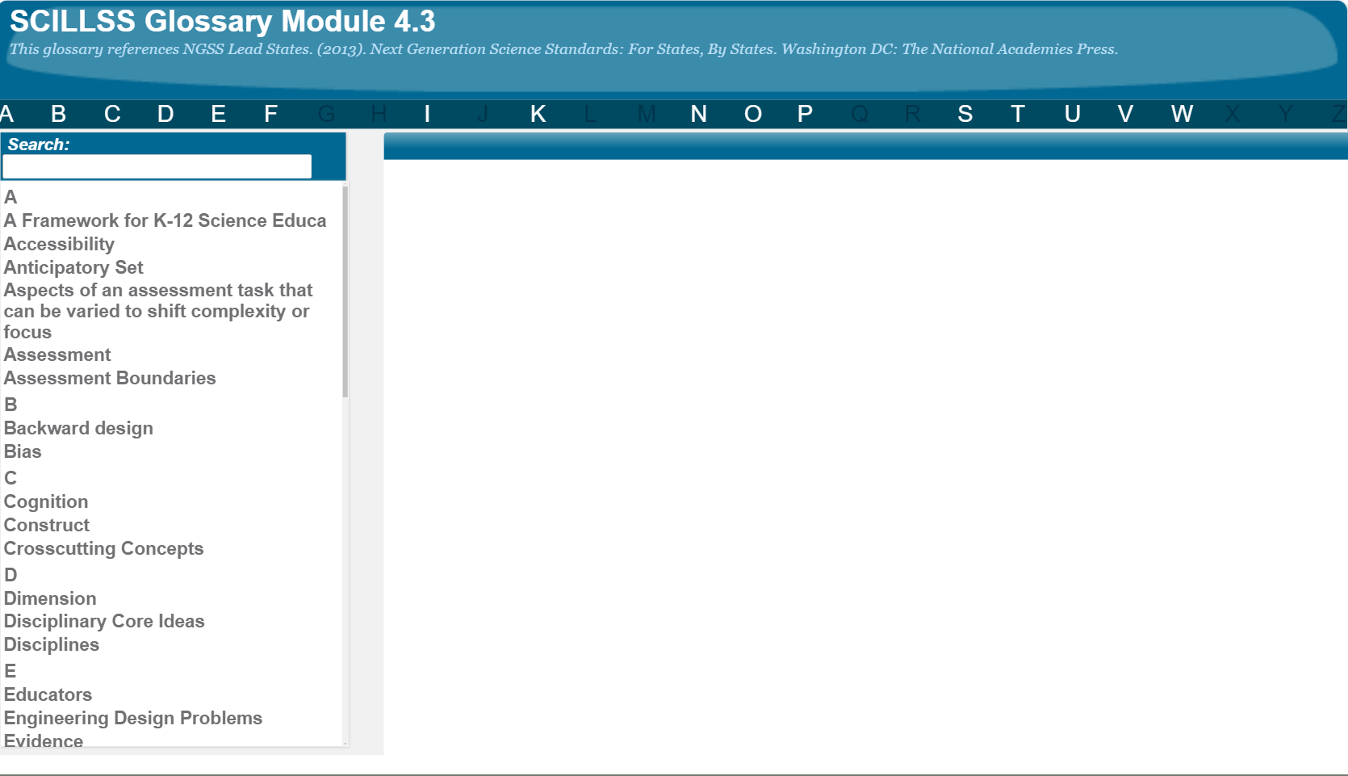
SCILLSS Glossary
Please refer to the SCILLSS Glossary for operational definitions of terms used.

Slide 9
Resources
In the Web Links pod, you can find the following resources:
A Framework for K-12 Science Education
Next Generation Science Standards
NGSS Evidence Statements
NGSS Appendices E, F, and G
STEM-Teaching-Tool-28-Qualities-of-Anchor-Phenomena
In the Resources pod, you can find the following resources:
Task Template
SCILLSS Model Tasks at grade 5, middle school, and high school
Guidance to Complete Activities – High-Quality Assessment Tasks
Existing Science Resources
Item Writing Review Worksheet
Bias, Sensitivity, and Accessibility Review Worksheet
Content Accuracy Review Worksheet
Classroom Assessment Task Review Worksheet

Slide 10
References
National Research Council. (2012). A Framework for K-12 Science Education: Practices, Crosscutting Concepts, and Core Ideas. Washington, DC: The National Academies Press. https://doi.org/10.17226/13165.

