Slide 1
Designing High- Quality Three-Dimensional Science Assessments for Classroom Use
Chapter 4: Development of Tasks, Rubrics, and Exemplars
Module 4.5: Application of Rubric to Evaluate Student Learning
This digital workbook on designing high quality three-dimensional science assessment tasks for classroom use was developed by edCount, LLC, under
Enhanced Assessment Grants Program, CFDA 84.368A.
Notes:
Welcome to the last of four chapters in a digital workbook on designing high-quality three-dimensional science assessment tasks for classroom use. This workbook is intended to help educators design and evaluate tasks that provide meaningful information about what students know and can do in science.
This digital workbook was developed by edCount, LLC, under the US Department of Education's Enhanced Assessment Grants Program, CFDA 84.368A.

Slide 2


Module 4.5:
Application of Rubric to Evaluate Student Learning
2
Notes:
Chapter 4 of this workbook includes a series of six modules. Together these six modules provide an in-depth exploration of the third phase of principled assessment design: development of tasks, rubrics, and exemplars. In this chapter, we focus on translating the unpacking of the three dimensions of a specific performance expectation or indicator and the design elements in the task specifications tool into an assessment task and rubric. We provide opportunities for you to engage in interactive activities and explore and use our design template to complete your own task and rubric, and learn how to apply scoring guidelines for a three-dimensional standard.
In this module, we continue our discussion of rubrics and their application to evaluate students' learning. We provide an example of how a grade 5 rubric, which delineates student performance across a range of score points, can be used to evaluate student work products or responses. In the last module of this chapter, we present a guided activity in which we apply the Classroom Assessment Task Review Worksheet to evaluate the quality of two classroom-based science assessment tasks.

Slide 3
Module 4.5 Outcomes
Evaluation of Student Work Products to Inform Instruction
Example Classroom Science Task Rubric
Example Classroom Science Task Rubric
To understand the outcomes of rubric development for classroom science assessment tasks by reviewing a model rubric at the elementary grade band
Evaluation of Student Work Products to Inform Instruction
To demonstrate how student work products (i.e., student responses) are evaluated by applying an elementary (grade 5) rubric
Notes:
In the previous Chapter 4 modules, we explored the purpose and use of classroom science assessment tasks, and you engaged in an interactive activity to gain a deeper understanding of the elements of high-quality classroom science assessment tasks. We also discussed the purpose and development of classroom-based task rubrics.
In this module, Module 4.5, we begin by considering the intended outcomes of rubric development for classroom science assessment tasks. We then offer guided practice to apply a model grade 5 rubric to evaluate student work products and consider how this evaluation informs instructional decisions to improve science learning for all students.

Slide 4


Continuing the Journey . . .
Phase 1: Unpacking Tool
Phase 2: Task Specifications Tool
Phase 3: Tasks and Rubrics
Phase 4: Task Administration and Exemplars
to Principled Assessment Design
Notes:
Congratulations on completing the first, second, and third phases of principled assessment design: development of an unpacking tool, task specifications tool, and development of tasks and rubrics and choosing to continue your journey to design high-quality three-dimensional classroom science tasks. In this module, Module 4.5, we will explore the fourth phase of principled assessment design, task administration, and the identification of student exemplars through the application of the rubric.
Phase 4 includes the administration and evaluation of the task and the purposeful use of the results. In this phase, educators determine when to assess. This decision is born out of observing students during science investigations, monitoring student-generated questions and problem-solving strategies, and when evidence of student learning is needed along the educational pathway. Assessments might be administered prior to instruction, within a unit, or after a single or multiple units of instruction.
Educators must also determine how to evaluate and use the results. Following the administration of the task and the application of the rubric to the student responses or work products, educators will have the necessary information to make informed decisions about when and how instruction may need to be adjusted for individual students, groups of students, or the whole class.

Slide 5
Classroom-based Rubrics for the NGSS
Classroom-based rubrics for the NGSS:
Provide criteria that can be reliably and consistently applied across a range of student work products (i.e., evidence) to accurately evaluate student learning
Provide information that informs teachers and students of strengths and weaknesses related to understanding of a phenomenon or design problem at a point in time along an instructional sequence
Serve as a tool used to inform and guide instructional decisions for individual students, small groups of students, or the class
Require that educators keep in mind the purpose for assessing and that students may have varying levels of understanding, and how the rubric will address these considerations
Notes:
Scoring rubrics used to evaluate three-dimensional science learning must be written with clarity and provide criteria for evaluating the degree and accuracy of students' science learning based on student responses or evidence for each question. If the primary purpose of designing and administering a high-quality science assessment task is to evaluate student learning, the rubric must enable educators to accurately and consistently evaluate evidence of all students' learning of three-dimensional NGSS or state standards given a range of student evidence. The evaluation of this range of evidence informs teachers and students of strengths and weaknesses related to sense-making using the dimensions for the selected KSA(s) at a point in time along the instructional sequence, which, in turn, can inform and guide further instruction. Remember, albeit that one intention for developing rubrics may be to assign grades, the primary intention is to gain an understanding of where students are in their science learning and to decide what, how, and with whom differentiated instruction is needed.
To develop high-quality rubrics that support these outcomes, consider what educators need to understand about the PEs and NGSS resources. The progressions in the NGSS are not learning progressions defined at each grade level, nor do they identify specific assessment targets or constructs to be measured at certain points in time. Remember, the PEs are based on the perspective that instruction and assessments must be designed to support and monitor students as they develop increasing sophistication in their ability to use practices, apply crosscutting concepts, and understand core ideas as they progress across the grade levels. Educators need to "unpack" the PEs to determine the content and sequence of instruction and design high-quality tasks to achieve this end. If this process begins with a clear understanding of the target knowledge, then the design of a task and its rubric, considered during the design of the task, can support accurate inferences about student learning.
Though designing a task-specific rubric may seem daunting, its creation can be made easier and strengthened using the phase 1 unpacking tool and phase 2 task specifications tool. The thoughtful and well-documented work that you have done during these phases using the Framework, NGSS resources, and your expertise will inform your design of the rubric in such a way that it garners for you, and your students, the right information at the right time about what they know and can do.

Slide 6
Differentiation of Score Points
Rubric (Criteria) For Performance Expectation
Score Point 0: Score Point 1: Score Point 2: Score Point 3: | Work product is missing, or the response is not related to the prompt (e.g., “I don’t know,” generic response distantly linked to prompt, off topic). Work product is missing evidence, support, rationale, or clear explanation to support claim, argument, solution, etc. Work product meets most, but not all, criteria/ expectations of the prompt. Work product is scientifically accurate, complete, coherent, and consistent with the type of expected student evidence.
Notes:
Assessment tasks are typically scored using a rubric that lays out criteria for assigning scores. The rubric describes the features of students' responses required for each score point. Clear rubrics that minimize the degree to which educators must interpret the criteria as it is applied to student responses help ensure scores are consistently applied across all students and support educators' ability to make accurate inferences about what students know and can do. Student responses should yield accurate inferences about students' understanding of the KSAs and their ability to sense-make using the three dimensions that, in turn, inform educator actions either to 1) continue with the instructional sequence as planned; or 2) adjust the design, delivery, and sequence of instruction. These instructional decisions can be made at the individual student level, for a small group of students, or at the class level.
Student responses, or work products, provide a way to assess the grade-appropriateness of the task and to consider how a student at the targeted grade or age might respond. The student work products can demonstrate examples of high-quality or low-quality student performance as they are considered age- and grade-appropriate.
Let's first consider more general descriptions of how score points can be differentiated across a score point range of 0 to 3. A score point of 0 indicates that the student did not provide a response, or the response is not related or interpretable. A low-level response assigned a score point of 1 may include misconceptions, be incomplete, or not consistent with the type of evidence expected. A well-written rubric enables an educator to differentiate a score point of 2 from a score point of 3. A score point of 2 may indicate that the student's response meets some or most of the criteria for a given question; whereas a score point of 3 indicates that the student response fully meets the criteria and is scientifically accurate, complete, and consistent with evidence that students have demonstrated and understand the knowledge, skills, and abilities (KSAs) assessed by the question.

Slide 7
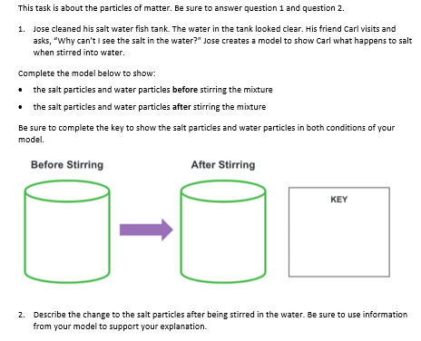
Grade 5 Example Task for 5-PS1-1
Notes:
A principled-design approach has been applied to develop an example grade 5 classroom-based assessment task presented here for the NGSS grade 5 PE, 5-PS1-1: Develop a model to describe that matter is made of particles too small to be seen. A completed unpacking tool and task specifications tool provided the necessary information to make informed decisions about the design of the task.
A well-designed assessment task presents engaging, authentic, real-world contexts and phenomena of interest to a wide range of students and calls for students to transfer and apply their knowledge in keeping with the goals of the Framework and the NGSS. A principled-design approach provides a seamless transition from science instruction to assessment of student learning. A classroom-based task measures, at a point in time determined by the educator, students' acquisition of KSAs taught during an instructional sequence. Student competency is required for additional, more sophisticated learning to occur in subsequent lessons in the instructional sequence. Developed in these ways, the classroom-based assessment tasks enable educators to get their fingers on the pulse of individual students, groups of students, and/or the entire class as to where they are in their science learning based on collected evidence of that learning to ultimately inform instruction.
A three-dimensional assessment task must elicit evidence related to students' integration of knowledge of DCIs, engagement with SEPs, and facility with building connections across ideas (CCCs) (NRC, 2012; Pellegrino, 2013). The task necessarily is comprised of multiple items to elicit evidence that provides specific information about student understanding and competence of the three dimensions as they relate to a PE. In this example task for 5-PS1-1, the three dimensions include the SEP, Developing and Using Models, the DCI, Structure and Properties of Matter, and the CCC, Scale, Proportion, and Quantity. A single item may not be sufficient to elicit evidence to allow educators to identify where students may have misunderstandings and need additional instruction. In this example, two questions are included.
Please take a moment to pause the presentation and review the example task before we analyze the task in further detail and discuss the rubric developed to evaluate evidence of student learning. Starting with question 1, read and familiarize yourself with the evidence of student performance elicited by each question. Consider how well and how complete the student response should be to make a judgment of what a student knows and can do about the question. For example, if the student's completed model does not show representations in the correct position and scale relative to each other or if the key is partially completed or correct, what would this tell you about the student's understanding of particles of matter and particles too small to be seen? How would these different student responses be captured in the rubric?

Slide 8
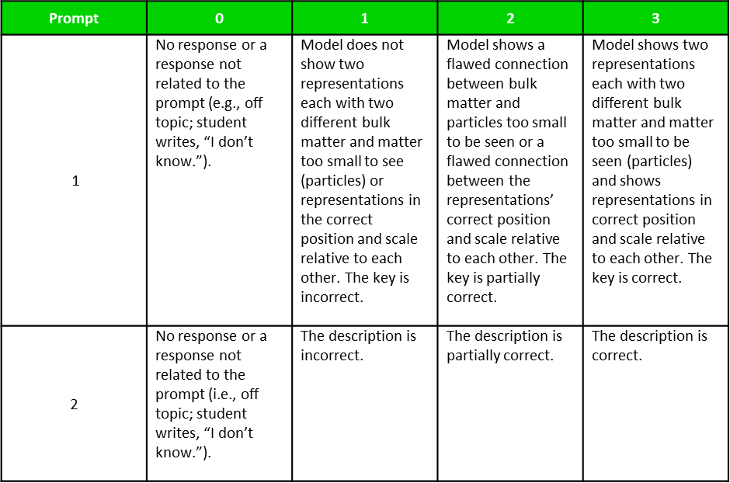
Grade 5 Example Rubric for 5-PS1-1
When scoring a student’s responses to a task, educators would apply each rubric component to the response, obtaining a set of scores that collectively describe the student’s proficiency with the learning performance.
Note that in the case of responses that require the development of a model (Question 1), the scoring rubric includes examples of the acceptable evidence in the response.
Notes:
A rubric must define criteria that educators can use to interpret and evaluate student evidence of learning. In addition to defining multiple aspects of students' ability needed to respond correctly to a task, the individual rubric components must focus educators' attention on specific features of students' responses to promote accurate and consistent applications of score points across a range of student responses.
This approach has several advantages over using a typical holistic, more general rubric to score student responses.
First, detailed descriptions for each score point for each question allow scoring decisions to be more tightly linked to distinct aspects of student ability.
Second, including a description for each aspect of the expected student response to each question allows educators to focus on a single aspect of the student response without the need to consider multiple aspects of the student response simultaneously.
Third, because detailed descriptions are provided for each score point to address all aspects of the student response for each question and thus provide information about a specific aspect of a student's ability, educators can then discern where students have an accurate understanding and where students may have inaccurate or incomplete understanding or misconceptions. This information will then inform educators as to what KSAs or aspects of the KSAs may require additional instruction.
The next set of slides presents example student responses for each question and the assigned score point along with a written explanation or justification for the assignment of that score point. Please access the Grade 5 Example Rubric for 5-PS1-1 in the Resources pod to support your evaluation of the student responses.

Slide 9
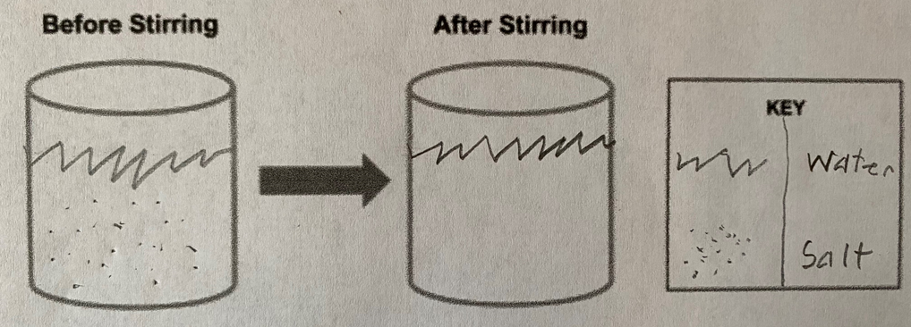
Question 1: Exemplar A
Complete the model below to show:
the salt particles and water particles before stirring the mixture
the salt particles and water particles after stirring the mixture
Be sure to complete the key to show the salt particles and water particles in both conditions of your model.
Score Point 1: Student has not learned the material and/or has misconceptions and reteaching of the key concepts is required.
Model shows a flawed connection between bulk matter and particles too small to be seen; the water particles are not shown in either condition; rather, the level of the water is indicated. Model does not show the position and relative scale of the water and salt particles.
Key is incomplete as it does not include representations of the salt and water molecules for both conditions.
Notes:
This slide presents an example student response to question number 1:
Complete the model below to show:
the salt particles and water particles before stirring the mixture
the salt particles and water particles after stirring the mixture
Be sure to complete the key to show the salt particles and water particles in both conditions of your model.
For this question, what do you expect students to notice, reflect, and show in their model and the key? For a score point of 3, the student's model would need to include both the salt and water particles before and after stirring, and show the correct position and scale of both particles. The student’s key should include representations of the salt and water particles in both conditions.
Please pause the presentation and review the student's response using the grade 5 rubric for 5-PS1-1. Then resume the presentation for an explanation of the assigned score point.
An evaluation of the student's response, based on application of the descriptions in the rubric for 5-PS1-1 as stated across the score points, results in the assignment of a score point of 1. The student response indicates that the student has not learned the material and/or has misconceptions, and reteaching of the key concepts is required. The model shows a flawed connection between bulk matter and particles too small to be seen; the water particles are not shown in either condition; rather, the level of the water is indicated. The model does not show the position and relative scale of the water and salt particles. The key is incomplete as it does not include representations of the salt and water molecules for both conditions.

Slide 10
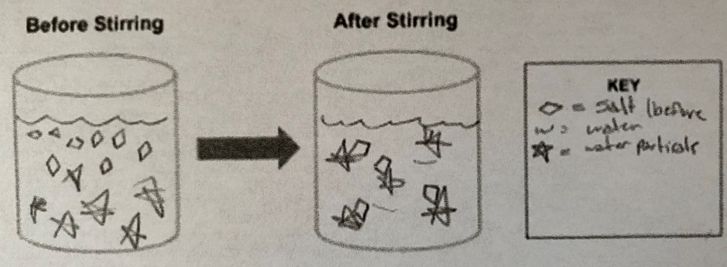
Question 1: Exemplar B
Score Point 2: Student has a partial understanding and needs additional instruction on some concepts before new instruction is provided.
Model shows a flawed connection between bulk matter and particles too small to be seen. Model shows a flawed connection between the representation's correct position and scale relative to each other.
Key is partially correct; it shows the salt particles in one condition.
Notes:
Please pause the presentation and review the student's response using the grade 5 rubric for 5-PS1-1. Then resume the presentation for an explanation of the assigned score point.
An evaluation of the student's response, based on application of the descriptions in the rubric for 5-PS1-1 as stated across the score points, results in the assignment of a score point of 2. This response shows some misconceptions about scale as well as the phenomenon. The student's response indicates that the water and salt molecules appear to bond or attach in the representation of the process of dissolving. In addition, the key shows two different states of water, which seems to also reinforce the student's idea of some water bonding with salt and some water remaining pure. The key is partially correct as it shows the salt particles in one condition. The response indicates significant flaws in reasoning and understanding, and clearly indicates that this student needs additional instruction regarding scale and the processes involved with substances that dissolve in a solvent.

Slide 11
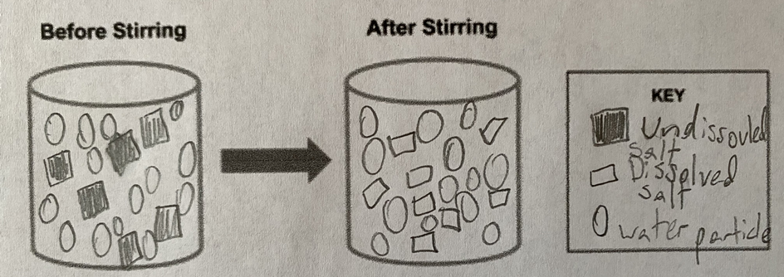
Question 1: Exemplar C
Score Point 3: Student has mastery/an understanding of the assessed skills and is ready for new, more sophisticated instruction.
Model shows two representations, each with two different bulk matter and matter too small to be seen (particles); the models for "Before Stirring" and "After Stirring" represent both salt and water particles. Model representations show correct position and scale relative to each other; the models for "Before Stirring" and "After Stirring" show the correct position and scale of the particles.
The key is correct and shows the salt particles in both conditions.
Notes:
Please pause the presentation and review the student's response using the grade 5 rubric for 5-PS1-1. Then resume the presentation for an explanation of the assigned score point.
An evaluation of the student's response, based on application of the descriptions in the rubric for 5-PS1-1 as stated across the score points, results in the assignment of a score point of 3.
This response shows the student's understanding of the phenomenon. The model shows two representations, each with two different bulk matter and matter too small to be seen; the models for "Before Stirring" and "After Stirring" represent both salt and water particles. The model representations show the correct position and scale relative to each other, and the models for "Before Stirring" and "After Stirring" show the correct position and scale of the particles.
The key is correct and shows the salt particles in both conditions.

Slide 12
Score Point 1: Student has not learned the material and/or has misconceptions and reteaching of the key concepts is required.
Model shows a flawed connection between bulk matter and particles too small to be seen; the water particles are not shown in either condition; rather, the level of the water is indicated. Model does not show the position and relative scale of the water and salt particles.
Key is incomplete as it does not include representations of the salt and water molecules for both conditions.
Score Point 3: Student has mastery/an understanding of the assessed skills and is ready for new, more sophisticated instruction.
Model shows two representations, each with two different bulk matter and matter too small to be seen (particles); the models for "Before Stirring" and "After Stirring" represent both salt and water particles. Model representations show correct position and scale relative to each other; the models for "Before Stirring" and "After Stirring" show the correct position and scale of the particles.
The key is correct and shows the salt particles in both conditions.
Score Point 2: Student has a partial understanding and needs additional instruction on some concepts before new instruction is provided.
Model shows a flawed connection between bulk matter and particles too small to be seen. Model shows a flawed connection between the representation's correct position and scale relative to each other.
Key is partially correct; it shows the salt particles in one condition.
Notes:
Let's review the student responses to question 1 and the assigned score points of 1, 2, and 3. Recall, this question asks the student to identify and describe relevant relationships between components of their model to show the relationship between bulk matter and tiny particles that cannot be seen (e.g., tiny particles of matter that cannot be seen make up bulk matter). This view allows for a quick comparison of score point explanations against the provided student evidence.
Using the next set of slides, we invite you to complete an independent activity in which you will be asked to review student responses to the second question in the grade 5 example task for PE 5-PS1-1, Develop a model to describe that matter is made of particles too small to be seen, and apply the grade 5 rubric to assign a score point to each student response.

Slide 13




Independent Activity: Score Point Assignments for Question 2 Responses
1.a.
Gather Materials
Look in the Resources pod for the Grade 5 Example Task for 5-PS1-1 and the Grade 5 Example Rubric for 5-PS1-1.
2.a
Get Started!
View the first slide, pause the presentation, and consider the student response, the evidence of student understanding and learning it represents, and then assign a score point.
3.a
Keep going!
View a second and third slide and consider the student response, and the evidence of student understanding and learning it represents, and then assign a score point.
1.b.
Use these tools to evaluate the student responses and to assign a score point to each response.
2.b
Eureka! Resume the presentation for a guided review of which score point is justified and an explanation.
3.b
Eureka! Resume the presentation for a guided review of which score point is justified and an explanation.
Notes:
In this independent activity, we provide you with an opportunity to use the Grade 5 Example Task for 5-PS1-1 and the Grade 5 Example Rubric for 5-PS1-1 to apply your skill at evaluating student responses—evidence of their learning and understanding—through the application of the rubric for the grade 5 PE, 5-PS1-1, Develop a model to describe that matter is made of particles too small to be seen.
Alright. Here are the steps to complete this independent activity. First, access the materials in the Resources pod to support your review of the student responses for question 2 of the Grade 5 Example Task for 5-PS1-1.
Once you've accessed the resources, view the first slide, and pause the presentation to consider the student response and to assign a score point. After you evaluate the student response and determine an appropriate score point based on the rubric, resume the presentation for guidance of which score point is justified given the evidence in the student response. Consider the explanation provided for why that score point was assigned.
Next, view the second slide, which is populated with another student response to assign a score point. After you evaluate the student response and determine an appropriate score point based on the rubric, resume the presentation for guidance of which score point is justified given the evidence in the student response. Consider the explanation provided for why that score point was assigned.
Repeat these steps for one additional student response.
Please note that you can obtain directions for completing this activity in the Resources pod titled, "Independent Activity—Score Point Assignments for Question 2 Responses."

Slide 14
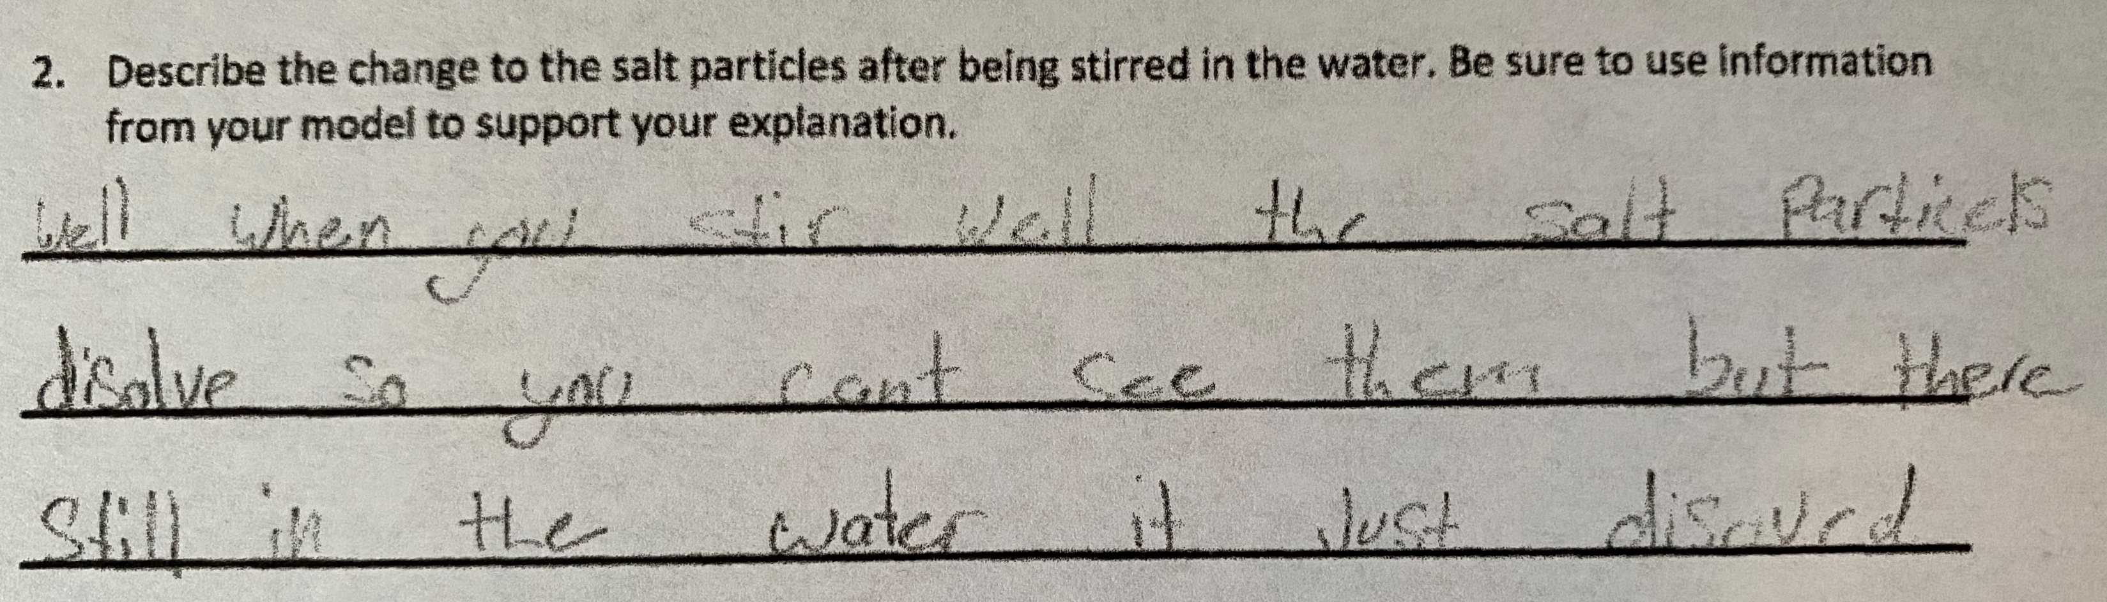
Question 2: Exemplar D
Score Point 2: Student has a partial understanding and needs additional instruction on some concepts before new instruction is provided.
Description is partially correct; the response correctly states that the salt particles have dissolved in the condition when they are stirred and that they cannot be seen; however, the response does not state why they cannot be seen, which is because the salt particles have broken into smaller pieces and get so small that they cannot be seen.
Notes:
Let's get started. To complete this independent activity, first, review the student response to the left of the slide. Refer to the rubric and examine the descriptions associated with question 2 to evaluate the student evidence. Read the description for each of the four score points beginning with score point 3, then score point 2, and so on. Then determine how you would score the student response.
For the second question of the task, Describe the change to the salt particles after being stirred in the water. Be sure to use information from your model to support your explanation, consider what evidence would be necessary to make a judgment of what a student knows and can do. Pause the presentation and consider the student response, the evidence of student understanding and learning it represents, and then assign a score point.
Resume the presentation for the assigned score point and explanation.
This student response earns a score point of 2. The response correctly states that the salt particles have dissolved in the condition when they are stirred and that they cannot be seen; however, the response does not state why they cannot be seen. Therefore, the student has a partial understanding and needs additional instruction on some concepts before new instruction is provided.
.

Slide 15
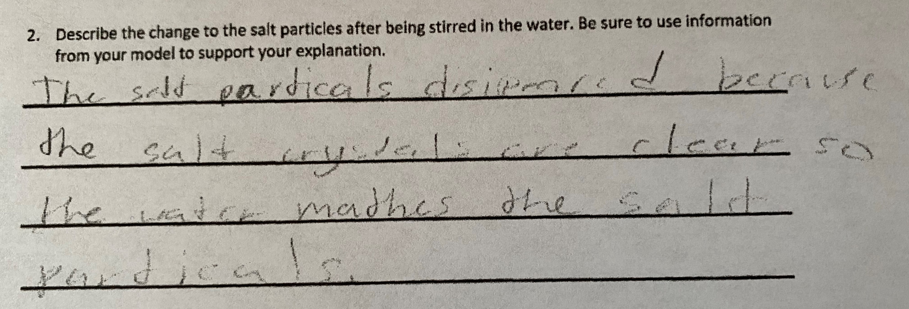
Question 2: Exemplar E
Score Point 1: Student has not learned the material and/or has misconceptions and reteaching of the key concepts is required.
Description is incorrect; the response includes a misconception that the salt has disappeared and also states that the salt particles become clear and cannot be seen.
Notes:
Here is another example of a student response for the second question of the task, Describe the change to the salt particles after being stirred in the water. Be sure to use information from your model to support your explanation. Consider what evidence would be necessary to make a judgment of what a student knows and can do. Pause the presentation and consider the student response, the evidence of student understanding and learning it represents, and then assign a score point.
Resume the presentation for the assigned score point and explanation.
This student response earns a score point of 1. The student response includes incorrect statements about why the salt can no longer be seen. The response includes a misconception that the salt has disappeared and also states that the salt particles become clear and cannot be seen. This student has not learned the material and/or has misconceptions, and reteaching of the key concepts is required.

Slide 16
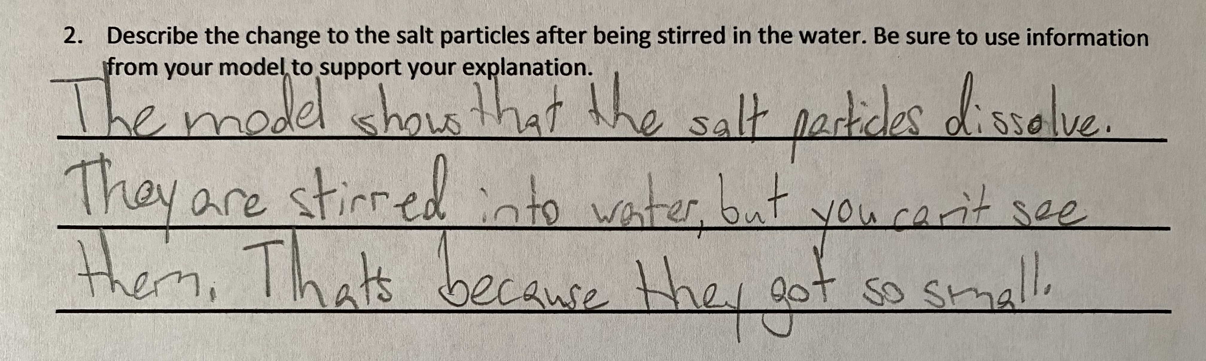
Question 2: Exemplar F
Score Point 3: Student has mastery/an understanding of the assessed skills and is ready for new, more sophisticated instruction.
Description is correct; the response refers to the condition after the water and salt are combined and specifically states that the salt does not disappear. It relates the observation of not being able to see the salt to a reason, which is that the salt has dissolved into small particles, the particles get smaller, and then are too small to be seen. It shows that the salt particles are not "gone."
Notes:
Here is the last example of a student response for the second question of the task, Describe the change to the salt particles after being stirred in the water. Be sure to use information from your model to support your explanation. Consider what evidence would be necessary to make a judgment of what a student knows and can do. Pause the presentation and consider the student response, the evidence of student understanding and learning it represents, and then assign a score point.
Resume the presentation for the assigned score point and explanation.
This student response earns a score point of 3. The description is correct; the response refers to the condition after the water and salt are combined and specifically states that the salt does not disappear; and the student used information from the model to support the explanation. The student demonstrates mastery and an understanding of the assessed skills and is ready for new, more sophisticated instruction.

Slide 17
Score Point 1: Student has not learned the material and/or has misconceptions and reteaching of the key concepts is required.
Description is incorrect; the response includes a misconception that the salt has disappeared and also states that the salt particles become clear and cannot be seen.
Score Point 2: Student has a partial understanding and needs additional instruction on some concepts before new instruction is provided.
Description is partially correct; the response correctly states that the salt particles have dissolved in the condition when they are stirred and that they cannot be seen; however, the response does not state why they cannot be seen, which is because the salt particles have broken into smaller pieces and get so small that they cannot be seen.
Score Point 3: Student has mastery/an understanding of the assessed skills and is ready for new, more sophisticated instruction.
Description is correct; the response refers to the condition after the water and salt are combined and specifically states that the salt does not disappear. It relates the observation of not being able to see the salt to a reason, which is that the salt has dissolved into small particles, the particles get smaller, and then are too small to be seen. It shows that the salt particles are not "gone."
Notes:
Let's review the student responses to question 2. Recall, this prompt asks the student to use their model to support their explanation of the idea that matter is made of particles too small to be seen. This view allows for a quick comparison of score point exemplars.

Slide 18
Exemplars of Student Responses to
Science Tasks
Are selected to be typical of levels of quality in work products or student ability
Provide examples of a range of student responses
Articulate clear expectations of evidence of student learning in student work products
Serve as models or key examples of student work products that provide evidence of learning
Provide annotations to show how the exemplar satisfies the stated criteria in a rubric for a given score point
Leads to improved student understanding of accurate and complete responses
Helps students self-evaluate their work products which may improve performance
Taken from actual student work or can be generated by the educator
Notes:
The Framework and the NGSS define a new vision for science education and provide educators an opportunity to improve science education and assessment of student achievement. Just as this new vision in science education requires shifts in educator practice and pedagogy—a shift away from providing instruction on science topics to providing learning experiences that enable students to better understand the world in which they live by explaining phenomena and creating solutions to design problems—so too are shifts required of students. Memorizing and reciting information is no longer sufficient; students are expected to get engaged with their learning and demonstrate, in new ways, their understanding and ability to sense-make multi-dimensional science standards. Students, like educators, need support, time, and tools.
Student exemplars can serve as an important tool in supporting students' ability to better understand and meet the expectations of three-dimensional science learning. Student exemplars are tools that can serve multiple purposes and support shifts required of students to demonstrate what they know and can do in keeping with this new vision. Please pause the presentation to review the ways in which exemplars of student responses to science tasks that you create may be useful to your students and you.

Slide 19

Resources and Additional Information
Notes:
Finally, we offer additional resources that may be helpful to anyone interested in learning more about the concepts presented in this module. A glossary of terms and our reference list follow.
Thank you for your engagement in this fourth chapter of the SCILLSS digital workbook on designing high-quality three-dimensional science assessment tasks for classroom use.

Slide 20
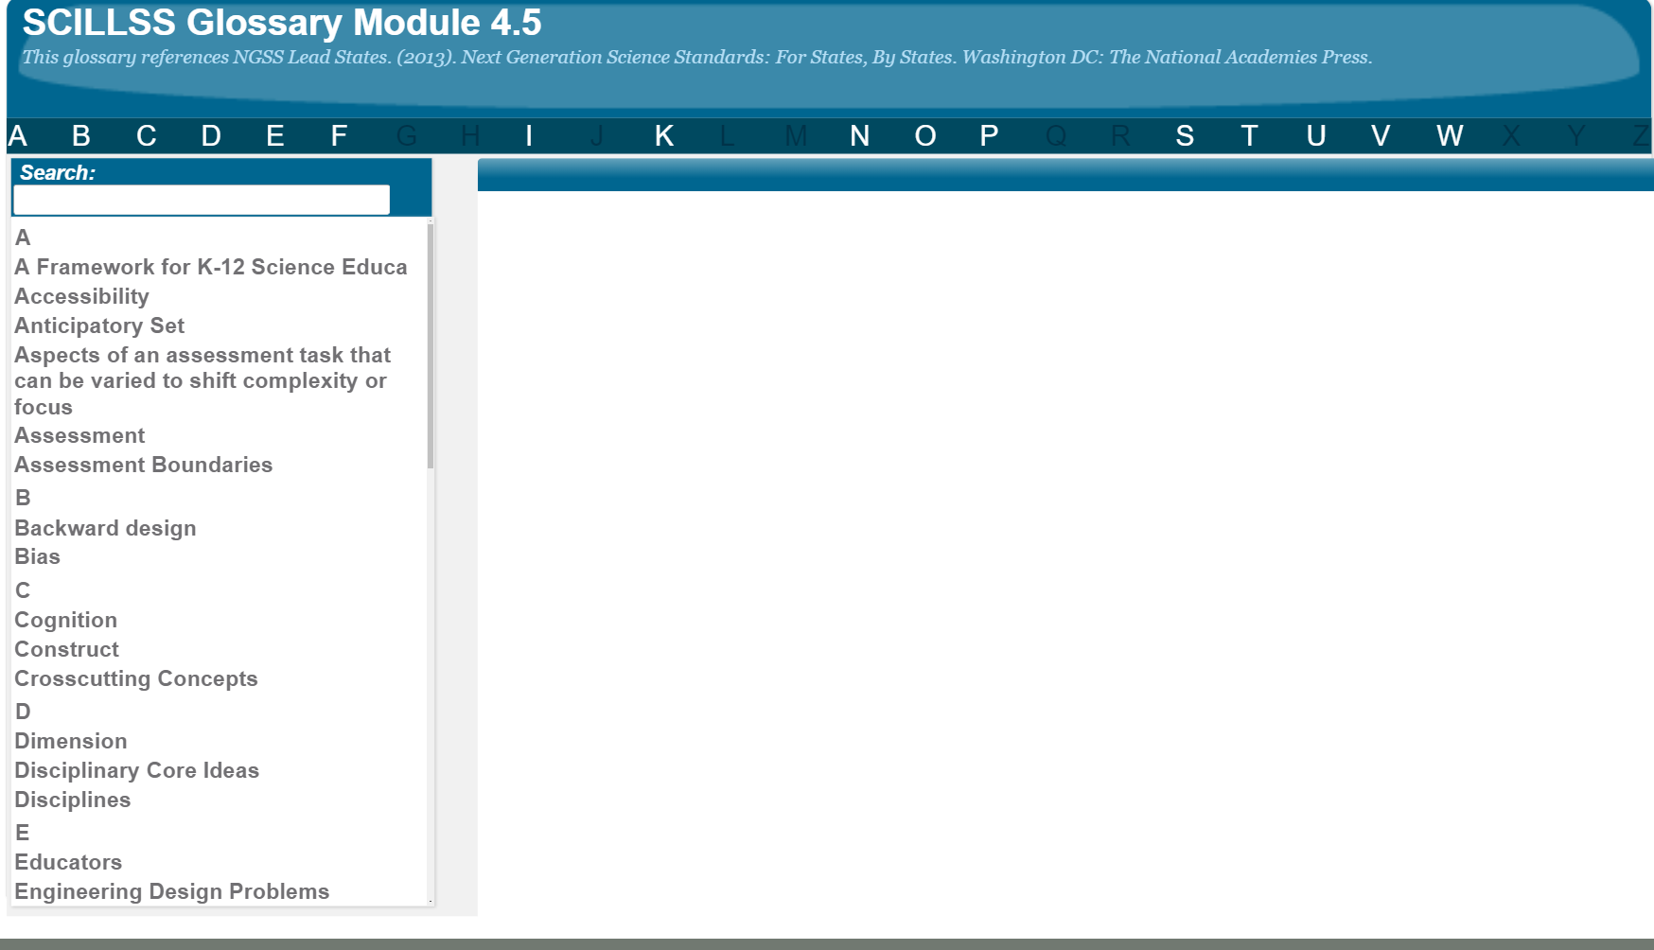
SCILLSS Glossary
Please refer to the SCILLSS Glossary for operational definitions of terms used.

Slide 21
Resources
In the Web Links pod, you can find the following resources:
A Framework for K-12 Science Education
In the Resources pod, you can find the following resources:
Grade 5 Example Task for 5-PS1-1
Grade 5 Example Rubric for 5-PS1-1
Independent Activity—Score Point Assignments for Question 2 Responses

Slide 22
References
McElhaney, K.W., Zaidi, S., Gane, B. D., Alozie, N., & Harris, C. J. (2018, March). Designing NGSS-aligned Assessment Tasks and Rubrics to Support Classroom-based Formative Assessment. Paper presented at the NARST Annual International Conference, Atlanta, GA. (http://nextgenscienceassessment.org/wp-content/uploads/2018/06/2-McElhaney_etal_NARST__tasks-rubrics-paper-FINAL-2018.pdf)
National Research Council. (2012). A Framework for K-12 Science Education: Practices, Crosscutting Concepts, and Core Ideas. Washington, DC: National Academies Press.
National Research Council. (2014). Developing Assessments for the Next Generation Science Standards. Committee on Developing Assessments of Science Proficiency in K-12. Board on Testing and Assessment and Board on Science Education, J.W. Pellegrino, M.R. Wilson, J.A. Koenig, and A.S. Beatty, Editors. Division of Behavioral and Social Sciences and Education. Washington, DC: The National Academies Press.
Pellegrino, J. W. (2013). Proficiency in science: Assessment challenges and opportunities. Science, 340, 320-323.

