Slide 1
Designing High- Quality Three-Dimensional Science Assessments for Classroom Use
Chapter 4: Development of Tasks, Rubrics, and Exemplars
Module 4.6: Guided Activity –Evaluating Classroom Science Assessment Tasks
This digital workbook on designing high quality three-dimensional science assessment tasks for classroom use was developed by edCount, LLC, under
Enhanced Assessment Grants Program, CFDA 84.368A.
Notes:
Welcome to the last of four chapters in a digital workbook on designing high-quality three-dimensional science assessment tasks for classroom use. This workbook is intended to help educators design and evaluate tasks that provide meaningful information about what students know and can do in science.
This digital workbook was developed by edCount, LLC, under the US Department of Education’s Enhanced Assessment Grants Program, CFDA 84.368A.

Slide 2


Module 4.6:
Guided Activity –Evaluating Classroom Science Assessment Tasks
2
Notes:
Chapter 4 of this workbook includes a series of six modules. Together these six modules provide an in-depth exploration of the third phase of principled assessment design: development of tasks, rubrics, and exemplars. In this chapter, we focus on translating the unpacking of the three dimensions of a specific performance expectation or indicator and the design elements in the task specifications tool into an assessment task and rubric. We provide opportunities for you to engage in interactive activities and explore and use our design template to complete your own task and rubric, and learn how to apply scoring guidelines for a three-dimensional standard.
In this module, we lead you in a guided activity to explore how to evaluate the quality of classroom science assessment tasks and verify their alignment to the unpacking and task specifications tools and the KSA or KSAs selected for measurement.

Slide 3
Module 4.6 Outcomes
Purpose and Process for Task Evaluation
Guided Activity: Task Comparison
Purpose and Process for Task Evaluation
To understand the purpose and process for applying the Classroom Assessment Task Review Worksheet to evaluate the quality of classroom science assessment tasks
Guided Activity: Task Comparison
To complete a guided activity to compare and contrast two grade 8 science assessment tasks to determine which task best represents a new way of assessing student science learning as envisioned by A Framework for K-12 Science Education
Notes:
In this module, Module 4.6, we begin by reviewing the purpose and process for evaluating classroom science assessment tasks and rubrics. Then, we provide an opportunity for you to engage in a guided activity to apply the Classroom Science Assessment Review Worksheet to compare and contrast two grade 8 science assessment tasks. This activity will deepen your understanding of the five review criteria and will help you to identify important features of assessment tasks that exemplify a new way of assessing student science learning as envisioned by the Framework. Our hope is that you will also develop a critical eye for evaluating assessment tasks to ensure they meet the intended purpose and use for assessing, align to the selected KSAs and elements of the unpacking and task specifications tools, and meet the expectations for high-quality assessments as defined in Achieve’s NGSS Task Screener. By engaging in this activity, our intent is to show why it is important to and how you can benefit from continually reviewing and refining your assessment tasks and design tools.

Slide 4
Purpose of Evaluating Assessment Tasks
Why is it necessary to evaluate the classroom assessment tasks we develop and/or use?
To ensure the classroom tasks:
  are high quality
  are designed to address the purpose for which they will be used
  contain questions that reflect an intentional design based on the assessed knowledge, skills, and abilities (KSAs)
  elicit evidence of three-dimensional performances and sense-making
  provide a range of questions with respect to complexity, evidence collected, and types of work products
  are fair and equitable and promote accessibility for ALL students (e.g., relevant and interesting, multiple response modes)
  are clear and provide directions that allow students to accurately and fully answer the questions
Notes:
Before we engage in the guided activity, we must first consider why it is necessary to evaluate the classroom assessment tasks we develop or select for use. As you understand well from your completion of the previous chapters, assessments created using a backward design approach, such as principled assessment design, are developed with the end goals for students in mind and with an intentionality regarding the purpose and use for assessing. It is this notion of intentional design that drives our need to be careful designers and critical users of assessments. By evaluating the tasks we use in the classroom, we can ensure they are designed to address the purpose for which they were intended, align to and elicit evidence of the selected knowledge, skills, and abilities to be measured, and are fair and promote accessibility for all students by providing relevant and engaging scenarios, offering multiple response modes, and providing clear directions, grade-appropriate language, and concise sentences to support students to accurately and fully respond to the questions.

Slide 5
Process for Task Review
Each question in the task reflects an intentional design based on the assessed knowledge, skills and abilities (e.g., varying degrees of complexity, types of demonstration of student learning, types of work products).
Completing the questions in the task requires students to use reasoning and integration of the three dimensions (SEP, DCI, CCC).
The questions are fair and equitable (i.e., relevant and interesting, include multiple modes for students to respond, accessible by all learners including students with disabilities or who are English learners, use scientifically-accurate information).
The questions provide evidence/artifacts that can be used by educators to make inferences about student learning that in turn can inform adjustments to planning and instruction and provide feedback to students (e.g., identify/make visible accurate science knowledge, partial science learning, and misconceptions).
Each question in the task is driven by a high-quality scenario that focuses on phenomena or design problems (i.e., a phenomenon or design problem is present; the information in the scenario is necessary and adequate to respond successfully to the task).
Check that…
Notes:
Let’s briefly review the five criteria within the Classroom Assessment Task Review Worksheet that you will use to evaluate the classroom science assessment tasks:
Criterion 1 ensures that each question in the task reflects an intentional design based on the assessed knowledge, skills, and abilities;
Criterion 2 ensures that each question in the task is driven by a high-quality scenario that focuses on a phenomenon or design problem;
Criterion 3 ensures that the questions in the task require students to use reasoning and integration of the three dimensions (SEP, DCI, CCC);
Criterion 4 ensures that the questions are fair and equitable for ALL students; and
Criterion 5 ensures that the questions in the task provide evidence that can be used by educators to make inferences about student learning that, in turn, can inform adjustments to planning and instruction and provide feedback to students.
An in-depth description and exploration of each criterion is provided in Module 4.1: Criteria and Considerations for Task Development. If needed, we encourage you to revisit the module to strengthen your familiarity with these criteria prior to completing the guided activity.

Slide 6
Guided Activity
Use the Classroom Assessment Task Review Worksheet to evaluate two grade 8 science assessment tasks: Task A and Task B.
For each task, consider the evidence/ artifacts of student learning that the questions in the task elicit and how the elements and design features within the unpacking and task specifications tools are addressed in each task.
Then, provide notes for each criterion to explain the rationale or reasoning for your ratings.
Based on your evaluation and comparison of the grade 8 science assessment tasks, consider which task best represents a new way of assessing student science learning as envisioned by A Framework for K-12 Science Education.
For each criterion in the review worksheet, rate each task on a scale of strongly evident, mostly evident, slightly evident, and not evident.
In this guided activity, we will evaluate, compare, and contrast (i.e., similarities and differences) two grade 8 science assessment tasks based on the presented criteria for high-quality science assessments:
  intentional design
  high-quality scenario
  sense-making using the dimensions
  accessibility (equitable and fair)
  right stakeholders, right information
Notes:
In this guided activity, we will evaluate, compare, and contrast two grade 8 science assessment tasks using the five criteria for high-quality science tasks. To prepare for this activity, please access five documents from the Resources pod: Grade 8 Science Assessment Task A, Grade 8 Science Assessment Task B, Grade 8 Unpacking Tool, Grade 8 Task Specifications Tool, and Classroom Assessment Task Review Worksheet.
When you are ready to begin, carefully review the unpacking tool, task specifications tool, and each assessment task. Consider the evidence of student learning that the questions in each task elicit and how the elements and design features within the unpacking and task specifications tool are represented in each task. Then, for each criterion in the review worksheet, rate each task on a scale of strongly evident, mostly evident, slightly evident, and not evident. Provide notes for each criterion to explain the rationale or reasoning for your ratings.
Based on your evaluation and comparison of the grade 8 science assessment tasks, consider which task best represents a new way of assessing student science learning as envisioned by A Framework for K-12 Science Education.

Slide 7
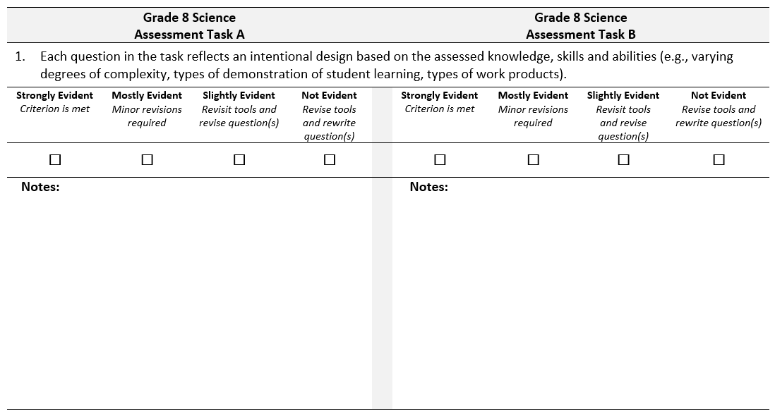
Classroom Assessment Task Review Worksheet
Notes:
Here we provide a preview of the Classroom Assessment Task Review Worksheet. The worksheet includes five tables, one for each criterion. To complete the worksheet, we ask you to provide your ratings and comments for Task A in the left column and Task B in the right column. The table shown here focuses on the first criterion, which you’ll notice is listed at the top of the table. This worksheet is available for download in the Resources pod.

Slide 8
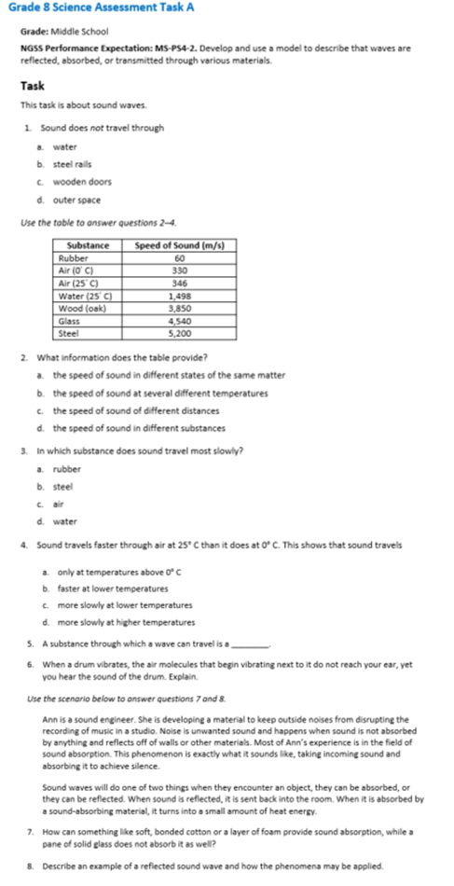
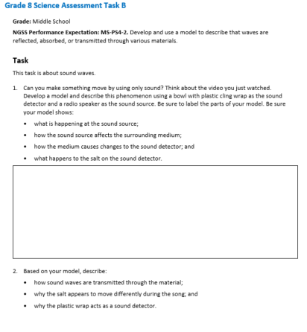
Notes:
Here are the two tasks we will evaluate. Task A is displayed on the left, and Task B is displayed on the right. These tasks are available for download in the Resources pod.
Please pause the presentation to complete your evaluation of Task A and Task B using the Classroom Assessment Task Review Worksheet. When you are ready to resume the presentation, we will review ratings and provide notes for each criterion and task.

Slide 9
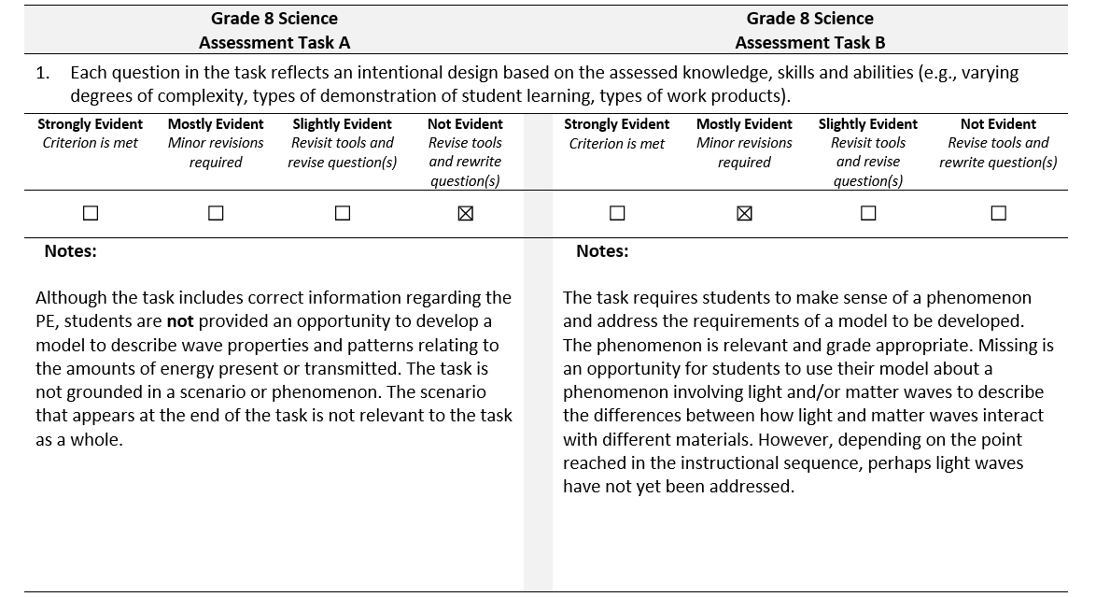
Criterion 1. Intentional Design
Notes:
Now that you have completed your evaluation, let’s consider the extent to which Task A and Task B address the criteria in the Classroom Assessment Task Review Worksheet. As we present our ratings and notes for each criterion, consider whether your perceptions of the tasks align with our perceptions. Are your ratings similar? Do you identify similar strengths and areas for improvement within the tasks? Also, based on your analysis, consider which task better addresses the vision for three-dimensional assessments espoused in the Framework.
Let’s begin with Criterion 1: Each question in the task reflects an intentional design based on the assessed knowledge, skills, and abilities.
We rate Task A as Not Evident. Although the task includes correct information regarding the PE, students are not provided an opportunity to develop a model to describe wave properties and patterns relating to the amounts of energy present or transmitted. The task is not grounded in a scenario or phenomenon. The scenario that appears at the end of the task is not relevant to the task as a whole.
In comparison, we rate Task B as Mostly Evident. The task requires students to make sense of a phenomenon and address the requirements of a model to be developed. The phenomenon is relevant and grade-appropriate. Missing is an opportunity for students to use their model about a phenomenon involving light and/or matter waves to describe the differences between how light and matter waves interact with different materials. However, depending on the point reached in the instructional sequence, perhaps light waves have not yet been addressed.

Slide 10
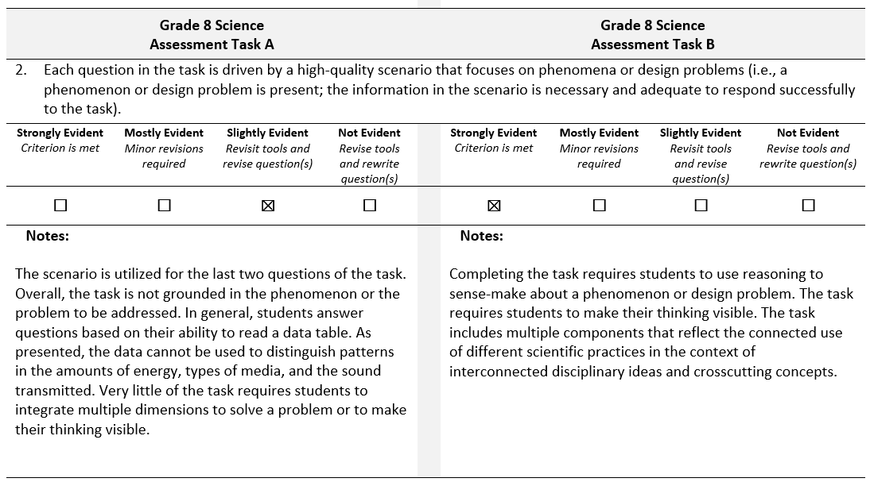
Criterion 2. High-Quality Scenario
Notes:
Next, let’s consider the extent to which Task A and Task B address Criterion 2: Each question in the task is driven by a high-quality scenario that focuses on phenomena or design problems.
We rate Task A as Slightly Evident. The scenario is utilized for the last two questions of the task. Overall, the task is not grounded in the phenomenon or the problem to be addressed. In general, students answer questions based on their ability to read a data table. As presented, the data cannot be used to distinguish patterns in the amounts of energy, types of media, and the sound transmitted. Very little of the task requires students to integrate multiple dimensions to solve a problem or to make their thinking visible.
In comparison, we rate Task B as Strongly Evident. Completing the task requires students to use reasoning to sense-make about a phenomenon or design problem. The task requires students to make their thinking visible. The task includes multiple components that reflect the connected use of different scientific practices in the context of interconnected disciplinary ideas and crosscutting concepts.
.

Slide 11
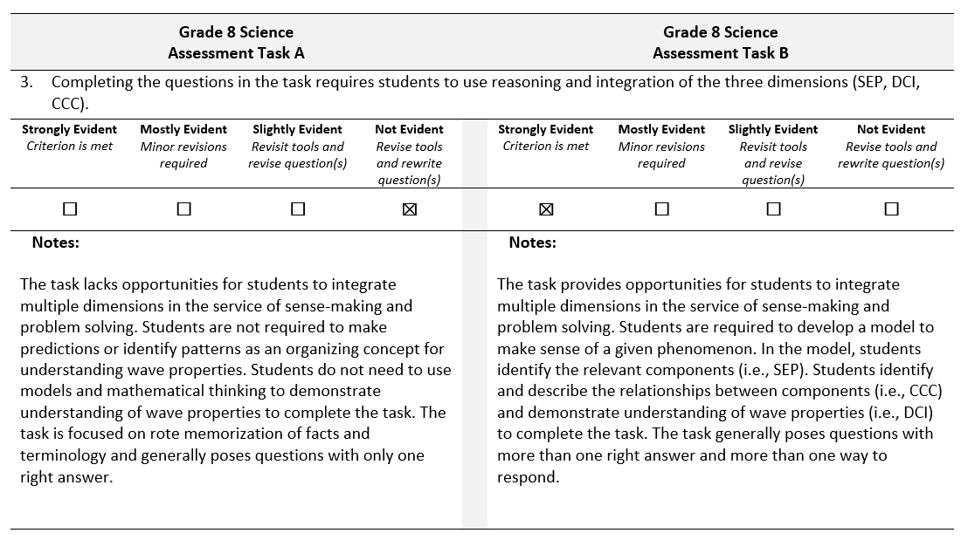
Criterion 3. Sense-Making Using the Dimensions
Notes:
Now let’s consider the extent to which Task A and Task B address Criterion 3: Completing the questions in the task require students to use reasoning and integration of the three dimensions.
For Criterion 3, we rate Task A as Not Evident. The task lacks opportunities for students to integrate multiple dimensions in the service of sense-making and problem-solving. Students are not required to make predictions or identify patterns as an organizing concept for understanding wave properties. Students do not need to use models and mathematical thinking to demonstrate understanding of wave properties to complete the task. The task is focused on rote memorization of facts and terminology and generally poses questions with only one right answer.
In comparison, we rate Task B as Strongly Evident. The task provides opportunities for students to integrate multiple dimensions in the service of sense-making and problem-solving. Students are required to develop a model to make sense of a given phenomenon. In the model, students identify the relevant components (i.e., SEP). Students identify and describe the relationships between components (i.e., CCC) and demonstrate understanding of wave properties (i.e., DCI) to complete the task. The task generally poses questions with more than one right answer and more than one way to respond.

Slide 12
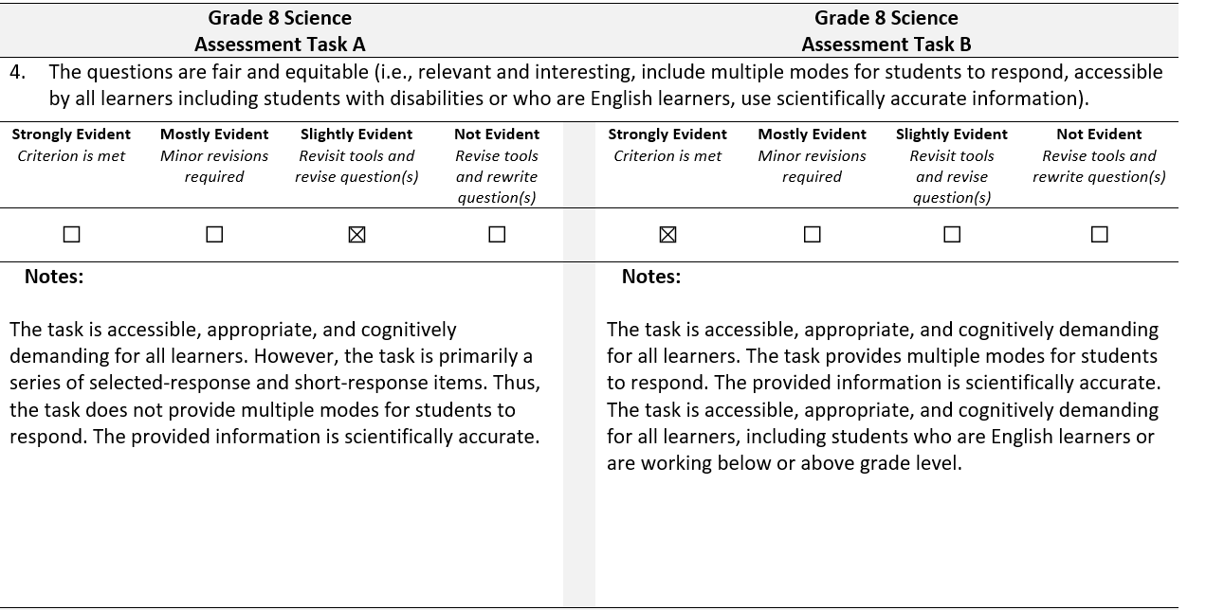
Criterion 4. Accessible (Equitable and Fair)
Notes:
For Criterion 4: The questions are fair and equitable, we rate Task A as Slightly Evident. The task is accessible, appropriate, and cognitively demanding for all learners. However, the task is primarily a series of selected-response and short-response items. Thus, the task does not provide multiple modes for students to respond. The provided information is scientifically accurate.
In comparison, we rate Task B as Strongly Evident. The task is accessible, appropriate, and cognitively demanding for all learners. The task provides multiple modes for students to respond. The provided information is scientifically accurate. The task is accessible, appropriate, and cognitively demanding for all learners, including students who are English learners or are working below or above grade level.

Slide 13
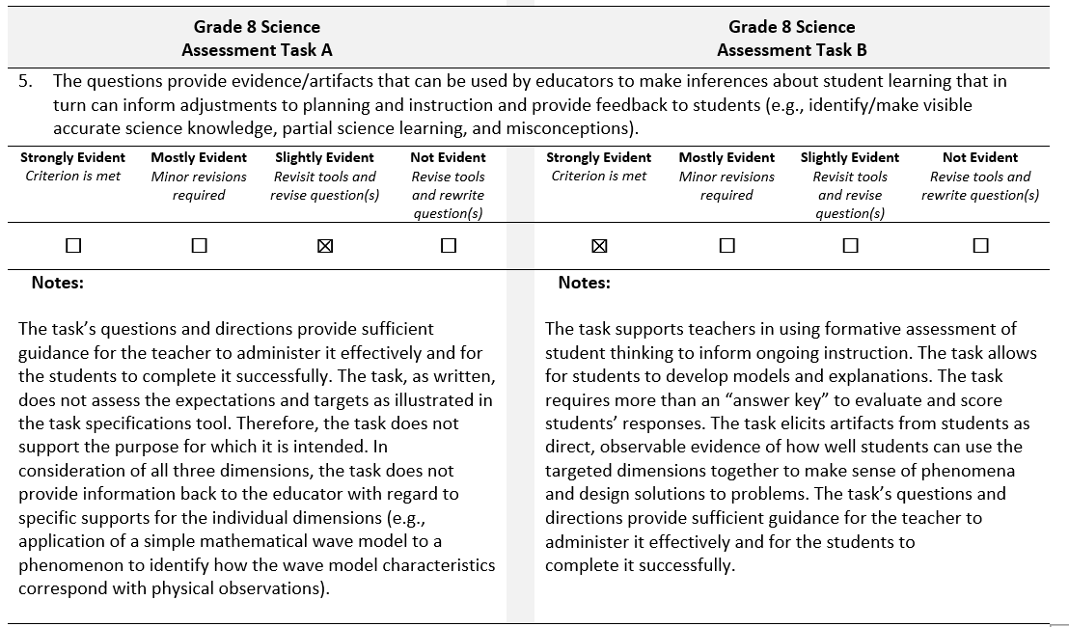
Criterion 5. Right Information, Right Stakeholders
Notes:
Finally, let’s consider the last criterion, Criterion 5: The questions provide evidence or artifacts that can be used by educators to make inferences about student learning that in turn can inform adjustments to planning and instruction and provide feedback to students.
We rate Task A as Slightly Evident. The task’s questions and directions provide sufficient guidance for the teacher to administer it effectively and for the students to complete it successfully. The task, as written, does not assess the expectations and targets, as illustrated in the task specifications tool. Therefore, the task does not support the purpose for which it is intended. In consideration of all three dimensions, the task does not provide information back to the educator with regard to specific supports for the individual dimensions (e.g., application of a simple mathematical wave model to a phenomenon to identify how the wave model characteristics correspond with physical observations).
In comparison, we rate Task B as Strongly Evident. The task supports teachers in using formative assessment of student thinking to inform ongoing instruction. The task allows for students to develop models and explanations. The task requires more than an “answer key” to evaluate and score students’ responses. The task elicits artifacts from students as direct, observable evidence of how well students can use the targeted dimensions together to make sense of phenomena and design solutions to problems. The task’s questions and directions provide sufficient guidance for the teacher to administer it effectively.
Thank you for engaging in this guided activity to review these two grade 8 classroom science assessment tasks. Our hope is that you have gained a deeper understanding of the five review criteria, a critical eye for evaluating assessment tasks, and an appreciation for why it is important to and how you can benefit from continually reviewing and refining your assessment tasks and design tools.

Slide 14

Resources and Additional Information
Notes:
Finally, we offer additional resources that may be helpful to anyone interested in learning more about the concepts presented in this module. A glossary of terms and our reference list follow.
Thank you for your engagement in this fourth chapter of the SCILLSS digital workbook on designing high-quality three-dimensional science assessment tasks for classroom use.

Slide 15
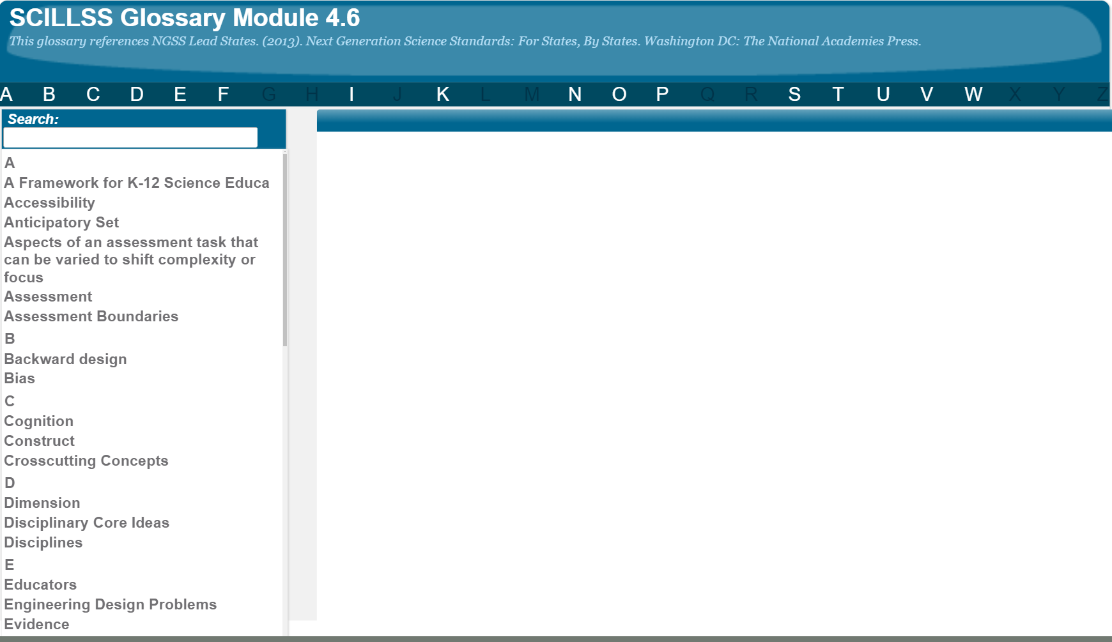
SCILLSS Glossary
Please refer to the SCILLSS Glossary for operational definitions of terms used.

Slide 16
Resources
In the Web Links pod, you can find the following resources:
A Framework for K-12 Science Education
NGSS Task Screener
In the Resources pod, you can find the following resources:
Unpacking Tool for MS-PS4-2
Task Specifications Tool for MS-PS4-2
Grade 8 Science Assessment Task A
Grade 8 Science Assessment Task B
Classroom Assessment Task Review Worksheet
Completed Classroom Assessment Task Review Worksheet for Task A and Task B

Slide 17
References
Achieve. (2018). NGSS Task Screener. Retrieved from https://www.nextgenscience.org/sites/default/files/resource/files/Achieve%20Task%20Screener_Final_9.21.18.pdf

